Slide 1
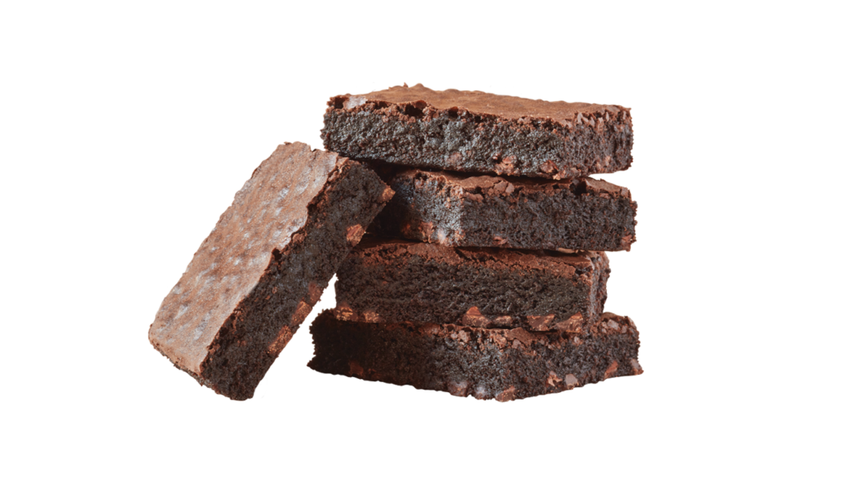
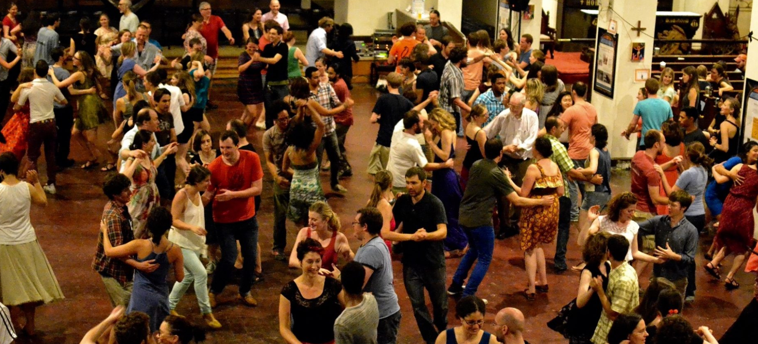
Planning and Preparing the “fudge factor”
It’s not Rocket Science
IT IS COMMON SENSE
Mel Wilkerson
Tumut NSW, Australia
wilkerso@bigpond.net.au

Slide 2
What is meant by “FUDGE FACTOR”
“A figure included in a calculation to account for error or unanticipated circumstances, or to ensure a desired result”.
With singing calls being prepare to succeed
Accept that any singing can fail
Accepting failure possibility – usually prepares you for success
Always have a Plan B
Alternate sing call, easier, but with target goals
Notes:
Planning and Preparation – What is the difference?.
To be clear preparation and planning are not the same thing. Like businesses and organisations, the great callers become great, and last only by doing both.
Great callers prepare for opportunity whether they create them or they just happen.
Great callers’ preparation is all about creating the circumstances to make the most of positioning for that opportunity.
So the question is, to be a good or even a great caller do I prepare for the future or do I plan for it?
The answer is, “yes.”
To be clear preparation and planning are not the same thing, and great callers become great by doing both.

Slide 3
WHY DO SINGING CALLS FAIL US SOMETIMES?
Most common errors:
Technical difficulty – death by definition doesn’t work
Caller delivery and timing – makes it hard for dancers
Poor music choices – if you can’t sing that song, DON’T
Bad Choreographic Flow – learn the movement mechanics
Just because you can, doesn’t mean you should
Practice when to say things and how
Be honest with yourself about your abilities
Learn movement mechanics – call analysis
Practice
Practice
Practice
All of these are Easy to fix
and NOT
why most Singing Calls fail
Notes:
Planning and Preparation – What is the difference?.
To be clear preparation and planning are not the same thing. Like businesses and organisations, the great callers become great, and last only by doing both.
Great callers prepare for opportunity whether they create them or they just happen.
Great callers’ preparation is all about creating the circumstances to make the most of positioning for that opportunity.
So the question is, to be a good or even a great caller do I prepare for the future or do I plan for it?
The answer is, “yes.”
To be clear preparation and planning are not the same thing, and great callers become great by doing both.

Slide 4
What is the most common problem
Most common errors:
We do not teach dancers to “DANCE” – Move with the music.
Callers encourage dancers NOT to dance on the beat
20 beats to dance square thru (12) or 10 for a Dosado (6)
Forward and back is 6 beats – callers give 2. – Balance is a word only
Class figure. Heads square thru (20/12), Dosado to a wave (10/6), Swing thru (6/6) boys trade (4/3), swing your corner (6/4), promenade (18/18) 64 beats used – 47 beats of dance action
THIS IS NOT “O.K.”
Notes:
Planning and Preparation – What is the difference?.
To be clear preparation and planning are not the same thing. Like businesses and organisations, the great callers become great, and last only by doing both.
Great callers prepare for opportunity whether they create them or they just happen.
Great callers’ preparation is all about creating the circumstances to make the most of positioning for that opportunity.
So the question is, to be a good or even a great caller do I prepare for the future or do I plan for it?
The answer is, “yes.”
To be clear preparation and planning are not the same thing, and great callers become great by doing both.

Slide 5
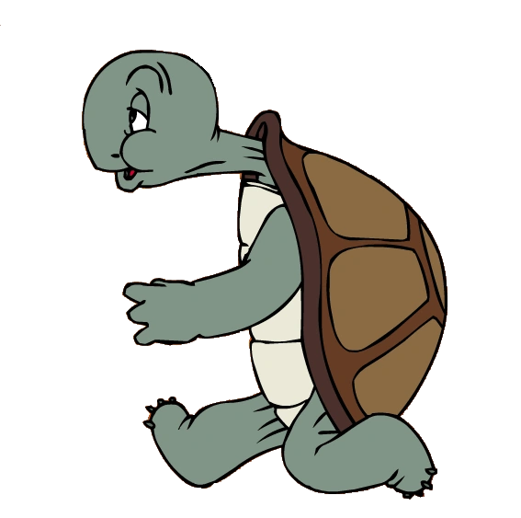
THIS IS THE LESSON OF TODAY BY TOO MANY
Do not dance to the music – it doesn’t matter
Styling and timing doesn’t count
I want you to feel ostracised when you travel
Callers adjust to you so “You” can dance – others be damned
Ignore the beat except for promenades - then run like hell
Grand Square
The sad part is: many do not even realise this is what they teach
Grand Square
Swing
Thru
Square Thru
Boys
Trade
Swing
Promenade
Dosado
SQUARE DANCING IS HARD ENOUGH
WITHOUT ALL THIS NONSENSE
Notes:
Planning and Preparation – What is the difference?.
To be clear preparation and planning are not the same thing. Like businesses and organisations, the great callers become great, and last only by doing both.
Great callers prepare for opportunity whether they create them or they just happen.
Great callers’ preparation is all about creating the circumstances to make the most of positioning for that opportunity.
So the question is, to be a good or even a great caller do I prepare for the future or do I plan for it?
The answer is, “yes.”
To be clear preparation and planning are not the same thing, and great callers become great by doing both.

Slide 6
CHECK YOUR MATERIAL
Review your chosen or written singing call choreography
HEADS SQUARE THRU, SWING THRU, BOYS RUN, TAG THE LINE, FACE LEFT, FERRIS WHEEL, CENTRES PASS THRU (48 / 34) SWING CORNER AND PROMENADE (16 / 20) | (H) SQUARE THRU, SWING THRU, BOYS RUN, FERRIS WHEEL, Cntr RIGHT & LEFT THRU WITH A FULL TURN, (48 / 36) SWING CORNER PROMENADE (16 / 20) | (H) PROMENADE 1/2, (S) SQUARE THRU, PASS THRU, TRADE BY, STAR THRU, PASS THRU, CAST OFF 3/4, PASS THRU, PARTNER TRADE, SLIDE THRU, (40 / 40) SWING CORNER PROMENADE (22 / 21) | (H) BOX THE GNAT, AND SQUARE THRU 2, DOSADO TO A WAVE, HINGE, CENTRES TRADE, CAST OFF 3/4, BOYS TRADE, BOYS RUN, FERRIS WHEEL, ZOOM, Cntr SLIDE THRU AND BOX THE GNAT, Cntr PASS THRU, (48 / 52) SWING CORNER PROMENADE (16 / 20)
Do what the caller says
Swing and stop at home
Notes:
Planning and Preparation – What is the difference?.
To be clear preparation and planning are not the same thing. Like businesses and organisations, the great callers become great, and last only by doing both.
Great callers prepare for opportunity whether they create them or they just happen.
Great callers’ preparation is all about creating the circumstances to make the most of positioning for that opportunity.
So the question is, to be a good or even a great caller do I prepare for the future or do I plan for it?
The answer is, “yes.”
To be clear preparation and planning are not the same thing, and great callers become great by doing both.

Slide 7
WHAT IS THE OUTCOME?
Dancer feel like they made a mistake
Even when caller adjusts lyrics – dancers feel corrected
Caller has created the circumstances for dancers to feel wrong
Message sent is: dancing to music is not important – caller will fix
Callers Are Human – CHECK TWICE – CUT ONCE
Notes:
Planning and Preparation – What is the difference?.
To be clear preparation and planning are not the same thing. Like businesses and organisations, the great callers become great, and last only by doing both.
Great callers prepare for opportunity whether they create them or they just happen.
Great callers’ preparation is all about creating the circumstances to make the most of positioning for that opportunity.
So the question is, to be a good or even a great caller do I prepare for the future or do I plan for it?
The answer is, “yes.”
To be clear preparation and planning are not the same thing, and great callers become great by doing both.

Slide 8
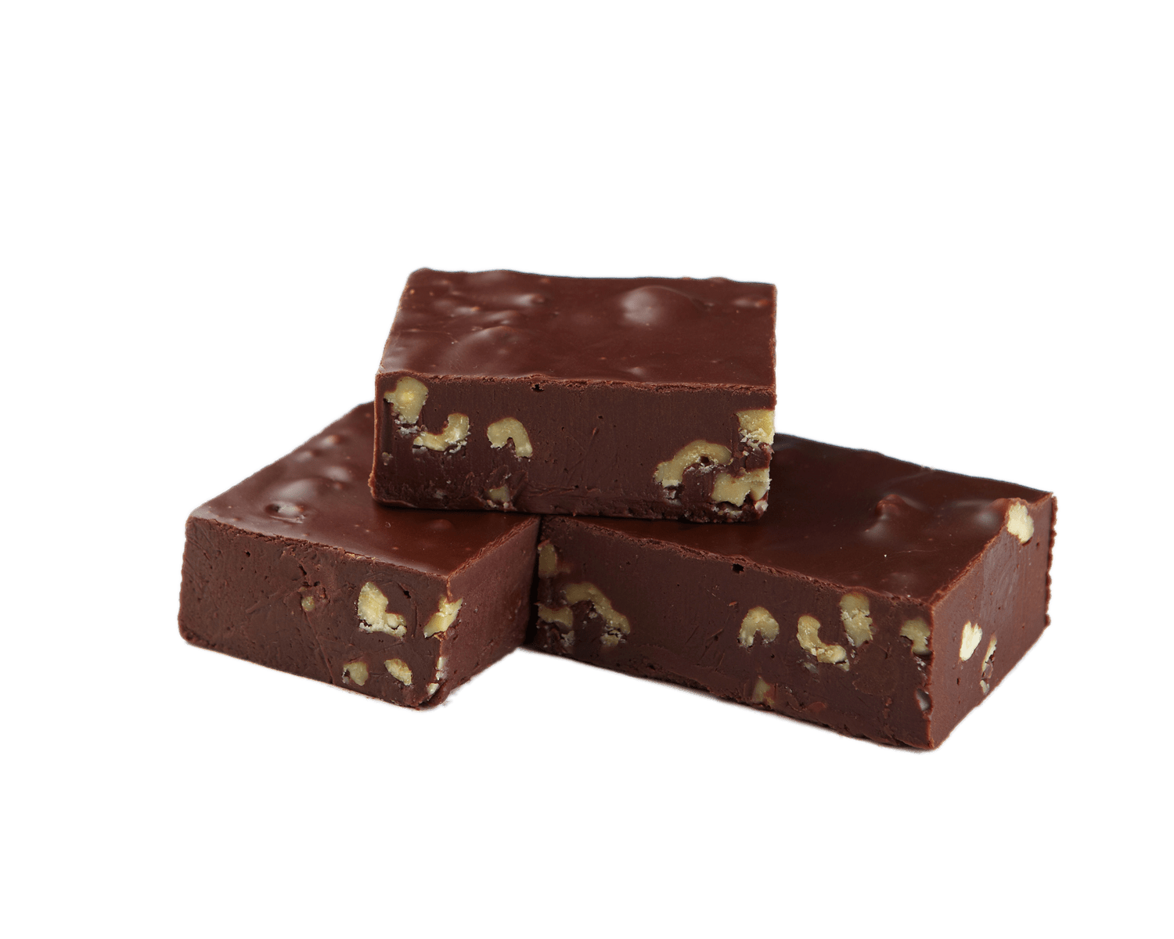
SINGING CALLS – TEACHING AND DANCING
Dance to the music – regardless of age
Learn to adapt choreography
Feel the dancers out in the Patter
Judge the dancer’s abilities and modify for success
Do not treat them like babies or incompetent
Use “add or drop” movements to get them on beat
Prepare your singing calls to allow “fudge factor”
FUDGE TASTES BETTER IF YOU TAKE TIME TO PREPARE IT RIGHT
Notes:
Planning and Preparation – What is the difference?.
To be clear preparation and planning are not the same thing. Like businesses and organisations, the great callers become great, and last only by doing both.
Great callers prepare for opportunity whether they create them or they just happen.
Great callers’ preparation is all about creating the circumstances to make the most of positioning for that opportunity.
So the question is, to be a good or even a great caller do I prepare for the future or do I plan for it?
The answer is, “yes.”
To be clear preparation and planning are not the same thing, and great callers become great by doing both.

Slide 9
HOW DO WE PREPARE THE FUDGE
SLOW & SLUGGISH FLOORS OR FAST & ENERGETIC FLOORS
1. Add or drop movements
Dosado
Forward and back
Box the gnat and swing
Wiggle your hips
Use whatever you need to fill in time and build them into the timing so you can drop them to gain time if needed.
4 BEATS IS A LITTLE
THAT MEANS A LOT
Notes:
Planning and Preparation – What is the difference?.
To be clear preparation and planning are not the same thing. Like businesses and organisations, the great callers become great, and last only by doing both.
Great callers prepare for opportunity whether they create them or they just happen.
Great callers’ preparation is all about creating the circumstances to make the most of positioning for that opportunity.
So the question is, to be a good or even a great caller do I prepare for the future or do I plan for it?
The answer is, “yes.”
To be clear preparation and planning are not the same thing, and great callers become great by doing both.

Slide 10
HOW DO WE PREPARE THE FUDGE
2. Short Modules to lengthen or replace
PASS THRU, ALLEMANDE LEFT to replace a SWING CORNER.
CB: SWING THRU, BOYS TRADE before SWING CORNER
CB: TOUCH ¼, SCOOT BACK, SWING CORNER
CB: PASS THRU, U-TURN BACK, (Box The Gnat) SWING CORNER.
CB: PASS THRU, U-TURN BACK, BOX THE GNAT, PULL BY, ALLEMANDE LEFT AND PROMENADE to replace SWING CORNER.
FROM WAVES – SCOOT BACK TWICE
PL/CL – BOX THE GNAT, PASS THRU, U-TURN BACK.
Often the difference between
Square Dancing and Square Standing
Notes:
Planning and Preparation – What is the difference?.
To be clear preparation and planning are not the same thing. Like businesses and organisations, the great callers become great, and last only by doing both.
Great callers prepare for opportunity whether they create them or they just happen.
Great callers’ preparation is all about creating the circumstances to make the most of positioning for that opportunity.
So the question is, to be a good or even a great caller do I prepare for the future or do I plan for it?
The answer is, “yes.”
To be clear preparation and planning are not the same thing, and great callers become great by doing both.

Slide 11
HOW DO WE PREPARE THE FUDGE
3. Equivalent Movements / sequences
When a standard Corner Line Get-out out is square thru 3, swing corner
Pass The Ocean, Ladies Trade, Swing Thru, Swing the Corner adds 6 beats.
By contrast if you have an ending with Pass The Ocean, Ladies Trade, Swing Thru, you can shorten it with square thru 3.
Right and left thru (6 beats) = Flutterwheel, Reverse Flutterwheel (16 beats)
Both sequences flow seamlessly into a promenade as ending movements.
Partner trade = girls run, boys run, half sashay. This is especially nice from standard lines after a pass thru or walk and dodge and the men doing the half sashay is fun but still feels right.
Heads promenade ½, star thru, pass thru (15-16 beats) = Heads promenade ½, pass the ocean, extend = heads square thru (12 beats)
CHOSEN MODULES SHOULD KEEP THE BASIC THEME
Notes:
Planning and Preparation – What is the difference?.
To be clear preparation and planning are not the same thing. Like businesses and organisations, the great callers become great, and last only by doing both.
Great callers prepare for opportunity whether they create them or they just happen.
Great callers’ preparation is all about creating the circumstances to make the most of positioning for that opportunity.
So the question is, to be a good or even a great caller do I prepare for the future or do I plan for it?
The answer is, “yes.”
To be clear preparation and planning are not the same thing, and great callers become great by doing both.

Slide 12
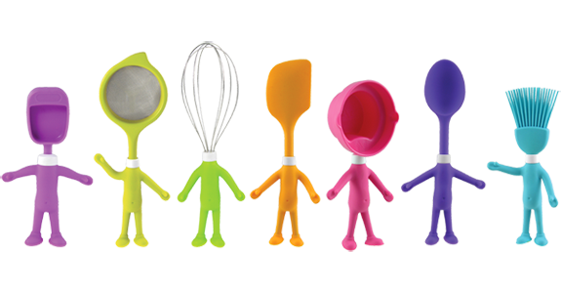
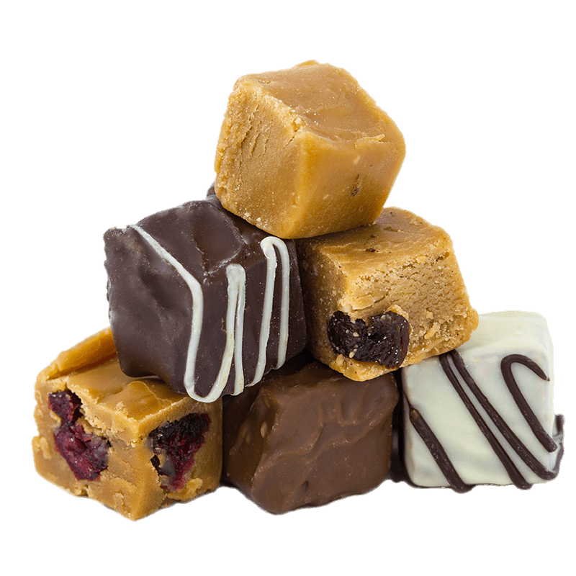
HOW DO WE PREPARE THE FUDGE
That is a good Start
Throw away movements
Replacement equivalents
Short modules
This takes time, practice and skill to deliver
Other techniques include
Playing with the ending - End in a courtesy turn to the promenade
Shorten your choreo sequence by 2 beats for CB exact
Change the finish quadrant – 12 beat promenade vs 16 beat promenade
Change the progression – adds variety and shortens promenade
LOTS OF OTHER METHODS BUT THESE ARE THE 7 BASIC TOOLS
Notes:
Planning and Preparation – What is the difference?.
To be clear preparation and planning are not the same thing. Like businesses and organisations, the great callers become great, and last only by doing both.
Great callers prepare for opportunity whether they create them or they just happen.
Great callers’ preparation is all about creating the circumstances to make the most of positioning for that opportunity.
So the question is, to be a good or even a great caller do I prepare for the future or do I plan for it?
The answer is, “yes.”
To be clear preparation and planning are not the same thing, and great callers become great by doing both.

Slide 13
Putting it in practice
(focus movement – Cross Run / Cross Fold)
Sequence: 64 beats
Heads Square Thru,
Dosado,
Swing Thru,
Boys Run,
Bend the Line,
Right and Left Thru,
Pass the Ocean,
Boys Cross Fold,
Swing Corner,
Promenade
Is there a throw away call – what does it do?
Is there an equivalent to save time?
Can I change the ending to eliminate swing
Can I flip flop the quadrant? – if I do how do I make up the extra time needed
Can I change the progression and the quadrant – sequence change?
The answer to all of these questions is YES,
Notes:
Planning and Preparation – What is the difference?.
To be clear preparation and planning are not the same thing. Like businesses and organisations, the great callers become great, and last only by doing both.
Great callers prepare for opportunity whether they create them or they just happen.
Great callers’ preparation is all about creating the circumstances to make the most of positioning for that opportunity.
So the question is, to be a good or even a great caller do I prepare for the future or do I plan for it?
The answer is, “yes.”
To be clear preparation and planning are not the same thing, and great callers become great by doing both.

Slide 14
Original figure (64 beats) | Throw away call - Drop the Dosado | Replacement Module - Change the square thru to give me extra time
Heads Square Thru, Dosado Swing Thru, Boys Run Bend the Line Right and Left Thru Pass the Ocean Boys Cross Fold Swing Corner and Promenade | Heads Square Thru DOSADO (6 BEATS) Swing Thru Boys Run Bend the Line Right and Left Thru Pass the Ocean Boys Cross Fold Swing Corner and Promenade | HEADS TOUCH 1/4 HEAD BOY RUN – (6 Beats) Dosado Swing Thru, Boys Run Bend the Line Right and Left Thru Pass the Ocean Boys Cross Fold Swing Corner & Promenade
Changing the ending- (44 beats into the arm turn and full promenade) | Right hand quadrant set up - 64 beats or 48 with the swing and you have a 12 beat promenade allowing 4 beats at home | Right hand lady progression keeping theme (chicken plucker) 48 beats to the swing and promenade 12 steps
Heads Square Thru, Dosado Swing Thru, Boys Run Bend the Line Right and Left Thru Pass the Ocean BOYS CROSS RUN LEFT ARM TURN – KEEP HER AND PROMENADE (40 beats + 4 for the arm turn into the promenade and 20 beats for the full promenade) | HEADS TOUCH 1/4 HEAD BOYS RUN Dosado Swing Thru, CIRCULATE TWICE (flip flops) Boys Run Bend the Line Right and Left Thru Pass the Ocean Boys Cross Fold Swing and promenade Or Pass Thru, Allemande Left and Promenade 64 beats | Heads Square Thru RIGHT AND LEFT THRU PASS THRU TRADE BY (chicken plucker) Dosado – (out of sequence) Swing Thru Boys Run Bend the Line (drop R&L Thru to put them in sequence) Pass the Ocean Boys Cross Fold (RHL lady) Swing And Promenade
Notes:
Planning and Preparation – What is the difference?.
To be clear preparation and planning are not the same thing. Like businesses and organisations, the great callers become great, and last only by doing both.
Great callers prepare for opportunity whether they create them or they just happen.
Great callers’ preparation is all about creating the circumstances to make the most of positioning for that opportunity.
So the question is, to be a good or even a great caller do I prepare for the future or do I plan for it?
The answer is, “yes.”
To be clear preparation and planning are not the same thing, and great callers become great by doing both.

Slide 15
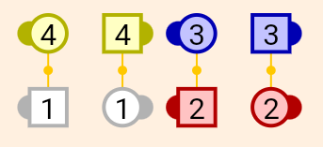
A SECOND LOOK Focus sequence – “Spin the Top, Hinge, Circulate”
Sequence: 64 beats
Heads Square Thru (12),
Swing Thru (6),
Spin the Top (8),
Hinge (2),
Circulate,(4)
Boys Run,(4)
Square Thru 3, (8) (44 beats)
Swing Corner (6) – (50) LH Quadrant
Promenade
What are some problems with this figure
End formation
WHAT CAN WE DO TO FIX THIS?
Notes:
Planning and Preparation – What is the difference?.
To be clear preparation and planning are not the same thing. Like businesses and organisations, the great callers become great, and last only by doing both.
Great callers prepare for opportunity whether they create them or they just happen.
Great callers’ preparation is all about creating the circumstances to make the most of positioning for that opportunity.
So the question is, to be a good or even a great caller do I prepare for the future or do I plan for it?
The answer is, “yes.”
To be clear preparation and planning are not the same thing, and great callers become great by doing both.

Slide 16
Original | Idea 1 | Idea 2 | Idea 3
(H) Square Thru Swing Thru Spin the Top Hinge Circulate Boys Run Square Thru 3 Swing Corner and Promenade | (H) TOUCH ¼ BOYS RUN Swing thru Spin the top Hinge Boys run MAKE A WAVE LADIES TRADE SWING THRU BOYS RUN CHAIN DOWN THE LINE AND PROMENADE (48 Beats) | (H)Square thru 2 Swing thru Spin the top Hinge Circulate Boys run PASS THRU TRADE BY ALLEMANDE LEFT (40) and promenade (or swing and promenade) | (H) TOUCH 1/4 BOYS RUN Swing Thru Spin the Top Hinge Circulate Boys Run PASS THRU TRADE BY SLIDE THRU PASS THRU Allemande left (48 beats) and promenade (14)
Notes:
Planning and Preparation – What is the difference?.
To be clear preparation and planning are not the same thing. Like businesses and organisations, the great callers become great, and last only by doing both.
Great callers prepare for opportunity whether they create them or they just happen.
Great callers’ preparation is all about creating the circumstances to make the most of positioning for that opportunity.
So the question is, to be a good or even a great caller do I prepare for the future or do I plan for it?
The answer is, “yes.”
To be clear preparation and planning are not the same thing, and great callers become great by doing both.

Slide 17
YOUR JOB IS TO KEEP THE DANCERS HAPPY
Square Dancing is better than:
Square Standing
Square Plodding or
Square running
Hints and tips:
64 beats
Move to the music (beat)
Teach styling - like tighten the promenades
Swing is min 4 – allow 6
Promenade is 16 beats from home – 18 from the CB exact
End facing direction and movement matters
Always try to allow 4 extra beats – it works.
Notes:
Planning and Preparation – What is the difference?.
To be clear preparation and planning are not the same thing. Like businesses and organisations, the great callers become great, and last only by doing both.
Great callers prepare for opportunity whether they create them or they just happen.
Great callers’ preparation is all about creating the circumstances to make the most of positioning for that opportunity.
So the question is, to be a good or even a great caller do I prepare for the future or do I plan for it?
The answer is, “yes.”
To be clear preparation and planning are not the same thing, and great callers become great by doing both.

Slide 18
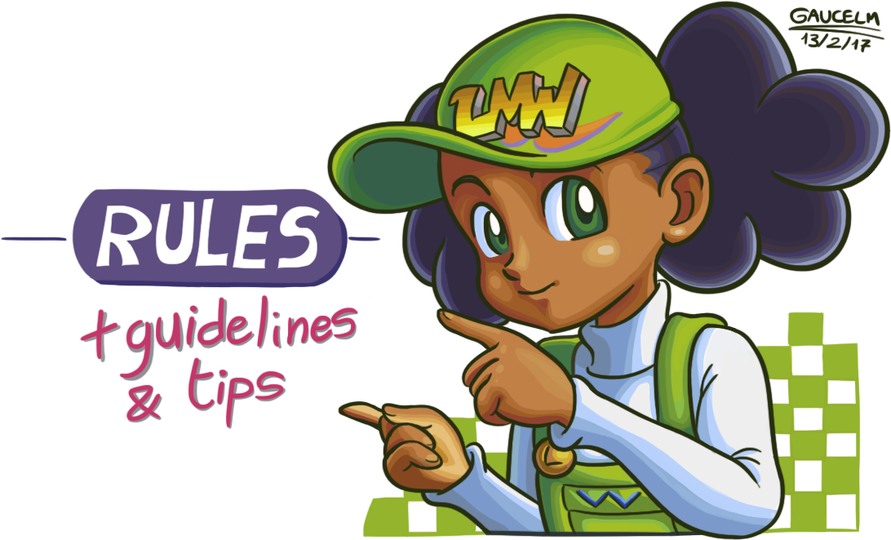
General Guidelines
CB at Home endings – 40-42 beats before the swing
Put add or drops in your Choreography
Dosado, Forward and Back
Use Do nothings at end of module
Touch ¼ - scoot back
Use Equivalents to shorten or lengthen
Swing thru = Scoot Back, Centres Trade
Right and left thru – Flutterwheel, Reverse Flutterwheel
Not every ending needs a swing
Star Thru & Promenade, Veer Right & Promenade, R&L Thru & Promenade
Use the right hand quadrant – 12 step promenades
Right hand Lady progression works
Slow dancers – use flip flops
let them catch on the promenade - get them dancing the beat
DANCER’s SUCCESS & ENTERTAINMEN IS THE GOAL
Notes:
Planning and Preparation – What is the difference?.
To be clear preparation and planning are not the same thing. Like businesses and organisations, the great callers become great, and last only by doing both.
Great callers prepare for opportunity whether they create them or they just happen.
Great callers’ preparation is all about creating the circumstances to make the most of positioning for that opportunity.
So the question is, to be a good or even a great caller do I prepare for the future or do I plan for it?
The answer is, “yes.”
To be clear preparation and planning are not the same thing, and great callers become great by doing both.

Slide 19
Questions and Discussion
Bonus short Zeros and Equivalents are attached to the notes of this presentation.

