Slide 1
FORMATION MANAGEMENT
Where do I start?
The Dancer’s action
Mel Wilkerson
28 Royce Cres
Lavington NSW 2641 Australia
wilkerso@bigpond.net.au
The Caller’s Mind

Slide 2
Formation vs FASR
Formation is only one part of F. A. S. R.
Formation management is the foundation of all management systems
Formation – just the structure and form
Arrangement – (standard or get there)
Sequence – not part of the formation
Relationship – Not part of the Formation
Why is Formation management so important to everything?
Without a formation
Nothing else can be defined

Slide 3
Life needs structure – so does Square Dance
Without structure, nothing can be defined
Structure defines relationships and arrangements
Short and long term structures, arrangements and relationships
Callerlab defines 79 formations used in square dancing
Most of them are transient things that pass occasionally
Important things in life and square dance repeat
Repeated structures are what we build our life and our dance from
There are 14 important formations to understand

Slide 4
Managing Formations
It is about identifying point a and point b and picking a route
Common movements from each formation – Get to know them
Definitions and movement mechanics are important.
Understand:
Keep or Preserve formation movements
Change formation movements
WHY IS THIS IMPORTANT?
The call analysis sheet will help you with this.

Slide 5
The new caller secret to FM success
DO IT.
PRACTICE IT WITH YOURSELF (AND OTHERS)
IT’S OK TO MAKE MISTAKES
Good judgement comes from experience
Experience comes from bad judgement
We are focused on the formation and individual movement mechanics
Arrangement – Sequence – Relationship – will come later
F(ormation management) makes A. S. R. much easier

Slide 6
Formation Management – 14 / 79
65 out of 79 Callerlab Formations are “transient passage”
14 out of 79 Formation are “event structures”
Repeated
Recognisable and comfortable
Lots of ways to get there
Familiar things considered
along the way
14 Regular Formations that we deliberately go to,
and deliberately do specific things

Slide 7
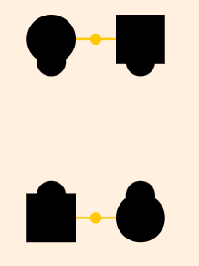
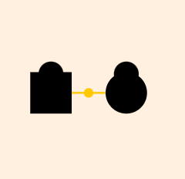
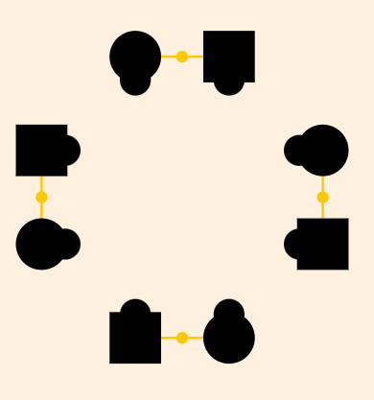
14 COMMON SQUARE DANCE FORMATIONS
STANDARD COUPLE 2. FACING COUPLE
NORMAL SQUARE 4. CIRCLE

Slide 8
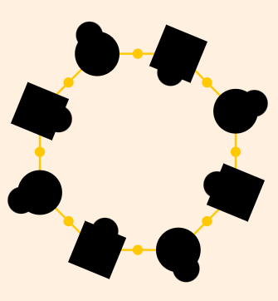
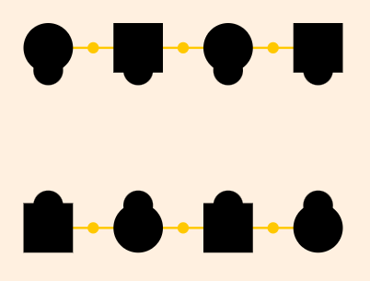
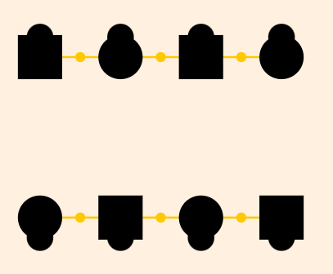
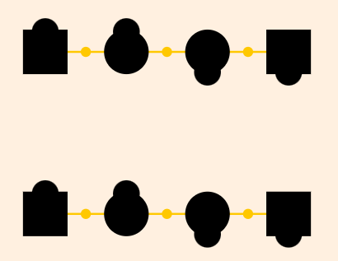
14 COMMON SQUARE DANCE FORMATIONS
5. ALAMO CIRCLE 6. FACING LINES
7. OUTFACING LINES 8. TWO FACED LINES

Slide 9
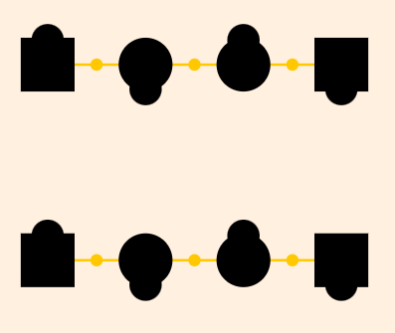
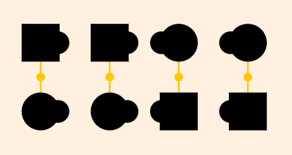
14 COMMON SQUARE DANCE FORMATIONS
9 OCEAN WAVES 10. 8 CHAIN THRU BOX
11. DOUBLE PASS THRU 12. COMPLETED DOUBLE PASS THRU

Slide 10
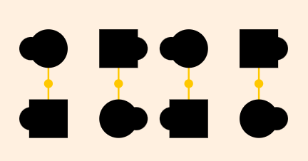
14 COMMON SQUARE DANCE FORMATIONS
13. TRADE BY 14. COLUMN
Many other formations exist
Many other movements can be done from each formation
Learn to move from one formation to another
DO IT – PRACTICE IT – MAKE MISTAKES
Learn from what you do.

Slide 11
There is a difference
Formation management is not F.A.S.R. Management
Learn formations first – not corner box, partner line, RBO etc.
FASR Management = resolution focused
Formation Management = Effectively moving dancers
Where am I?
What can I do from here?
Where does that put me for the next call?
Does what I call keep or change the formation?

Slide 12
Formation Keeper / Formation Changer
Because we are not worried about ASR, we can focus on formation and understanding if it changes or does not change with the movements. Example:
Keeper: Ladies Chain, Flutterwheel, Right And Left Thru etc.
Changer: Pass Thru, Star Thru, Touch ¼, Pass The Ocean, Veer Left, U-turn Back, Face A Direction etc.
Two couple movements have a similar effect on 4 couple movements
A change in structure or a change in aspect = formation change
Understanding this makes
Formation Flow Management Easy

Slide 13
Natural Progression from 2 to 4
2 couple management leads smoothly to 4 couple management
The concept limits all the worries to:
Knowing what the formation is
Knowing what we can call from here
Knowing a call keeps or changes the formation
Being able to repeat the process with control
Start small and focused
Build bigger and better.

Slide 14
One step at a time
Understand 2 couple movement mechanics
Practice 4 couple formation management 1 move / 2 moves / 2 moves
Transient formations can be fixed with 2 couple movers/2 dancer movers
Take a step back and look at it - DON’T RUSH to F.A.S.R.
EFFECTIVE FORMATION MANAGEMENT MEANS
MORE COMFORTABLE DANCING,
FASTER CALLER LEARNING, AND
BETTER CONTROL.

Slide 15
FORMATION MANAGEMENT
Questions and practice
Mel Wilkerson
28 Royce Cres
Lavington NSW 2641 Australia
wilkerso@bigpond.net.au

