Slide 1
Degree
Of
Difficulty
A topic that many avoid
Talking about

Slide 2
Why??
Because It’s A “Personal” Thing
However, I Could Spend Hours On This Topic. There Are So Many Components. Today We Are Going To Talk About Some Basic Components!

Slide 3
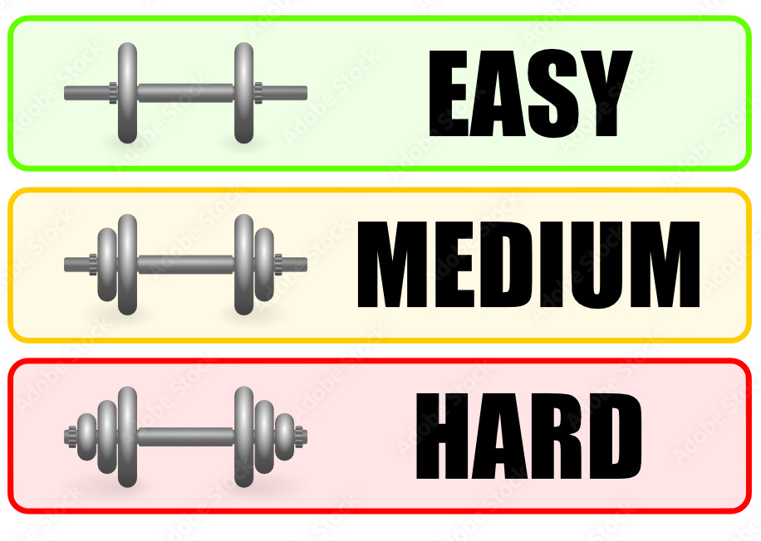
What Terms Should We use to Measure Difficulty?
Outrageous

Slide 4
Should we Call with any component of Difficulty at all?
I am going to suggest that, in my opinion, every caller introduces an element of difficulty almost every time they call a dance!

Slide 5
Does it effect every Dancer?
Maybe – Maybe Not
Does it happen on purpose?
Maybe – Maybe Not
Does it cause damage?
Maybe – Maybe Not
Can it be taken back?
No!
Once called you can’t retract it
Can it be repaired or softened?
Possibly!
Our Topic tonight is …

Slide 6
Degree
Of
Difficulty

Slide 7
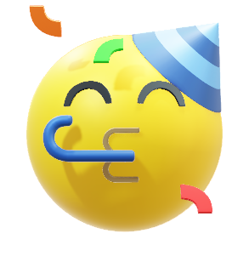

Fun
Vs
Frustration

Slide 8


Can We Have
A Perfect
Balance?
So …
I Believe We Can!

Slide 9
Let’s
Look At
Some Things That Can Cause Difficulties
But It Takes Work!

Slide 10
Things to Consider
Lack Of Knowledge
Unfamiliar setup (Left/DBD)
Consecutive Program Calls
Flow
Speed (Tempo)
Tip Length
Call Delivery (Lead Time)
    Cadence, Stacking, Clipping
Acoustics
Age, Ability
Interest
Atmosphere
Gimmicks

Slide 11

But, In My Opinion,
One Of the Biggest Difficulties The Dancers Experience
Is
Caller
Creativity
EGO

Slide 12
What I want to talk about is how to soften the blow and reduce the Frustration level when you want to introduce something that “MIGHT” be difficult.
However, before we can discuss how to soften the blow, YOU need to know what is difficult and why!
So for the next part, you need to participate. I am going to show you some figures and I want you to tell me why they MIGHT or MIGHT NOT be difficult.

Slide 13
You See, To Truly Control Your Degree Of Difficulty, You Need To Know Your Audience!
AND Within Any Audience, You Need To Recognize That There Are At Least Three Skill Levels Of Dancers!
Those That Have Attended Regularly
Those That Have attended when They Could
Those That Dance With Other Callers or In Other Programs

Slide 14
Based on my experience my opinion is: you need to temper your Degree Of Difficulty to the first group listed
Those That Have Attended Regularly
These are the supporters
These are the mainstay of the group.
You can’t base your calling on the hotshots or those that only come when it suits them.

Slide 15
These sequences don’t go beyond Mainstream so hopefully everyone will be able to participate.
Understand everything in these sequences is completely legal!
Okay so on the next few slides I am going to show you some sequences that I have seen called, by callers, in a live environment. They either didn’t realize the impact or really wanted to see if the dancers could dance what they called.

Slide 16
Here we are calling for dancers that have just graduated from the basic program.
Heads Lead Right,
Veer Right,
Couples Circulate,
Bend The Line,
Reverse Flutter Wheel,
Pass The Ocean,
Ladies Trade,
Boys Run,
Bend The Line,
Pass Thru,
Bend The Line,
Circle Left To Home
Lead Right and Veer Right Doesn’t Flow at all
Bend the line (CCW) and Reverse Flutterwheel also present reversal of body flow. Flutterwheel would be better.
Having the Boys Run when on the ends is fine but the next call should be a forward action - circulate or trade not bend the line.

Slide 17
Same Group!
Heads Star Thru,
Centers Pass Thru,
Veer Right,
Wheel & Deal,
Pass Thru,
Trade By,
Veer Left,
Ferris Wheel,
Zoom,
Centers Pass Thru,
Al,
Veer right from a forward motion will in most cases cause issues
Wheel and Deal from CCW lines is usually a surprise to some.
Veer left, again from a forward motion is tough

Slide 18
For the next sequence we have a Mainstream group that is celebrating their club anniversary
It’s a Party Night – lots of thinking doesn’t fit.
Swing thru in this situation has all the center people with their right hand down toward their back.
Ladies are running LEFT
Wheel and Deal is CCW
The Veer Left is total Reversal of Body Flow
Flutterwheel after this bend the line is very poor flow. Should be a Reverse Flutterwheel or FAB first
Heads Left Sq. Thru,
Swing Thru,
Boys Trade,
Boys Cross Run,
Girls Run,
Wheel & Deal,
Sweep 1/4 Twice,
Veer Left,
Bend The Line,
Flutterwheel,
Pass Thru,
Allemande Left

Slide 19
Same Group!
Heads Right & Left Thru,
Heads Lead Right,
Veer Right,
Partner Trade,
Bend The Line,
Star Thru,
Veer Left,
Ladies Run,
Boys Cross Run,
Recycle,
Veer Right,
Bend The Line,
Square Thru Two,
Al
Still a Party Night!
After the Right and Left Thru the body flow is LEFT. Lead Right … Veer Right??
Partner Trade and Bend The Line – total body reversal for the new center.
Star Thru and Veer Left - the dancers do it but the flow is horrible for Ladies.
Recycle and Veer Right
Wow…

Slide 20
This one is for a mainstream teen club graduation dance!
Heads Pass The Ocean,
Extend,
Left Swing Thru,
Boys Run,
Bend The Line,
Flutter Wheel,
Pass Thru,
Bend The Line,
Star Thru,
Pass Thru,
Trade By,
Allemande Left,
Promenade Home
Left Swing Thru from a right hand wave is nice has good flow but is a surprise for most dancers.
The Boys Run here is a bit of overflow but not horrible.
However the Flutterwheel Should be a Reverse Flutterwheel or something to break the flow, FAB

Slide 21
Same Group!
Heads Square Thru 4,
Swing Thru,
Boys Run,
Bend The Line,
Right & Left Thru,
Dixie Style To A Wave
Boys Trade,
Boys Run,
Bend The Line,
(B) Dixie Style To A Wave
Boys Fold,
Girls U-Turn Back,
Al
The second Boys Run Is To The Left.
Dixie Style to a Wave with the boys in the right hand position would drop most Mainstream Floors.

Slide 22
This is for a new caller night. You are calling the patter for a student caller who will be doing the singing call.
Heads Forward & Back
Star Thru
Centers U-Turn Back
Everybody Dosado
Everybody Pass Thru
Everybody U-Turn Back
Pass Thru
Centers Right & Left Thru
Outsides U-Turn Back
Centers Pass Thru
AL
This is too involved as a warm up tip for a new caller
Same Sex Dosado ….
You should call simple basics that are standard & relaxed.
Best to use the singing call figure the new caller is going to use to ensure THEIR success!

Slide 23
What about Gimmicks or Trickery
Allemande Left to an Alamo Ring
Everybody Circle, Boys Right, Girls Left
Circle left …. Walk All Around the Great Big Ring….
Square Thru 4 …. Heads!
Right and Left Thru … Right After You Bend The Line
Ladies Lead … Flutterwheel
Ladies Lead …
Dixie Style to A Wave
Heads Star Thru ….
Side Face Grand Square
Heads Sq. Thru 3 … Al

Slide 24
So, I have given you some of my observations of what “can” cause difficulties. So if you feel that you must use any of these things we have pointed out so far, let’s see how to “Soften The Blow”
There are callers who thrive on breaking a floor down. They want to prove they know more than the dancers.
Personally, I don’t believe in that!
I believe the dancers want to be entertained with how much “THEY” know, not with how much “I” know.

Slide 25
So…How to soften the blow
I am a big believer in CLUE words not CUE words. Help with Direction or Motions or Flow Hints. If it’s different, don’t just give the definition and expect them to figure it out.
Referring to some of our examples:
Heads lead Right and Veer Right. IF you really feel the need to use that… Break up the calls. Lead Right, “Smile” now veer Right, “Oops not smooth but we got there”
Bend the line and Reverse Flutterwheel
(CCW) Again if that is what you really want to call, break the flow between the two. Bend the line, “Forward Come ALL The Way Back”, Reverse Flutterwheel, Boys go…

Slide 26
Veer Left or Right from a forward motion.
If you must call this action, precede it with - CAREFUL… or Listen UP and follow it with OUCH… They will groan or laugh!
Partner Trade and Bend The Line
Is total body reversal for either the end or center dancer. Again, you need to break up the calls with something - Forward & Back or Balance works from any type of line. From a two faced line, you will get a smile or a laugh.
Swing Thru from L/H Wave
This has nice flow if set up correctly, but the dancers will fail in many cases. I usually say “RIGHT”
Wheel and Deal from CCW Lines
I often say “Go LEFT ” or Boy Pivot

Slide 27
In my Opinion, the difference between
FUN and FRUSTRATION is the success rate!
If dancers are successful, they are usually happy which makes it FUN.
Anything you can do to make them successful makes YOU successful. CLUE words are very beneficial to their success! Don’t be afraid to use these types of hints.
Give them the direction Left or Right if it is unusual. Use “Balance” or “Forward & Back” – say WooHoo if it is unusual.
Use Dosado as a direction neutralizer. Use “Smile” as a pause to neutralize direction.

Slide 28
I have a few things that I say to warn them if I am going to call something that MIGHT be difficult
I will say things like:
Do what I call and not what you think I called.
Or Expect The Unexpected.
Or Listen Up!
These phrases will alert them to pay a bit more attention.
Or afterwards I might say: ouch, I will try not to call that again.
After they groan I will say “Be Nice or I’ll Mumble”

Slide 29
Let’s open the session now to questions, comments or general discussion of experiences!
Let us know something you called that didn’t go quite as you planned!

