Slide 1
How To Be
A Successful
Teacher
By Jeff Priest

Slide 2
These Are The Items We Will Be Discussing In Detail!
Know “Who” your students are
Know & Use All 4 learning Styles
Know CALLERLAB definitions
Know The Styling
Know The Timing
Develop LOTS Of Patience
Don’t Over-teach
Use Some Humour…

Slide 3
Know “Who” your students are
Age!
Terminology
Gender
A New Language
Willingness…

Slide 4
Know “Who” your students are
Learning Styles
Visual
Auditory
Reading
Kinesthetic or Tactile …

Slide 5
Use CALLERLAB definitions
Use it on New Teach
Call Analysis Sheet

Slide 6
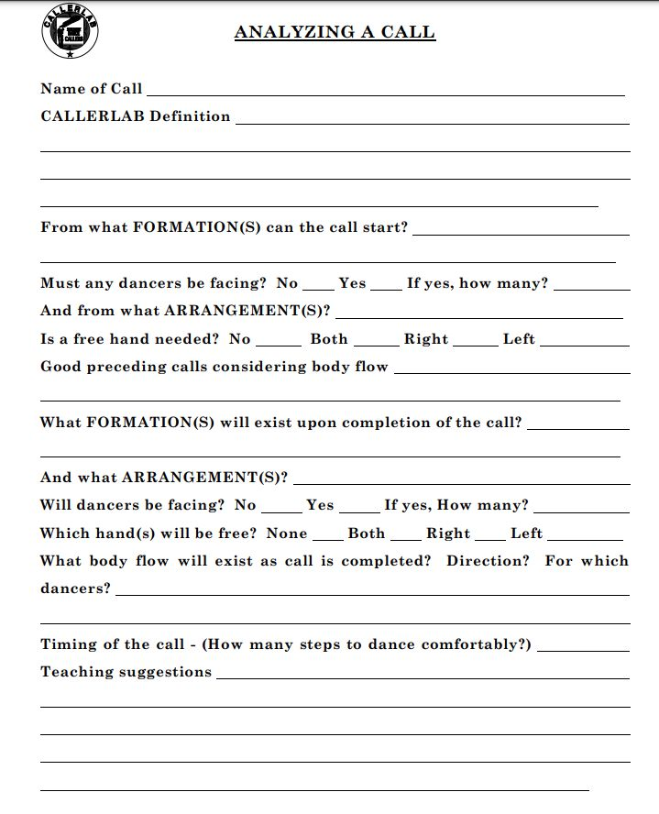

Slide 7
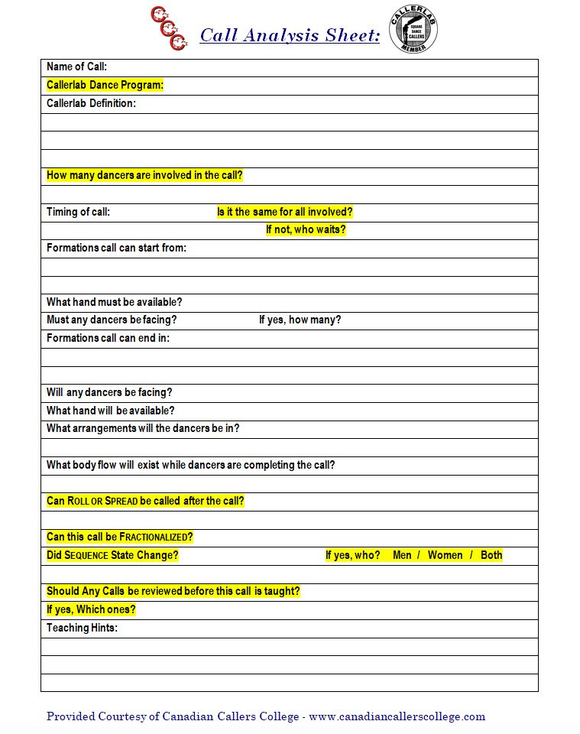

Slide 8
Use CALLERLAB definitions
Shortcuts or hints
Example of teach…

Slide 9
Styling
Part of Definition
Shorter Classes
Back Burner
Eventually…

Slide 10
Timing
Name of Call
Starting Position
Definition
Ending Position
Number of Beats
Name of Call…

Slide 11
Timing
Patter Music
Singing Call
Adjust Tempo
Modules…

Slide 12
LOTS Of Patience
Adult Recreation
New Language
Relaxed
Know when to drop it
Be Complimentary
Full Moon/Party Nights…

Slide 13
Don’t Over-teach
10 Minutes
Definition
Concise & Clear
Re-teach…

Slide 14
Add Some Humour
Light Hearted
NOT Sarcasm
Don’t Pick On Anyone
Simple Routines
Have Fun…

Slide 15
Summary
Be Aware Of Your Customer
Address ALL Learning Styles
Use CALLERLAB Definitions
Introduce Styling As You Go
Pick Good Music For Timing
Use Singing Calls Every Time
Develop Lots Of Patience
Don’t Over Teach
Use Humour And Smile A Lot…

Slide 16
Teaching
How Do You Employ it?
Party Dance
First Class Night
Club Night…

Slide 17
Questions?

Slide 18
B A S I C
FULL Teaching System
Created By Jeff Priest
This Is A Building Block System
It Is Based On Modules
The Benefits Are Many
The System Is Very Flexible…
Once the Core 20 is taught

Slide 19
20 Core Calls!
Circle left / Right
Forward and Back
DoSaDo
Swing – Partner / Corner
Promenade – Couples / Singles
Allemande Left
Weave The Ring/Right & Left Grand
Stars – Right / Left
Pass Thru
U-Turn Back
Separate @ 2 – (Lines)
Courtesy Turn
Ladies Chain – 2 & 4
Lead Right
Veer Left
Bend The Line
Right and Left Thru
Star Thru
California Twirl
Dive Thru

Slide 20
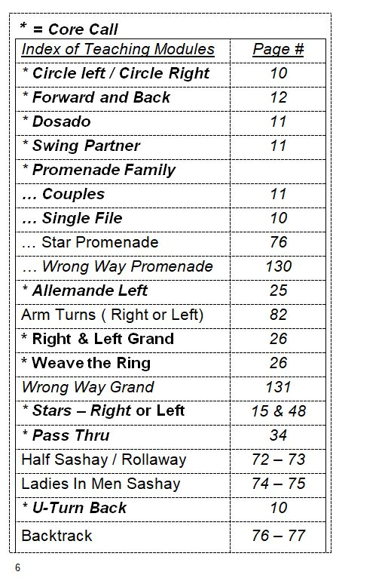

Slide 21
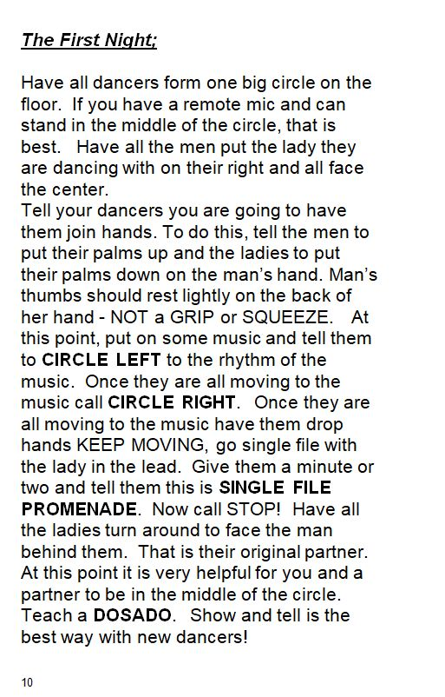

Slide 22
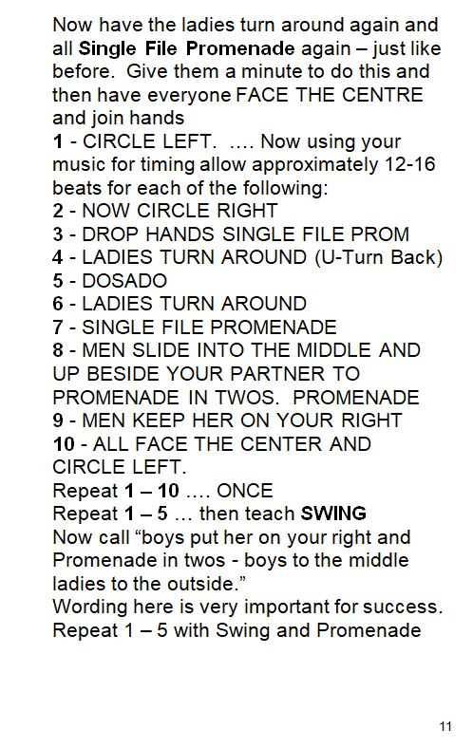

Slide 23
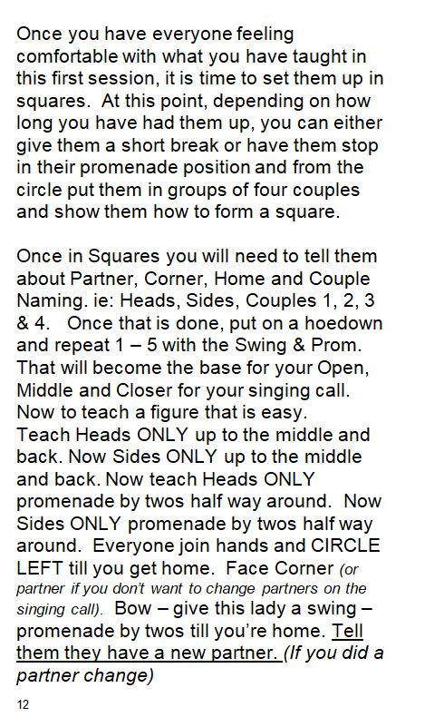

Slide 24
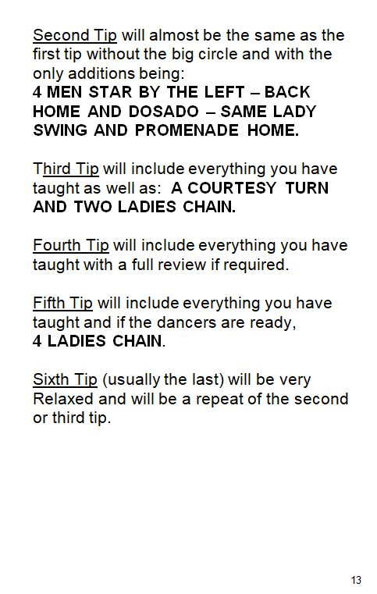

Slide 25
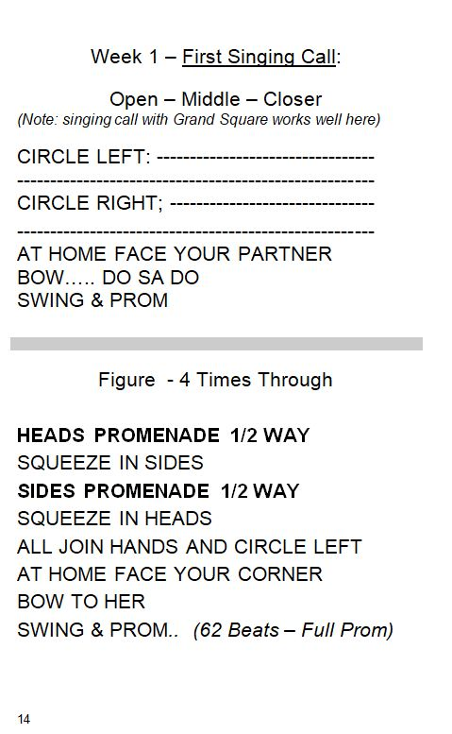

Slide 26
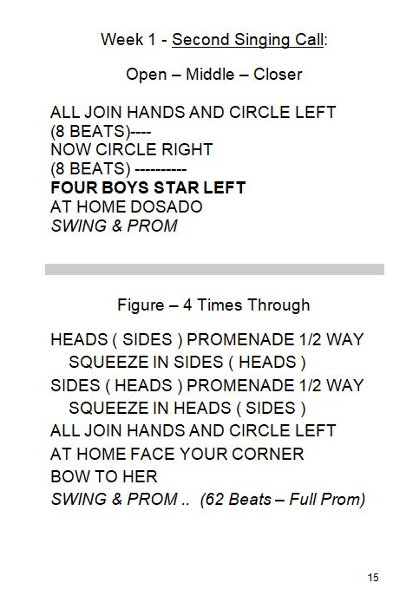

Slide 27
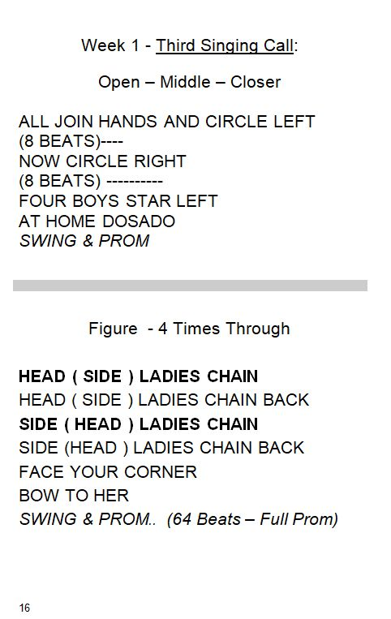

Slide 28
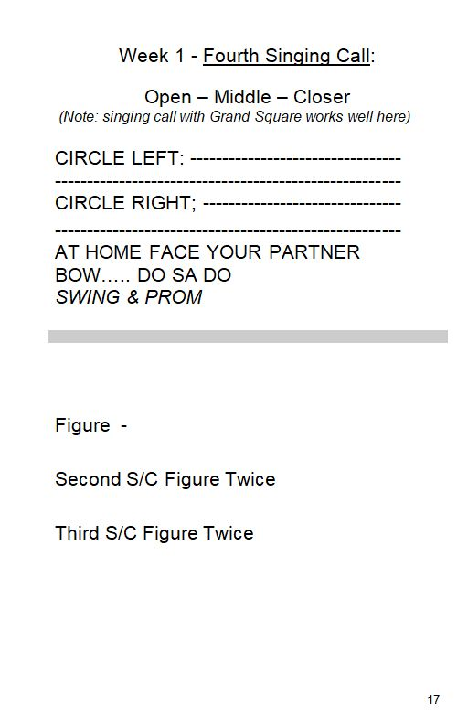

Slide 29
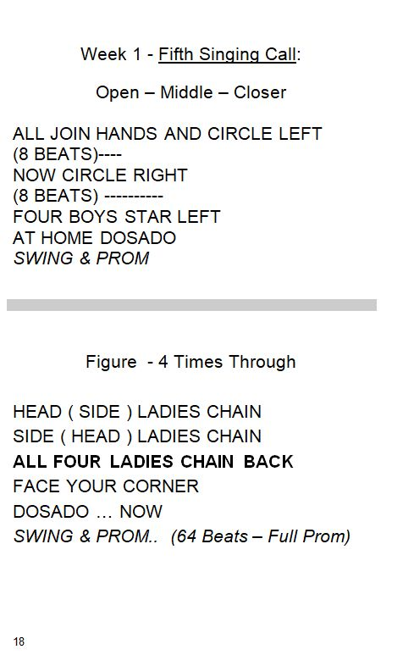

Slide 31
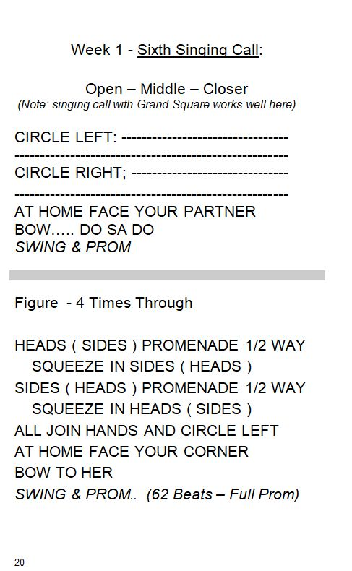

Slide 33
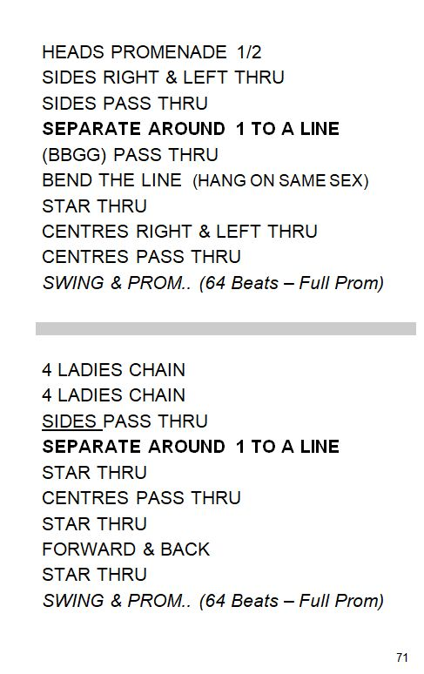

Slide 34
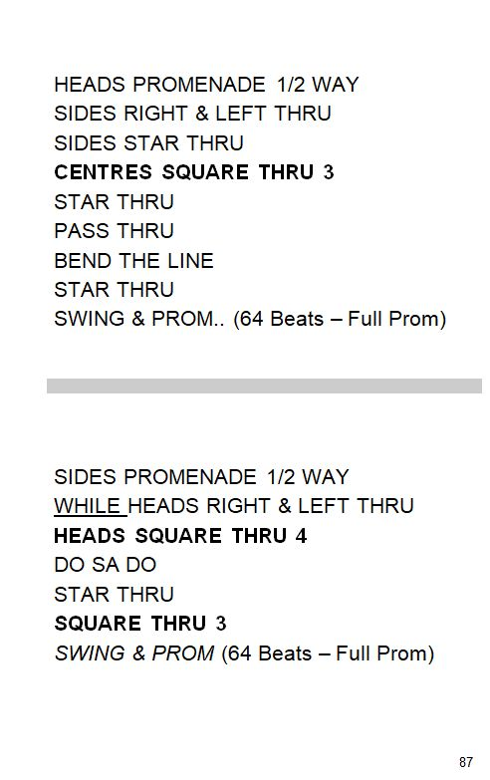

Slide 35
The Books!
There Are 4 Books In Total!
Basic Teaching System ….. $45.00
Dancing The Basics …… $15.00
Mainstream Teaching System … $15.00
Plus Teaching System … $20.00
All 4 Books Purchased Together… $85.00
S h i p p i n g I s E x t r a
Canada = $20.00
USA = $30.00
Overseas = $40.00
For More Information Or To Order on PayPal
Visit our website: www.canadiancallerscollege.com
E-transfers to: jeff@canadiancallerscollege.com
No password required! If your bank requires one use “teachbooks”

Slide 36
Questions?

