Slide 1
Layers of Data
}
}
Raw
Organised
Reporting
1
People
Events
Customer View
2
Agrmnt
3
Product Risk
4
Places
Prodcts
5

Slide 2
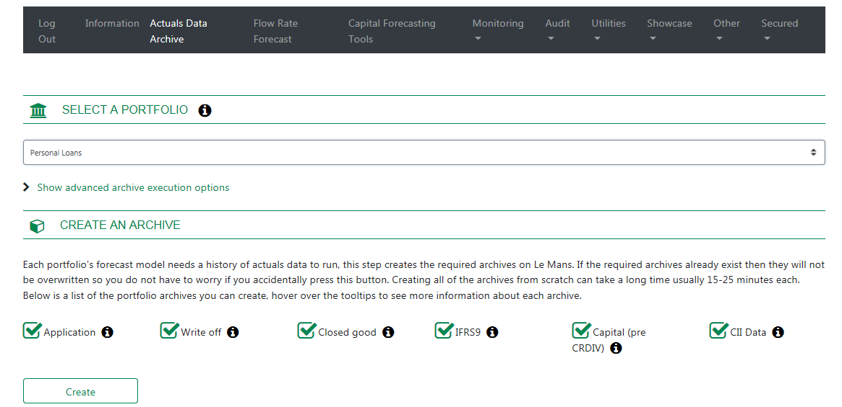
Visualisation
Crossfilter

