Slide 1

Database Structures
Thomas Russell, M.Ed. D hon (cybersecurity)

Slide 2

Understanding Data Structure
Data ranges from highly structured to unstructured.
Structured Data: Organized into tables (e.g., spreadsheets).
Semi-Structured Data: Some structure but not rigid (e.g., JSON).
Unstructured Data: No predefined structure (e.g., text files).

Slide 3

Structured Data - Relational Databases
Data stored in tables with rows and columns.
Primary Key: Uniquely identifies each record.
Foreign Key: Links tables by referencing a primary key.
Example:
  Customer Table: CustomerID (Primary), FirstName, LastName
  Order Table: OrderID (Primary), CustomerID (Foreign)
Relationship Types: One-to-one, one-to-many, many-to-many.

Slide 4
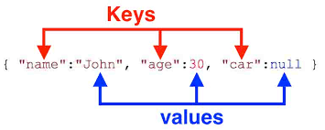
Non-Relational Databases
Does not use structured tables.
Key-Value Stores: Data stored as key-value pairs.
Document Stores: Stores documents like JSON, XML.
Advantages: Flexible structure, fast data retrieval.
Examples: DynamoDB (Key-Value), MongoDB (Document).

Slide 5
Comparing Relational and Non-Relational Databases
Aspect | Relational DB | Non-Relational DB
Data Structure | Tables (rows/columns) | Key-Value, Document
Query Language | SQL | Varies (NoSQL)
Use Case | Structured data, complex queries | Flexible, semi-structured
Example | MySQL, PostgreSQL | MongoDB, DynamoDB

Slide 6
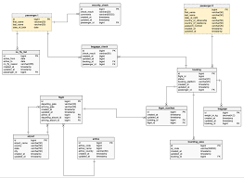
Database Schema
Defines the structure of a database (tables, fields, relationships).
Example: AdventureWorks schema diagram.
Purpose: Organizes data efficiently, maintains relationships.

Slide 7

Practice Questions and Answers
Q1: Which key best represents a student-course relationship?
  Answer: Composite key in a junction table (StudentID, CourseID).
Q2: Which statement about non-relational databases is true?
  Answer: Suitable for flexible, varied data formats.
  Visual: Use question icons and speech bubbles for Q&A format.

Slide 8
Key Takeaways
Relational Databases: Use structured tables and relationships.
Non-Relational Databases: Flexible, suited for varied data types.
Primary Key: Uniquely identifies records.
Foreign Key: Creates relationships between tables.
Schema: Blueprint defining the database structure.

Slide 9

Questions

Slide 10
Database Structures
Thomas Russell, M.Ed. D hon (cybersecurity)

