Slide 1

Understanding the Caesar Cipher: A Foundation in Classical Cryptography
Bridging History and Cybersecurity
Thomas Holt Russell, M.Ed., Hon D. (cybersecurity)

Slide 2
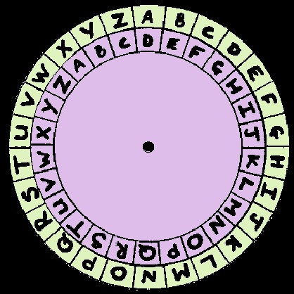
What is a Caesar Cipher?
A Caesar cipher is a substitution cipher used in ancient Rome.
Each letter in the plaintext is shifted to a fixed number of places in the alphabet.
Named after Julius Caesar, who used it to protect military messages.

Slide 3
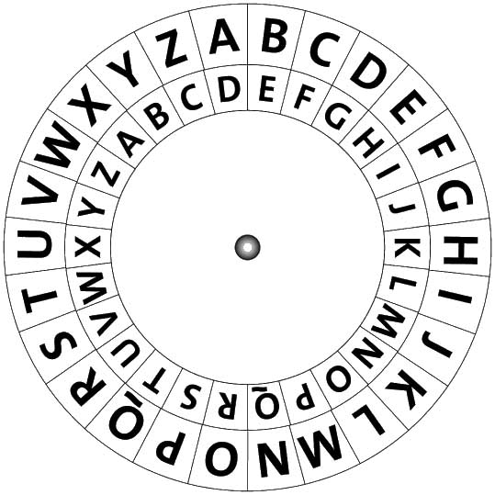
How It Works
Choose a shift value (e.g., +3)
Replace each letter in the message with the letter that appears three positions later in the alphabet
Example:
  Plaintext: HELLO
  Shift: +3
  Ciphertext: KHOOR

Slide 4
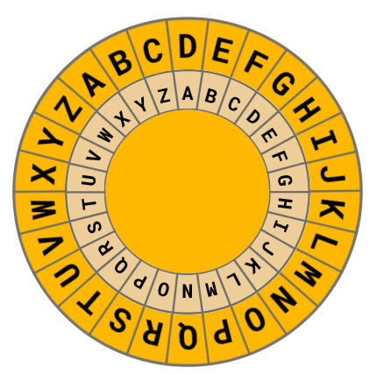
Caesar Cipher in Action
Interactive example (pose a short word and walk through the encryption)
Include:
  Plaintext
  Shift amount
  Encrypted message
Optional: Embed a short video clip from Simply Explained

Slide 5
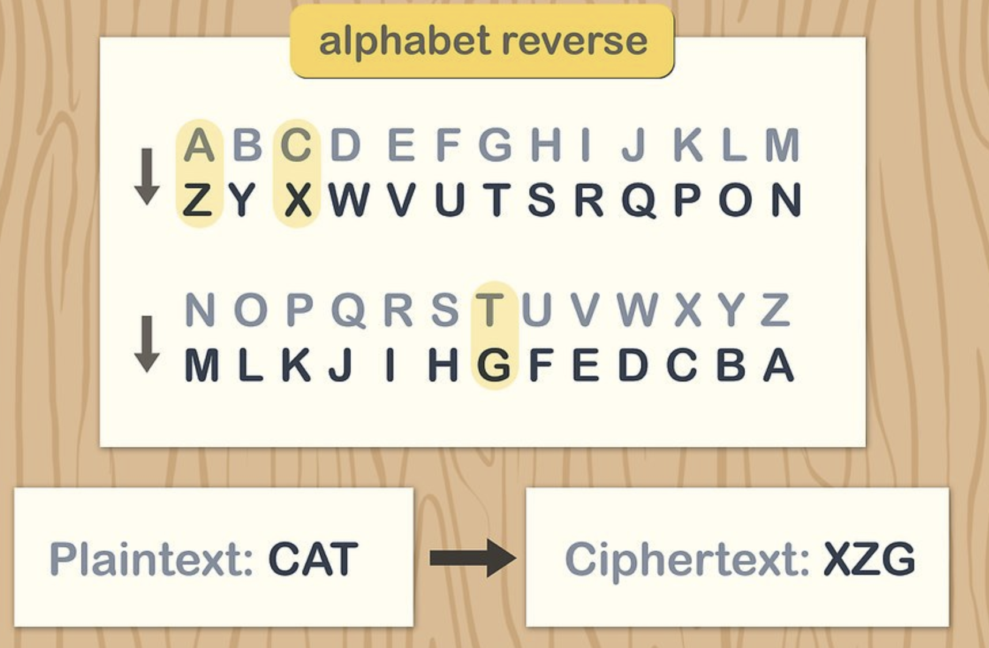
Decrypting a Caesar Cipher
Reverse the shift to return to the original message
Brute-force is possible due to only 25 shift options
Demonstrate:
  Ciphertext: KHOOR
  Shift: -3
  Decrypted: HELLO

Slide 6
Strengths and Weaknesses
Strengths:
Simple and easy to understand
Historical importance
Weaknesses:
Easy to break with brute-force
No key exchange mechanism

Slide 7
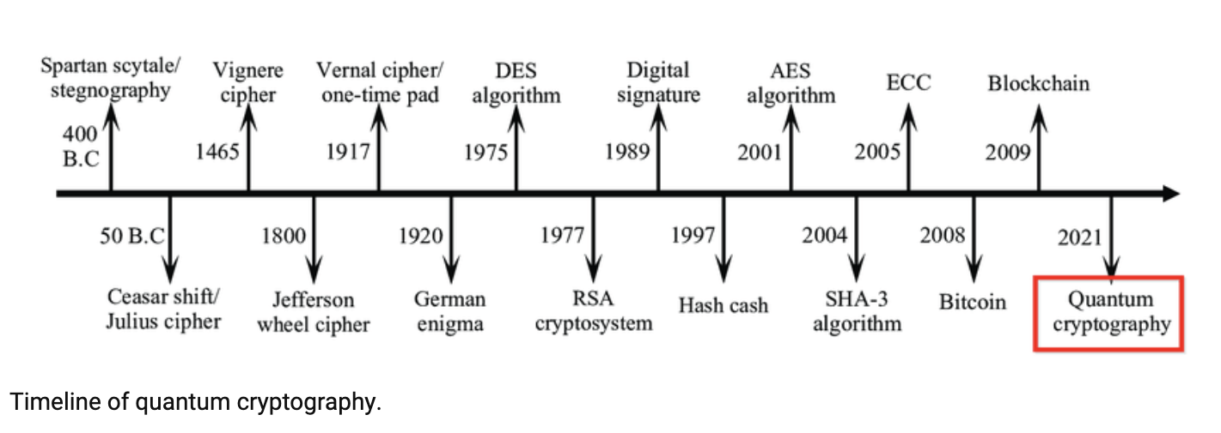
Real-World Connections
Foundation of modern substitution ciphers
Helps explain concepts of encryption keys, frequency analysis, and secure communication

Slide 8

Try It Yourself
Provide an encrypted message and ask the audience to decode it
Example:
  Ciphertext: ZHOFRPH
  Hint: Shift -3

Slide 9

Conclusion
Caesar cipher is a great entry point into the world of cryptography
Understands the importance of secure communication
Encourages further study into modern encryption algorithms

Slide 10

Resources & Further Learning
Video: Simply Explained – Caesar Cipher
Try online cipher tools: https://www.dcode.fr/caesar-cipher
Recommended reading:
The Code Book by Simon Singh
Cryptography and Network Security by William Stallings
Image: Stack of books or digital learning icons

Slide 11
Understanding the Caesar Cipher: A Foundation in Classical Cryptography
Bridging History and Cybersecurity
Thomas Holt Russell, M.Ed., Hon D. (cybersecurity)

