Slide 1
Notational Systems
Dr. Thomas Holt Russell

Slide 2
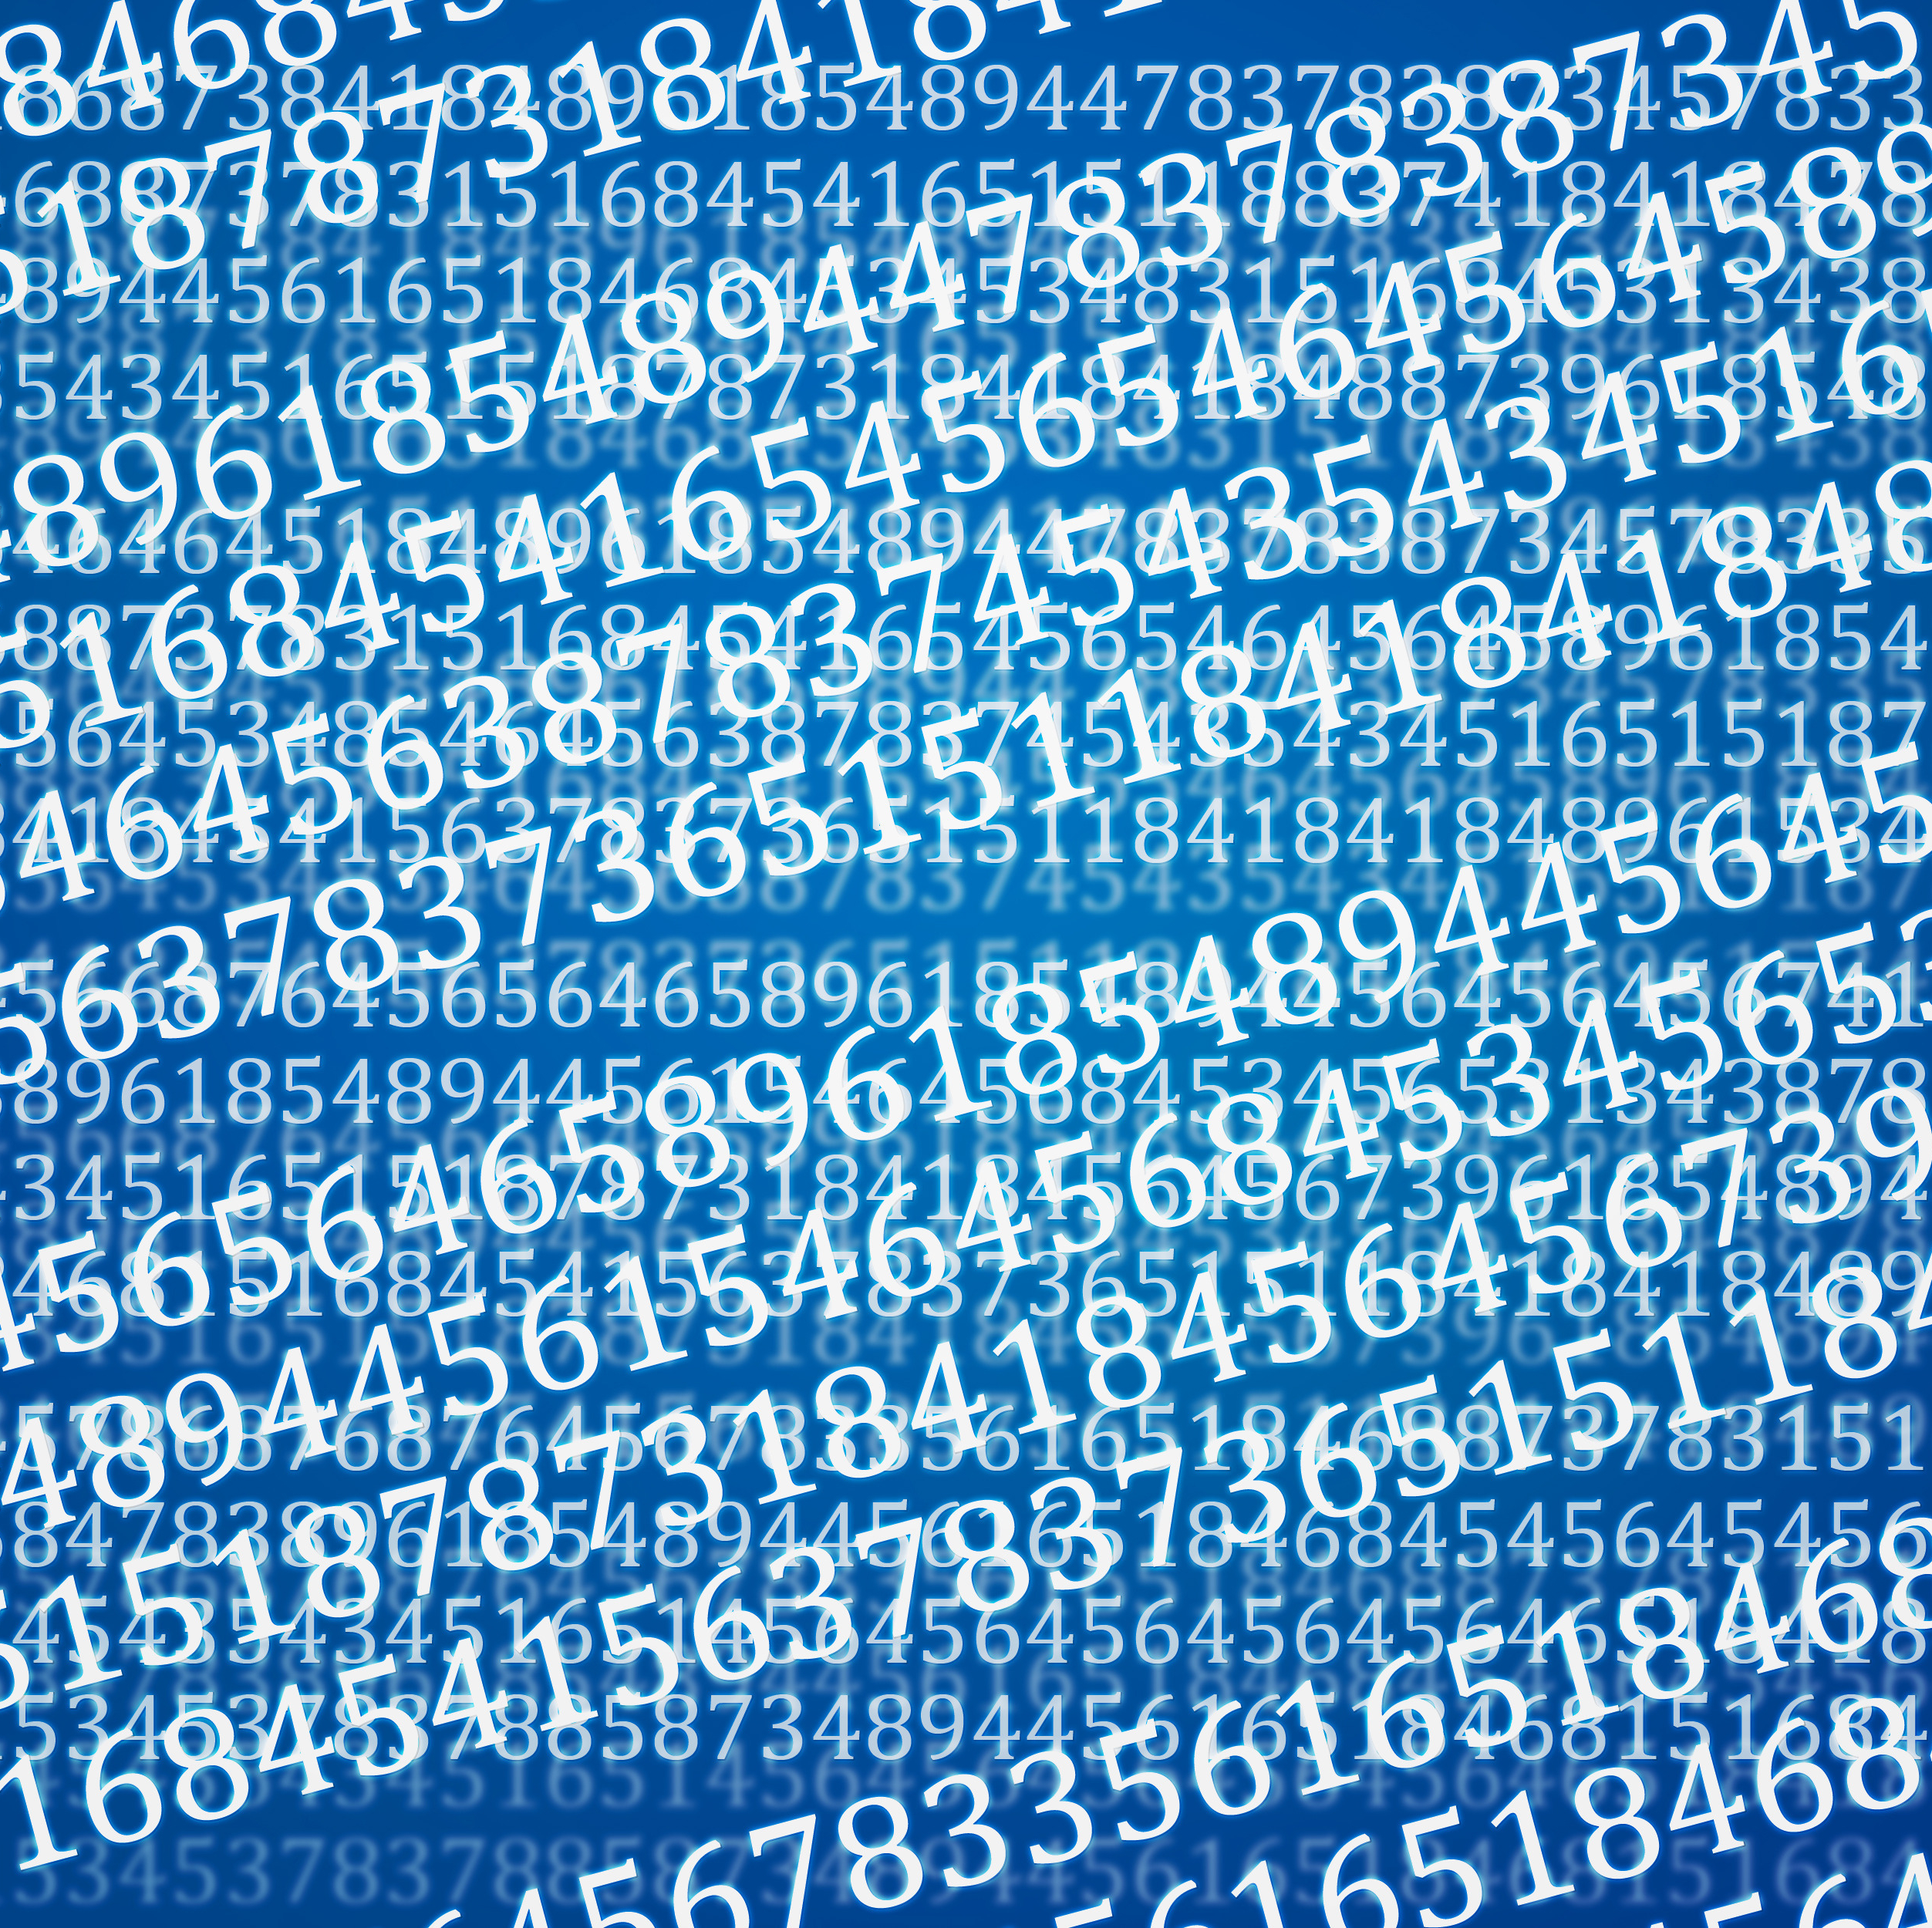
Understanding Number Systems
Binary, Hexadecimal, and Decimal

Slide 3
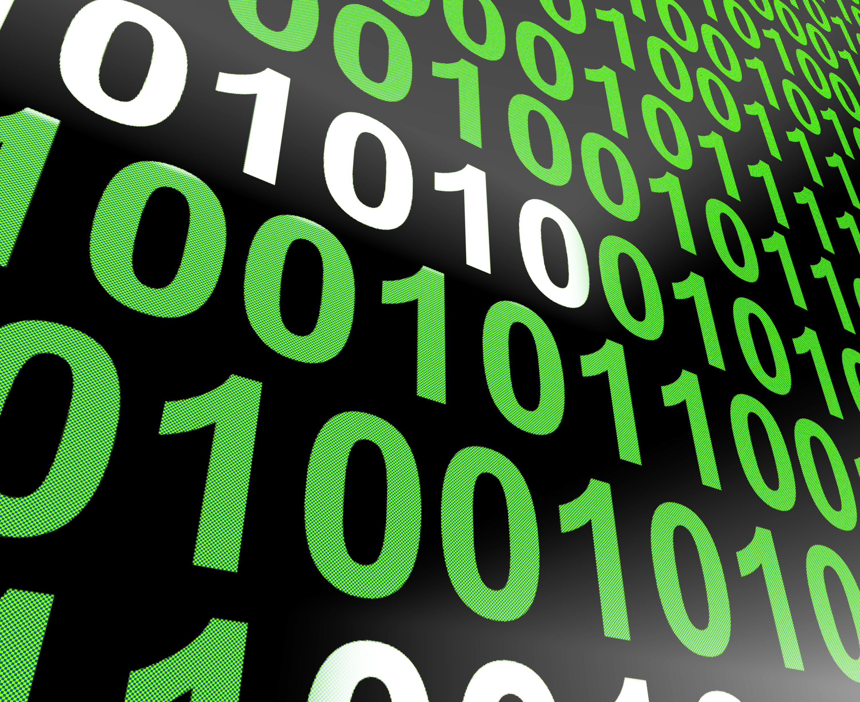
Binary Number System What is Binary?
The binary numbering system uses only two digits: 0 and 1. It’s the language of computers because electronics easily understand binary as on (1) and off (0) states. Each binary digit is called a bit. By combining bits, binary can represent numbers, letters, and even pictures! Example: The number 5 in binary is written as 101.

Slide 4
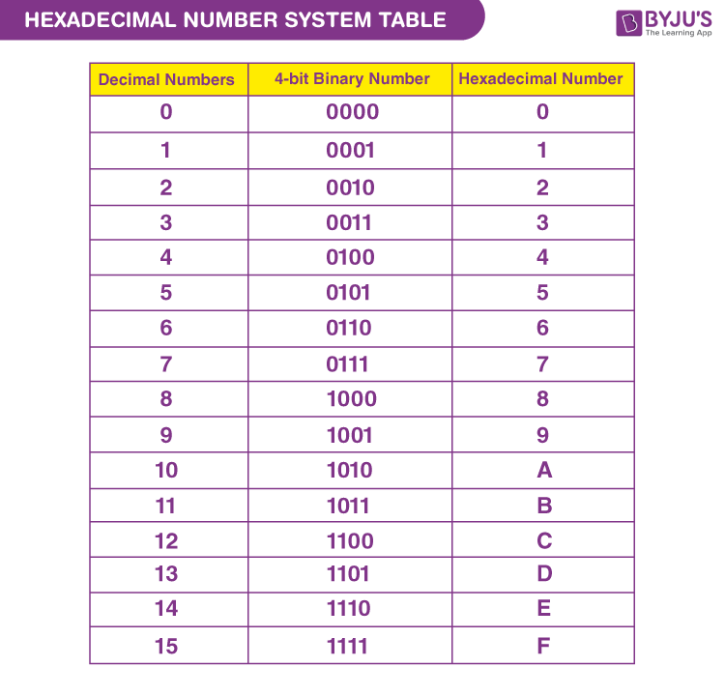
Hexadecimal Number System What is Hexadecimal?
The hexadecimal numbering system uses 16 symbols: the digits 0 to 9, and the letters A to F.Letters A to F represent numbers 10 to 15.Hex is widely used in computing because it’s shorter and easier to read than binary.
Example:Decimal 10 = Hexadecimal A.
Decimal 255 = Hexadecimal FF.

Slide 5
Decimal Number System What is a decimal?
The decimal numbering system is the way we count in everyday life.It uses 10 digits: 0, 1, 2, 3, 4, 5, 6, 7, 8, 9.Each digit’s place value represents a power of 10 (e.g., ones, tens, hundreds).Example: In the number 345:
3 is in the hundreds place.
4 is in the tens place.
5 is in the ones place.

Slide 6
When to use Binary
Binary is the core numbering system used in computer science because computers operate on binary logic. Here’s where it’s essential:
Hardware and Logic Gates: Computers use transistors that have two states: on (1) and off (0). Binary directly represents these states.
File Storage: Data in computers is stored as bits (binary digits). For example, a text file, image, or video is ultimately represented as sequences of 0s and 1s.
The ASCII code for "A" is 01000001 in binary.
Networking Protocols: IP addresses (IPv4) are binary numbers under the hood. For example, 192.168.1.1 in decimal translates to binary as 11000000.10101000.00000001.00000001.

Slide 7
When to use hex
Hexadecimal is widely used in computer science because it provides a compact, human-readable way to represent binary data.
Memory Addresses: In low-level programming (e.g., assembly language), memory locations in RAM or storage are identified using hexadecimal.
For example, a memory address might look like 0x1F4A instead of its much longer binary equivalent.
Color Codes in Web Design:
Web developers use hex codes to define colors in CSS. For instance, #FF5733 is a shade of orange, where FF (255 in decimal) is the red intensity, 57 is green, and 33 is blue.
Debugging and Reverse Engineering: Hexadecimal is used in debugging tools to inspect machine code, where each instruction is represented in a hex form for better readability.

Slide 8
When to use decimal
Decimal is used in scenarios where humans interact with computers because it’s intuitive and easier for us to understand.
Everyday Applications: Decimal is used for numbers we see on screens, such as calculations in a calculator app, timestamps, or statistics. For example:
A program displays 100 files in decimal for users instead of a binary equivalent (1100100) or hex (64).
Programming with User Input: In high-level programming, user input and outputs are often handled in decimal because it aligns with what users expect.
Measurements and Units: Decimal is used for measurements like file sizes (e.g., 1,024 KB = 1 MB) and time (e.g., 24 hours).

Slide 9
Remember…
Binary -The binary numbering system uses only two digits: 0 and 1. It’s the language computers use to store and process information because it’s easy for electronics to understand—on (1) and off (0). Each digit in binary is called a bit, and by combining bits, we can represent numbers, letters, and even pictures! For example, the number 5 in binary is written as 101.
The hexadecimal-numbering system uses 16 symbols: the digits 0 to 9, and the letters A to F. Each letter stands for numbers 10 to 15. Hex is often used in computers because it’s shorter and easier to read than binary. For example, the number 10 in decimal is A in hex, and the number 255 in decimal is FF in hex.
Decimal - The decimal numbering system is the way we count in everyday life. It uses 10 digits: 0 through 9. Each digit’s place in a number represents a power of 10 (like ones, tens, hundreds, etc.).

Slide 10
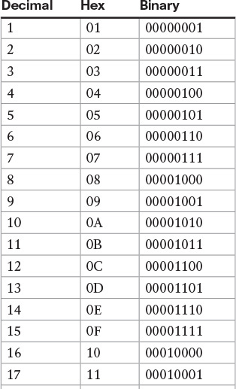
Summary & Key Takeaways
Binary: Computers' language using 0s and 1s.Hexadecimal: Compact system using 16 symbols (0–9, A–F), great for computing. Decimal: Everyday counting system using 10 digits and powers of 10.

Slide 11
Notational Systems
Dr. Thomas Holt Russell

