Slide 1

Database Interfaces:
Summarizing Methods Used to Interface with Databases
Thomas Russell, M.Ed. D hon (cybersecurity)

Slide 2

Introduction to Databases
Definition and importance of databases
Role of SQL in managing data
Notes:
Databases are essential tools that store, organize, and manage data efficiently.
SQL (Structured Query Language) is the standard language for interacting with databases.

Slide 3
Key Objectives
Relational Methods
Database Access Methods
Export/Import Methods
Notes:
Understand relational methods for data organization
Learn database access methods for data interaction
Explore exporting and importing data

Slide 4
Structured Query Language (SQL)
Bullet Points:
Standard language for database interaction
Two major sublanguages: DDL and DML
Notes:
SQL is the standard for interacting with relational databases.
Divided into:
Data Definition Language (DDL): Modifies structure
Data Manipulation Language (DML): Manages data

Slide 5
Data Definition Language (DDL)
Used to define database structure
01
Primarily used by administrators and developers
02
Key Commands: CREATE, ALTER, DROP
03
Notes:
DDL is used to define and modify database structure.
Commands:
CREATE: Creates tables
ALTER: Modifies tables
DROP: Deletes tables/databases

Slide 6
DDL Commands Explained
CREATE: Makes new tables
01
ALTER: Modifies existing tables
02
DROP: Deletes entire tables or databases
03
Notes:
Example:
CREATE TABLE Employees (ID INT, Name VARCHAR(50));
ALTER TABLE Employees ADD Salary DECIMAL;
DROP TABLE Employees;

Slide 7
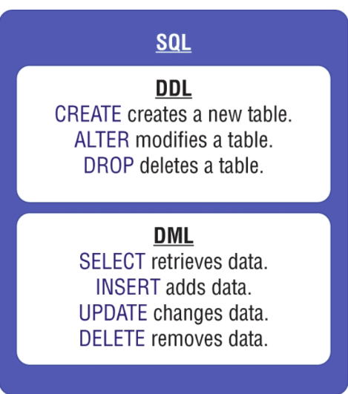
Data Manipulation Language (DML)
Used to manipulate data within existing tables
Key Commands: SELECT, INSERT, UPDATE, DELETE
Notes:
DML manages data within tables without altering structure.
Commands:
SELECT: Retrieves data
INSERT: Adds new data
UPDATE: Modifies existing data
DELETE: Removes specific rows

Slide 8
DML Commands Explained
SELECT: Retrieves data
01
INSERT: Adds new data
02
UPDATE: Changes existing data
03
DELETE: Removes specific rows
04
Notes:
DML manages data within tables without altering structure.
Commands:
SELECT: Retrieves data
INSERT: Adds new data
UPDATE: Modifies existing data
DELETE: Removes specific rows
Example:
SELECT * FROM Employees;
INSERT INTO Employees (ID, Name) VALUES (1, 'Alice');
UPDATE Employees SET Name='Alice Smith' WHERE ID=1;
DELETE FROM Employees WHERE ID=1;

Slide 9
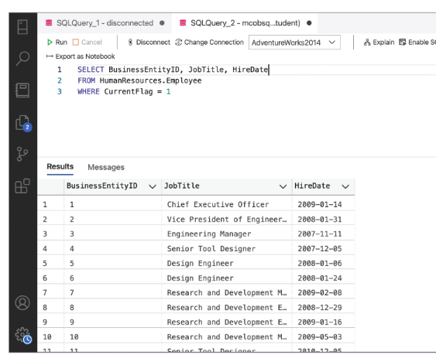
Database Access Methods
Direct SQL Command Input
Graphical Interfaces (e.g., Azure Data Studio)
Query and Report Builders
Notes:
Direct SQL Input: Typing commands directly
Graphical Interfaces: Tools like Azure Data Studio
Query and Report Builders: Simplify data retrieval

Slide 10
Exporting Data
Direct SQL Command Input
Graphical Interfaces (e.g., Azure Data Studio)
Query and Report Builders
Notes:
Export data for backups or migration
Methods:
Database Dumps
Data Export Formats (CSV, JSON)

Slide 11
Programmatic Interactions
Software applications using SQL commands
Automating data processing
Notes:
Software applications can send SQL commands to the database.
Example: Online forms storing user data.

Slide 12
Key Differences: DDL vs. DML
DDL: Modifies structure (CREATE, ALTER, DROP)
DML: Modifies data (SELECT, INSERT, UPDATE, DELETE)
Notes:
DDL: Changes structure (CREATE, ALTER, DROP)
DML: Changes data (SELECT, INSERT, UPDATE, DELETE)

Slide 13
Practice Questions
Example Question: "What command deletes an entire table?"
Answer: DROP
Notes:
Q1: What command deletes an entire table? (Answer: DROP)
Q2: How do you add a new employee to a table? (Answer: INSERT)

Slide 14
Real-World Example
Scenario: Updating employee job titles using the UPDATE command
Example Command: UPDATE Employees SET JobTitle = 'Manager' WHERE JobTitle = 'Assistant';
Notes:
Scenario: Update job titles in an employee database
Command:
UPDATE Employees SET JobTitle = 'Manager' WHERE JobTitle = 'Assistant';

Slide 15
Exam Tips
Focus on command purposes, not syntax
Understand DDL vs. DML differences
Practice identifying scenarios for each command
Notes:
Focus on command purposes rather than syntax
Distinguish between DDL and DML
Practice identifying the correct command for specific scenarios

Slide 16

Questions
Notes:
"Any questions or clarifications?"
"Let's discuss practical scenarios."

