Slide 1
Canadian Carbon

Slide 2
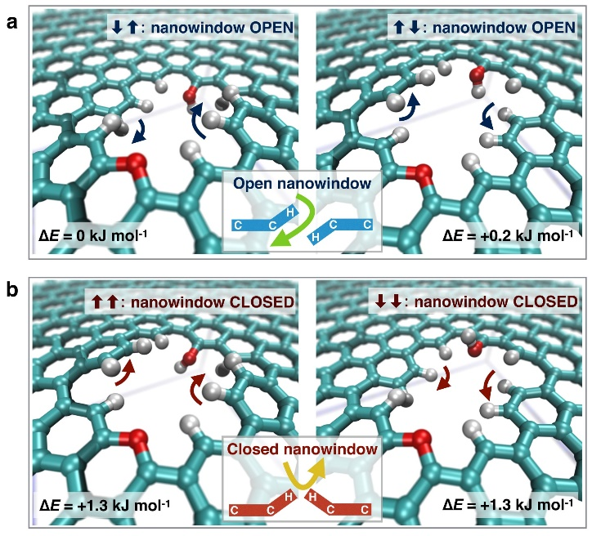
Stage One: Remove the carbon dioxide
Water molecule: 275 picometres
Hydrogen Gas Molecule: 289 picometres
Scientists from Shinshu University and PSL University, France, theoretically proved the concerted motion of a nanowindow rim within a graphene mesh to selectively allow molecules to pass in a fast, energy-efficient way. This brings up new possibilities to create an advanced molecular separation membrane technology.
A filtration mesh made of graphene with nano-windows approximately 330 picometres in diameter (larger than Oxygen, Hydrogen, Water and Carbon Dioxide molecules, but smaller than Nitrogen)
A second graphene filter with nano-windows approximately 300 picometres in diameter (larger than Oxygen, Hydrogen and Water molecules, but smaller than Carbon Dioxide gas)
Sealed inner chamber and tank for removal of carbon dioxide
Also remove Hydrogen gas from the air during this phase if possible
Particle Dimensions
Water molecule: 275 picometres
Hydrogen Gas Molecule: 289 picometres
Oxygen Gas Molecule: 292 picometres (O2 permeates faster through 0.29 nm nanowindows than 0.33 nm nanowindows)
Carbon Dioxide Gas Molecule: 330 picometres
Nitrogen Gas Molecule: 364 picometres
Carbon Atom: 140 picometres
Source: https://phys.org/news/2018-06-mechanisms-air.html
Journal: Fernando Vallejos-Burgos et al, Air separation with graphene mediated by nanowindow-rim concerted motion, Nature Communications (2018). DOI: 10.1038/s41467-018-04224-6

Slide 3
Stage Two: Add Hydrogen to produce Methane
Water molecule: 275 picometres
Hydrogen Gas Molecule: 289 picometres
Scientists developed a new method to convert carbon dioxide to methane with an electric field at low temperatures. In comparison to previous methods, this new method can produce any amount of methane whenever necessary.
“This method involves a reaction of nanoparticles called cerium oxide with carbon dioxide in presence of ruthenium catalyst with an electric field," explains Sekine. "The results show that the catalyst exhibited high and stable catalytic activity for converting carbon dioxide to methane through hydrogenation with the electric field.“
Use the Carbon Dioxide captured from the air in Stage One
Use Hydrogen gas captured in phase one if possible (if not, hydrogen supply is needed)
The stage two machine will produce Methane gas
At this stage, a usable product has already come from the air (fuel)
Methane gas is captured and stored
Source: https://www.sciencedaily.com/releases/2020/02/200227114523.htm
Journal Reference: Kensei Yamada, Shuhei Ogo, Ryota Yamano, Takuma Higo, Yasushi Sekine. Low-temperature Conversion of Carbon Dioxide to Methane in an Electric Field. Chemistry Letters, 2020; 49 (3): 303 DOI: 10.1246/cl.190930

Slide 4
Stage Three: Make Graphene from Methane
Water molecule: 275 picometres
Hydrogen Gas Molecule: 289 picometres
A new technique was invented at Caltech to produce graphene—a material made up of an atom-thick layer of carbon—at room temperature. It could help pave the way for commercially feasible graphene-based solar cells and light-emitting diodes, large-panel displays, and flexible electronics.
In 2012, Caltech staff scientist David Boyd was trying to reproduce a graphene-manufacturing process he had read about in a journal. In the process, heated copper is used to catalyze graphene growth. During an attempt to reproduce the experiment, the phone rang. While Boyd took the call, he unintentionally let a copper foil heat for longer than usual before exposing it to methane vapor, which provides the carbon atoms needed for graphene growth. The trick is in the removal of copper oxide using nano-particles (hydrogen plasma) to create an extremely smooth surface, also heating the copper. The graphene is produced simultaneously when methane gas is slowly introduced.
“With this new technique, we can grow large sheets of electronic-grade graphene in much less time and at much lower temperatures,” says Boyd. David Boyd
Use the Methane gas collected in Stage Two
Use copper, but experiment with other surfaces through which to conduct electricity and generate sheets of graphene
Source: https://www.caltech.edu/about/news/caltech-scientists-develop-cool-process-make-better-graphene-45961
Paper: Single-Step Deposition of High-Mobility Graphene at Reduced Temperatures

Slide 5
Stage Four: Use Graphene to make more filters
Now, we can use the graphene to produce electronics, long-lasting structures, and more. The carbon will remain sequestered in its new form indefinitely.
More importantly, the Graphene can be used to make more nano-filters, vastly reducing the cost of manufacturing. It’s a cyclical process that continues to improve, becoming ever more self-sustaining the longer it goes.

Slide 6
Supplemental Materials on Graphene Production

Slide 7
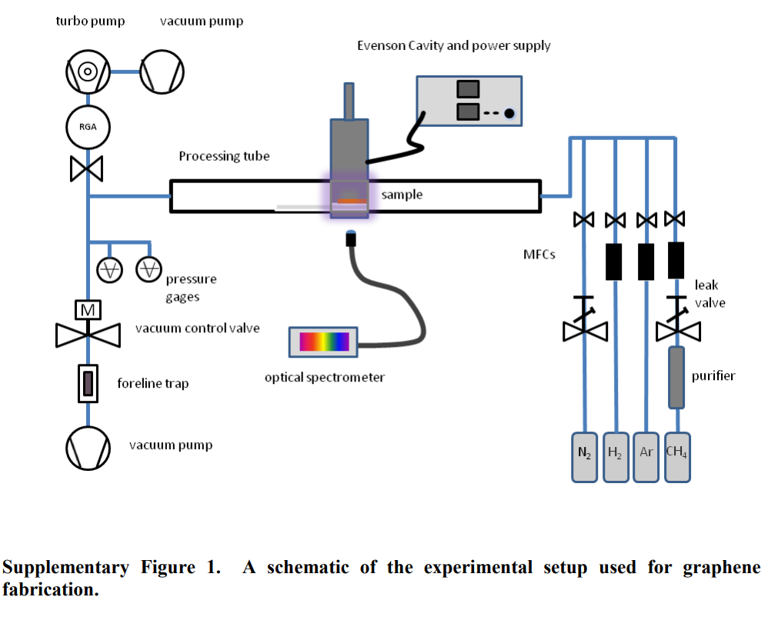

Slide 8
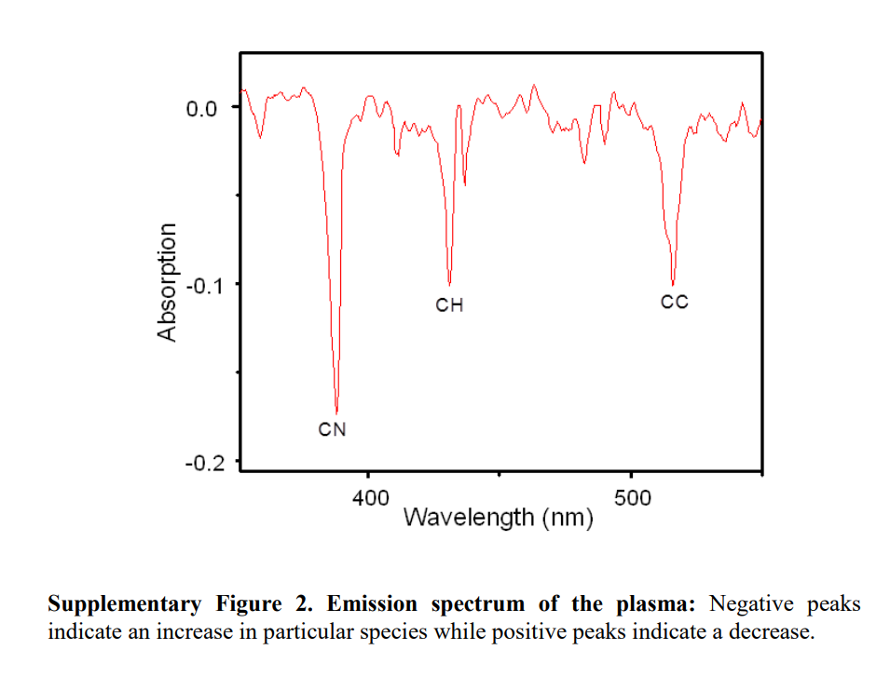

Slide 9
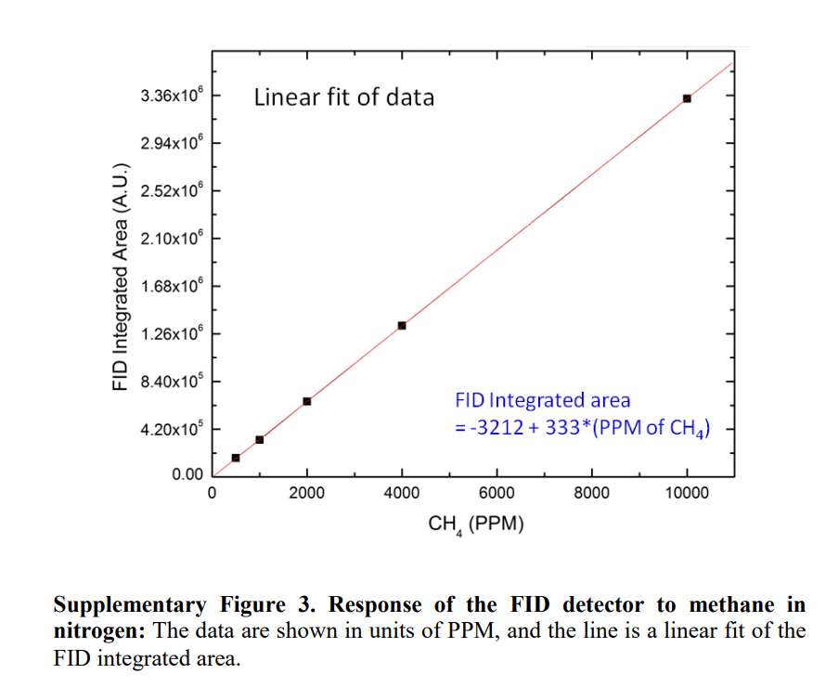

Slide 10
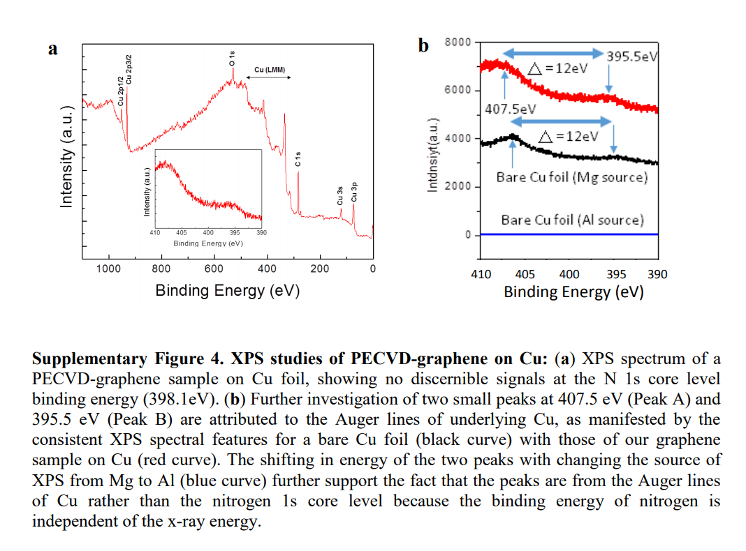

Slide 11
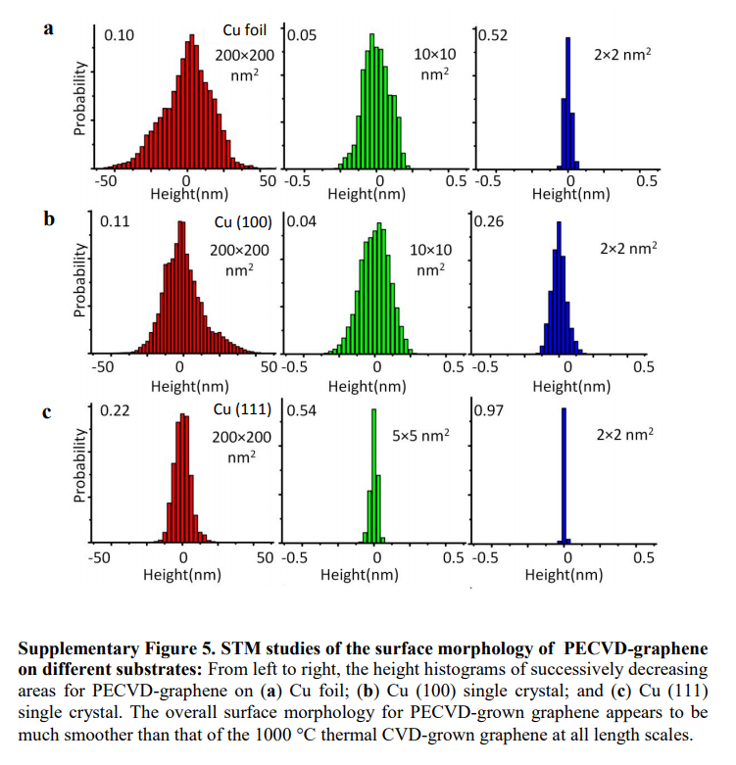

Slide 12
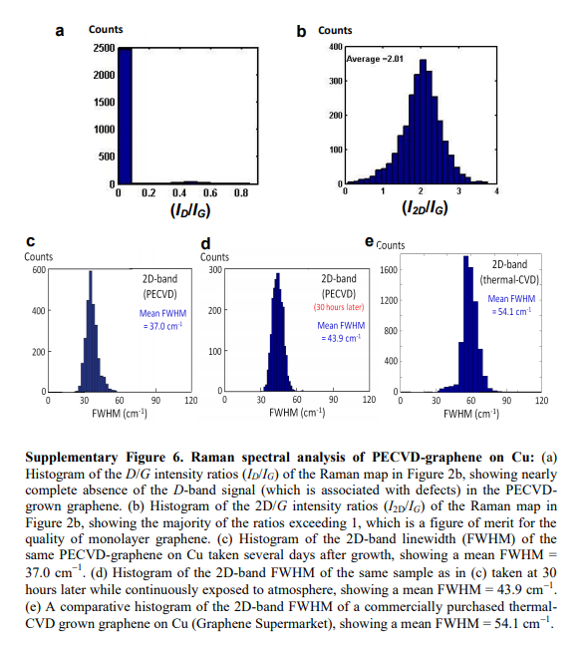

Slide 13
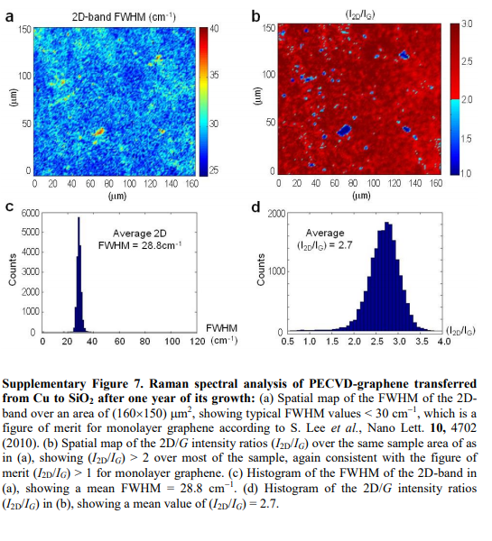

Slide 14
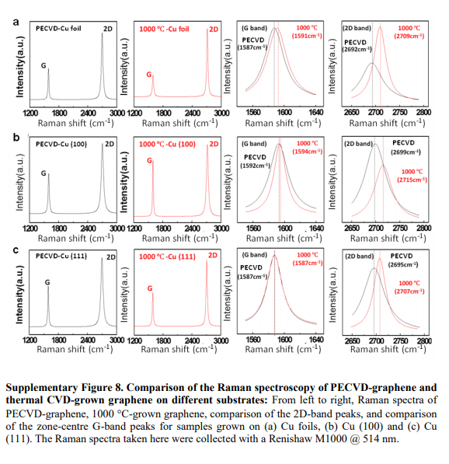

Slide 15
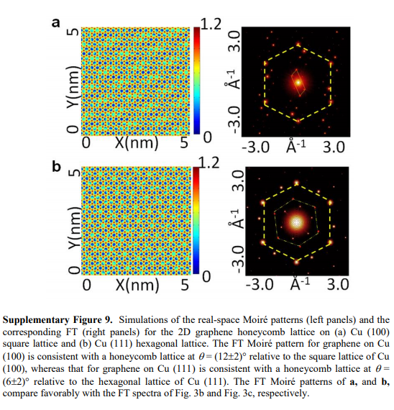

Slide 16
ADDITIONAL REFERENCES ON GRAPHENE PRODUCTION
Chatei, H. Bougdira, J. Rémy, M. Alnot, P. Bruch, C. Krüger, J. K. Effect of nitrogen concentration on plasma reactivity and diamond growth in a H2-CH4-N2 microwave discharge. Diamond and Related Materials 6, 107-119 (1997).
For patent information, see the website http://www.faqs.org/patents/app/20130017672
Yin, X. et al. Evolution of the Raman spectrum of graphene grown on copper upon oxidation of the substrate. Nano Research, 1-10 (2014); doi:10.1007/s12274-014-0521-0.
Lee, S. et al. Wafer scale homogeneous bilayer graphene films by chemical vapor deposition. Nano Lett. 10, 4702 (2010)
Ferrari, A. C. et al. Raman spectrum of graphene and graphene layers. Phys. Rev. Lett. 97, 187401 (2006)
Wu, W. et al. Control of thickness uniformity and grain size in graphene films for transparent conductive electrodes. Nanotechnology 23, 035603 (2012)
Dimiev, A. et al. Layer-by-layer removal of graphene for device patterning. Science 331, 1168 (2011)
Zhou, H. et al. Chemical vapour deposition growth of large single crystals of monolayer and bilayer graphene. Nature Communications 4, Article number: 3096

