Slide 1
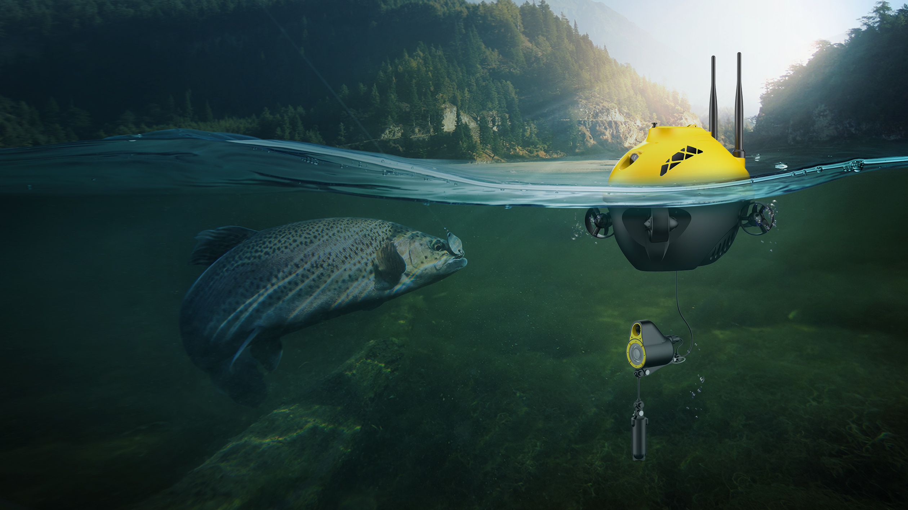


More than fish finding.

Slide 2

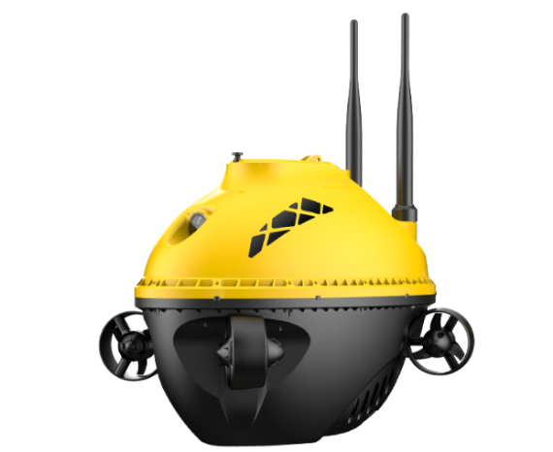
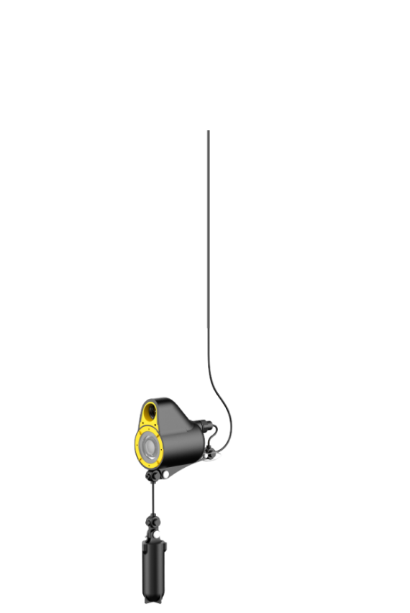












CHASING F1 CHASING F1 is a hi-tech digital full HD fish finder drone with remote control designed for all types of fishing. F1 provides you with intelligent information about the underwater terrain, surroundings, other objects underneath, the location of fish masses, and the position of fish in water. In addition to fishing situations, F1 delivers both real-time water temperature readings and accurate depth readings. It has the ability to take both great quality pictures and to capture high-definition videos during the process of fishing.
Full HD digital stellar camera
Infrared night vision
Vector layout with four thrusters
Supporting accessories to mount
Built-in
automatic reel
Real-time
display
GPS Cruise
One-click return
Live broadcasting One-click sharing
Swappable battery

Slide 3
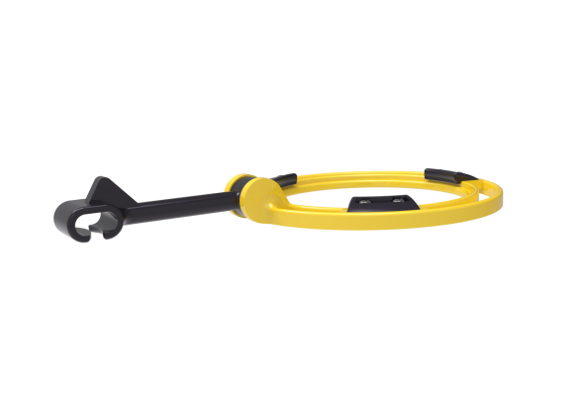

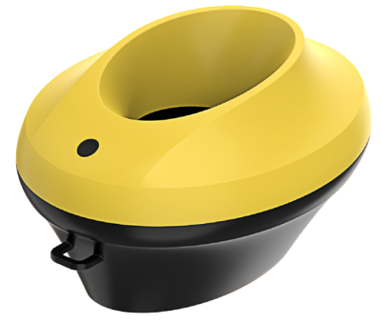
Main Components
Sonar Bracket
Fish Finder Drone
（Standard 28-meter wire ）
Camera
Small Bait Boat
(Optional accessories)
Lead Weight

Slide 4
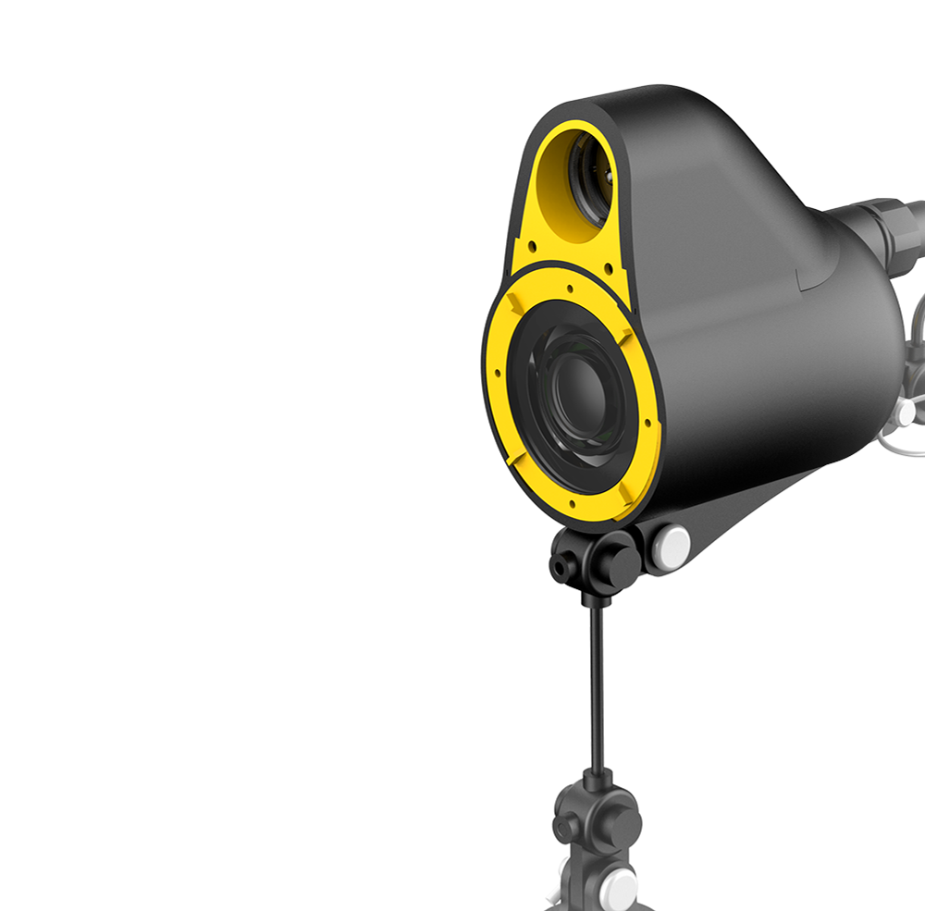

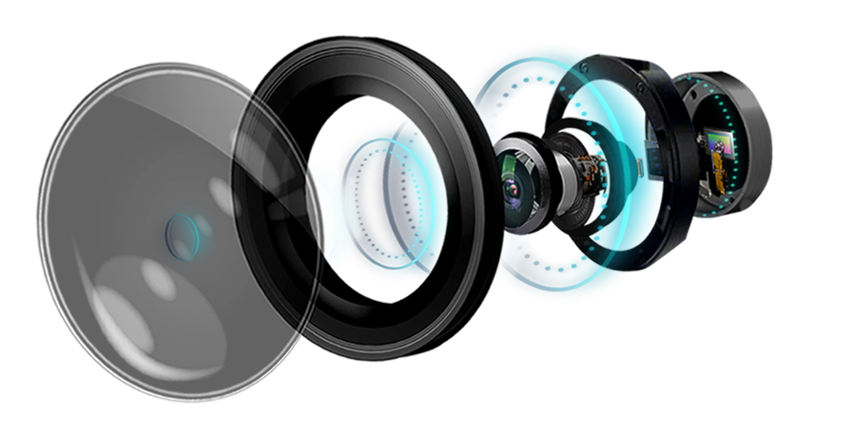
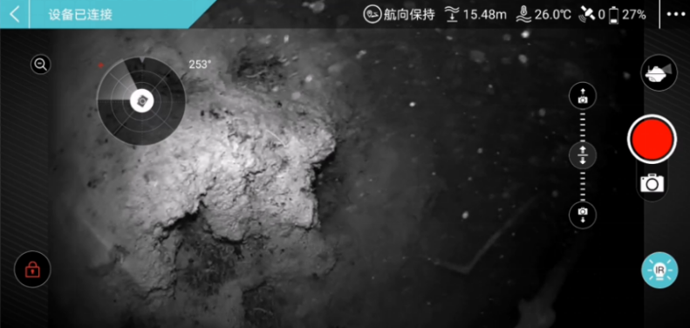
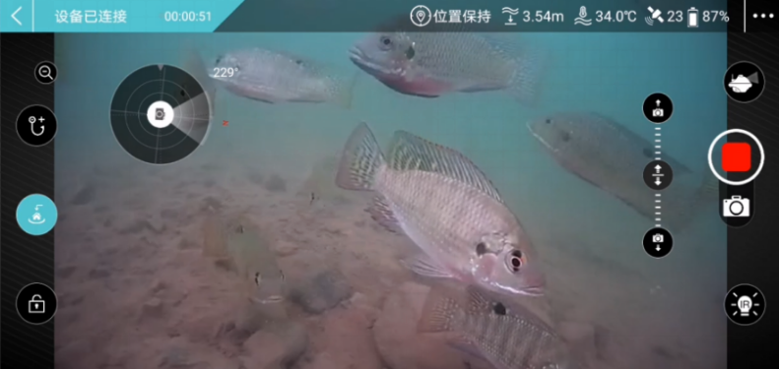
1080P Full HD Digital Stellar Camera Plus IR Shooting at Night
Infrared Light (IR)
CHASING F1 supports 1080P videos/2M pixel photos. The built-in Sony stellar camera sensor,with Infrared Light, even in dark environment, the visual range can reach up to 1 meter,and the fishing process can be monitored and video-recorded clearly.

Slide 5

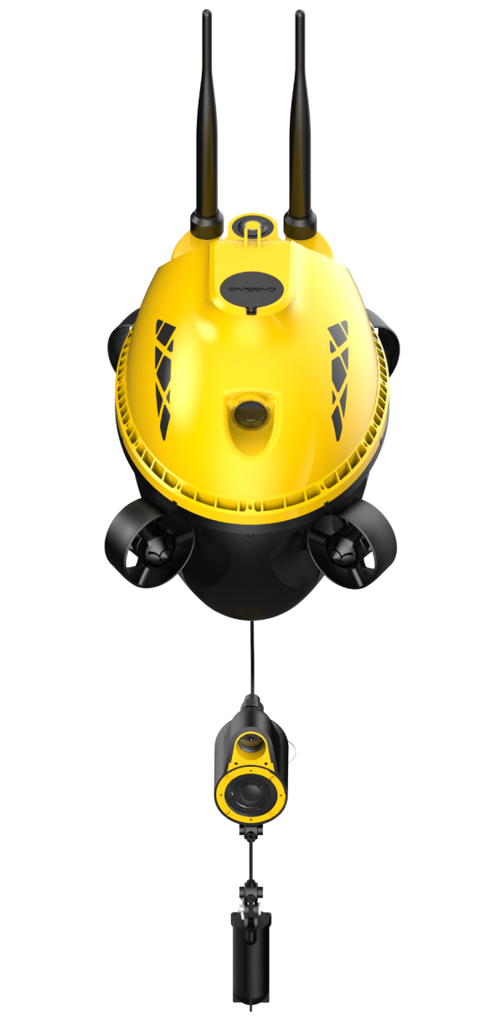



Vector layout with four thrusters, all-directional horizontal movement
CHASING F1 has a vector layout propulsion system with four thrusters, which can achieve multiple-freedom motion.
The all-directional horizontal movements controlled through APP make finding fish faster and more accurately.

Slide 6
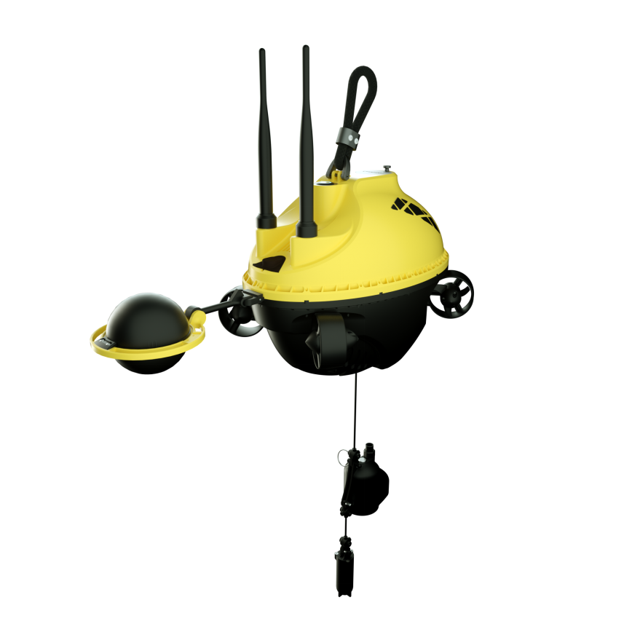
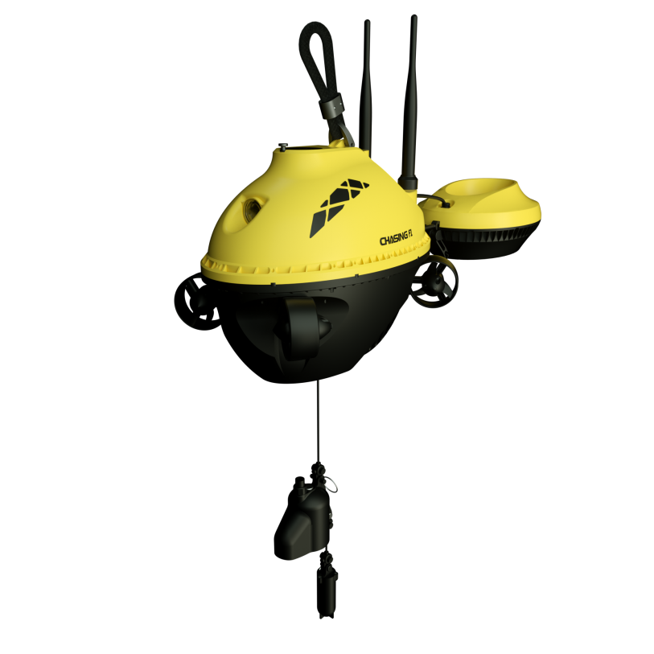
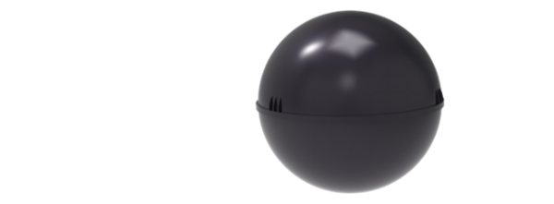

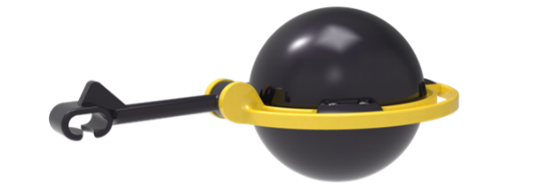
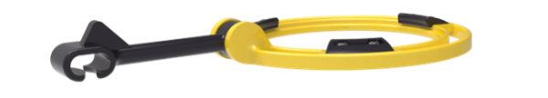
Support bait boat,
sonar bracket other accessories to mount
The use of F1 can be extended by means of newly added communication and power supply interface and expanded by mount accessories.
F1 can be mounted with bait boat.
The distribution of bait material can be realized by one click on the APP in fishing spot.
It also supports sonar bracket mounts (such as DEEPER Sonar and other brand names)

Slide 7
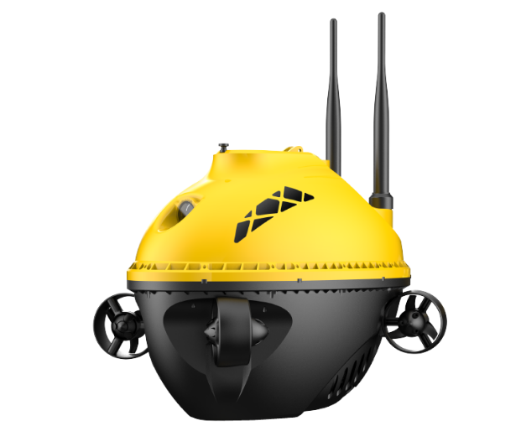
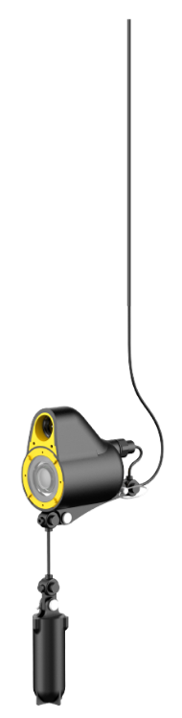
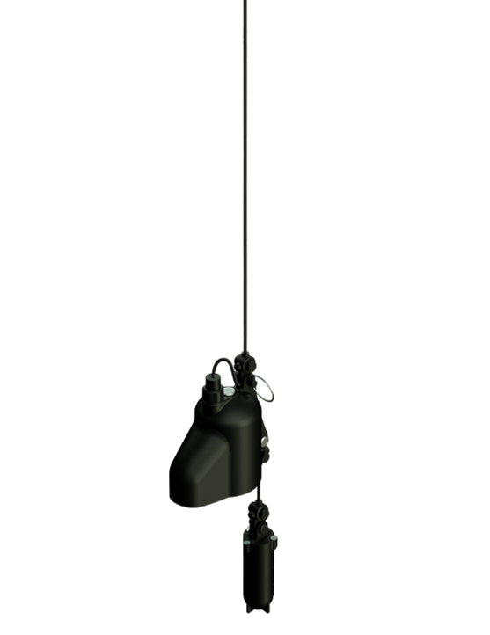


Built-in automatic reel，Adjustable angle, Maximum depth 28 meters
The detector camera probe can be controlled by APP using built-in automatic reel. It will be recovered automatically when it hits the bottom. The maximum depth range is 28 meters. The camera angles can be adjusted in advance to quickly monitor the location of fishes.

Slide 8
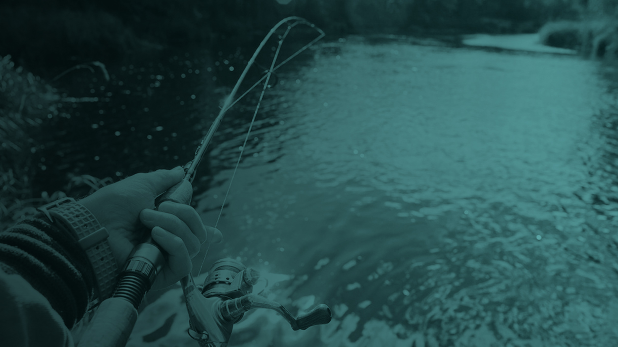


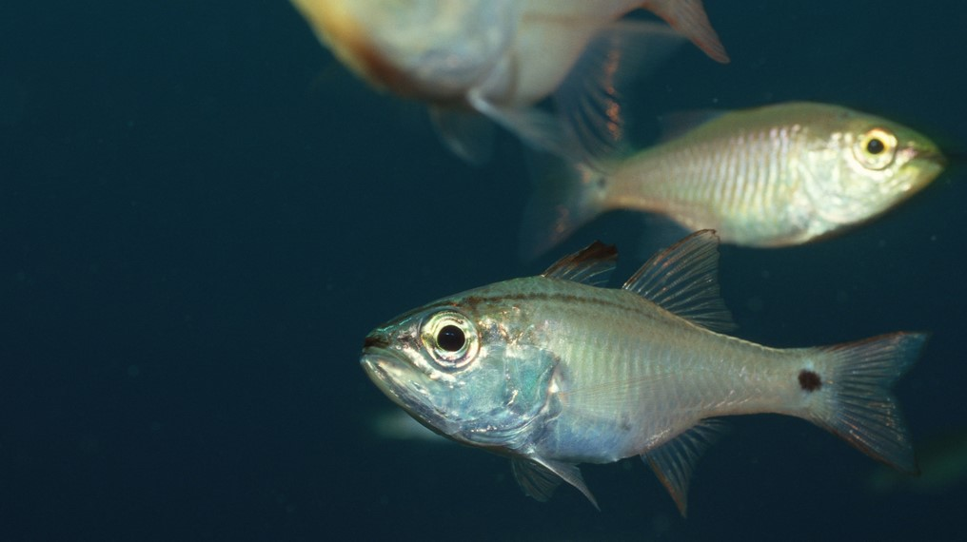
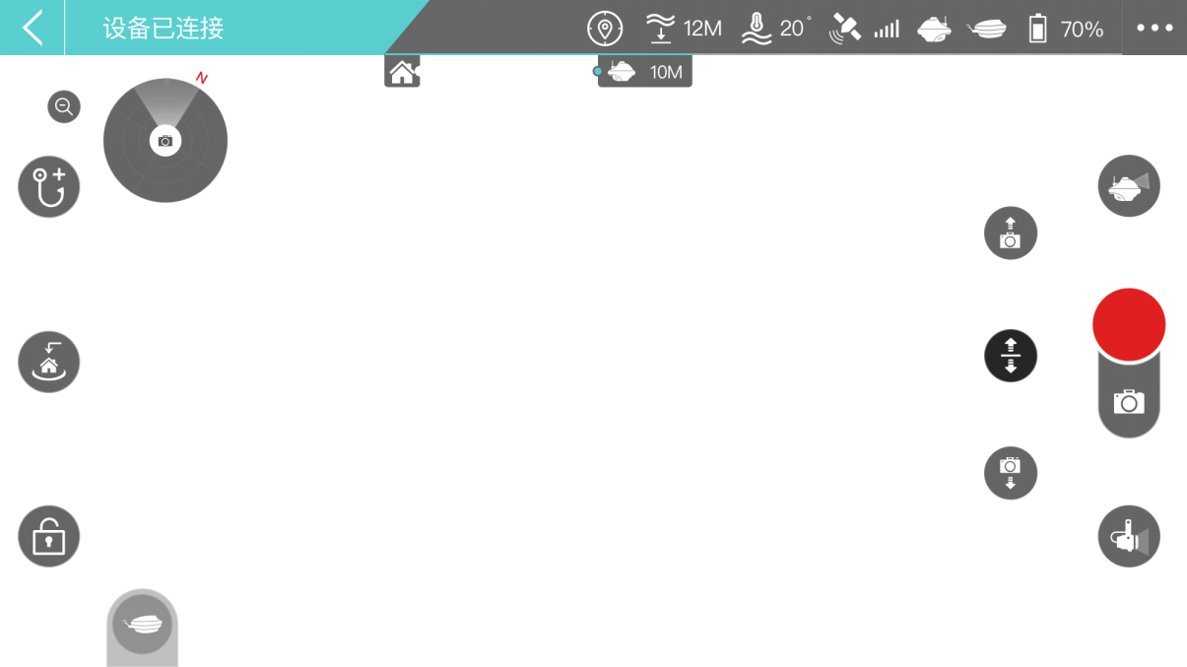
Real-time display of images,
and real-time info about depth,
temperature
C
C
Built-in depth and temperature sensors can deliver images, real-time readings of depth and temperature back to the app interface through WiFi.

Slide 9
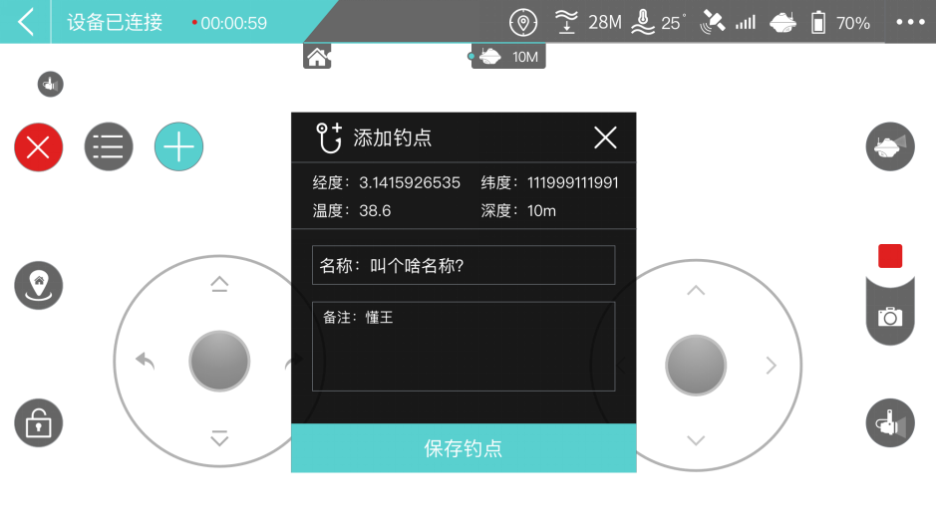
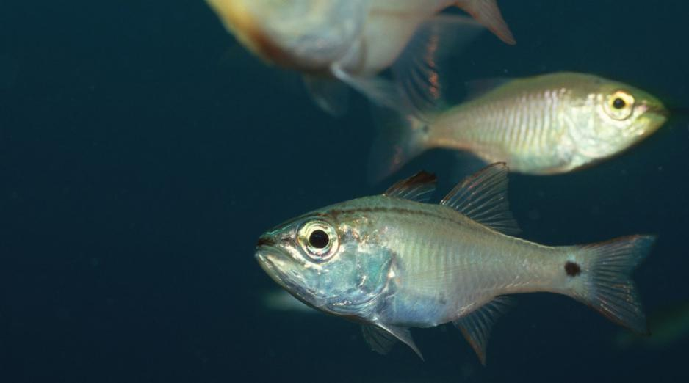


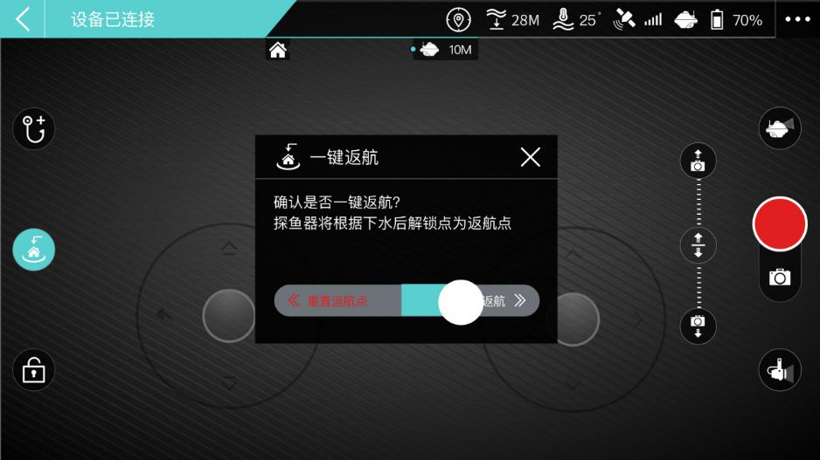

GPS
CHASING F1 has GPS function, which supports maintaining position, tracking,multiple fishing spots recording and one key return. If the remote control distance is exceeded, CHASING F1 will automatically return to the original set point of return.

Slide 10

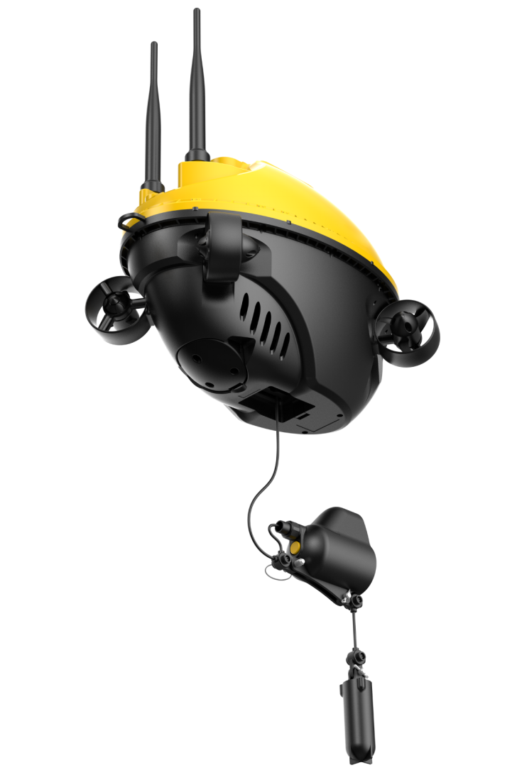
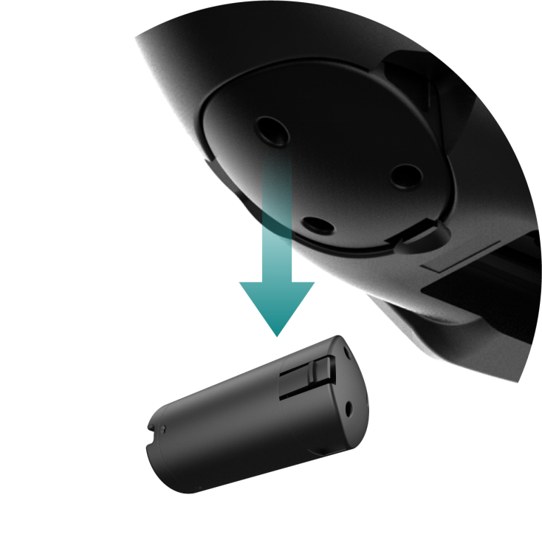

6 Hours Battery Life, Swappable Battery
4800mAh lithium battery can last up to 6 hours. It is replaceable and can extend working hours as needed.

Slide 11


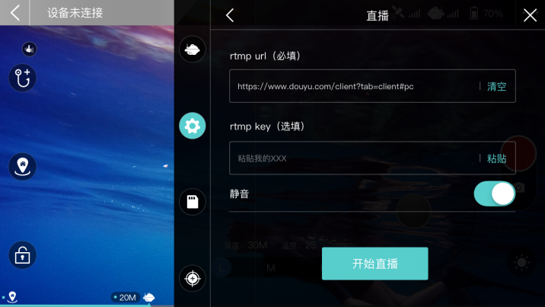
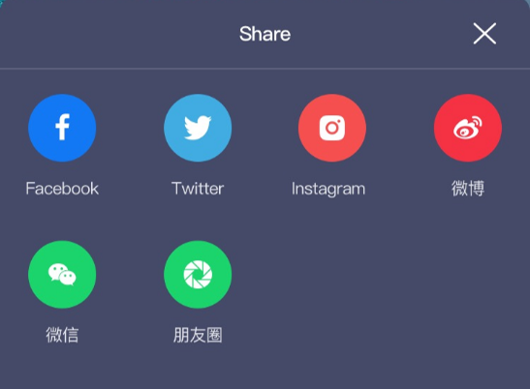


Support Live Streaming, One-key Sharing
users to upload and broadcast video content to their audience to Youtube and other major live streaming platforms.
It supports one-key photo/video sharing to social platforms.
Built-in Micro SD card is pluggable, and the maximum storage size can be 256G. The images and videos can be downloaded and shared anytime, anywhere.

Slide 12
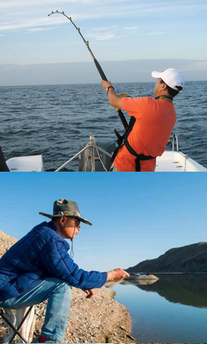
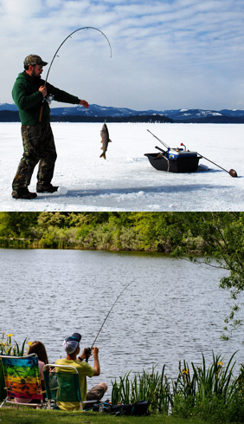
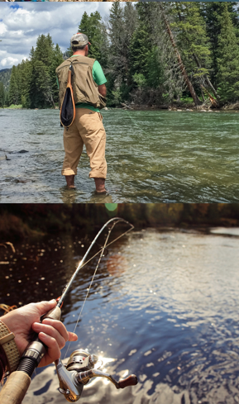
Application Scenarios

Slide 13
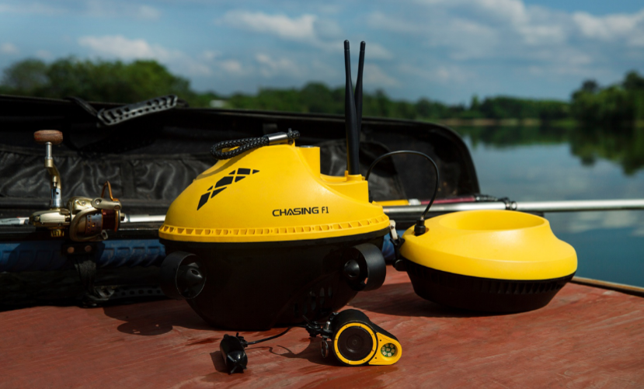
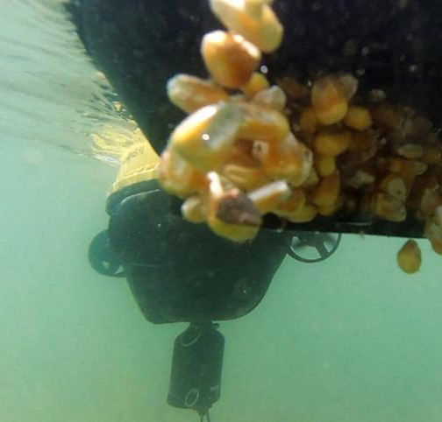
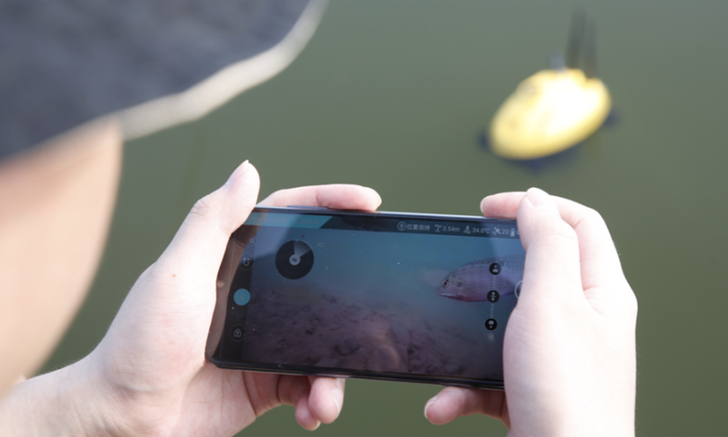
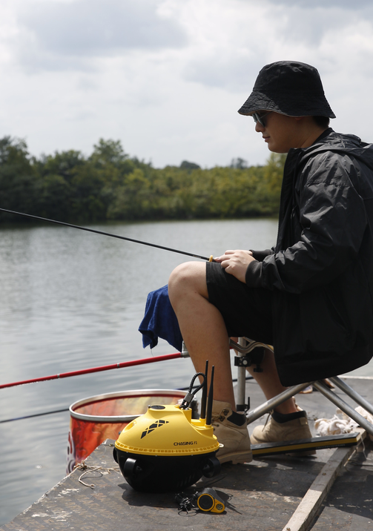
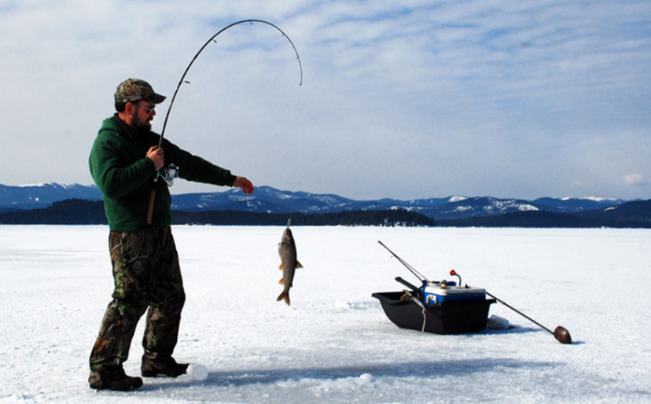
Detect underwater terrain and obstacles，look for groups of fish and identify fish species.
Support bait boat mount, drop bait off in the water with one-click.
Provide observation of fish situations.
Support sonar ball mount and other accessories.
Support live streaming, one-key sharing.

Slide 14
Parameters
Fish Detector | Size(mm) | 278x154x215
 | Weight | 2KG
 | Max Depth | 28M
 | Wire Length | 28.5M
 | Working Time | 4-6Hours
 | Battery Cycle Times | >300Times
 | Working Temperature | -10℃~45℃
Sensor | IMU | Triaxial Gyroscope / Accelerometer / Compass
 | Depth Sensor | ＜±0.25m
 | Temperature Sensor | ＜±2℃
 | GPS | ±1m
Charger | Power | 2A/12.6V
 | Charging Time | 2.4H
Camera | CMOS | 1/2.8
 | Lens Aperture | F2.0
 | Focal Length(EFL) | 2.7mm
 | ISO Range | 100-102400
 | FOV | Diagonal 164.6°
 | Photo Maximum Resolution | Two-mega-pixel（1920*1080）
 | Photo Format | JPEG
 | Video Resolution | 1080P@30Fps
 | Video Maximum Bitstream | 4M
 | Video Format | MP4
LED | Infrared Light (IR) | 7*IR Infrared Light LED

Slide 15

www.chasing.com

