Slide 1

History of Israel
Background to Mark’s Gospel

Slide 2
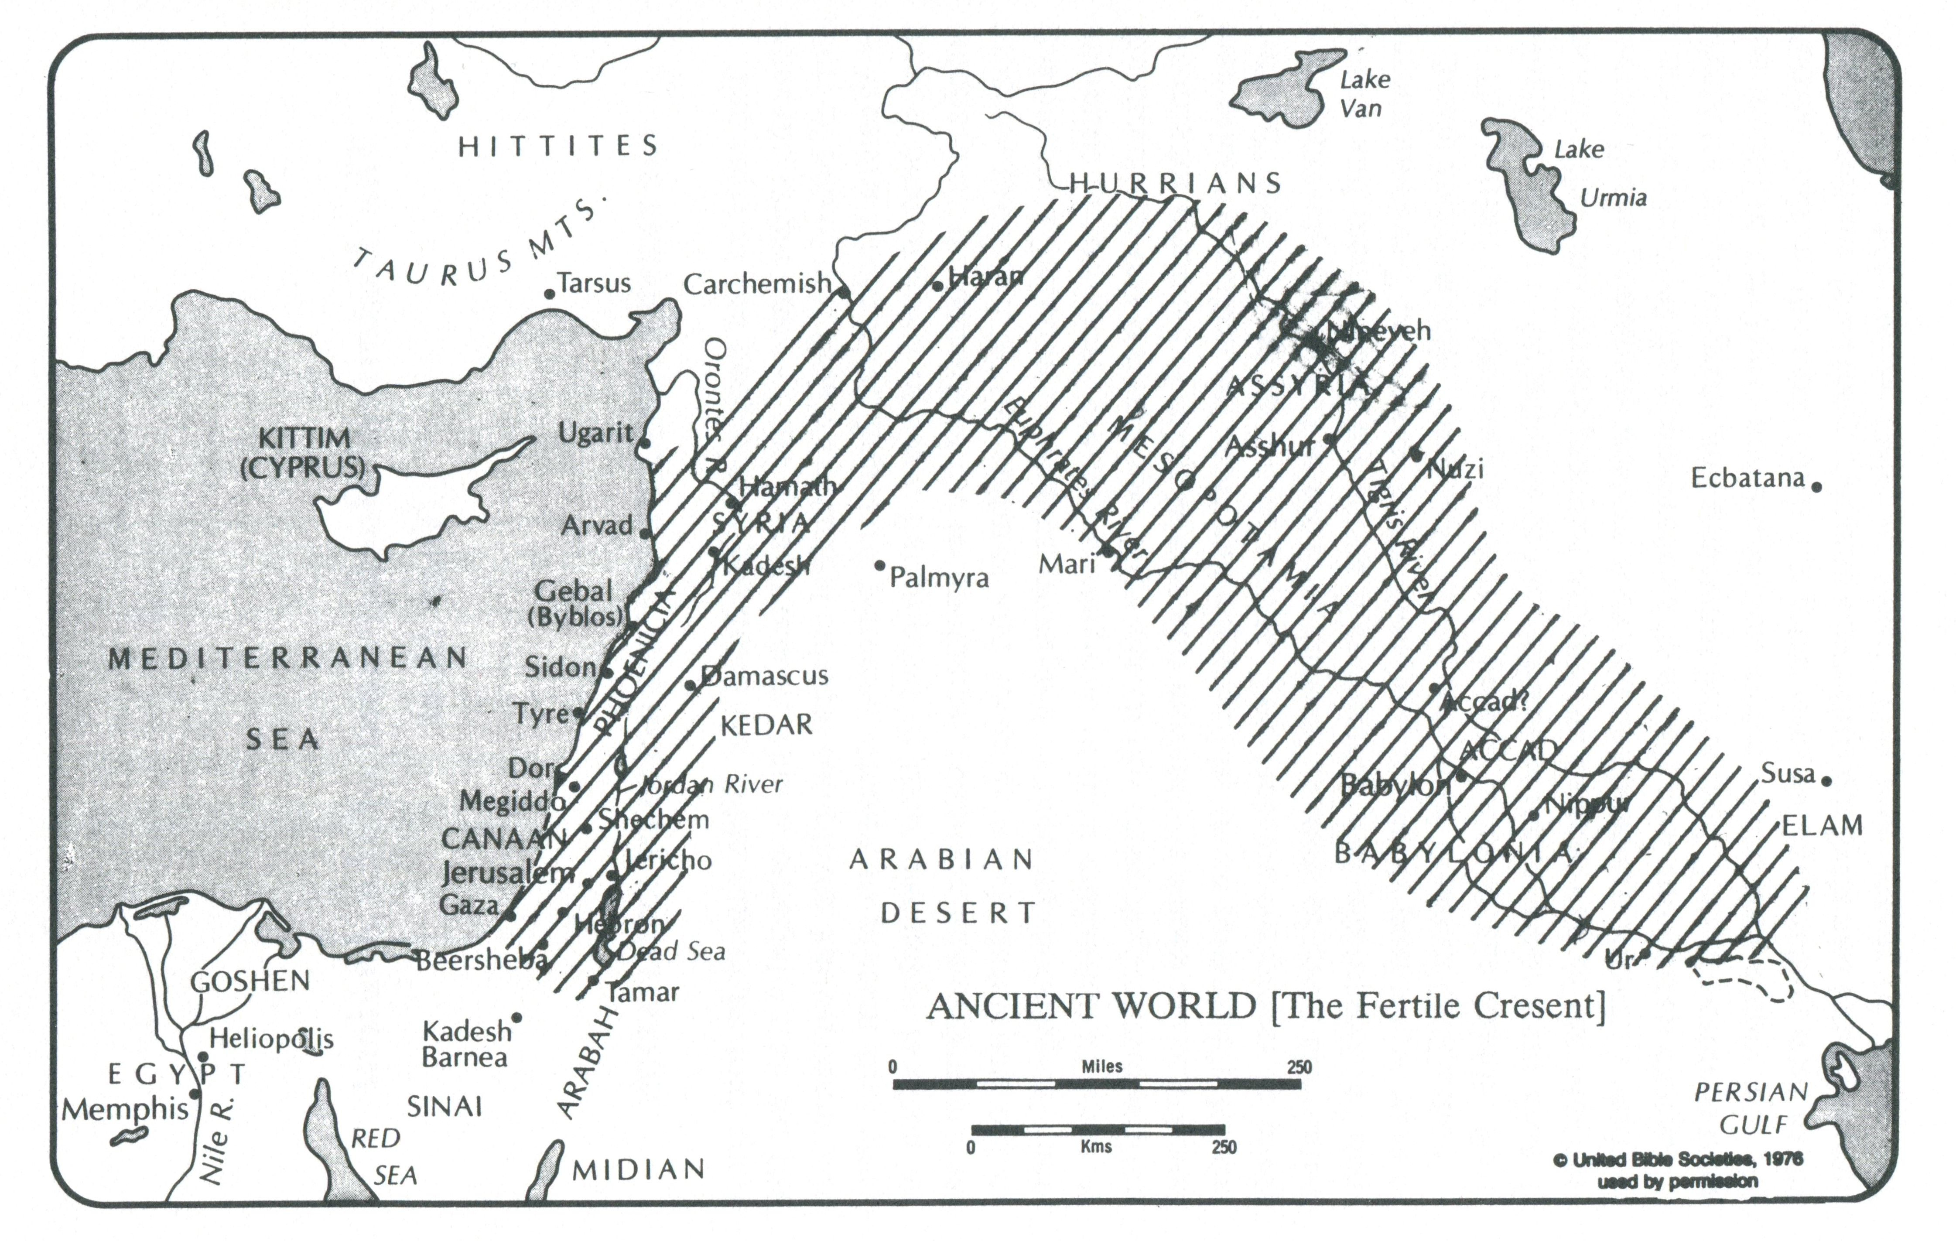
Ancient Middle East
Last Ice Age
10,000 BCE
Neolithic Revolution
c. 9,000 BCE
Writing
c. 3,000 BCE

Slide 3
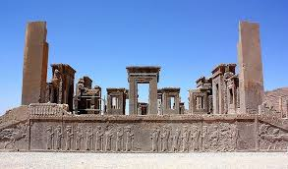
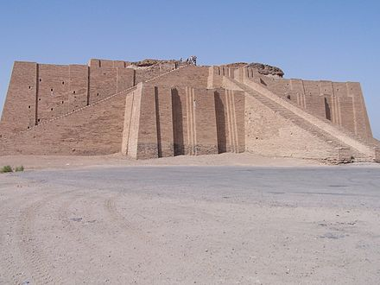
Centralized State
Palace
Temple
Palace of King Darius (518-486 BCE)
Ziggurat of Ur (21st century BCE)

Slide 4
Social Structure
Ruling classes
King
Nobility
Merchants
Scribes (bureaucrats)
Professional military
Temple personnel: priests, scribes
Artisans
Lower classes
Peasants
Herders
Slaves
Some artisans
-5%
+50% goods produced
Tenants
Surplus produce
Forced labour
Military service
+95%
Villages

Slide 5
The Role of Religion
To legitimize the existing order – the state
  The state enjoys the sanction and protection if divine beings – the gods
  An unchanging reality
The cosmos is a reflection of the socio-economic-political structure of society
  A god
  A divine court
  The rest

Slide 6
Official History
Told from the point of view of the winners
  Those with political and economic power
To serve the interests of those in power:
  To justify their right to rule
  To strengthen their hold on power
  To enhance their reputations and memory

Slide 7
Ancestors of Israel – Genesis 12-50
A different kind of history
  Memories of groups outside the dominant social structure
A God who stands in solidarity with and acts on behalf of the poor, the outsider, the marginal
  Who defends the powerless
Tribal groups
  Genealogies
  Stories that reflect the effort to come together and learn to live together
Concerns
  Offspring
  Productive land
  The role of women

Slide 8
Foundational Story – The Birth of Israel
Historical Record
Biblical Account
Exodus
Sinai
Historical Reconstruction
Social revolution
Wilderness
Entry into the promised land
Creation of an anti-society

Slide 9
The Exodus
Who
  Indigenous and diverse groups of Canaanites
    Village-based peasants, herders,
    Itinerant metal workers
    Renegage priests
    Mercenaries (Hebrews)
  Egyptian escapees – the Moses group
    c. 1280 BCE
    A story of liberation
What
  Tribal league
  Common struggle to create a just and peaceful community free from domination by the powerful
Loyalty to one god: Yahweh
  Source and symbol of unity

Slide 10
The Covenant
Contrast with “Egypt”
Patriarchal
Hierarchical
Stratified
A binding agreement
Yahweh: the liberating god
Israel: the liberated people
Institutions and legal procedures
To inhibit the accumulation of power or resources
The mechanism to overcome differences
Self-determination
They owed allegiance to no human sovereign
They could create their own history
A common bond to a single god

Slide 11
Timeline
Exodus 1250
Phlistines 1050
David 1000
Assyrians 722
Babylon: Exile 587-539
Persia:
Second Temple 539-326
Solomon:
First Temple 962-922
Divided Monarchy
922-722
Greeks 334-326
Rome 63

Slide 12
Centuries of Conquest and Resistance
Solomon
Ten Northern tribes rebelled and formed their own kingdom – Samaria and Galilee
Not under Jerusalem rule until 100 years before Jesus
Ahab
Elijah led widespread popular resistance
Healings and feedings
Persians
Ezra and Nehemiah: Torah – first fruits and tithes to priestly aristocracy
Temple – forced labour
Canaanite-style state and religion
Assyrians
Northern Israelites under imperial administration
Babylonians
Jerusalem under imperial administration
Exile – deportation of 70% of the population of Judah
Priestly aristochracy controlled the land and people
Judean ruling class restored -- Second Temple
Seleucids
Greek culture
Antiochus Epiphanes IV: abandon God and covenant
Maccabean Revolt – Hasmoneans : high-priestly rulers
Conquered the North – destroyed the Samaritan temple at Gerizim

Slide 13
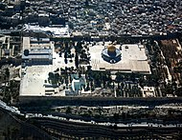
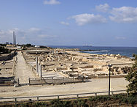
Rome and Herod
Conquest 40 BCE
  Magdala: enslaved thousands
Herod established as King of the Judeans 40 BCE
  Galilean revolts – three in three years
Herod (d. 4 BCE)
  Building projects
    Rebuilt Temple and expanded the Temple Mount
    Tomb of the Patriarchs in Hebron
    Port city of Caesarea Maritima
    Fortress of Masada
    Herodium
  Taxes

Slide 14
Under Rome
Galilee
Judea
Antipas, son of Herod
  Educated in Rome
Rulers had never resided in Galilee
Built two new capital cities
  Sepphoris and Tiberias
  Taxes
Galilean peasants’ antipathy to Sepphoris and Tiberias
Direct Roman rule
High Priests appointed by Roman governors
Most Scribes and Pharisees acquiesced in Roman rule
Some scribes revolted: Sicarii who assassinated members of the high-priestly families

Slide 15
Resistance to Rome
After Herod
First Jewish War 60-66 AD
“Kings” proclaimed in Galilee and Judea
Rebels attacked fortress city of Sepphoris
Roman reconquest and enslavement
Suppressed by Rome
Destruction of the Temple
Simon ben Giora executed as “king of the Judeans”
Judea revolted again in the Bar Kokhba Revolt 132-35

Slide 16
Movements against Rome at the Time of Jesus
Theudas (d. c. 46 AD)
  A new Moses
  Led his followers into the wilderness at the River Jordan
  The waters will open in a new act of God’s liberation
An “Egyptian prophet” (Jewish)
  A new Joshua at the Battle of Jericho
  Led his followers up to the Mount of Olives
  “You will see the walls of the city fall down and the Romans disappear”
Fourth Philosophy in Judea 6 BCE
  After Herod and his son Archelaus – direct Roman rule
  Led by Pharisees
  Refusing tribute to Rome in adherence to the covenant

