Slide 1
Jesus and the temple
Gospel of Mark

Slide 2
False Assumptions
Separation of church and state
Jesus was a religious figure who dealt with individuals
There was a religion (“Judaism”) that Jesus was opposing
The Temple was a religious institution

Slide 3
Basic Understanding
Politics of Roman Palestine was inseparable from religious-cultural conflict

Slide 4
Summary
Three Temples
Kings/Empires
Solomon
Persians
Herod
Persians
Greeks
Hasmoneans
Herod the Great
Rome

Slide 5
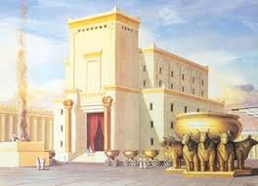
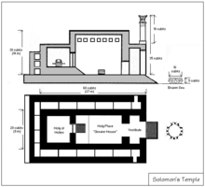
Solomon’s Temple
Built mid-10thC
Destroyed 587 BCE

Slide 6
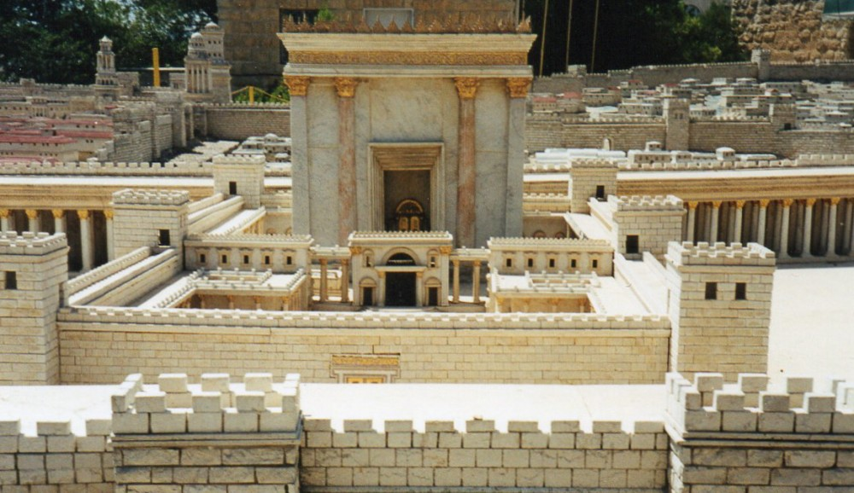
Second (Persian) Temple
Built circa 515 BCE
A local instrument of Persian administration
  To collect revenues and keep order
Judean opposition to High Priests and the Temple
  God’s judgement for oppressing the poor
    Epistle of Enoch (1:94-105)
High Priests abandoned the Covenant

Slide 7
Hasmonean High Priests
Popular revolt led by Judas Maccabeus
  Against Seleucid emperor Antioches IV Epiphanes 167–160 BCE
  And against the High Priests
Hasmonean brothers got themselves appointed High Priests
Hasmonean High Priests conquered Idumea (south) and Samaria (north) with mercenary troops
Prior to Roman conquest Hasmoneans had control over all areas of Israelite heritage:
  Galilee
  Samaria
  Trans-Jordan (east)
  Judea

Slide 8
Hasmonean Control
Destroyed the Samaritans’ temple on Mt. Gerizim
  To remove any rival political-religious centre
104 BCE got control of Galilee from the Itureans and allowed the inhabitants to stay provided they agreed to observe “the laws of the Judeans”
  i.e. subjection to Judean Temple-state in terms of tithes etc.
Galilee: under Jerusalem for the first time in 800 years
  Hasmoneans and Herod the Great set up fortresses with military garrisons in Galilee

Slide 9
Active Resistance to the Hasmonean High Priesthood
High Priests after the Hasmonean-Macabbean revolt were never seen as legitimate because they had negotiated with the Seleucids
Widespread resistance to Alexander Jannai 103-76 BCE (second king, son of John Hyrcanus)
Daniel 11:20-35 — Maskilim
Daniel 7, 8, 10-12: visions of renewal of the people omit the Temple
Qumran
  Protest against “the wicked priest”
  Renewed covenantal community in the wilderness
Psalms of Solomon 2, 17
  “They had done evil one and all, in not hearkening. And the heavens were angry, and the earth abhorred them”

Slide 10
Herod the Great 47—4 BCE
Appointed “King of the Judeans” by Rome
  Violent treatment of Galileans
  Conquered Judea with the help of Roman troops
Kept the Temple and High Priests as instruments of his rule
  Sacrifices on behalf of Rome and Caesar
  Eagle over gate
Temple an instrument of Roman imperial rule

Slide 11
Herod the Model Roman Client King
Building projects:
  Temples to the emperor
  Cities named for the emperor
  Seaport city Caesarea Maritima
  Established military colonies in Samaria, Sebaste
Lavish court
Funding of imperial court and cities
Introduced Roman institutions
  Theatre
  Amphitheater (hippodrome)
  Games in Jerusalem in honour of Caesar

Slide 12
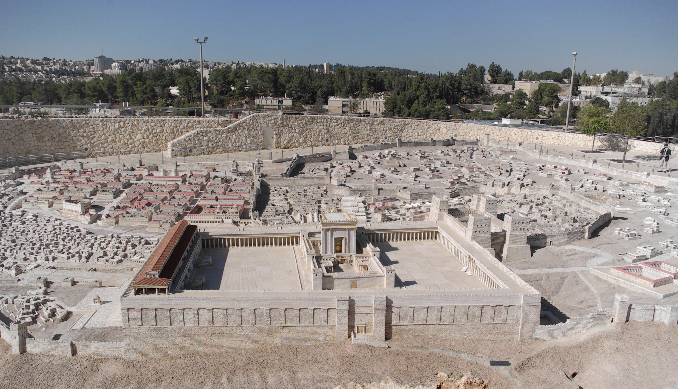
Temple of Herod the Great
64 BCE—70 CE

Slide 13
Herod and the Temple
Temple
  Massive rebuilding in Hellenistic-Roman style
  Roman eagle over a gate
Imposed taxes
Police state:
  Loyalty oaths to Rome and Herod
  Informers
  Executed dissenters
Judean temple-state expanded its rule over most of palestine

Slide 14
The Temple was Illegitimate in the Eyes of the People – “Authority”
Central governing institution of Judea under Rome
  Herod the Great gave control of Judea to four High Priestly families
  Temple headed by High Priests
  High Priests collected tribute to Rome
Tradition of Jeremiah prophecying against Jerusalem priests
  “My anger and my wrath shall be poured out on this place” (Jer. 7, 26)
High Priests were appointed by Herod from diaspora families
  i.e. not native Judeans
After Herod’s death the people clamoured for a High Priest more in keeping with the law

Slide 15
Pharisees Under Herod
Loyalty Oath
Eagle
Refused the loyalty oath to Herod and Rome
  Got away with it
Revolt at Herod’s death
While Herod lay dying
Judeas ben Saripha and Matthias ben Margala: “most learned interpreters of the ancestral laws”
40 students cut down the eagle with axes “to avenge the honour of God”
Burned alive
Inspired a wider protest

Slide 16
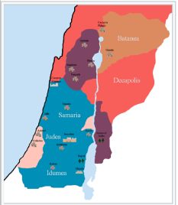

After Herod
Herod Archelaus: Judea, Samaria, Idumea
Herod Antipas: Galilee, Perea
Salome: Jamnia
Philip: Batanea, Trachonitis, Auranitis

Slide 17
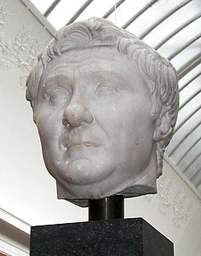
Rome: Conquest and Reconquest
63 BCE Pompey
  Last area of eastern Mediterranean conquered
Judeans and Galileans resisted
  Reconquest
Devastated the countryside
Destroyed villages
Slaughtered or enslaved large numbers
Crucified those who resisted
Terrorized people into submission

Slide 18
Direct Rule by Rome — Judea
Rome deposed Archelaus, son of Herod the Great, in 6 BCE
Judea was made a Roman province
Roman governor was based in Caesarea Maritima
Governor oversaw the High Priestly aristocracy
High Priests were the face of Roman rule

Slide 19
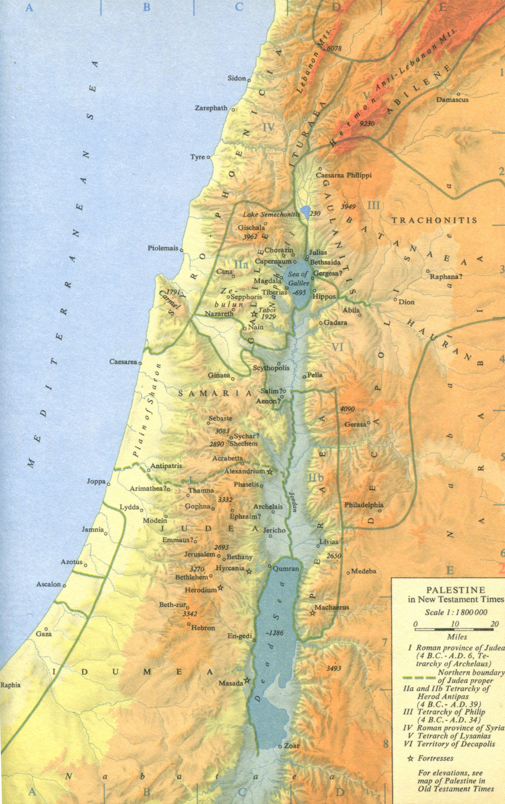
Map of New Testament Palestine

Slide 20
The Importance of Rome
Rome was never mentioned in New Testament studies, sermons, theology
  Western assumption of separation of religion and politics
Rome was the largest factor in determining the historical conditions surrounding Jesus’ mission
  Military conquest/reconquest
  Demand for tribute
  Client rulers

Slide 21
Roman Judea and the Temple
Ten years after Herod the Great’s death Judea was a Roman province
Roman governor
  Power to appoint and depose High Priests
  Four High Priestly families that Herod had elevated
  Custody of vestments
Each successive governor designated their own High Priests
Caiaphas lasted a long time — evidence of his collaboration
High Priests were responsible for collecting tribute

Slide 22
Jerusalem Temple-state
Headed by High Priestly aristocracy
Exercised political control on behalf of the Roman Empire
Supported by tithes and offerings, taxes and tribute

Slide 23
Tribute
Quirinius, Legate of Syria, conducted an assessment for the tribute (Luke 2:1-2)
Purposes of tribute:
  Humiliation
  Subjugation
  Revenue
Failure or slowness to pay was treated as rebellion — Rome retaliated with a vengeance
¼ of the harvest every second year (except Sabbatical years)
  Under the High Priest Hyrcanus
Cassius imposed an extraordinary levy during the Republican Civil War 49–45 BCE
  “Beyond the peoples’ ability to pay” (Josephus)

Slide 24
Fourth Philosophy
Scribe Judas of Gamla and Pharisee Saddok organized a refusal to pay the tribute
The people owed exclusive loyalty to God therefore no tribute to Caesar as Lord
  The people should live under the direct rule (i.e. “kingdom”) of God
Payment to Caesar would mean violating the first two commandments
First two commandments: Exodus 20: 3-5, Deuteronomy 5:7-9
  “You shall have no other gods before me. You shall not make for yourself an idol…You shall not bow down to them or worship them…”
  i.e. you shall not bow down and serve them with your produce and labour

Slide 25
High Priests Were Seen as Illegitimate
They did not protest Roman provocations against the people
Increasingly predatory behaviour against the people
Popular resentment against High Priestly families
Many popular movements rejected High Priests and Rome
Sicarii: a group of scribes began assassinating High Priestly figures after the middle of the 1st C CE

