Slide 2
Why You Should Have an Open House Strategy

Slide 3
Let’s Debunk Some Myths About Open Houses
• I am just doing it to appease the seller
You don’t actually sell the house at an Open House
• I have nothing else to do
• I can get other work done while sitting there
• Well, there is a good game on Sunday that I can watch uninterrupted!
• What say you?

Slide 4
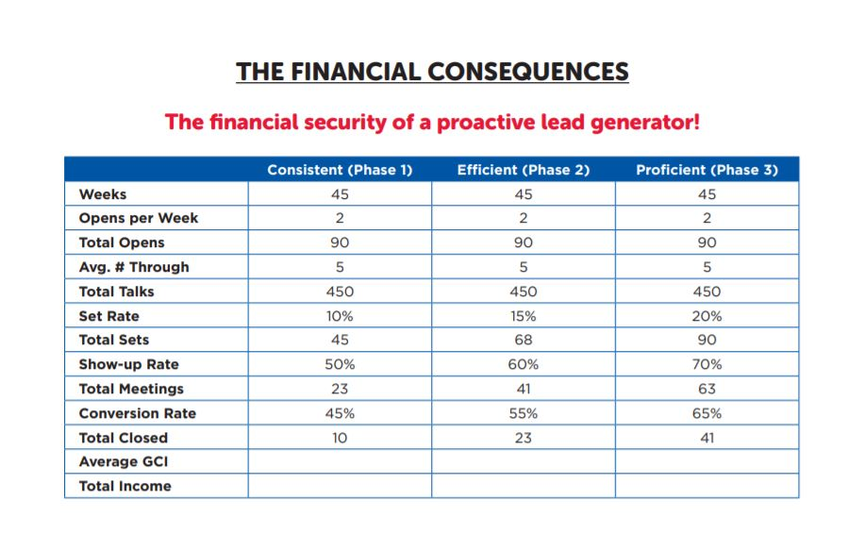

Slide 5
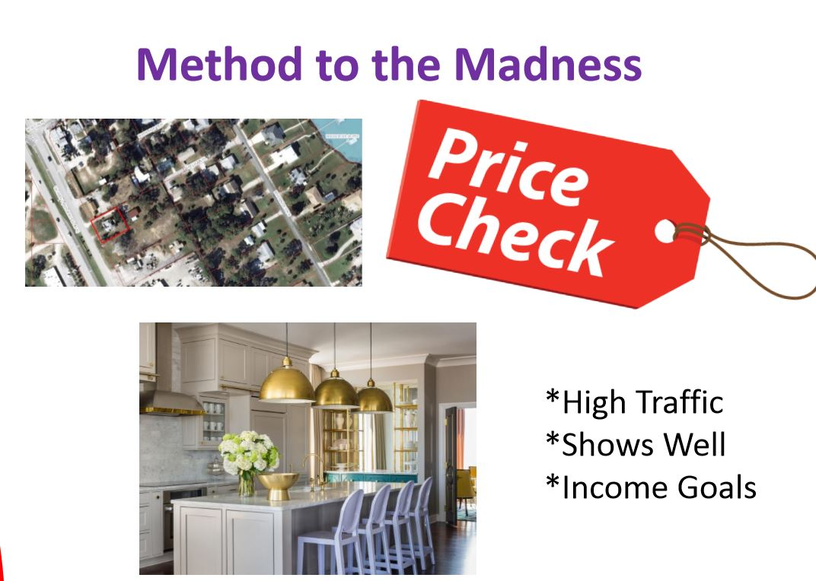
Method To the Madness

Slide 6
The Before
• Try to start 2 weeks prior
• Mail letter to entire neighborhood and draw from neighboring communities as well if desired
• Pull up Expired Listings

Slide 7
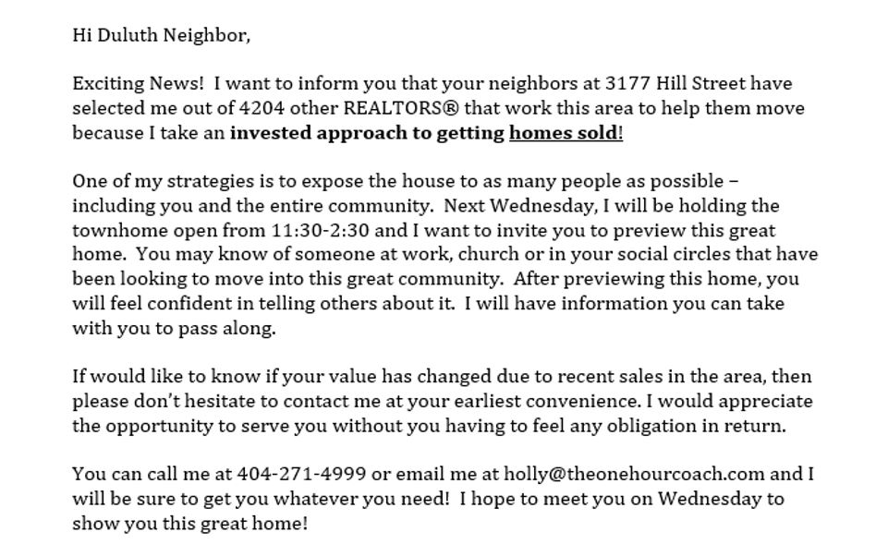
Sample Mailer

Slide 8
Knock on 10 Doors
“Hi, My name is Joe and I am the REALTOR® for your neighbors at
123 FSBO Street. As an added service I will be holding the Smith’s home open on Sunday! I would like to invite you to tour the home in case you know of any friends or coworkers in the area that may be interested in moving in here! After touring the home you will be comfortable telling others about it and I will provide you with a packet you can share.”

Slide 9
Before Continued…
“Come by and have lunch and say goodbye to your neighbors!”
“Are you thinking of making any changes this year or have any questions?”
NEIGHBORS Welcome! Sign out front
Post Card or Door Knockers (Lender resources)

Slide 10
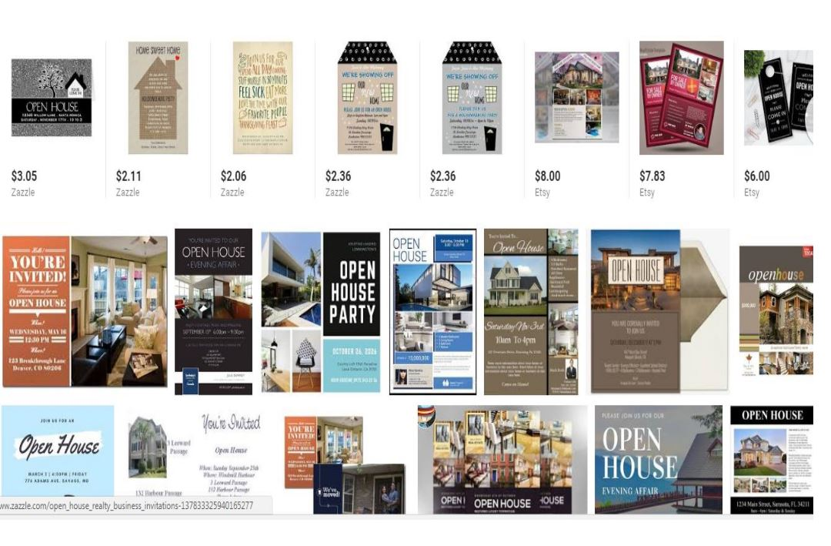
Door Hangers

Slide 11
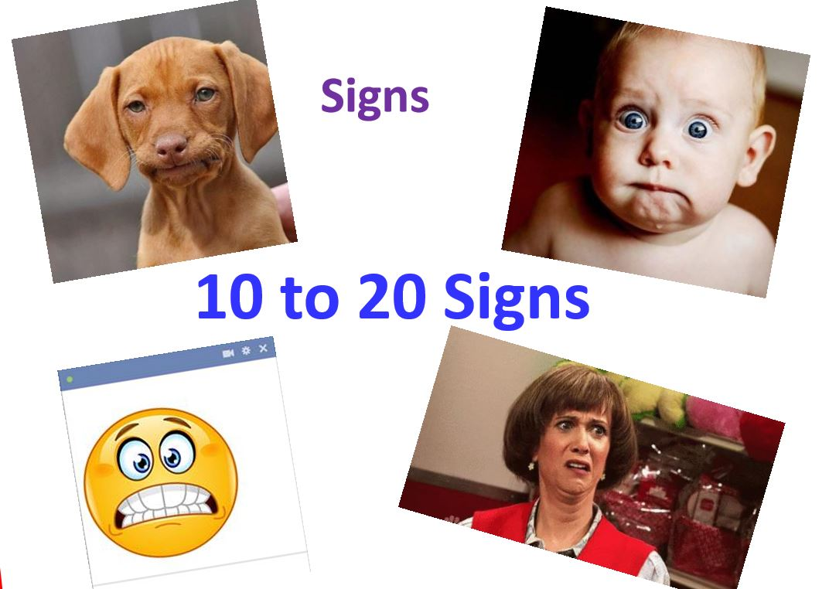

Slide 12

More Signs

Slide 13
More of the Before
Notify ENTIRE Database via VIDEO Email (bombbomb)
• Video to share – Seller, DB
• Make sure you ask people to share!
• Share in office FB account or in-house system
• Ask your fellow agents to stop by if in the area
• Create an avatar ad in FB – direct audience
• Boost – video ad
• Personal page – ask people to share
• Instagram, Twitter, etc.

Slide 14
Advertise on the following:
• Zillow Video App
• Company Platforms
• MLS Platforms
• Facebook Groups
Every OTHER day for 2 weeks prior – nugget a day FB live or SHORT write up – include link to house to your website

Slide 15
The Day Of Prep

Slide 16
• Put out as MANY signs as possible – the bigger the better!
• Add Balloons to front of community and house
• Arrive 30 minutes prior
• Turn on ALL lights including closets
• Open ALL drapes
• 72 degrees
• Flush all toilets
• Soft Music and nice smelling candles
• Registration areas – avoid using the kitchen!

Slide 17
The At

Slide 18
Party Atmosphere Anyone???
What to HAVE on hand! Have goodie packs! Have a PARTY Attitude
Packets of the following:
How to Protect Yourself When Buying a Home
Tax Record and Surrounding Properties
Excellent Color Brochure of Property
Buyer Brochure Buyer Needs and Wants Analysis All in a Folder!

Slide 19
Registration
Clipboards
Electronic

Slide 20
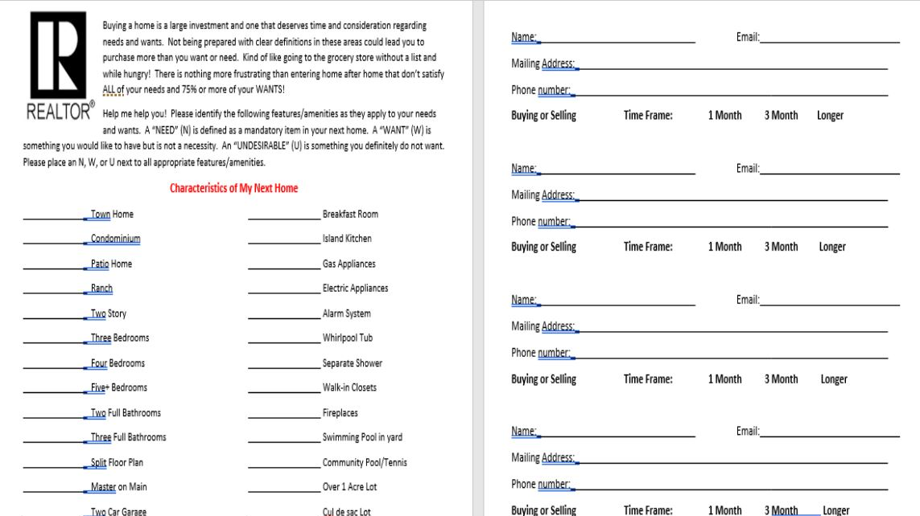

Slide 21
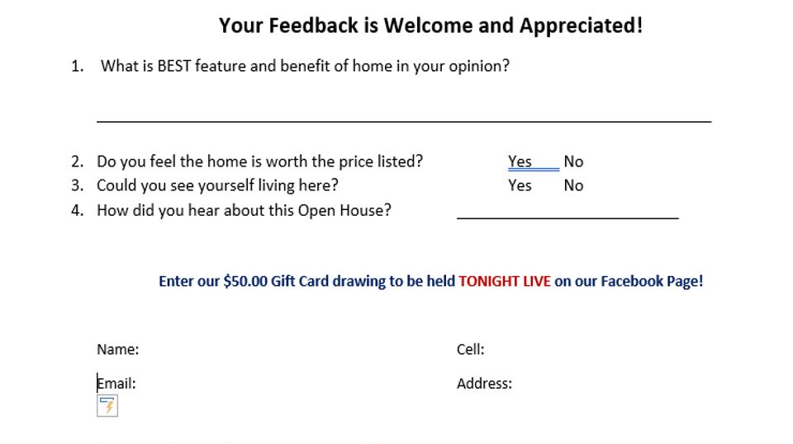

Slide 22
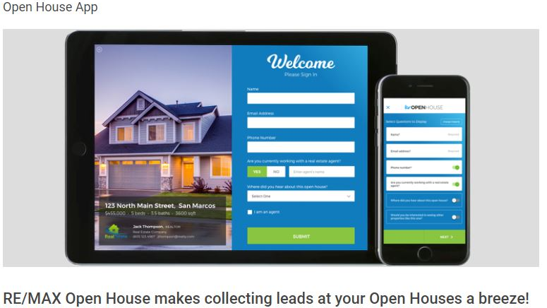

Slide 23
The During

Slide 24
The Bottom Line
YOU MUST ENGAGE
“Classify the Customer”

Slide 25
Enter the Open House with a Strategy to fill 2 appointments that week. Know the times/days you are trying to fill.
ASK

Slide 26
A B C’s
The Timeframe will determine the letter and thus the plan for effective follow up!
A= less than 30 days, have a deadline
B= 30-90 days out, deadline
C= 90+ - deadline or no real deadline

Slide 27
“Welcome! Come on in!”
“Do you live in the neighborhood? How did you hear about the Open House today?”
Well, check it out and before you leave I have a few things to share with you!
You have a better chance at engaging toward the END of the visit in many instances!

Slide 28
Timeframe is the most important thing you can obtain
Where do you currently live?
Where do you work?
What do they like about this area?
Do you have friends and family in the area?
How long have you been looking?
How are you going about finding your dream home?
Do you have someone sending the deals as they hit the market?
What is your monthly budget?
Can we get together for a strategy session?
I have today after open or next Saturday at 11:00? Establish a NEXT step for each customer

Slide 29
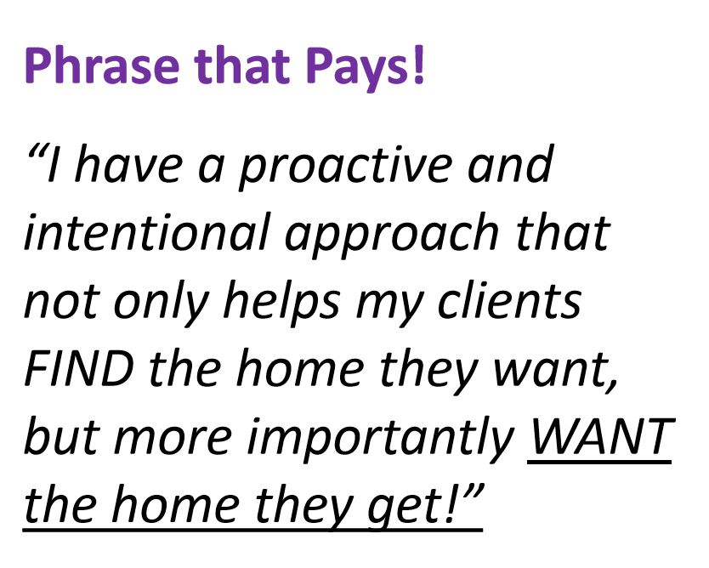

Slide 30
The After

Slide 31
Who Attended? –
Self Assessment Thank you Notes for all attendees – via mail first, email and/or FB Video
Thank you for all attendees
Put on Property Searches
Commit to NEXT step within week

Slide 32
Remember….
The Fortune is in the Follow-UP

