Slide 1
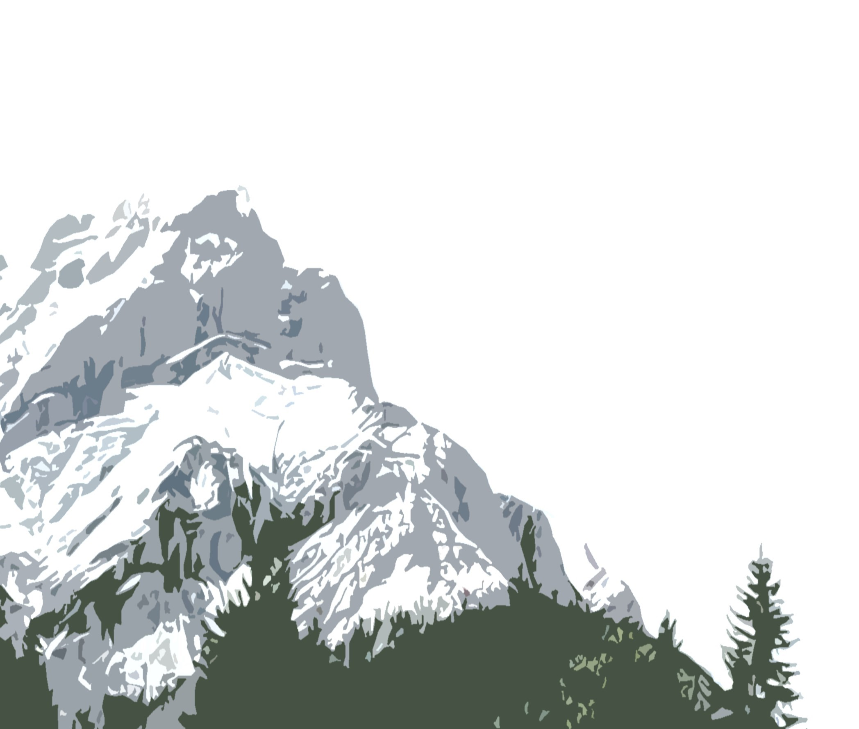
The 2nd Joint Symposium of the International Societies for Environmental Biogeochemistry and Subsurface Microbiology
Banff, Alberta, Canada
22 – 28 October 2023

Slide 2
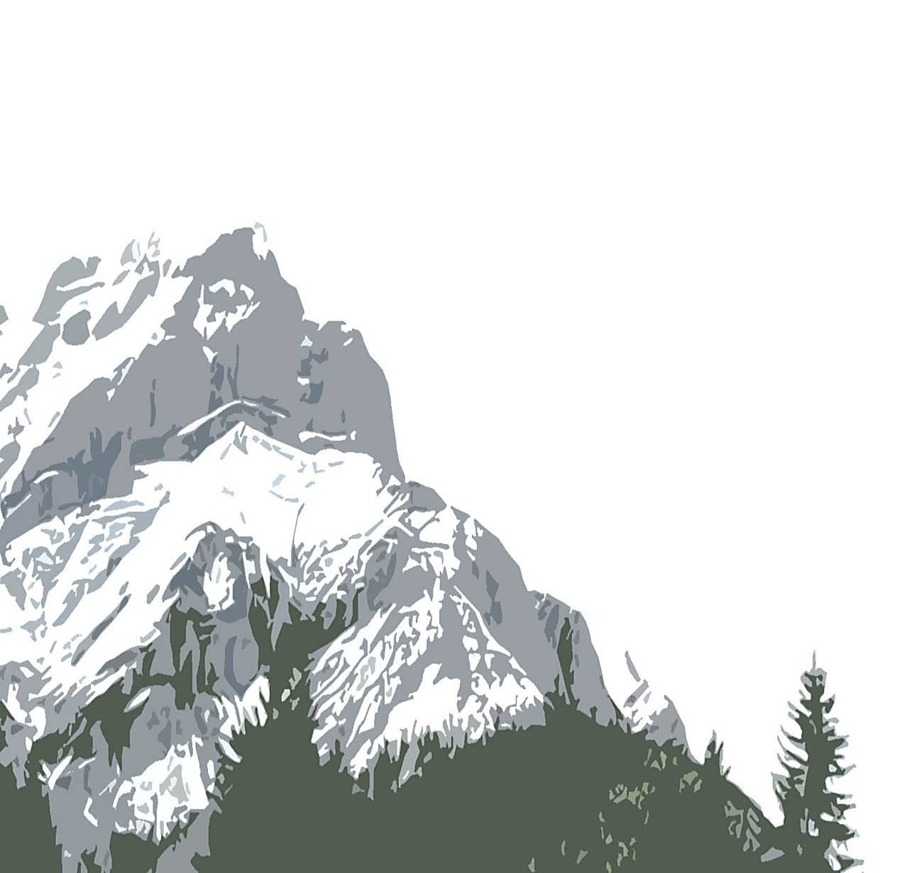
The 2nd Joint Symposium of the International Societies for Environmental Biogeochemistry and Subsurface Microbiology
Banff, Alberta, Canada
22 – 28 October 2023

Slide 3
The 2nd Joint Symposium of the International Societies for Environmental Biogeochemistry and Subsurface Microbiology
Banff, Alberta, Canada 22 – 28 October 2023

