Slide 1
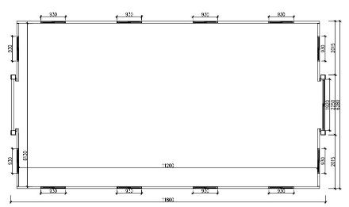
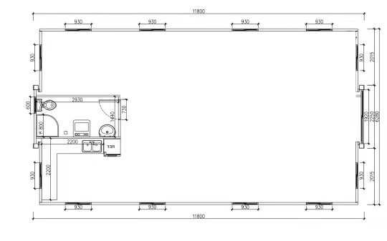
CREATE YOUR OWN FLOORPLAN HERE
Please choose your floorplan and email through to us any modifications prefabfutures@gmail.com Thankyou

Slide 2
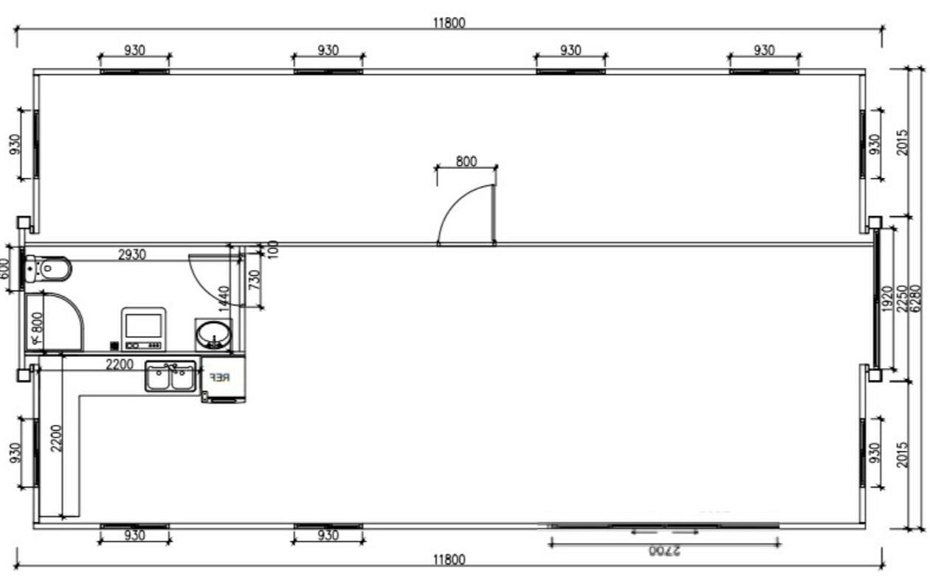
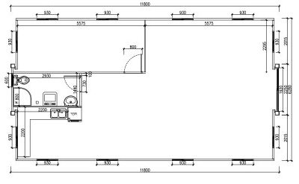
40FT 1 BEDROOM

Slide 3
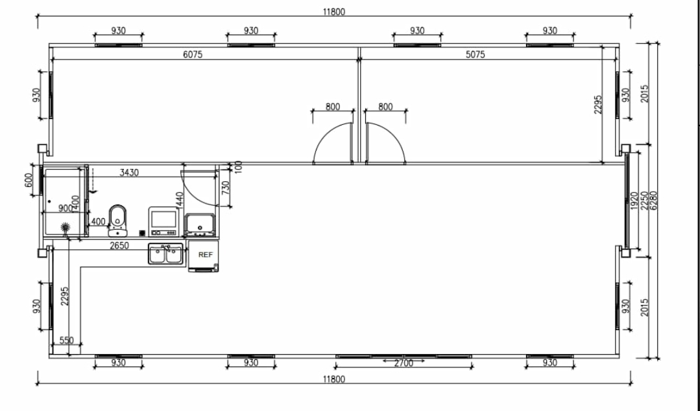
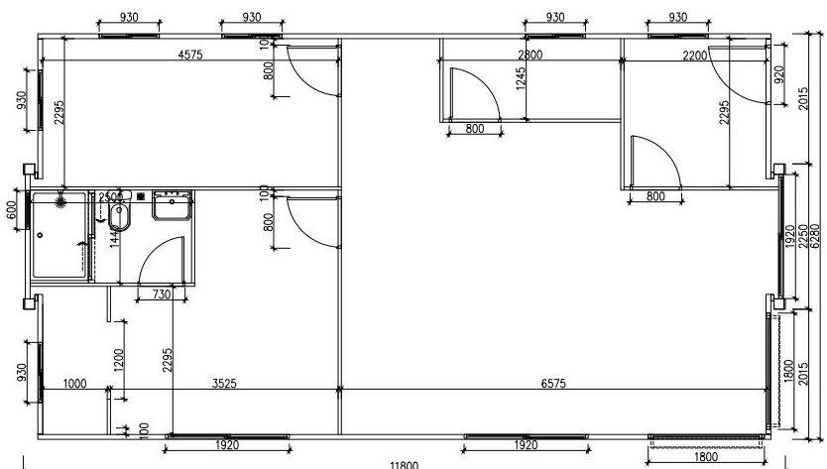
40FT 2 BEDROOM

Slide 4
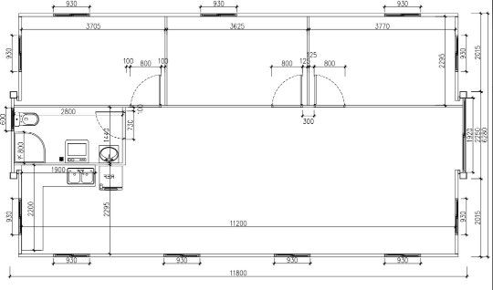
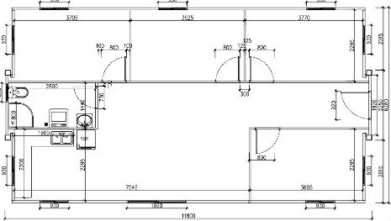
40FT 3 BEDROOM. 40FT 4 BEDROOM

