Slide 1
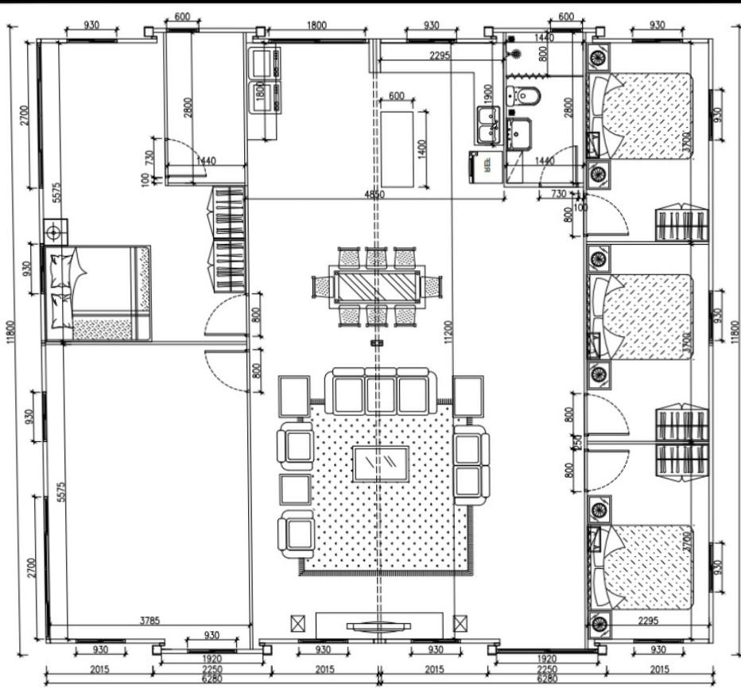
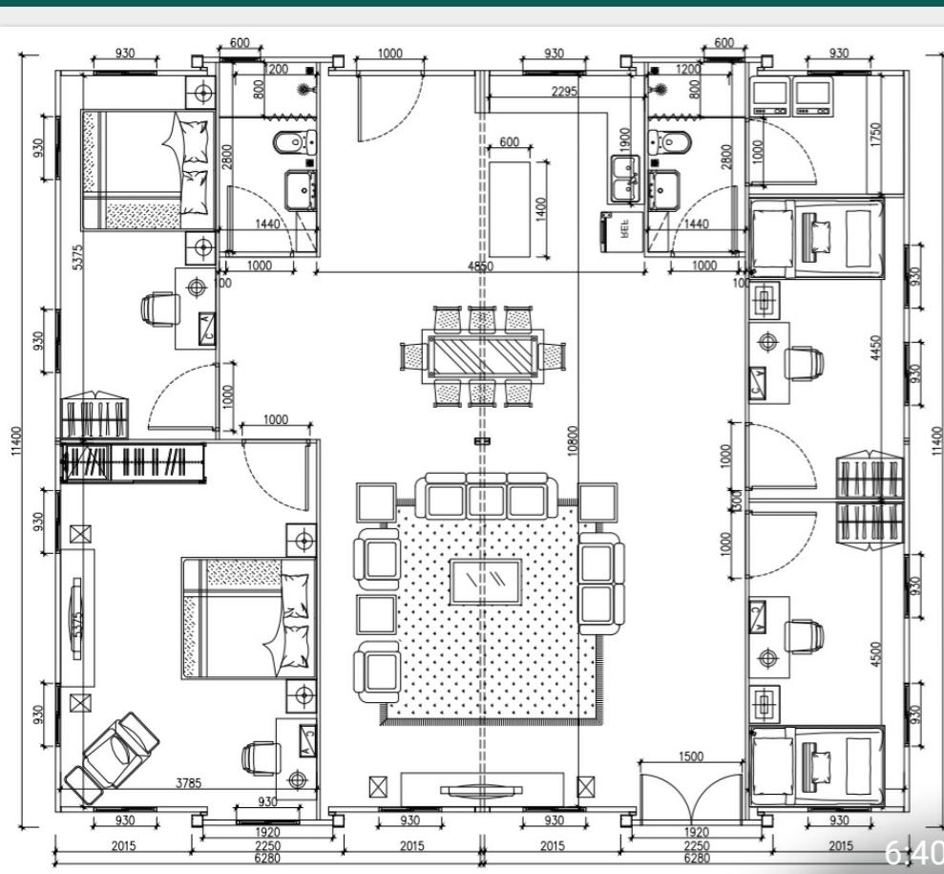
2x40FT FLOORPLAN DESIGN IDEAS
Please Choose or email your required modifications to
prefabfuture@gmail.com

Slide 2
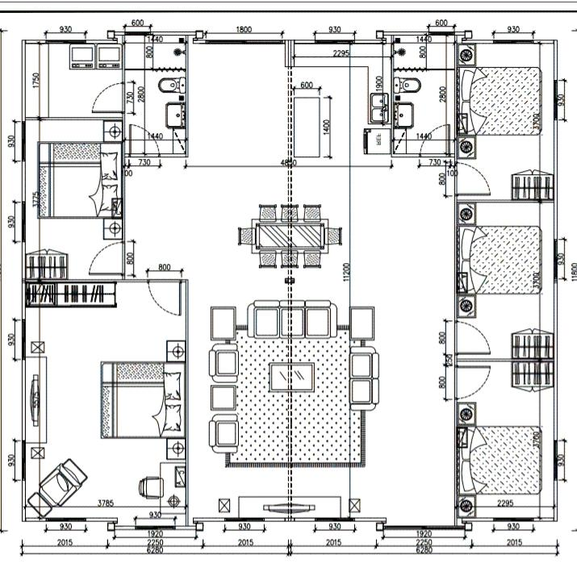
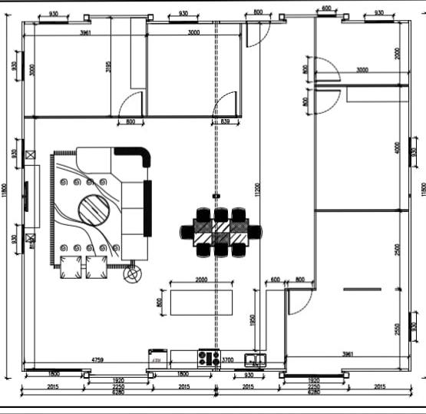

Slide 3
