Slide 1
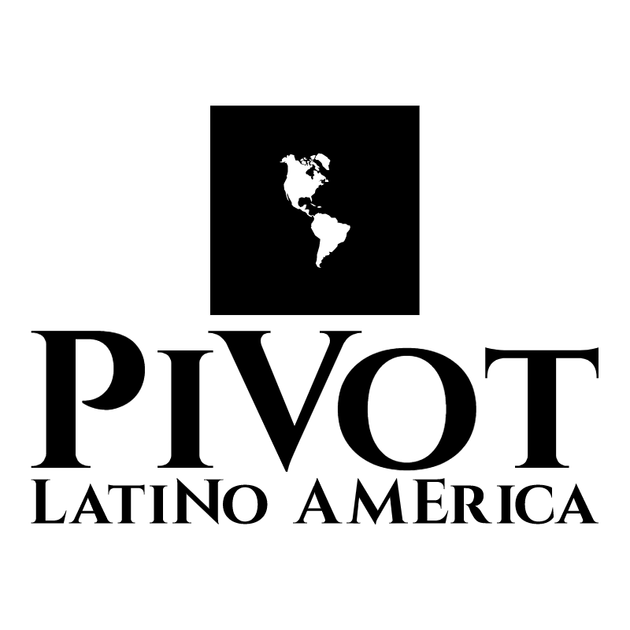
SUSTAINABLE DEVELOPMENT
PLAN

Slide 2
Sustainable Development Plan
Conservation & Research
Economic Environment
Citizen Engagement
Programs
& Structures

Slide 3
Conservation and Research
Organization/ Project Management
Commerce /
Developmental Impact
Governance
Citizen Engagement
Resource Allocation / Management
Pivot Latino America is a Transnational Corporation it holds assets in the southwest Region of the State of Mexico. We aim at conserving and preserving our land through responsible management of Natural Resources, hence creating bioregional economic structure to benefit The State of Mexico and its trading Partners alike. The socioeconomic wellbeing of the region is pivotal to the economic growth and development of Mexico and its relationship with the rest of the world. Working with local municipalities and governments to implement these structured programs and wealth management will promote productive cooperation with member nations (states). Economic development through Soft & Hard Commodities Markets and Investment's in Industries such as Energy, Tourism, Agriculture, Retail and Housing will pivot the Internal and external growth across the board.

Slide 4
Economic Environment
Government
Bioregional Economic Structure’s
Assets – Capital
Industries
Distribution - Logistics
Personnel - Talent
Socioeconomic factors to consider:
Globalization
Trans-National Entity’s
Technologies
Public Trading
Market Potential
Stocks – Shareholders
Stakeholders

Slide 5
Commerce
Entertainment
VIP Series
Transformative
Advocacy Informed
Product Design & Marketing
Product Catalog Development
Strategic Venture Investments
Market Research

Slide 6
Citizen Engagement
Cultural Exchange Program
Public
Community Input
Volunteer Opportunity’s
Responsive
Management
Campaign Strategy
Independent Think Tanks

Slide 7

Sustainable Development Goals :
Maintain Eco Friendly Systems backed by company policies and guidelines.
Produce Markets –Increasing Photosynthesis - Compost
Mitigate Climate Change through responsible Forestry and Irrigation processes
Non- Renewable Natural Resource Management
Implement Responsible Water Management systems
Renewable Energy Investment (Hydro)
S

Slide 8
Economic Development – Capital Campaign
Resource
Allocation & Management
Project Management
Trading Partners
Capital Pledge’s
Capital Investments (Endowment)
Working Capital
ROI’s (Passive Income)
Fundraising
Natural Regeneration (Environment)

Slide 9
Land Stewardship
Natural Regeneration
Water Budgets and constraints
Quality Control & Expansion
Irrigation Implementation
Marine Life Biodiversity
Research
Environment & Eco system

Slide 10




Structures / Trading Partners
Bilateral Investment Treaty (BIT)
Comprehensive Economic Partnership Agreement’s (CEPA)
Trilateral Investment Treaty (TIT)
Master Limited Partnership (MLP)

