Slide 1
Topical Therapy Guide
For Skin & Hair
Remember to always dilute the following oils with a carrier oil like Coconut Oil or Olive Oil, before putting them on your skin in order to avoid sensitivity:
See how to apply oils on the next page & ways to use each essential oil .
Cinnamon Bark
Cumin
Cassia
Clove
Lemongrass
Geranium
Thyme
Oregano

Slide 2
Applying Essential Oils Topically:
After dilution of the essential oil, apply to the effected area. Below are the different areas to apply the oil.
Face:
Add essential oils to your daily skincare regimen to improve the skin and maintain a clear complexion. Simply add a few drops of an oil to your facial cleanser, moisturizer, or body lotion. You can also dilute essential oils with Fractionated Coconut Oil and apply the blend to your face.
Temples, forehead, base of the skull and neck:
Applying essential oils to any of these areas promotes relaxation and will target any tension. For tension in your neck; for example, working long days behind a desk or to unwind, apply soothing and relaxing oils for relief.
Abdomen:
Apply essential oils topically to the abdomen to experience the soothing and calming effects. Apply essential oils to the abdomen major digestive organs to support their healthy function, and help alleviate digestive discomfort. You can also apply essential oils to the abdomen during your menstrual cycle when you want to help provide comfort.
Continues on next page

Slide 3
Arms, legs, back:
Massage essential oils onto the arms, wrists, legs, feet, and back after a workout, physical activity or for sore muscles.
Chest:
Apply essential oils to the chest to help clear breathing, which gives aroma therapy as well.
Bottoms of the feet:
The ideal place to apply essential oils is the bottom of feet, because they readily absorb the oils due to being thick and less prone to sensitivity.
It is ideal to apply the oil to feet especially for the following reasons:
-When trying an essential oil for the first time
-For children
-Sensitivity to essential oil
See next page for essential oils idea guide

Slide 4
Topical Therapy Ideas:
Arborvitae: Apply to wrists and ankles to help naturally repel insects
Basil: Apply to the temples and back of the neck to reduce tension
Bergamot: Apply to the skin while showering to experience a calming effect and skin-purifying benefits
Black Pepper: For a pick-me-up, apply Black Pepper to the bottoms of your feet for a stimulating wake up
Cardamom: Apply to the chest to promote clear breathing while outside
Cassia: Massage the body with a blend of Cassia and Fractionated Coconut Oil for a warming effect.
Cedarwood: Adding two drops of Cedarwood to your facial toner or moisturizer will aid in clarifying properties
Cilantro: Keep fingernails and toenails healthy and clean by applying cilantro
Cinnamon Bark: During winter, dilute Cinnamon with Fractionated Coconut oil to create a warming massage for cold, achy joints
Clary Sage: Sooth your menstrual cycle by apply Clary Sage to the abdomen
Clove: Add two drops of Clove to a lotion for a warming massage
Coriander: Apply topically to oily skin to maintain a clear complexion and help reduce the appearance of blemishes
Continued on next page

Slide 5
Cypress: Combine Marjoram, Lavender, and Peppermint for a soothing massaging oil blend
Eucalyptus: Apply topically to the chest and breathe deeply for aroma therapy
Fennel: Dilute with carrier oil and use for a soothing abdominal muscle massage
Frankincense: Add Frankincense to your daily moisturizer to reduce the appearance of blemishes and rejuvenate the skin
Geranium: Apply this oil directly to the skin. Enjoy an aroma therapy facial to beautify the skin
Ginger: Use for a stimulating massage any where on the body
Grapefruit: Add grapefruit to your nightly facial routine to improve the appearance of blemishes. This works well for Teens. (make sure to avoid sun exposure)
Helichrysum: Apply to the face to reduce the appearance of wrinkles and for a glowing, youthful complexion
Jasmine: Jasmine can be used on the skin or hair to help nourish and protect the skin and scalp
Continued on next page

Slide 6
Juniper Berry: For a clear, healthy complexion, place one drop of Juniper Berry on the skin
Lavender: Add Lavender to bath water to de-stress, or apply it to the temples or back of the neck
Lemon: Washing hands with Lemon oil will remove grease
Lemongrass: For a refreshing feeling (after a workout for example), apply Lemongrass to the feet
Lime: Combine Lime with Melaleuca (Tea Tree) for a soothing scalp massage
Marjoram: Apply to the muscles to help target tired, stressed muscles
Melaleuca (Tea Tree): For skin irritations, apply one to two drops onto the affected area
Melissa: For emotional well-being and to de-stress, rub Melissa on the forehead, shoulders, or chest
Myrrh: Combine a few drops of Myrrh with Wild Orange and Roman Chamomile and than add to your bath for an aroma therapy experience that promotes healthy skin
Oregano: Combine with a carrier oil for a soothing massage
Patchouli: Add to a daily moisturizer to help reduce the appearance of blemishes Peppermint: For an energy boost, rub peppermint on temples in the morning
Petitgrain: For relaxation at bedtime, add a few drops of Petitgrain to the bottoms of the feet before going to bed
Continued on next page

Slide 7
Roman Chamomile: For youthful looking skin and hair, add one to two drops to your favorite moisturizer, shampoo, or conditioner
Rose: Use topically to promote even skin tone and healthy complexion
Rosemary: Apply to the scalp and massage for hair growth.
Sandalwood: Add one to two drops to a hot bath to promote relaxation and reduce stress
Spikenard: For health, glowing skin, add one to two drops of Spikenard to your favorite cleanser or anti-aging product
Tangerine: For feelings of happiness, apply to flex points or abdomen
Thyme: Add to hair products to promote thick and healthy looking hair
Vetiver: After standing for long periods, apply to the feet for a soothing massage
White Fir: After strenuous activity, massage into the skin for a soothing comfort
Wild Orange: For an energizing boost, dispense one to two drops in the palm of hand, along with Peppermint and Frankincense. Next, rub palms together and inhale, then rub on the back of neck for an energizing boost
Wintergreen: For a soothing and warming sensation after exercise, massage Wintergreen into hands, back, and legs
Ylang Ylang: Apply to the back of the neck for a calming and uplifting effect
*Remember, always dilute these essential oils.

Slide 8
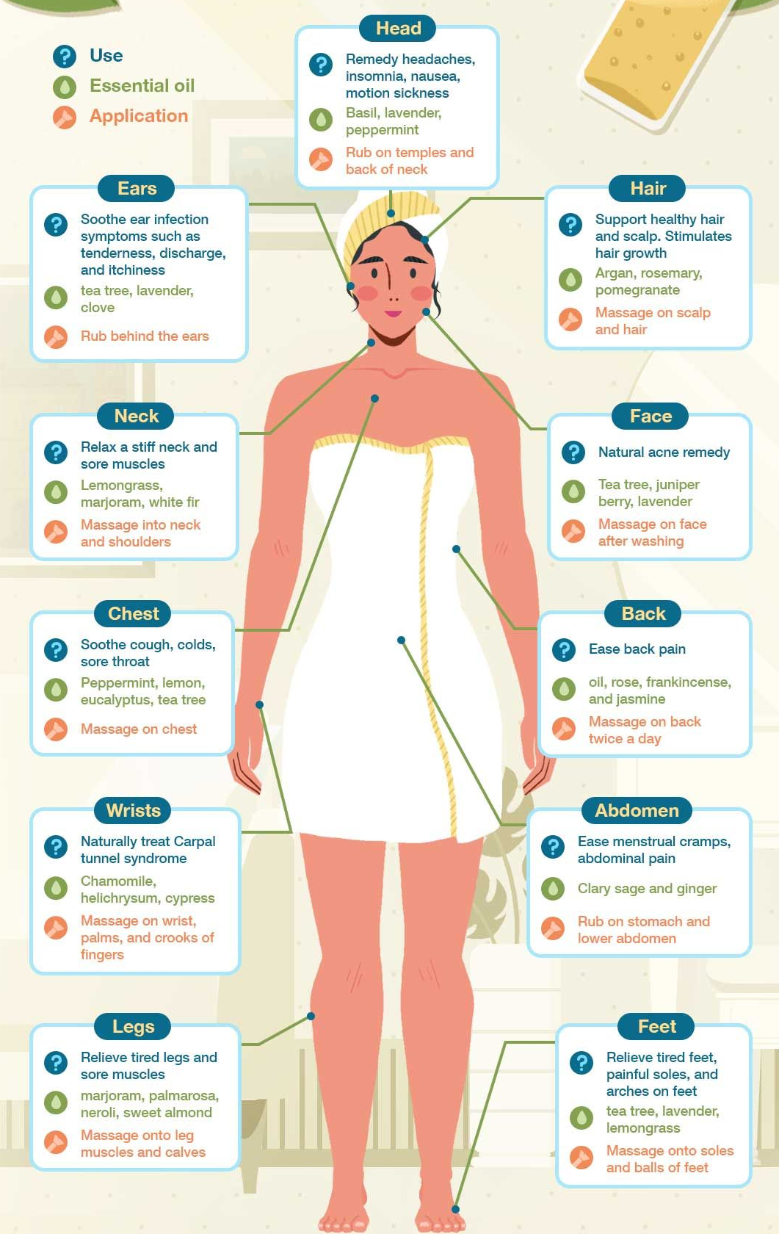
Essential Oil – Body Points Guide

