Slide 1

Applications of Integration
Chapter 5

Slide 2
5.1 Areas Between Curves

Slide 3
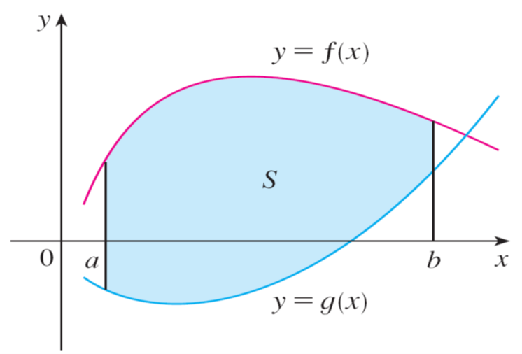
Areas Between Curves (1 of 11)
Consider the region S that lies between two curves y = f (x) and y = g(x) and between the vertical lines x = a and x = b, where f and g are continuous functions and f (x) ≥ g(x) for all x in [a, b]. (See Figure 1.)
Figure 1

Slide 4
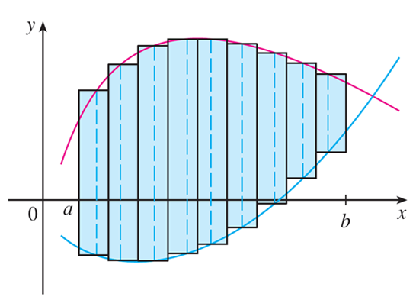
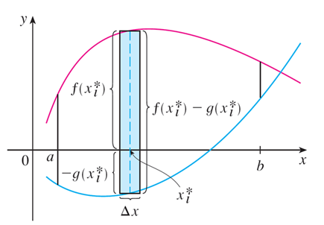
Areas Between Curves (2 of 11)
We divide S into n strips of equal width and then we approximate the i th strip by a rectangle with base Δx and height f (x_{i}∗) − g(x_{i}∗). (See Figure 2. If we like, we could take all of the sample points to be right endpoints, in which
case x_{i}∗ = x_{i}.)
(a) Typical rectangle
(b) Approximating rectangles
Figure 2

Slide 5
Areas Between Curves (3 of 11)
The Riemann sum
is therefore an approximation to what we intuitively think of as the area of S.
This approximation appears to become better and better as n → ∞. Therefore we define the area A of the region S as the limiting value of the sum of the areas of these approximating rectangles.

Slide 6
Areas Between Curves (4 of 11)
We recognize the limit in (1) as the definite integral of f − g. Therefore we have the following formula for area.
2 The area A of the region bounded by the curves y = f(x), y = g(x), and the
lines x = a, x = b, where f and g are continuous and f(x) ≥ g(x) for all x in
[a, b] is
Notice that in the special case where g(x) = 0, S is the region under the graph of f and our general definition of area (1) reduces.

Slide 7
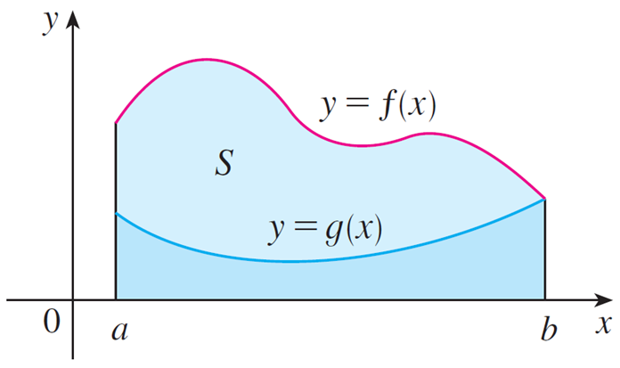
Areas Between Curves (5 of 11)
In the case where both f and g are positive, you can see from Figure 3 why (2) is true:
A = [area under y = f (x)] − [area under y = g(x)]
Figure 3

Slide 8
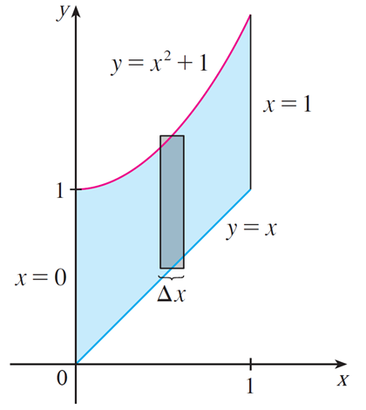
Example 1
Find the area of the region bounded above by
bounded below by y = x,
and bounded on the sides by x = 0 and x = 1.
Solution:
The region is shown in Figure 4. The upper
boundary curve is
and the lower
boundary curve is y = x.
Figure 4

Slide 9
Example 1 – Solution
So we use the area formula (2) with
a = 0, and b = 1:

Slide 10

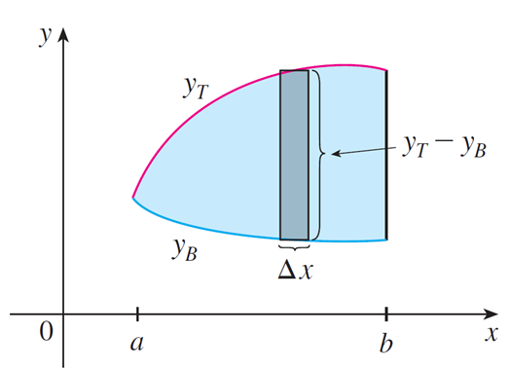
Areas Between Curves (6 of 11)
In Figure 4 we drew a typical approximating rectangle with width Δx as a reminder of the procedure by which the area is defined in (1).
In general, when we set up an integral for an area, it’s helpful to sketch the region to identify the top curve y_{T}, the bottom curve y_{B}, and a typical approximating rectangle as in Figure 5.
Figure 4
Figure 4

Slide 11

Areas Between Curves (7 of 11)
Then the area of a typical rectangle is (y_{T} − y_{B}) Δx and the equation
summarizes the procedure of adding (in a limiting sense) the areas of all the typical rectangles.
Notice that in Figure 5 the left-hand boundary reduces to a point, whereas in Figure 3 the right-hand boundary reduces to a point.
Figure 3

Slide 12
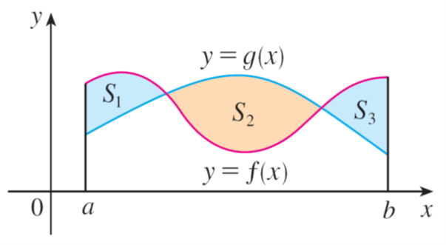
Areas Between Curves (8 of 11)
If we are asked to find the area between the curves y = f(x) and y = g(x) where f(x) ≥ g(x) for some values x of but g(x) ≥ f(x) for other values of x, then we split the given region S into several regions S₁, S₂ , . . . with areas A₁, A₂ , . . . as shown in Figure 11. We then define the area of the region S to be the sum of the areas of the smaller regions S₁, S₂ , . . . , that is, A = A₁ + A₂ + . . .. Since
Figure 11

Slide 13
Areas Between Curves (9 of 11)
We have the following expression for A.
3 The area between the curves y = f(x) and y = g(x) and between x = a and x = b is
When evaluating the integral in (3), however, we must still split it into integrals corresponding to A₁, A₂,….

Slide 14
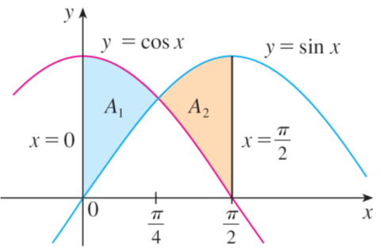
Example 6
Find the area of the region bounded by the curves y = sin x, y = cos x, x = 0, and
Solution:
The points of intersection occur when sin x = cos x, that is, when
The region is sketched in Figure 12. Observe that cos x ≥ sin x when
sin x ≥ cos x when
Figure 12

Slide 15
Example 6 – Solution (1 of 2)
Therefore the required area is

Slide 16
Example 6 – Solution (2 of 2)
In this particular example we could have saved some work by noticing that the
region is symmetric about

Slide 17
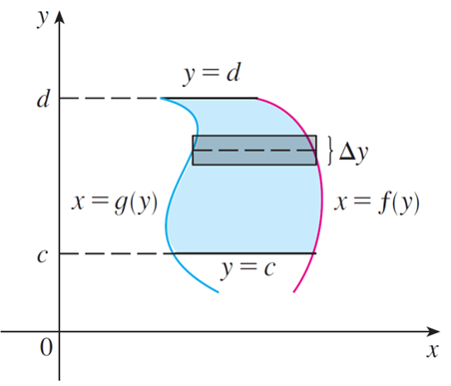
Areas Between Curves (10 of 11)
Some regions are best treated by regarding x as a function of y. If a region is bounded by curves with equations x = f (y), x = g (y), y = c, and y = d, where f and g are continuous and f (y) ≥ g (y) for c ≤ y ≤ d (see Figure 13), then its area is
Figure 13

Slide 18
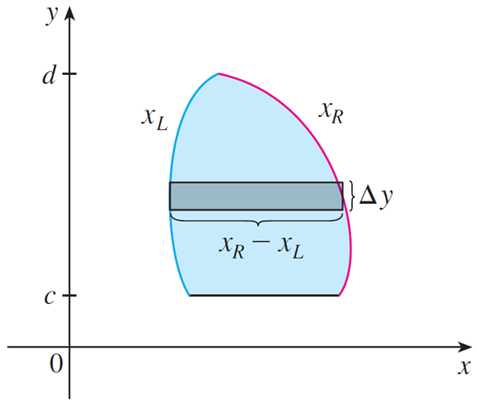
Areas Between Curves (11 of 11)
If we write x_{R} for the right boundary and x_{L} for the left boundary, then, as Figure 14 illustrates, we have
Figure 14

