Slide 1
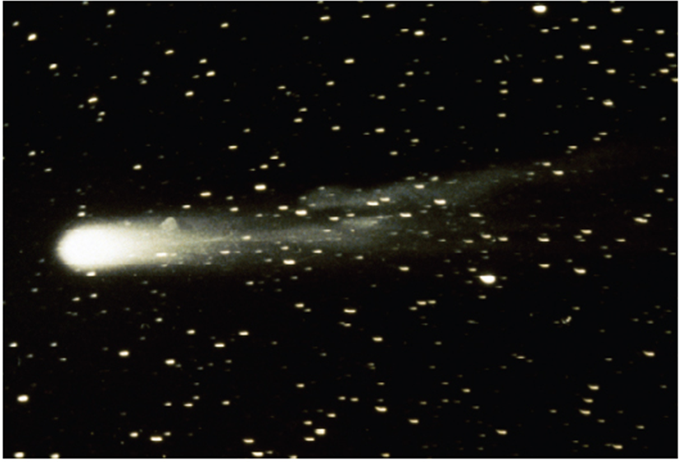
Parametric Equations and Polar Coordinates
Chapter 10

Slide 2
10.1 Curves Defined by Parametric Equations

Slide 3
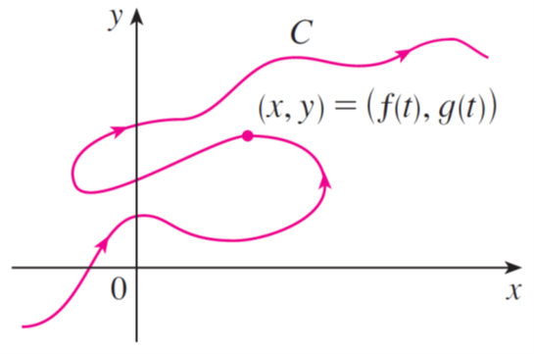
Curves Defined by Parametric Equations (1 of 5)
Imagine that a particle moves along the curve C shown in Figure 1. It is impossible to describe C by an equation of the form y = f (x) because C fails the Vertical Line Test.
Figure 1

Slide 4
Curves Defined by Parametric Equations (2 of 5)
But the x- and y-coordinates of the particle are functions of time and so we can write x = f (t) and y = g (t). Such a pair of equations is often a convenient way of describing a curve and gives rise to the following definition.
Suppose that x and y are both given as functions of a third variable t (called a parameter) by the equations
(called parametric equations).

Slide 5
Curves Defined by Parametric Equations (3 of 5)
Each value of t determines a point (x, y), which we can plot in a coordinate plane.
As t varies, the point (x, y) = (f (t), g (t)) varies and traces out a curve C, which we call a parametric curve.
The parameter t does not necessarily represent time and, in fact, we could use a letter other than t for the parameter.
But in many applications of parametric curves, t does denote time and therefore we can interpret (x, y) = (f (t), g (t)) as the position of a particle at time t.

Slide 6
Example 1
Sketch and identify the curve defined by the parametric equations
Solution:
Each value of t gives a point on the curve, as shown in the table.
t | x | y
−2 | 8 | −
−1 | 3 | 0
0 | 0 | 1
1 | −1 | 2
2 | 0 | 3
3 | 3 | 4
4 | 8 | 5

Slide 7
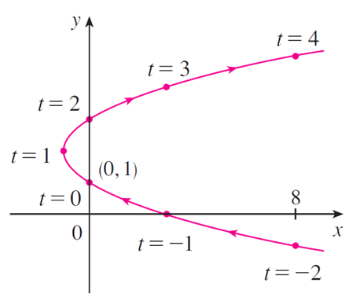
Example 1 – Solution (1 of 3)
For instance, if t = 0, then x = 0, y = 1 and so the corresponding point is (0, 1).
In Figure 2 we plot the points (x, y) determined by several values of the parameter and we join them to produce a curve.
Figure 2

Slide 8
Example 1 – Solution (2 of 3)
A particle whose position is given by the parametric equations moves along the curve in the direction of the arrows as t increases.
Notice that the consecutive points marked on the curve appear at equal time intervals but not at equal distances. That is because the particle slows down and then speeds up as t increases.
It appears from Figure 2 that the curve traced out by the particle may be a parabola.

Slide 9
Example 1 – Solution (3 of 3)
This can be confirmed by eliminating the parameter t as follows. We obtain t = y − 1 from the second equation and substitute into the first equation.
This gives
and so the curve represented by the given parametric equations is the parabola

Slide 10
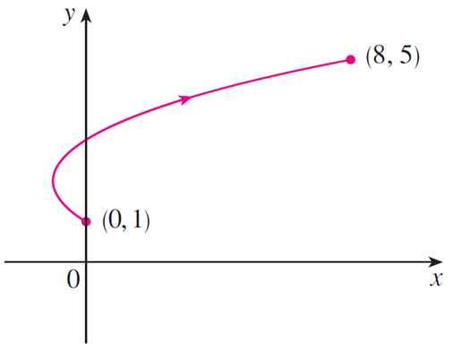
Curves Defined by Parametric Equations (4 of 5)
No restriction was placed on the parameter t in Example 1, so we assumed that t could be any real number.
But sometimes we restrict t to lie in a finite interval. For instance, the parametric curve
shown in Figure 3 is the part of the parabola in Example 1 that starts at the point (0, 1) and ends at the point (8, 5).
Figure 3

Slide 11
Curves Defined by Parametric Equations (5 of 5)
The arrowhead indicates the direction in which the curve is traced as t increases from 0 to 4.
In general, the curve with parametric equations
has initial point (f (a), g (a)) and terminal point (f (b), g (b)).

Slide 12
Example 2
What curve is represented by the following parametric equations?
Solution:
If we plot points, it appears that the curve is a circle. We can confirm this impression by eliminating t. Observe that
Thus the point (x, y) moves on the unit circle

Slide 13
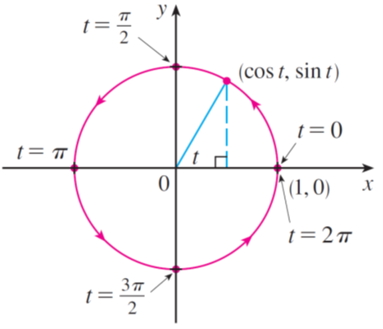
Example 2 – Solution
Notice that in this example the parameter t can be interpreted as the angle (in radians) shown in Figure 4.
Figure 4
As t increases from 0 to 2π, the point (x, y) = (cos t, sin t) moves once around the circle in the counterclockwise direction starting from the point (1, 0).

Slide 14
Graphing Devices

Slide 15
Graphing Devices (1 of 2)
Most graphing calculators and other graphing devices can be used to graph curves defined by parametric equations.
In fact, it’s instructive to watch a parametric curve being drawn by a graphing calculator because the points are plotted in order as the corresponding parameter values increase.

Slide 16
Example 6
Use a graphing device to graph the curve
Solution:
If we let the parameter be t = y, then we have the equations

Slide 17
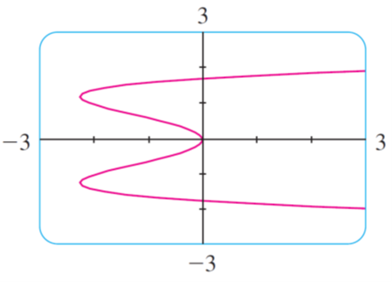
Example 6 – Solution
Using these parametric equations to graph the curve, we obtain Figure 9.
Figure 9
It would be possible to solve the given equation
for y as four
functions of x and graph them individually, but the parametric equations provide a much easier method.

Slide 18
Graphing Devices (2 of 2)
One of the most important uses of parametric curves is in computer-aided design (CAD).
In the Laboratory Project, we will investigate special parametric curves, called Bézier curves, that are used extensively in manufacturing, especially in the automotive industry.
These curves are also employed in specifying the shapes of letters and other symbols in laser printers.

Slide 19
The Cycloid

Slide 20
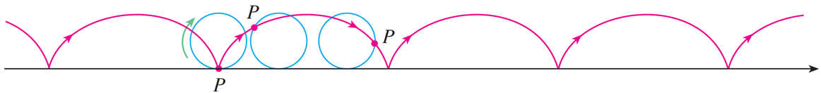
Example 7
The curve traced out by a point P on the circumference of a circle as the circle rolls along a straight line is called a cycloid (see Figure 13).
Figure 13
If the circle has radius r and rolls along the x-axis and if one position of P is the origin, find parametric equations for the cycloid.

Slide 21
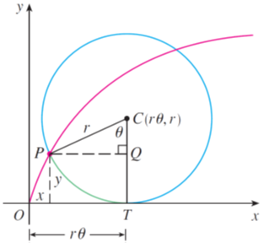
Example 7 – Solution (1 of 4)
We choose as parameter the angle of rotation θ of the circle (θ = 0 when P is at the origin). Suppose the circle has rotated through θ radians.
Figure 14
Because the circle has been in contact with the line, we see from Figure 14 that the distance it has rolled from the origin is

Slide 22
Example 7 – Solution (2 of 4)
Therefore the center of the circle is C (rθ, r). Let the coordinates of P be (x, y). Then from Figure 14 we see that
Therefore parametric equations of the cycloid are

Slide 23
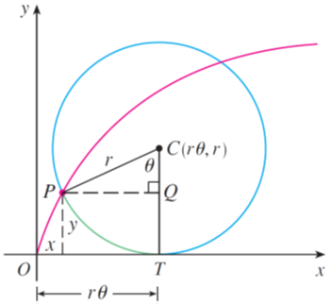
Example 7 – Solution (3 of 4)
One arch of the cycloid comes from one rotation of the circle and so is described by 0 ≤ θ ≤ 2π.
Although Equations 1 were derived from Figure 14, which illustrates the case
where
it can be seen that these equations are still valid for other
values of θ.
Figure 14

Slide 24
Example 7 – Solution (4 of 4)
Although it is possible to eliminate the parameter θ from Equations 1, the resulting Cartesian equation in x and y is very complicated and not as convenient to work with as the parametric equations.

Slide 25
The Cycloid (1 of 4)
One of the first people to study the cycloid was Galileo, who proposed that bridges be built in the shape of cycloids and who tried to find the area under one arch of a cycloid.
Later this curve arose in connection with the brachistochrone problem: Find the curve along which a particle will slide in the shortest time (under the influence of gravity) from a point A to a lower point B not directly beneath A.

Slide 26
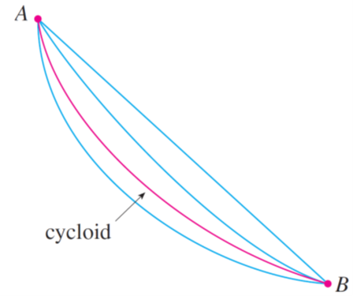
The Cycloid (2 of 4)
The Swiss mathematician John Bernoulli, who posed this problem in 16 96, showed that among all possible curves that join A to B, as in Figure 15, the particle will take the least time sliding from A to B if the curve is part of an inverted arch of a cycloid.
Figure 15

Slide 27
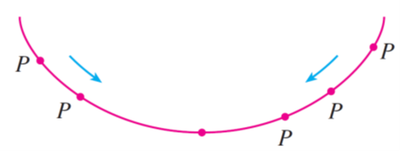
The Cycloid (3 of 4)
The Dutch physicist Huygens had already shown that the cycloid is also the solution to the tautochrone problem; that is, no matter where a particle P is placed on an inverted cycloid, it takes the same time to slide to the bottom (see Figure 16).
Figure 16

Slide 28
The Cycloid (4 of 4)
Huygens proposed that pendulum clocks (which he invented) should swing in cycloidal arcs because then the pendulum would take the same time to make a complete oscillation whether it swings through a wide or a small arc.

Slide 29
Families of Parametric Curves

Slide 30
Example 8
Investigate the family of curves with parametric equations
What do these curves have in common? How does the shape change as a increases?

Slide 31
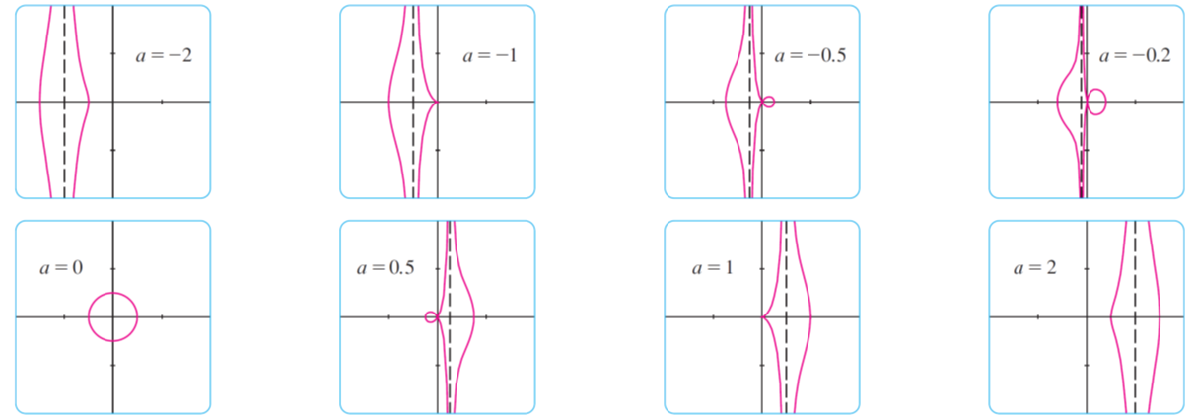
Example 8 – Solution (1 of 3)
We use a graphing device to produce the graphs for the cases a = −2, −1, −0.5, −0.2, 0, 0.5, 1, and 2 shown in Figure 17.
Members of the family x = a + cos t, y = a tan t + sin t, all graphed in the viewing rectangle [−4, 4] by [−4, 4]
Figure 17

Slide 32
Example 8 – Solution (2 of 3)
Notice that all of these curves (except the case a = 0) have two branches, and both branches approach the vertical asymptote x = a as x approaches a from the left or right.
When a < −1, both branches are smooth; but when a reaches −1, the right branch acquires a sharp point, called a cusp.
For a between −1 and 0 the cusp turns into a loop, which becomes larger as a approaches 0. When a = 0, both branches come together and form a circle.

Slide 33
Example 8 – Solution (3 of 3)
For a between 0 and 1, the left branch has a loop, which shrinks to become a cusp when a = 1.
For a > 1, the branches become smooth again, and as a increases further, they become less curved. Notice that the curves with a positive are reflections about the y-axis of the corresponding curves with a negative.
These curves are called conchoids of Nicomedes after the ancient Greek scholar Nicomedes. He called them conchoids because the shape of their outer branches resembles that of a conch shell or mussel shell.

