Slide 1
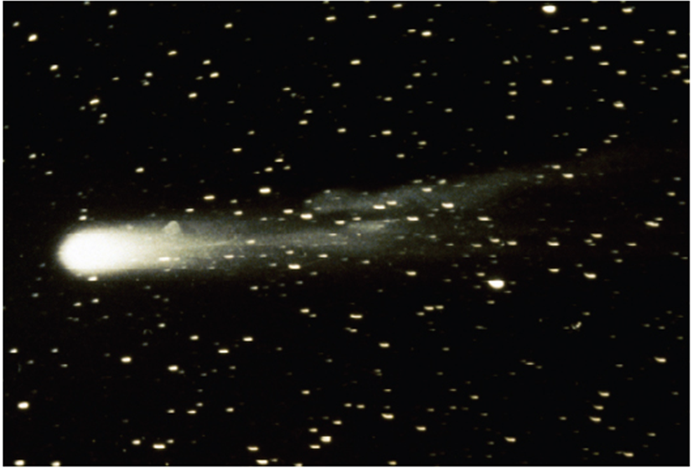
Parametric Equations and Polar Coordinates
Chapter 10

Slide 2
10.2 Calculus with Parametric Curves

Slide 3
Tangents

Slide 4
Tangents (1 of 3)
Suppose f and g are differentiable functions and we want to find the tangent line at a point on the parametric curve x = f(t), y = g(t), where y is also a differentiable function of x.
Then the Chain Rule gives

Slide 5
Tangents (2 of 3)
If
we can solve for
Equation 1 (which you can remember by thinking of canceling the dt’s) enables
us to find the slope
of the tangent to a parametric curve without having
to eliminate the parameter t.

Slide 6
Tangents (3 of 3)
We see from (1) that the curve has a horizontal tangent when
(provided that
and it has a vertical tangent when
(provided that
This information is useful for sketching parametric curves.
It is also useful to consider
This can be found by replacing y by
in Equation 1:

Slide 7
Example 1
A curve C is defined by the parametric equations
(a) Show that C has two tangents at the point (3, 0) and find their equations.
(b) Find the points on C where the tangent is horizontal or vertical.
(c) Determine where the curve is concave upward or downward.
(d) Sketch the curve.

Slide 8
Example 1 – Solution (1 of 5)
(a) Notice that
Therefore the point
(3, 0) on C arises from two values of the parameter,
This indicates that C crosses itself at (3, 0).

Slide 9
Example 1 – Solution (2 of 5)
Since
the slope of the tangent when
so the equations
of the tangents at (3, 0) are

Slide 10
Example 1 – Solution (3 of 5)
(b) C has a horizontal tangent when
that is, when
Since
this happens when
The corresponding points on C are (1, −2) and (1, 2).
C has a vertical tangent when
that is, t = 0. (Note that
The corresponding point on C is (0, 0).

Slide 11
Example 1 – Solution (4 of 5)
(c) To determine concavity we calculate the second derivative:
Thus the curve is concave upward when t > 0 and concave downward when t < 0.

Slide 12
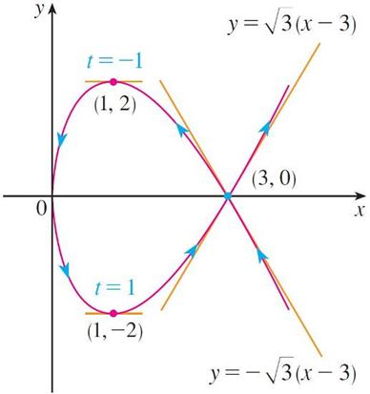
Example 1 – Solution (5 of 5)
(d) Using the information from parts (b) and (c), we sketch C in Figure 1.
Figure 1

Slide 13
Areas

Slide 14
Areas
We know that the area under a curve y = F(x) from a to b is
where F(x) ≥ 0.
If the curve is traced out once by the parametric equations x = f(t) and y = g(t), α ≤ t ≤ β, then we can calculate an area formula by using the Substitution Rule for Definite Integrals as follows:

Slide 15
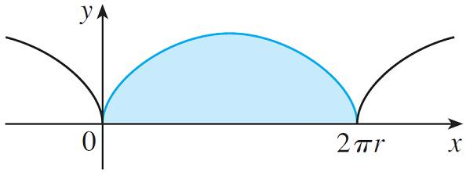
Example 3
Find the area under one arch of the cycloid
(See Figure 3.)
Figure 3

Slide 16
Example 3 – Solution (1 of 2)
One arch of the cycloid is given by 0 ≤ θ ≤ 2π.
Using the Substitution Rule with y = r(1 − cos θ) and dx = r(1 − cos θ)dθ, we have

Slide 17
Example 3 – Solution (2 of 2)

Slide 18
Arc Length

Slide 19
Arc Length (1 of 9)
We already know how to find the length L of a curve C given in the form y = F(x), a ≤ x ≤ b.
If
is continuous, then
Suppose that C can also be described by the parametric equations x = f(t) and
y = g(t), α ≤ t ≤ β, where

Slide 20
Arc Length (2 of 9)
This means that C is traversed once, from left to right, as t increases from α to β and f(α) = a, f(β) = b.
Putting Formula 1 into Formula 2 and using the Substitution Rule, we obtain
Since
we have

Slide 21
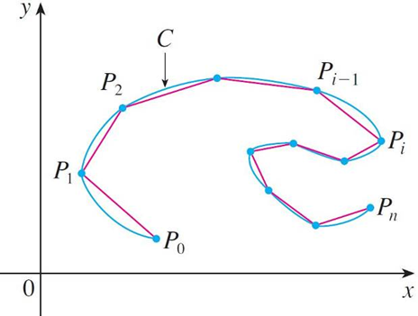
Arc Length (3 of 9)
Even if C can’t be expressed in the form y = F(x), Formula 3 is still valid but we obtain it by polygonal approximations.
We divide the parameter interval [α, β] into n subintervals of equal width Δt.
If t₀, t₁, t₂, . . . , t_{n} are the endpoints of these subintervals, then x_{i} = f(t_{i}) and y_{i} = g(t_{i}) are the coordinates of points P_{i}(x_{i}, y_{i}) that lie on C and the polygon with vertices P₀, P₁, . . . , P_{n} approximates C. (See Figure 4.)
Figure 4

Slide 22
Arc Length (4 of 9)
We define the length L of C to be the limit of the lengths of these approximating polygons as n →∞:
The Mean Value Theorem, when applied to f on the interval [t_{i −1}, t_{i}], gives a number t_{i}* in (t_{i −1}, t_{i}) such that

Slide 23
Arc Length (5 of 9)
If we let Δx_{i} = x_{i} − x_{i −1} and Δy_{i} = y_{i} − y_{i −1}, this equation becomes
Similarly, when applied to g, the Mean Value Theorem gives a number t_{i}** in (t_{i −1}, t_{i}) such that

Slide 24
Arc Length (6 of 9)
Therefore
and so

Slide 25
Arc Length (7 of 9)
The sum in (4) resembles a Riemann sum for the function
but it is not exactly a Riemann sum because t_{i}* ≠ t_{i}** in general.
Nevertheless, if
are continuous, it can be shown that the limit in
(4) is the same as if t_{i}* and t_{i}** were equal, namely,

Slide 26
Arc Length (8 of 9)
Thus, using Leibniz notation, we have the following result, which has the same form as Formula 3.
5 Theorem If a curve C is described by the parametric equations x = f(t), y = g(t),
α ≤ t ≤ β). where
are continuous on [α, β] and C is traversed exactly
once as t increases from α to β, then the length of C is
Notice that the formula in Theorem 5 is consistent with the general formulas

Slide 27
Arc Length (9 of 9)
Notice that the integral gives twice the arc length of the circle because as t increases from 0 to 2π, the point (sin 2t, cos 2t) traverses the circle twice.
In general, when finding the length of a curve C from a parametric representation, we have to be careful to ensure that C is traversed only once as t increases from α to β.

Slide 28
Example 5
Find the length of one arch of the cycloid x = r(θ − sin θ), y = r(1 − cos θ).
Solution:
From Example 3 we see that one arch is described by the parameter interval 0 ≤ θ ≤ 2π.
Since

Slide 29
Example 5 – Solution (1 of 3)
We have

Slide 30
Example 5 – Solution (2 of 3)
To evaluate this integral we use the identity
which gives
Since 0 ≤ θ ≤ 2π, we have
and so
Therefore

Slide 31
Example 5 – Solution (3 of 3)
and so

Slide 32
Surface Area

Slide 33
Surface Area
Suppose the curve c given by the parametric equations x = f(t), y = g(t), α ≤ t ≤ β,
where
are continuous, g(t) ≥ 0, is rotated about the x-axis. If C is
traversed exactly once as t increases from α to β, then the area of the resulting surface is given by
The general symbolic formulas
are still valid,
but for parametric curves we use

Slide 34
Example 6
Show that the surface area of a sphere of radius r is
Solution:
The sphere is obtained by rotating the semicircle
about the x-axis.
Therefore, from Formula 6, we get

Slide 35
Example 6 – Solution

