Slide 1
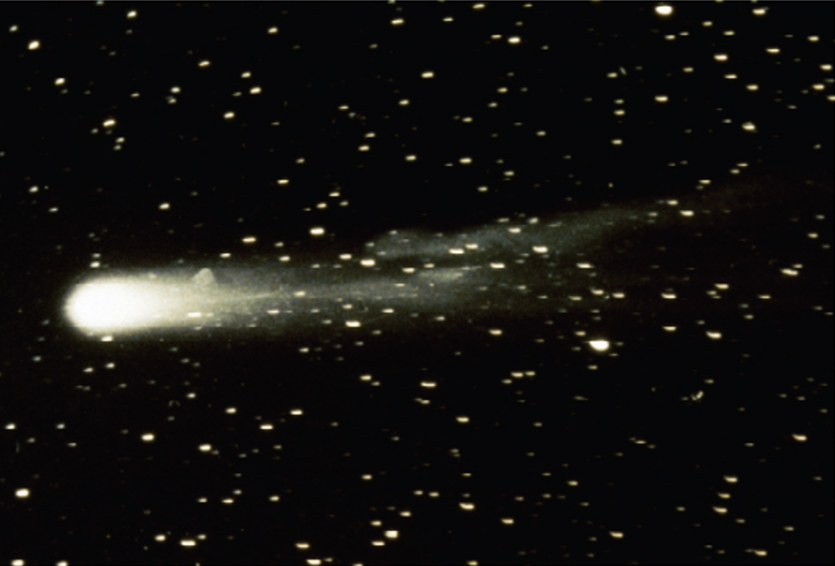
Parametric Equations and Polar Coordinates
Chapter 10

Slide 2
10.4 Areas and Lengths in Polar Coordinates

Slide 3
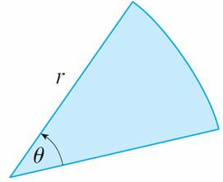
Areas and Lengths in Polar Coordinates (1 of 7)
In this section we develop the formula for the area of a region whose boundary is given by a polar equation. We need to use the formula for the area of a sector of a circle:
where, as in Figure 1, r is the radius and θ is the radian measure of the central angle.
Figure 1

Slide 4
Areas and Lengths in Polar Coordinates (2 of 7)
Formula 1 follows from the fact that the area of a sector is proportional to its central angle:

Slide 5
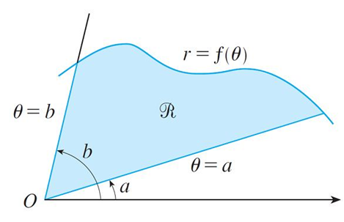
Areas and Lengths in Polar Coordinates (3 of 7)
Let
be the region, illustrated in Figure 2, bounded by the polar curve r = f (θ )
and by the rays θ = a and θ = b, where f is a positive continuous function and where 0 < b − a ≤ 2π.
Figure 2
We divide the interval [a, b] into subintervals with endpoints
and equal width Δθ.

Slide 6
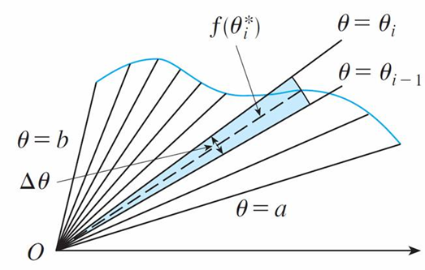
Areas and Lengths in Polar Coordinates (4 of 7)
The rays θ = θ_{i} then divide
into n smaller regions with central angle
Δθ = θ_{i} − θ_{i −1}. If we choose θ*_{i} in the ith subinterval [θ_{i − 1}, θ_{i}], then the area ΔA_{i} of the ith region is approximated by the area of the sector of a circle with central angle Δθ and radius f (θ*_{i}). (See Figure 3.)
Figure 3

Slide 7
Areas and Lengths in Polar Coordinates (5 of 7)
Thus from Formula 1 we have
and so an approximation to the total area A of
It appears from Figure 3 that the approximation in (2) improves as n → ∞.

Slide 8
Areas and Lengths in Polar Coordinates (6 of 7)
But the sums in (2) are Riemann sums for the function
It therefore appears plausible that the formula for the area A of the polar region

Slide 9
Areas and Lengths in Polar Coordinates (7 of 7)
Formula 3 is often written as
with the understanding that r = f (θ). Note the similarity between Formulas 1 and 4.
When we apply Formula 3 or 4 it is helpful to think of the area as being swept out by a rotating ray through O that starts with angle a and ends with angle b.

Slide 10
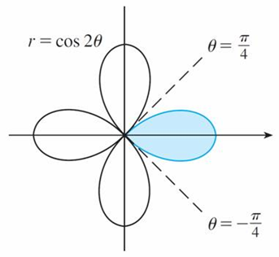
Example 1
Find the area enclosed by one loop of the four-leaved rose r = cos 2θ.
Solution:
Notice from Figure 4 that the region enclosed by the right loop is swept out by a
ray that rotates from
Figure 4

Slide 11
Example 1 – Solution (1 of 2)
Therefore Formula 4 gives

Slide 12
Example 1 – Solution (2 of 2)

Slide 13
Arc Length

Slide 14
Arc Length (1 of 3)
To find the length of a polar curve r = f (θ), a ≤ θ ≤ b, we regard θ as a parameter and write the parametric equations of the curve as
Using the Product Rule and differentiating with respect to θ, we obtain

Slide 15
Arc Length (2 of 3)
So, using
we have

Slide 16
Arc Length (3 of 3)
Assuming that
is continuous, we can write the arc length as
Therefore the length of a curve with polar equation r = f (θ), a ≤ θ ≤ b, is

Slide 17
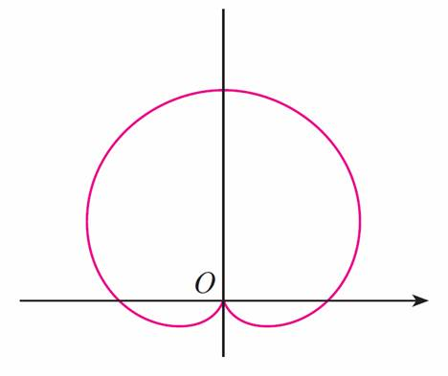
Example 4
Find the length of the cardioid r = 1 + sin θ.
Solution:
The cardioid is shown in Figure 8.
r = 1 + sin θ
Figure 8

Slide 18
Example 4 – Solution (1 of 2)
Its full length is given by the parameter interval 0 ≤ θ ≤ 2π, so Formula 5 gives

Slide 19
Example 4 – Solution (2 of 2)
We could evaluate this integral by multiplying and dividing the integrand by
or we could use a computer algebra system.
In any event, we find that the length of the cardioid is L = 8.

