Slide 1

Infinite Sequences and Series
Chapter 11

Slide 2
11.3 The Integral Test and Estimates of Sums

Slide 3
The Integral Test and Estimates of Sums (1 of 11)
In general, it is difficult to find the exact sum of a series.
We were able to accomplish this for geometric series and the series
because in each of those cases we could find a simple formula for the nth partial sum s_{n}.
But usually it isn’t easy to discover such a formula.

Slide 4
The Integral Test and Estimates of Sums (2 of 11)
We begin by investigating the series whose terms are the reciprocals of the squares of the positive integers:

Slide 5
The Integral Test and Estimates of Sums (3 of 11)
There’s no simple formula for the sum s_{n} of the first n terms, but the computer-generated table of approximate values given in the margin suggests that the partial sums are approaching a number near 1.64 as n → ∞ and so it looks as if the series is convergent.
n | (s_n) = sum_(i = 1)^n(1/(i^2))
5 | 1.4636
10 | 1.5498
50 | 1.6251
100 | 1.6350
500 | 1.6429
1000 | 1.6439
5000 | 1.6447

Slide 6
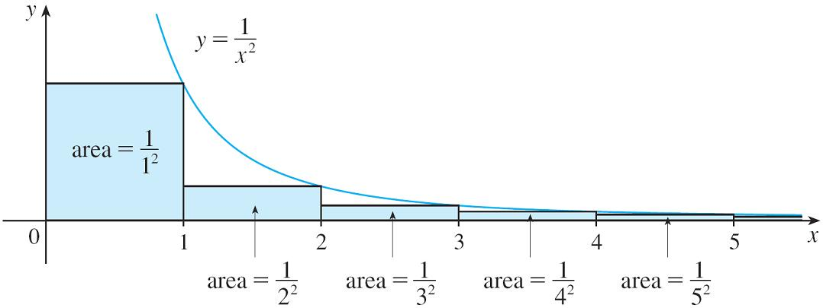
The Integral Test and Estimates of Sums (4 of 11)
We can confirm this impression with a geometric argument. Figure 1 shows the
curve
and rectangles that lie below the curve.
Figure 1
The base of each rectangle is an interval of length 1; the height is equal to the
value of the function
at the right endpoint of the interval.

Slide 7
The Integral Test and Estimates of Sums (5 of 11)
So the sum of the areas of the rectangles is
If we exclude the first rectangle, the total area of the remaining rectangles is
smaller than the area under the curve
for x ≥ 1, which is the value of the
integral
This improper integral is convergent and has value 1. So the picture shows that all the partial sums are less than

Slide 8
The Integral Test and Estimates of Sums (6 of 11)
Thus the partial sums are bounded. We also know that the partial sums are increasing (because all the terms are positive). Therefore the partial sums converge (by the Mono tonic Sequence Theorem) and so the series is convergent. The sum of the series (the limit of the partial sums) is also less than 2:
Now let’s look at the series

Slide 9
The Integral Test and Estimates of Sums (7 of 11)
The table of values of s_{n} suggests that the partial sums aren’t approaching a finite number, so we suspect that the given series may be divergent.
n | (s_n) = sum_(i = 1)^n(1/(sqrt(i)))
5 | 3.2317
10 | 5.0210
50 | 12.7524
100 | 18.5896
500 | 43.2834
1000 | 61.8010
5000 | 139.9681

Slide 10
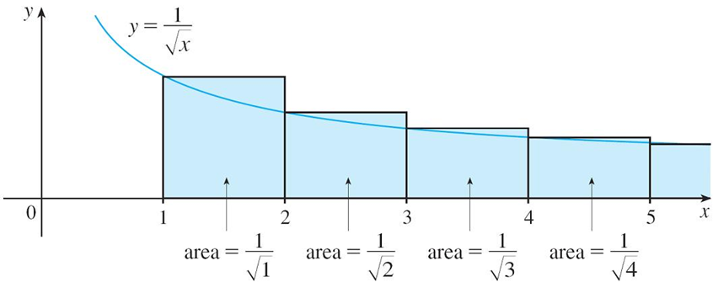
The Integral Test and Estimates of Sums (8 of 11)
Again we use a picture for confirmation. Figure 2 shows the curve
but this time we use rectangles whose tops lie above the curve.
Figure 2
The base of each rectangle is an interval of length 1. The height is equal to the
value of the function
at the left endpoint of the interval.

Slide 11
The Integral Test and Estimates of Sums (9 of 11)
So the sum of the areas of all the rectangles is
This total area is greater than the area under the curve
for x ≥ 1, which
is equal to the integral
But we know that this improper integral is divergent. In other words, the area under the curve is infinite. So the sum of the series must be infinite, that is, the series is divergent.

Slide 12
The Integral Test and Estimates of Sums (10 of 11)
The same sort of geometric reasoning that we used for these two series can be used to prove the following test.
The Integral Test Suppose f is a continuous, positive, decreasing function on
and let a_{n} = f(n). Then the series
is convergent if and only if the
improper integral
is convergent. In other words:
(i) If
is convergent, then
(ii) If
is divergent, then

Slide 13
Example 1
Test the series
for convergence or divergence.
Solution:
The function
is continuous, positive, and decreasing on
so we use the Integral Test:
Thus
is a convergent integral and so, by the Integral Test, the series
is convergent.

Slide 14
The Integral Test and Estimates of Sums (11 of 11)
The series
is called the p-series.
1 The p-series
is convergent if p > 1 and divergent if p ≤ 1.

Slide 15
Example 3
(a) The series
is convergent because it is a p-series with p = 3 > 1.
(b) The series
is divergent because it is a p-series with

Slide 16
Example 4 (1 of 2)
Determine whether the series
converges or diverges.
Solution:
The function
is positive and continuous for x > 1 because the
logarithm function is continuous.
But it is not obvious whether or not f is decreasing, so we compute its derivative:

Slide 17
Example 4 (2 of 2)
Thus
when ln x > 1, that is, x > e. It follows that f is decreasing when
x > e and so we can apply the Integral Test:
Since this improper integral is divergent, the series
is also divergent
by the Integral Test.

Slide 18
11.4 The Comparison Tests

Slide 19
The Comparison Tests (1 of 8)
In the comparison tests the idea is to compare a given series with a series that is known to be convergent or divergent. For instance, the series
reminds us of the series
which is a geometric series with
and is therefore convergent. Because the series (1) is so similar to a convergent series, we have the feeling that it too must be convergent. Indeed, it is.

Slide 20
The Comparison Tests (2 of 8)
The inequality
shows that our given series (1) has smaller terms than those of the geometric series and therefore all its partial sums are also smaller than 1 (the sum of the geometric series).
This means that its partial sums form a bounded increasing sequence, which is convergent. It also follows that the sum of the series is less than the sum of the geometric series:

Slide 21
The Comparison Tests (3 of 8)
Similar reasoning can be used to prove the following test, which applies only to series whose terms are positive. The first part says that if we have a series whose terms are smaller than those of a known convergent series, then our series is also convergent.
The second part says that if we start with a series whose terms are larger than those of a known divergent series, then it too is divergent.
The Comparison Test Suppose that
are series with positive terms.
(i) If
is convergent and a_{n} ≤ b_{n} for all n, then
is also convergent.
(ii) If
is divergent and a_{n} ≥ b_{n} for all n, then
is also divergent.

Slide 22
The Comparison Tests (4 of 8)
In using the Comparison Test we must, of course, have some known series
for the purpose of comparison. Most of the time we use one of these series:
A p-series
converges if p > 1 and diverges if p ≤ 1]
A geometric series

Slide 23
Example 1
Determine whether the series
converges or diverges.
Solution:
For large n the dominant term in the denominator is
so we compare the
given series with the series
Observe that
because the left side has a bigger denominator.
(In the notation of the Comparison Test, a_{n} is the left side and b_{n} is the right side.)

Slide 24
Example 1 – Solution
We know that
is convergent because it’s a constant times a p-series with p = 2 > 1.
Therefore
is convergent by part (i) of the Comparison Test.

Slide 25
The Comparison Tests (5 of 8)
Note 1:
Although the condition a_{n} ≤ b_{n} or a_{n} ≥ b_{n} in the Comparison Test is given for all n, we need verify only that it holds for n ≥ N, where N is some fixed integer, because the convergence of a series is not affected by a finite number of terms.

Slide 26
The Comparison Tests (6 of 8)
Note 2:
The terms of the series being tested must be smaller than those of a convergent series or larger than those of a divergent series.
If the terms are larger than the terms of a convergent series or smaller than those of a divergent series, then the Comparison Test doesn’t apply.

Slide 27
The Comparison Tests (7 of 8)
Consider, for instance, the series
The inequality
is useless as far as the Comparison Test is concerned because
is convergent and a_{n} > b_{n}.

Slide 28
The Comparison Tests (8 of 8)
Nonetheless, we have the feeling that
ought to be convergent because it
is very similar to the convergent geometric series
In such cases the following test can be used.
The Limit Comparison Test Suppose that
are series with positive
terms. If
where c is a finite number and c > 0, then either both series converge or both diverge.

Slide 29
Example 3
Test the series
for convergence or divergence.
Solution:
We use the Limit Comparison Test with
and obtain

Slide 30
Example 3 – Solution
Since this limit exists and
is a convergent geometric series, the given
series converges by the Limit Comparison Test.

