Slide 1
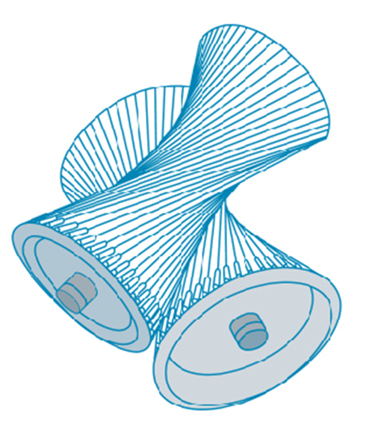
Vectors and the Geometry of Space
Chapter 12

Slide 2
12.1 Three-Dimensional Coordinate Systems

Slide 3
3D Space

Slide 4
3D Space (1 of 11)
To locate a point in a plane, two numbers are necessary.
We know that any point in the plane can be represented as an ordered pair (a, b) of real numbers, where a is the x-coordinate and b is the y-coordinate.
For this reason, a plane is called two-dimensional. To locate a point in space, three numbers are required.
We represent any point in space by an ordered triple (a, b, c) of real numbers.

Slide 5
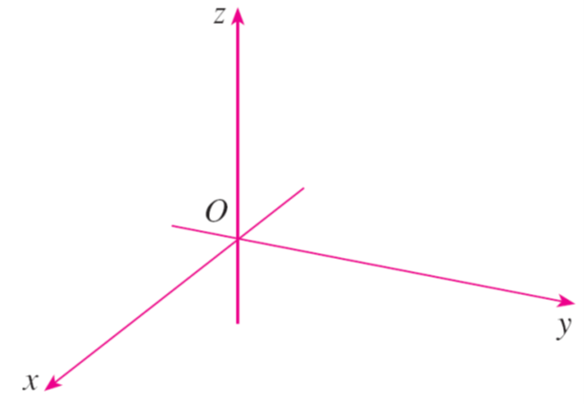
3D Space (2 of 11)
In order to represent points in space, we first choose a fixed point O (the origin) and three directed lines through O that are perpendicular to each other, called the coordinate axes and labeled the x-axis, y-axis, and z-axis.
Usually we think of the x- and y-axes as being horizontal and the z-axis as being vertical, and we draw the orientation of the axes as in Figure 1.
Coordinate axes
Figure 1

Slide 6
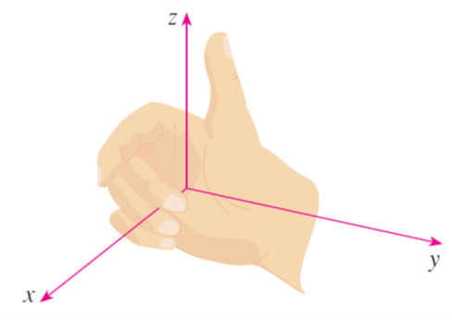
3D Space (3 of 11)
The direction of the z-axis is determined by the right-hand rule as illustrated in Figure 2:
Right-hand rule
Figure 2
If you curl the fingers of your right hand around the z-axis in the direction of a 90°counterclockwise rotation from the positive x-axis to the positive y-axis, then your thumb points in the positive direction of the z-axis.

Slide 7
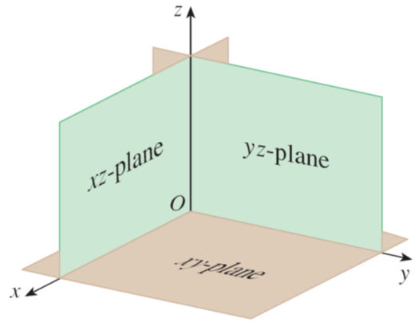
3D Space (4 of 11)
The three coordinate axes determine the three coordinate planes illustrated in Figure 3(a).
The xy-plane is the plane that contains the x- and y-axes; the yz-plane contains the y- and z-axes; the xz-plane contains the x- and z-axes.
These three coordinate planes divide space into eight parts, called octants. The first octant, in the foreground, is determined by the positive axes.
Coordínate planes
Figure 3(a)

Slide 8
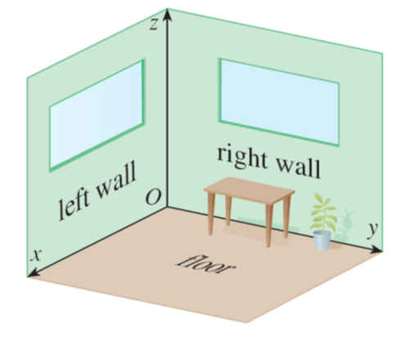
3D Space (5 of 11)
Because many people have some difficulty visualizing diagrams of three-dimensional figures, you may find it helpful to do the following [see Figure 3(b)].
Look at any bottom corner of a room and call the corner the origin.
The wall on your left is in the xz-plane, the wall on your right is in the yz-plane, and the floor is in the xy-plane.
Figure 3(b)

Slide 9
3D Space (6 of 11)
The x-axis runs along the intersection of the floor and the left wall.
The y-axis runs along the intersection of the floor and the right wall.
The z-axis runs up from the floor toward the ceiling along the intersection of the two walls.
You are situated in the first octant, and you can now imagine seven other rooms situated in the other seven octants (three on the same floor and four on the floor below), all connected by the common corner point O.

Slide 10
3D Space (7 of 11)
Now if P is any point in space, let a be the (directed) distance from the yz-plane to P, let b be the distance from the xz-plane to P, and let c be the distance from the xy-plane to P.
We represent the point P by the ordered triple (a, b, c) of real numbers and we call a, b, and c the coordinates of P; a is the x-coordinate, b is the y- coordinate, and c is the z-coordinate.

Slide 11
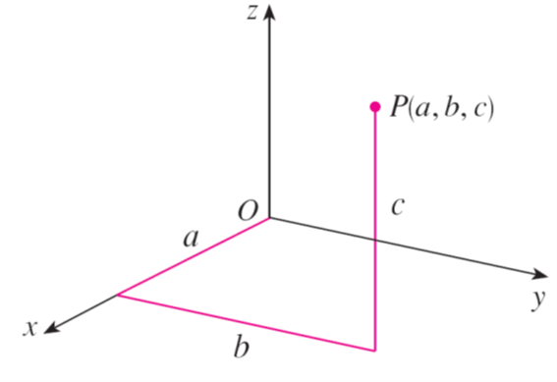
3D Space (8 of 11)
Thus, to locate the point (a, b, c), we can start at the origin O and move a units along the x-axis, then b units parallel to the y-axis, and then c units parallel to the z-axis as in Figure 4.
Figure 4

Slide 12
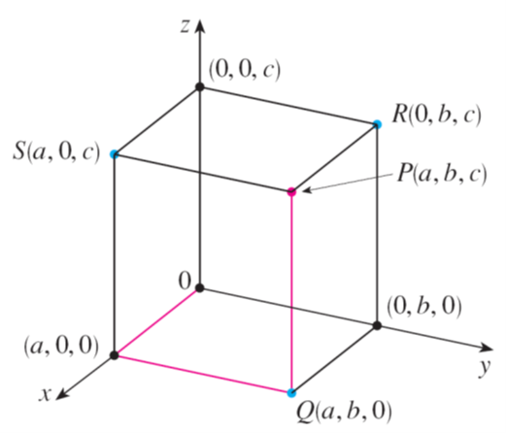
3D Space (9 of 11)
The point P(a, b, c) determines a rectangular box as in Figure 5.
If we drop a perpendicular from P to the xy-plane, we get a point Q with coordinates (a, b, 0) called the projection of P onto the xy-plane.
Similarly, R(0, b, c) and S(a, 0, c) are the projections of P onto the yz-plane and xz-plane, respectively.
Figure 5

Slide 13
3D Space (10 of 11)
As numerical illustrations, the points (−4, 3, −5) and (3, −2, −6) are plotted in Figure 6.
Figure 6

Slide 14
3D Space (11 of 11)
The Cartesian product
is the set of all ordered
triples of real numbers and is denoted by
We have given a one-to-one correspondence between points P in space and
and ordered triples (a, b, c) in
It is called a three-dimensional rectangular
coordinate system.
Notice that, in terms of coordinates, the first octant can be described as the set of points whose coordinates are all positive.

Slide 15
Surfaces

Slide 16
Surfaces (1 of 2)
In two-dimensional analytic geometry, the graph of an equation involving x and
y is a curve in
In three-dimensional analytic geometry, an equation in x, y, and z represents a
surface in

Slide 17
Example 1
What surfaces in
are represented by the following equations?
(a) z = 3
(b) y = 5
Solution:
(a) The equation z = 3 represents the set
which is the set of all
points in
whose z-coordinate is 3. (x and y can each be any value).

Slide 18
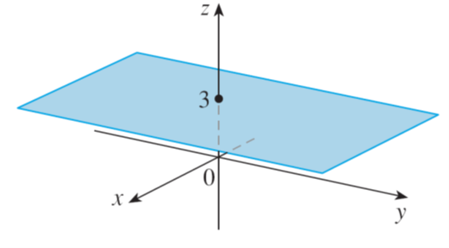
Example 1 – Solution (1 of 2)
This is the horizontal plane that is parallel to the xy–plane and three units above it as in Figure 7(a).
z =3, a plane in
Figure 7(a)

Slide 19
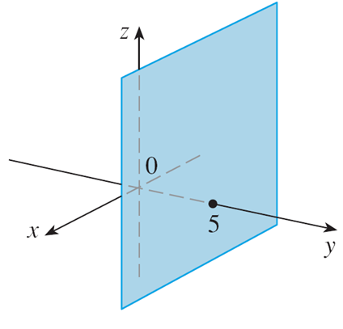
Example 1 – Solution (2 of 2)
(b) The equation y = 5 represents the set of all points in
whose y-coordinate is 5.
This is the vertical plane that is parallel to the xz-plane and five units to the right of it as in Figure 7(b).
y = 5, a plane in
Figure 7(b)

Slide 20

Surfaces (2 of 2)
In general, if k is a constant, then x = k represents a plane parallel to the yz-plane, y = k is a plane parallel to the xz-plane, and z = k is a plane parallel to the xy-plane.
In Figure 5, the faces of the rectangular box are formed by the three coordinate planes x = 0 (the yz-plane), y = 0 (the xz-plane), and z = 0 (the xy-plane), and the planes x = a, y = b, and z = c.
Figure 5

Slide 21
Distance and Spheres

Slide 22
Distance and Spheres (1 of 2)
The familiar formula for the distance between two points in a plane is easily extended to the following three-dimensional formula.
Distance Formula in Three Dimensions The distance
between the points
P₁(x₁, y₁, z₁) and P₂(x₂, y₂, z₂) is

Slide 23
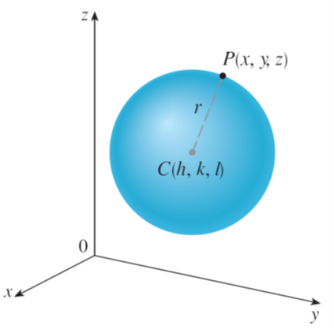
Example 5
Find an equation of a sphere with radius r and center C(h, k, l ).
Solution:
By definition, a sphere is the set of all points P(x, y, z) whose distance from C is r. (See Figure 12.)
Figure 12

Slide 24
Example 5 – Solution
Thus P is on the sphere if and only if
Squaring both sides, we have
or

Slide 25
Distance and Spheres (2 of 2)
The result of Example 5 is worth remembering.
Equation of a Sphere An equation of a sphere with center C(h, k, I) and radius r is
In particular, if the center is the origin O, then an equation of the sphere is

