Slide 1
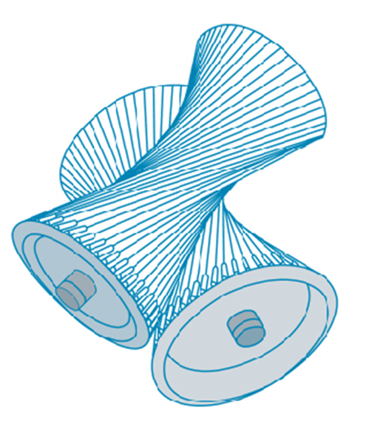
Vectors and the Geometry of Space
Chapter 12

Slide 2
12.2 Vectors

Slide 3
Vectors (1 of 3)
The term vector is used by scientists to indicate a quantity (such as displacement or velocity or force) that has both magnitude and direction.
A vector is often represented by an arrow or a directed line segment. The length of the arrow represents the magnitude of the vector and the arrow points in the direction of the vector.
We denote a vector by printing a letter in boldface (v) or by putting an arrow
above the letter

Slide 4
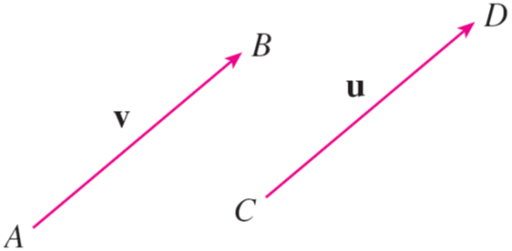
Vectors (2 of 3)
For instance, suppose a particle moves along a line segment from point A to point B.
The corresponding displacement vector v, shown in Figure 1, has initial point A (the tail) and terminal point B (the tip) and we indicate this by writing
Equivalent vectors
Figure 1

Slide 5
Vectors (3 of 3)
Notice that the vector
has the same length and the same direction as v
even though it is in a different position.
We say that u and v are equivalent (or equal) and we write u = v.
The zero vector, denoted by 0, has length 0. It is the only vector with no specific direction.

Slide 6
Combining Vectors

Slide 7
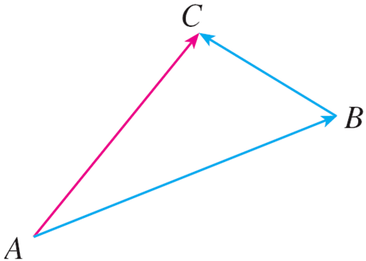
Combining Vectors (1 of 7)
Suppose a particle moves from A to B, so its displacement vector is
Then the particle changes direction and moves from B to C, with displacement
vector
as in Figure 2.
The combined effect of these displacements is that the particle has moved from A to C.
The resulting displacement vector
is called the sum of
and we write
Figure 2

Slide 8
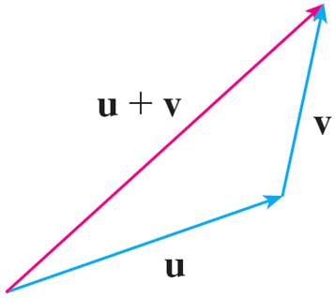
Combining Vectors (2 of 7)
In general, if we start with vectors u and v, we first move v so that its tail coincides with the tip of u and define the sum of u and v as follows.
Definition of Vector Addition If u and v are vectors positioned so the initial point of v is at the terminal point of u, then the sum u + v is the vector from the initial point of u to the terminal point of v.
The definition of vector addition is illustrated in Figure 3. You can see why this definition is sometimes called the Triangle Law.
The Triangle Law
Figure 3

Slide 9
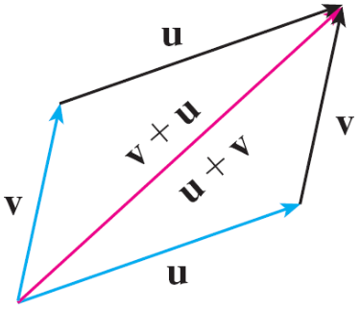
Combining Vectors (3 of 7)
In Figure 4 we start with the same vectors u and v as in Figure 3 and draw another copy of v with the same initial point as u.
Completing the parallelogram, we see that u + v = v + u.
This also gives another way to construct the sum: If we place u and v so they start at the same point, then u + v lies along the diagonal of the parallelogram with u and v as sides. (This is called the Parallelogram Law.)
The Parallelogram Law
Figure 4

Slide 10
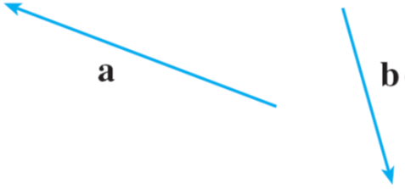
Example 1
Draw the sum of the vectors a and b shown in Figure 5.
Figure 5
Solution:
First we move b and place its tail at the tip of a, being careful to draw a copy of b that has the same length and direction.

Slide 11
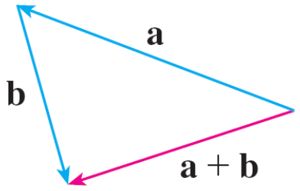
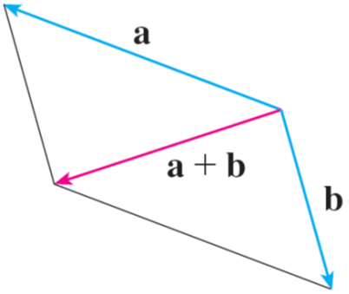
Example 1 – Solution
Then we draw the vector a + b [see Figure 6(a)] starting at the initial point of a and ending at the terminal point of the copy of b.
Figure 6(a)
Alternatively, we could place b so it starts where a starts and construct a + b by the Parallelogram Law as in Figure 6(b).
Figure 6(b)

Slide 12
Combining Vectors (4 of 7)
It is possible to multiply a vector by a real number c. (In this context we call the real number c a scalar to distinguish it from a vector.)
For instance, we want 2v to be the same vector as v + v, which has the same direction as v but is twice as long. In general, we multiply a vector by a scalar as follows.
Definition of Scalar Multiplication If c is a scalar and v is a vector, then the
scalar multiple cv is the vector whose length is
times the length of v and
whose direction is the same as v if c > 0 and is opposite to v if c < 0. If c = 0 or v = 0, then cv = 0.

Slide 13
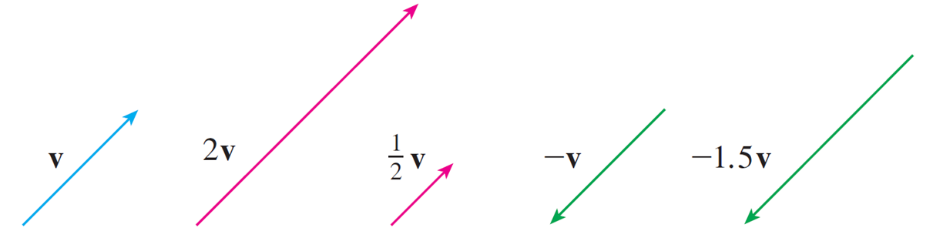
Combining Vectors (5 of 7)
This definition is illustrated in Figure 7.
Scalar multiples of v
Figure 7
We see that real numbers work like scaling factors here; that’s why we call them scalars.

Slide 14
Combining Vectors (6 of 7)
Notice that two nonzero vectors are parallel if they are scalar multiples of one another.
In particular, the vector −v = (−1)v has the same length as v but points in the opposite direction. We call it the negative of v.
By the difference u − v of two vectors we mean
u − v = u + (−v)

Slide 15
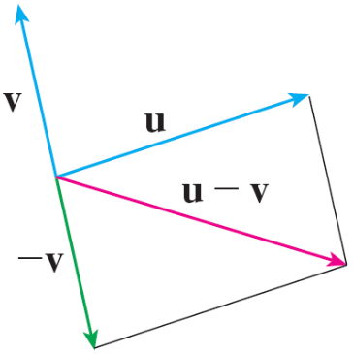
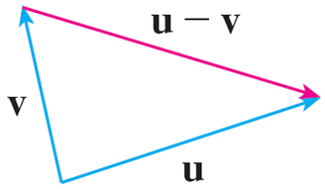
Combining Vectors (7 of 7)
So we can construct u − v by first drawing the negative of v, −v, and then adding it to u by the Parallelogram Law as in Figure 8(a).
Alternatively, since v + (u − v) = u, the vector u − v, when added to v, gives u. So we could construct u − v as in Figure 8(b) by means of the Triangle Law.
(a)
(b)
Figure 8
Drawing u − v

Slide 16
Components

Slide 17
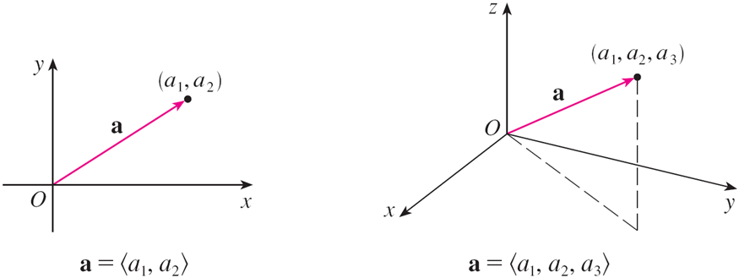
Components (1 of 16)
For some purposes it’s best to introduce a coordinate system and treat vectors algebraically.
If we place the initial point of a vector a at the origin of a rectangular coordinate system, then the terminal point of a has coordinates of the form (a₁, a₂) or (a₁, a₂, a₃), depending on whether our coordinate system is two- or three-dimensional (see Figure 11).
Figure 11

Slide 18
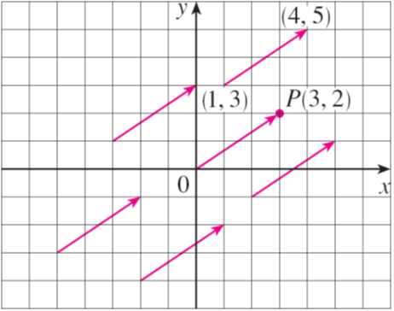
Components (2 of 16)
These coordinates are called the components of a and we write
We use the notation
for the ordered pair that refers to a vector so as
not to confuse it with the ordered pair (a₁, a₂) that refers to a point in the plane.
For instance, the vectors shown in Figure 12 are all equivalent to the vector
whose terminal point is P(3, 2).
Figure 12

Slide 19
Components (3 of 16)
What they have in common is that the terminal point is reached from the initial point by a displacement of three units to the right and two upward.
We can think of all these geometric vectors as representations of the
algebraic vector
The particular representation
from the origin to the point P(3, 2) is called
the position vector of the point P.

Slide 20
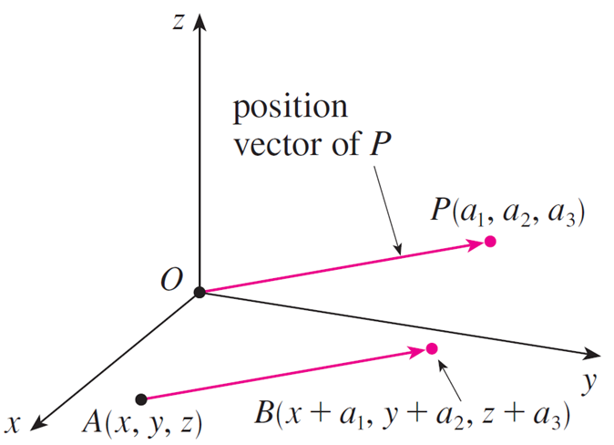
Components (4 of 16)
In three dimensions, the vector
is the position vector of the
point P(a₁, a₂, a₃). (See Figure 13.)
Figure 13

Slide 21
Components (5 of 16)
Let’s consider any other representation
of a, where the initial point is
A(x₁, y₁, z₁) and the terminal point is B(x₂, y₂, z₂).
Then we must have x₁ + a₁ = x₂, y₁ + a₂ = y₂, and z₁ + a₃ = z₂ and so a₁ = x₂ − x₁, a₂ = y₂ − y₁, and a₃ = z₂ − z₁.
Thus we have the following result.
1 Given the points A(x₁, y₁, z₁) and B(x₂, y₂, z₂), the vector a with representation

Slide 22
Example 3
Find the vector represented by the directed line segment with initial point A(2, −3, 4) and terminal point B(−2, 1, 1).
Solution:
By (1), the vector corresponding to

Slide 23
Components (6 of 16)
The magnitude or length of the vector v is the length of any of its
representations and is denoted by the symbol
By using the distance
formula to compute the length of a segment O P, we obtain the following formulas.
The length of the two-dimensional vector
The length of the three-dimensional vector

Slide 24
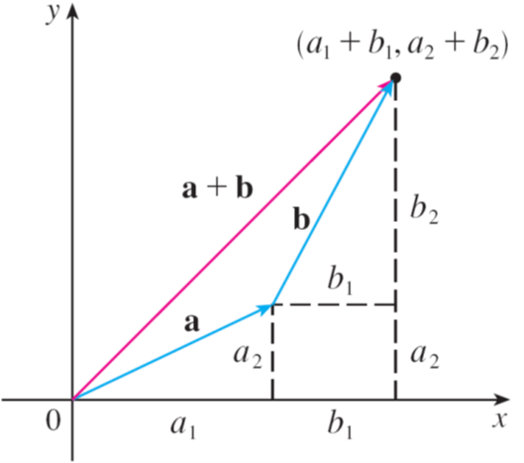
Components (7 of 16)
How do we add vectors algebraically? Figure 14 shows that if
then the sum is
at least for the
case where the components are positive.
In other words, to add algebraic vectors we add corresponding components. Similarly, to subtract vectors we subtract corresponding components.
Figure 14

Slide 25
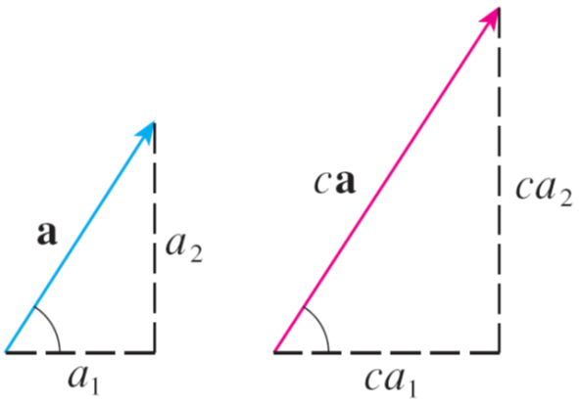
Components (8 of 16)
From the similar triangles in Figure 15 we see that the components of ca are ca₁ and ca₂.
So to multiply a vector by a scalar we multiply each component by that scalar.
Figure 15

Slide 26
Components (9 of 16)
If
Similarly, for three-dimensional vectors,

Slide 27
Components (10 of 16)
We denote by V₂ the set of all two-dimensional vectors and by V₃ the set of all three-dimensional vectors.
More generally, we will consider the set V_{n} of all n-dimensional vectors.
An n-dimensional vector is an ordered n-tuple:
where a₁, a₂, . . . , a_{n} are real numbers that are called the components of a.

Slide 28
Components (11 of 16)
Addition and scalar multiplication are defined in terms of components just as for the cases n = 2 and n = 3.
Properties of Vectors If a, b, and c are vectors in V_{n} and c and d are scalars, then
a + b = b + a
a + (b + c) = (a + b) + c
a + 0 = a
a + (−a) = 0
c(a + b) = ca + cb
(c + d)a = ca + da
(cd)a = c(da)
1a = a

Slide 29
Components (12 of 16)
Three vectors in V₃ play a special role. Let
These vectors i, j, and k are called the standard basis vectors.
They have length 1 and point in the directions of the positive x-, y-, and z-axes.

Slide 30
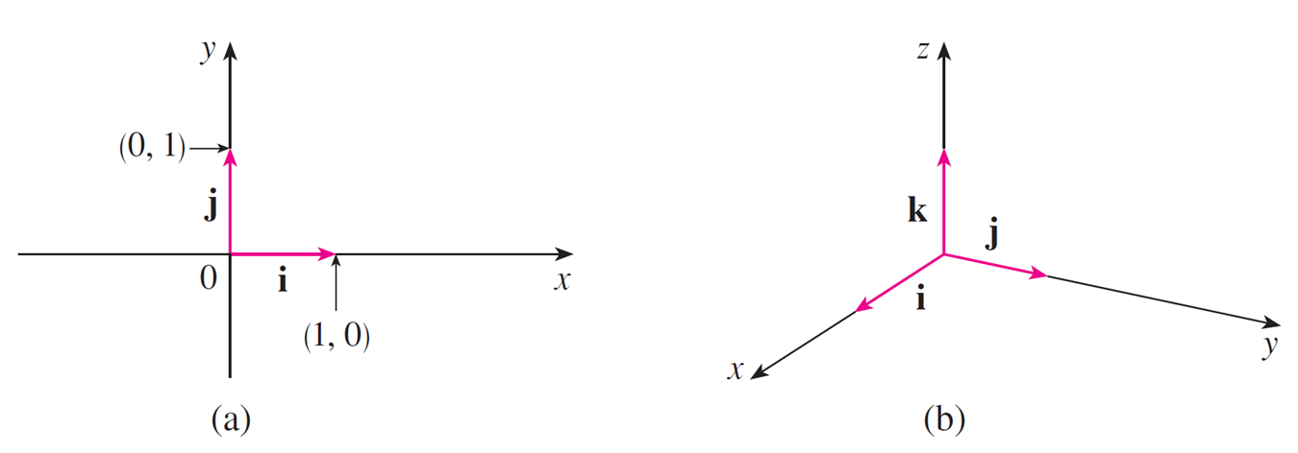
Components (13 of 16)
Similarly, in two dimensions we define
(See Figure 17.)
Standard basis vectors in V₂ and V₃
Figure 17

Slide 31
Components (14 of 16)
If
then we can write
Thus any vector in V₃ can be expressed in terms of i, j, and k. For instance,
Similarly, in two dimensions, we can write

Slide 32
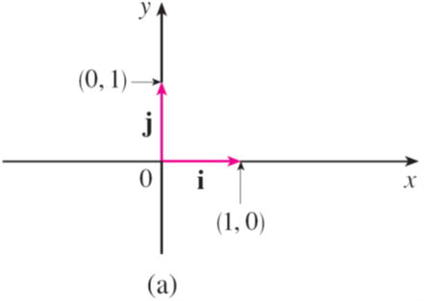
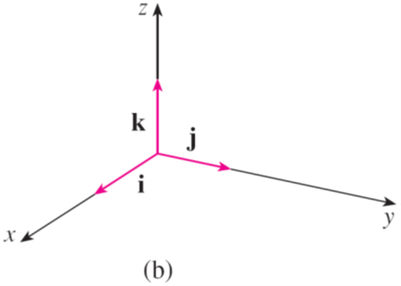
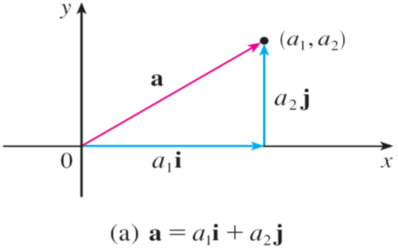
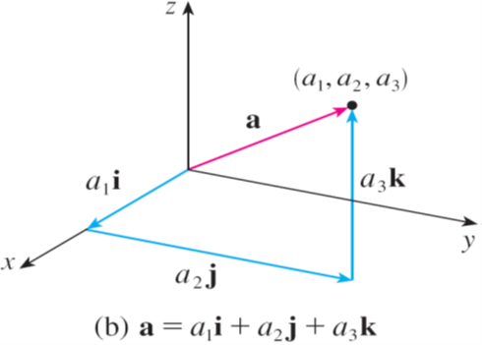
Components (15 of 16)
See Figure 18 for the geometric interpretation of Equations 3 and 2 and compare with Figure 17.
Standard basis vectors in V₂ and V₃
Figure 17
Figure 18

Slide 33
Components (16 of 16)
A unit vector is a vector whose length is 1. For instance, i, j, and k are all unit vectors. In general, if a ≠ 0, then the unit vector that has the same direction as a is
In order to verify this, we let
Then u = ca and c is a positive scalar,
so u has the same direction as a. Also

Slide 34
Applications

Slide 35
Applications
Vectors are useful in many aspects of physics and engineering. Here we look at forces.
A force is represented by a vector because it has both a magnitude (measured in pounds or newtons) and a direction.
If several forces are acting on an object, the resultant force experienced by the object is the vector sum of these forces.

Slide 36
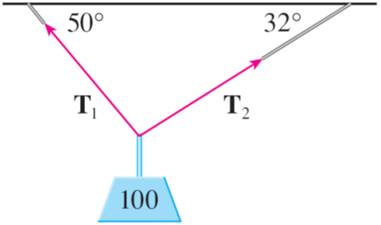
Example 7
A 100-lb weight hangs from two wires as shown in Figure 19. Find the tensions (forces) T₁ and T₂ in both wires and the magnitudes of the tensions.
Figure 19

Slide 37
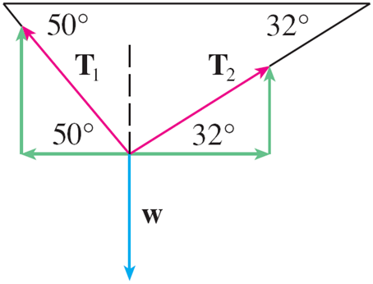
Example 7 – Solution (1 of 4)
We first express T₁ and T₂ in terms of their horizontal and vertical components. From Figure 20 we see that
Figure 20
The resultant T₁ + T₂ of the tensions counterbalances the weight w = −100 j and so we must have
T₁ + T₂ = −w = 100 j

Slide 38
Example 7 – Solution (2 of 4)
Thus
Equating components, we get

Slide 39
Example 7 – Solution (3 of 4)
Solving the first of these equations for
and substituting into the second, we get
So the magnitudes of the tensions are
and

Slide 40
Example 7 – Solution (4 of 4)
Substituting these values in (5) and (6), we obtain the tension vectors

