Slide 1
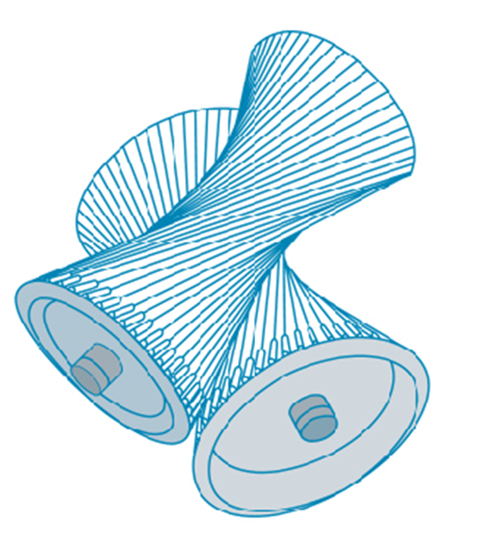
Vectors and the Geometry of Space
Chapter 12

Slide 2
12.3 The Dot Product

Slide 3
The Dot Product (1 of 10)
So far we have added two vectors and multiplied a vector by a scalar. The question arises: Is it possible to multiply two vectors so that their product is a useful quantity? One such product is the dot product, whose definition follows.
1 Definition If
then the dot product of a
and b is the number a • b given by
Thus, to find the dot product of a and b, we multiply corresponding components and add.

Slide 4
The Dot Product (2 of 10)
The result is not a vector. It is a real number, that is, a scalar. For this reason, the dot product is sometimes called the scalar product (or inner product).
Although Definition 1 is given for three-dimensional vectors, the dot product of two-dimensional vectors is defined in a similar fashion:

Slide 5
Example 1

Slide 6
The Dot Product (3 of 10)
The dot product obeys many of the laws that hold for ordinary products of real numbers. These are stated in the following theorem.
2 Properties of the Dot Product If a, b, and c are vectors in V, and c is a scalar, then

Slide 7
The Dot Product (4 of 10)
These properties are easily proved using Definition 1. For instance, here are the proofs of Properties 1 and 3:

Slide 8
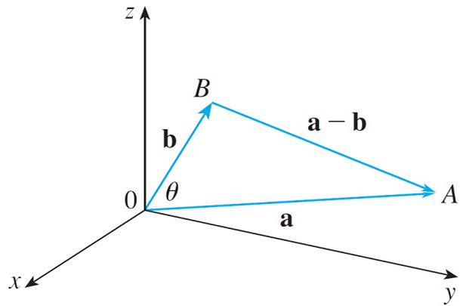
The Dot Product (5 of 10)
The dot product a  b can be given a geometric interpretation in terms of the angle θ between a and b, which is defined to be the angle between the representations of a and b that start at the origin, where 0 ≤ θ ≤ π.
In other words, θ is the angle between
the line segments
in Figure 1. Note that if a and b are parallel vectors, then θ = 0 or θ = π.
Figure 1

Slide 9
The Dot Product (6 of 10)
The formula in the following theorem is used by physicists as the definition of the dot product.
3 Theorem If θ is the angle between the vectors a and b. then

Slide 10
Example 2
If the vectors a and b have lengths 4 and 6, and the angle between them is
Solution:
Using Theorem 3, we have

Slide 11
The Dot Product (7 of 10)
The formula in Theorem 3 also enables us to find the angle between two vectors.
6 Corollary If θ is the angle between the nonzero vectors a and b, then

Slide 12
Example 3
Find the angle between the vectors
Solution:
Since
and since

Slide 13
Example 3 – Solution
We have, from Corollary 6,
So the angle between a and b is

Slide 14
The Dot Product (8 of 10)
Two nonzero vectors a and b are called perpendicular or orthogonal if the
angle between them is
Then Theorem 3 gives
and conversely if a  b = 0, then cos θ = 0, so
The zero vector 0 is
considered to be perpendicular to all vectors.
Therefore we have the following method for determining whether two vectors are orthogonal.
7 Two vectors a and b are orthogonal if and only if

Slide 15
Example 4
Show that 2i + 2j – k is perpendicular to 5i – 4j + 2k.
Solution:
Since
these vectors are perpendicular by (7).

Slide 16
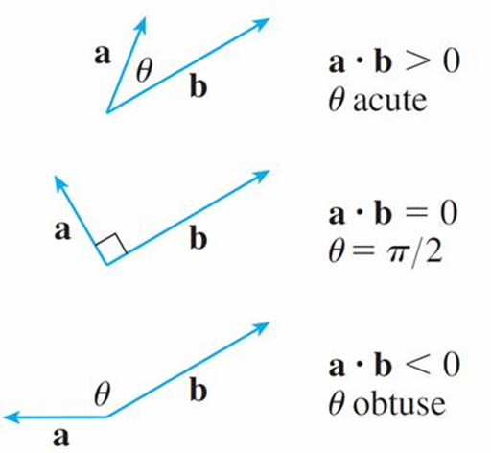
The Dot Product (9 of 10)
Because cos θ > 0 if
and cos
we see that a  b is positive for
and negative for
We can think of a  b as measuring the extent to
which a and b point in the same direction.
The dot product a  b is positive if a and b point in the same general direction, 0 if they are perpendicular, and negative if they point in generally opposite directions (see Figure 2).
Figure 2

Slide 17
The Dot Product (10 of 10)
In the extreme case where a and b point in exactly the same direction, we have θ = 0, so cos θ = 1 and
If a and b point in exactly opposite directions, then we have θ = π and so cos θ
= –1 and

Slide 18
Direction Angles and Direction Cosines

Slide 19
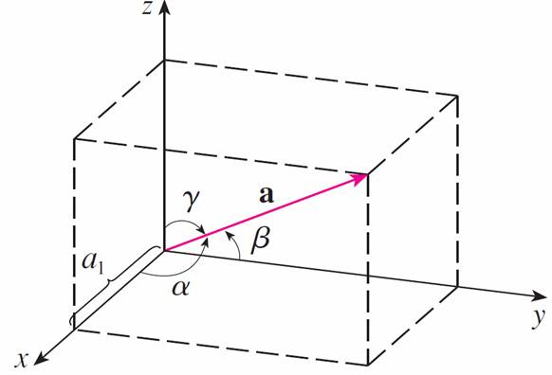
Direction Angles and Direction Cosines (1 of 4)
The direction angles of a nonzero vector a are the angles α, β, and γ (in the interval [0, π]) that a makes with the positive x-, y-, and z-axes, respectively. (See Figure 3.)
Figure 3

Slide 20
Direction Angles and Direction Cosines (2 of 4)
The cosines of these direction angles, cos α, cos β, and cos γ, are called the direction cosines of the vector a. Using Corollary 6 with b replaced by i, we obtain
(This can also be seen directly from Figure 3.) Similarly, we also have

Slide 21
Direction Angles and Direction Cosines (3 of 4)
By squaring the expressions in Equations 8 and 9 and adding, we see that
We can also use Equations 8 and 9 to write

Slide 22
Direction Angles and Direction Cosines (4 of 4)
Therefore
which says that the direction cosines of a are the components of the unit vector in the direction of a.

Slide 23
Example 5
Find the direction angles of the vector
Solution:
Since
Equations 8 and 9 give
and so

Slide 24
Projections

Slide 25
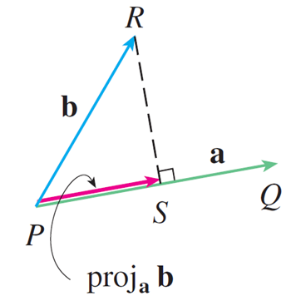
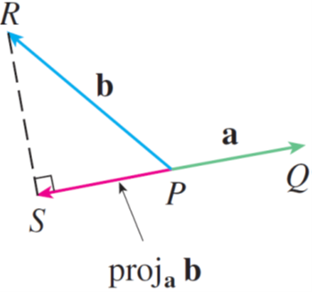
Projections (1 of 6)
Figure 4 shows representations
of two vectors a and b with the same
initial point P. If S is the foot of the perpendicular from R to the line containing
then the vector with representation
is called the vector projection of b
onto a and is denoted by proj_{a} b. (You can think of it as a shadow of b).
Vector projections
Figure 4

Slide 26
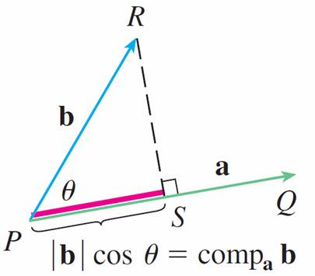
Projections (2 of 6)
The scalar projection of b onto a (also called the component of b along a) is defined to be the signed magnitude of the vector projection, which is the
number
where θ is the angle between a and b. (See Figure 5.)
Scalar projection
Figure 5

Slide 27
Projections (3 of 6)
This is denoted by comp_{a} b. Observe that it is negative if
The equation
shows that the dot product of a and b can be interpreted as the length of a times the scalar projection of b onto a. Since
the component of b along a can be computed by taking the dot product of b with the unit vector in the direction of a.

Slide 28
Projections (4 of 6)
We summarize these ideas as follows.
Scalar projection of b onto a:
Vector projection of b onto a:
Notice that the vector projection is the scalar projection times the unit vector in the direction of a.

Slide 29
Example 6
Find the scalar projection and vector projection of
Solution:
Since
the scalar projection of b onto a is

Slide 30
Example 6 – Solution
The vector projection is this scalar projection times the unit vector in the direction of a:

Slide 31
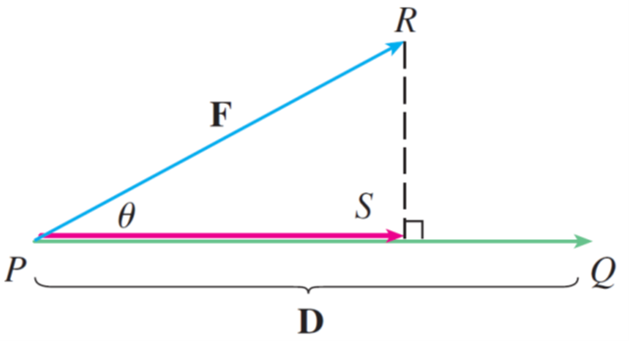
Projections (5 of 6)
The work done by a constant force F in moving an object through a distance d as W = Fd, but this applies only when the force is directed along the line of motion of the object. Suppose, however, that the constant force is a vector
pointing in some other direction, as in Figure 6.
Figure 6

Slide 32
Projections (6 of 6)
If the force moves the object from P to Q, then the displacement vector is
The work done by this force is defined to be the product of the
component of the force along D and the distance moved:
But then, from Theorem 3, we have
Thus the work done by a constant force F is the dot product F  D, where D is the displacement vector.

Slide 33
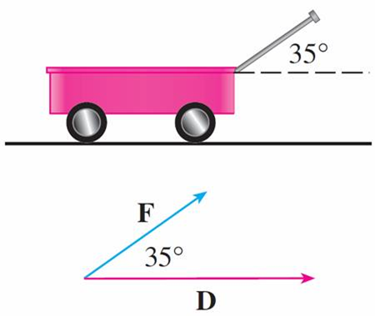
Example 7
A wagon is pulled a distance of 100 m along a horizontal path by a constant force of 70 N. The handle of the wagon is held at an angle of 35° above the horizontal. Find the work done by the force.
Solution: If F and D are the force and displacement vectors, as pictured in Figure 7, then the work done is
Figure 7

Slide 34
Example 7 – Solution

