Slide 1
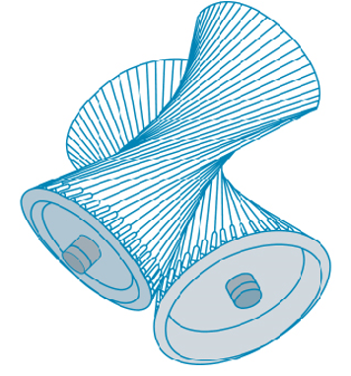
Vectors and the Geometry of Space
Chapter 12

Slide 2
12.4 The Cross Product

Slide 3
The Cross Product (1 of 19)
Given two nonzero vectors
it is very useful
to be able to find a nonzero vector c that is perpendicular to both a and b.
If
is such a vector, then

Slide 4
The Cross Product (2 of 19)
To eliminate c₃ we multiply (1) by b₃ and (2) by a₃ and subtract:
Equation 3 has the form pc₁ + qc₂ = 0, for which an obvious solution is c₁ = q and c₂ = −p. So a solution of (3) is

Slide 5
The Cross Product (3 of 19)
Substituting these values into (1) and (2), we then get
c₃ = a₁b₂ − a₂b₁
This means that a vector perpendicular to both a and b is
The resulting vector is called the cross product of a and b and is denoted by a × b.

Slide 6
The Cross Product (4 of 19)
4 Definition If
then the cross product of a
and b is the vector
Notice that the cross product a × b of two vectors a and b, unlike the dot product, is a vector. For this reason it is also called the vector product.
Note that a × b is defined only when a and b are three-dimensional vectors.

Slide 7
The Cross Product (5 of 19)
In order to make Definition 4 easier to remember, we use the notation of determinants.
A determinant of order 2 is defined by
For example,

Slide 8
The Cross Product (6 of 19)
A determinant of order 3 can be defined in terms of second-order determinants as follows:
Observe that each term on the right side of Equation 5 involves a number a_{i} in the first row of the determinant, and a_{i} is multiplied by the second-order determinant obtained from the left side by deleting the row and column in which a_{i} appears.

Slide 9
The Cross Product (7 of 19)
Notice also the minus sign in the second term. For example,

Slide 10
The Cross Product (8 of 19)
If we now rewrite Definition 4 using second-order determinants and the standard basis vectors i, j, and k, we see that the cross product of the vectors a = a₁ i + a₂ j + a₃ k and b = b₁ i + b₂ j + b₃ k is

Slide 11
The Cross Product (9 of 19)
In view of the similarity between Equations 5 and 6, we often write
Although the first row of the symbolic determinant in Equation 7 consists of vectors, if we expand it as if it were an ordinary determinant using the rule in Equation 5, we obtain Equation 6.
The symbolic formula in Equation 7 is probably the easiest way of remembering and computing cross products.

Slide 12
Example 1
If

Slide 13
The Cross Product (10 of 19)
We constructed the cross product a × b so that it would be perpendicular to both a and b. This is one of the most important properties of a cross product.
8 Theorem The vector a × b is orthogonal to both a and b.

Slide 14
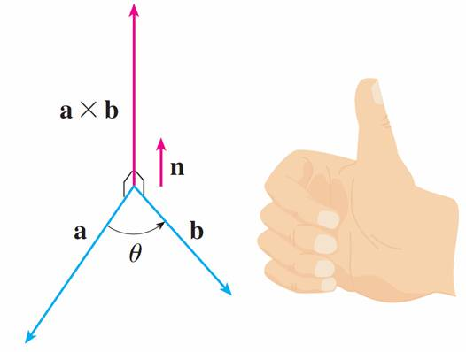
The Cross Product (11 of 19)
If a and b are represented by directed line segments with the same initial point (as in Figure 1), then Theorem 8 says that the cross product a × b points in a direction perpendicular to the plane through a and b.
The right-hand rule gives the direction of a × b.
Figure 1

Slide 15
The Cross Product (12 of 19)
It turns out that the direction of a × b is given by the right-hand rule: If the fingers of your right hand curl in the direction of a rotation (through an angle less than 180°) from to a to b, then your thumb points in the direction of a × b.
Now that we know the direction of the vector a × b, the remaining thing we
need to complete its geometric description is its length
This is given by
following theorem.
9 Theorem If θ is the angle between a and b (so 0 ≤ θ ≤ π), then

Slide 16
The Cross Product (13 of 19)
Since a vector is completely determined by its magnitude and direction, we can now say that a × b is the vector that is perpendicular to both a and b, whose
orientation is determined by the right-hand rule, and whose length is
In fact, that is exactly how physicists define a × b.
10 Corollary Two nonzero vectors a and b are parallel if and only if

Slide 17
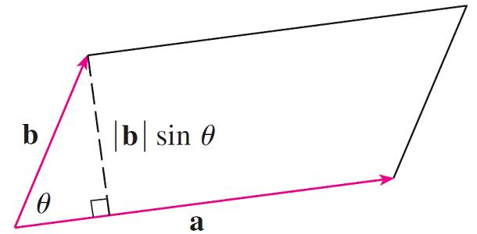
The Cross Product (14 of 19)
The geometric interpretation of Theorem 9 can be seen by looking at Figure 2.
Figure 2

Slide 18
The Cross Product (15 of 19)
If a and b are represented by directed line segments with the same initial point,
then they determine a parallelogram with base
and area
Thus we have the following way of interpreting the magnitude of a cross product.
The length of the cross product a × b is equal to the area of the parallelogram determined by a and b.

Slide 19
Example 4
Find the area of the triangle with vertices P (1, 4, 6), Q (−2, 5, −1), and R (1, −1, 1).
Solution:
We computed that
The area of the parallelogram with
adjacent sides PQ and PR is the length of this cross product:
The area A of the triangle PQR is half the area of this parallelogram, that is,

Slide 20
The Cross Product (16 of 19)
If we apply Theorems 8 and 9 to the standard basis vectors i, j, and k using
we obtain
Observe that
i × j ≠ j × i

Slide 21
The Cross Product (17 of 19)
Thus the cross product is not commutative. Also
i × (i × j) = i × k = −j
whereas
(i × i) × j = 0 × j = 0
So the associative law for multiplication does not usually hold; that is, in general,
(a × b) × c ≠ a × (b × c)
However, some of the usual laws of algebra do hold for cross products.

Slide 22
The Cross Product (18 of 19)
The following theorem summarizes the properties of vector products.
11 Properties of the Cross Product If a, b, and c are vectors and c is a scalar, then
1. a × b = −b × a
2. (c a) × b = c(a × b) = a × (c b)
3. a × (b + c) = a × b + a × c
4. (a + b) × c = a × c + b × c
5. a ∙ (b × c) = (a × b) · c
6. a × (b × c) = (a · c)b − (a · b)c

Slide 23
The Cross Product (19 of 19)
These properties can be proved by writing the vectors in terms of their components and using the definition of a cross product.

Slide 24
Triple Products

Slide 25
Triple Products (1 of 5)
The product a · (b × c) that occurs in Property 5 is called the scalar triple product of the vectors a, b, and c. Notice from Equation 12 that we can write the scalar triple product as a determinant:

Slide 26
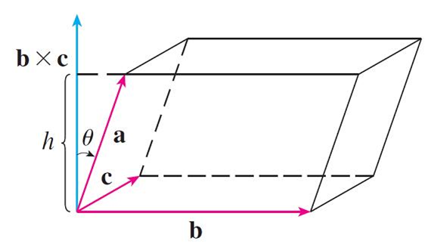
Triple Products (2 of 5)
The geometric significance of the scalar triple product can be seen by considering the parallelepiped determined by the vectors a, b, and c. (See Figure 3.)
Figure 3
The area of the base parallelogram is

Slide 27
Triple Products (3 of 5)
If θ is the angle between a and b × c, then the height h of the parallelepiped is
(We must use
instead of cos θ in case
) Therefore the
volume of the parallelepiped is
Thus we have proved the following formula.
14 The volume of the parallelepiped determined by the vectors a, b, and c is the magnitude of their scalar triple product:

Slide 28
Triple Products (4 of 5)
If we use the formula in (14) and discover that the volume of the parallelepiped determined by a, b, and c is 0, then the vectors must lie in the same plane; that is, they are coplanar.

Slide 29
Example 5
Use the scalar triple product to show that the vectors
are coplanar.
Solution:
We use Equation 13 to compute their scalar triple product:

Slide 30
Example 5 – Solution
Therefore, by (14), the volume of the parallelepiped determined by a, b, and c is 0. This means that a, b, and c are coplanar.

Slide 31
Triple Products (5 of 5)
The product a × (b × c) that occurs in Property 6 is called the vector triple product of a, b, and c.

Slide 32
Torque

Slide 33
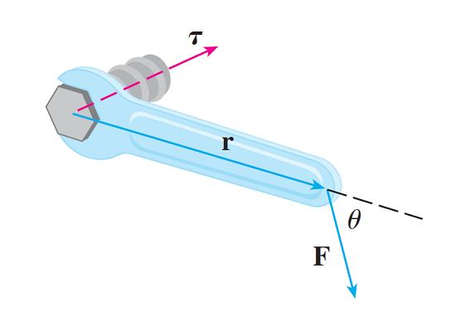
Torque (1 of 3)
The idea of a cross product occurs often in physics. In particular, we consider a force F acting on a rigid body at a point given by a position vector r. (For instance, if we tighten a bolt by applying a force to a wrench as in Figure 4, we produce a turning effect.)
Figure 4

Slide 34
Torque (2 of 3)
The torque
(relative to the origin) is defined to be the cross product of the
position and force vectors
and measures the tendency of the body to rotate about the origin. The direction of the torque vector indicates the axis of rotation.

Slide 35
Torque (3 of 3)
According to Theorem 9, the magnitude of the torque vector is
where θ is the angle between the position and force vectors. Observe that the only component of F that can cause a rotation is the one perpendicular to r,
that is,
The magnitude of the torque is equal to the area of the parallelogram determined by r and F.

Slide 36
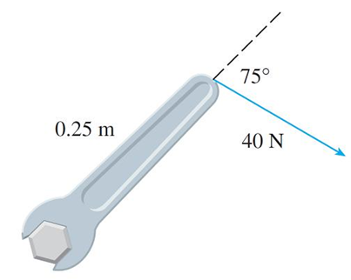
Example 6
A bolt is tightened by applying a 40-N force to a 0.25-m wrench as shown in Figure 5.
Figure 5
Find the magnitude of the torque about the center of the bolt.

Slide 37
Example 6 – Solution
The magnitude of the torque vector is
If the bolt is right-threaded, then the torque vector itself is
where n is a unit vector directed down into the page.

