Slide 1
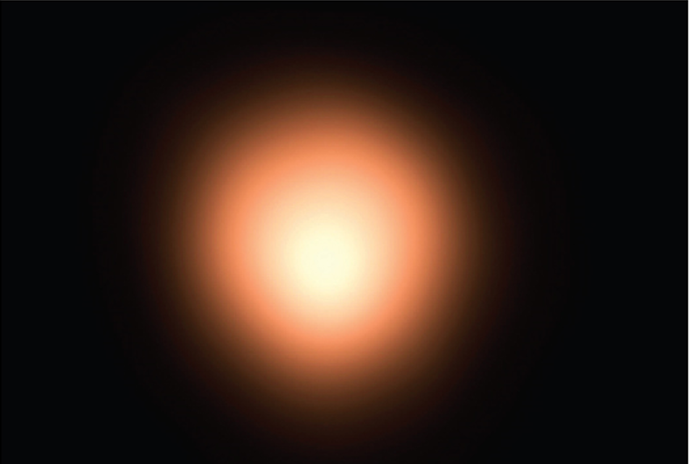
Infinite Sequences and Series
Chapter 11

Slide 2
11.8 Power Series

Slide 3
Power Series (1 of 12)
A power series is a series of the form
where x is a variable and the c_{n}’s are constants called the coefficients of the series.
For each fixed x, the series (1) is a series of constants that we can test for convergence or divergence.
A power series may converge for some values of x and diverge for other values of x.

Slide 4
Power Series (2 of 12)
The sum of the series is a function
whose domain is the set of all x for which the series converges. Notice that f resembles a polynomial. The only difference is that f has infinitely many terms.
For instance, if we take c_{n} = 1 for all n, the power series becomes the geometric series
which converges when −1 < x < 1 and diverges when

Slide 5
Power Series (3 of 12)
In fact if we put
in the geometric series (2) we get the convergent series
but if we put x = 2 in (2) we get the divergent series

Slide 6
Power Series (4 of 12)
More generally, a series of the form
is called a power series in (x − a) or a power series centered at a or a power series about a.
Notice that in writing out the term corresponding to n = 0 in Equations 1 and 3
we have adopted the convention that
even when x = a.
Notice also that when x = a, all of the terms are 0 for n ≥ 1 and so the power series (3) always converges when x = a.

Slide 7
Example 1
For what values of x is the series
convergent?
Solution:
We use the Ratio Test. If we let a_{n}, as usual, denote the nth term of the series,
then
If x ≠ 0, we have
By the Ratio Test, the series diverges when x ≠ 0. Thus the given series converges only when x = 0.

Slide 8
Power Series (5 of 12)
We will see that the main use of a power series is that it provides a way to represent some of the most important functions that arise in mathematics, physics, and chemistry.
In particular, the sum of the power series,
is called a
Bessel function.
We know that the sum of a series is equal to the limit of the sequence of partial sums. So when we define the Bessel function as the sum of a series we mean
that, for every real number x,

Slide 9
Power Series (6 of 12)
The first few partial sums are

Slide 10
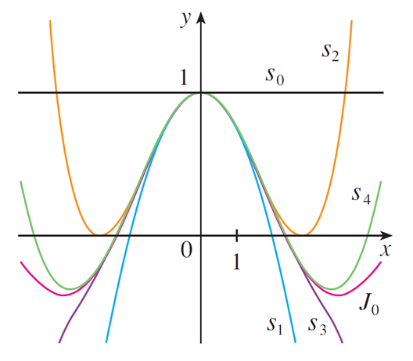
Power Series (7 of 12)
Figure 1 shows the graphs of these partial sums, which are polynomials. They are all approximations to the function J₀, but notice that the approximations become better when more terms are included.
Partial sums of the Bessel function J₀
Figure 1

Slide 11
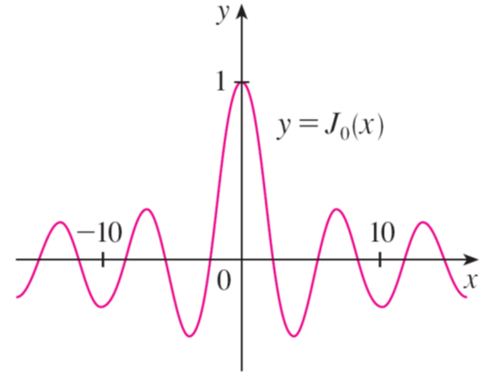
Power Series (8 of 12)
Figure 2 shows a more complete graph of the Bessel function.
Figure 2
For the power series that we have looked at so far, the set of values of x for which the series is convergent has always turned out to be an interval.

Slide 12
Power Series (9 of 12)
The following theorem says that this is true in general.
4 Theorem For a given power series
there are only three possibilities:
The series converges only when x = a.
The series converges for all x.
There is a positive number R such that the series converges if
and diverges if
The number R in case (iii) is called the radius of convergence of the power series. By convention, the radius of convergence is R = 0 in case (i) and R = ∞ in case (ii).

Slide 13
Power Series (10 of 12)
The interval of convergence of a power series is the interval that consists of all values of x for which the series converges.
In case (i) the interval consists of just a single point a.
In case (ii) the interval is (−∞, ∞).
In case (iii) note that the inequality
can be rewritten as a − R < x
< a + R.

Slide 14
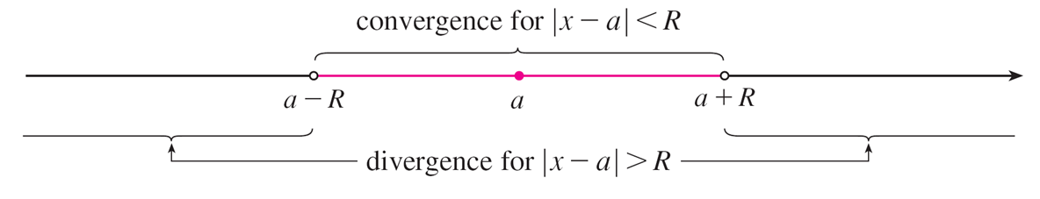
Power Series (11 of 12)
When x is an endpoint of the interval, that is, x = a ± R, anything can happen—the series might converge at one or both endpoints or it might diverge at both endpoints.
Thus in case (iii) there are four possibilities for the interval of convergence:
The situation is illustrated in Figure 3.
Figure 3

Slide 15
Power Series (12 of 12)
We summarize here the radius and interval of convergence for each of the examples already considered in this section.
blank | Series | Radius of convergence | Interval of convergence
Geometric series | sum_(n = 0)^infinity(x^n) | R = 1 | (−1, 1)
Example 1 | sum_(n = 0)^infinity(n!)(x^n) | R = 0 | {0}
Example 2 | sum_(n = 0)^infinity(((x minus 3)^n)/n) | R = 1 | [2, 4)
Example 3 | sum_(n = 0)^infinity((negative 1)^n(x^2n)/((2^2n)(n!)^2)) | R = ∞ | (−∞, ∞)

