Slide 1
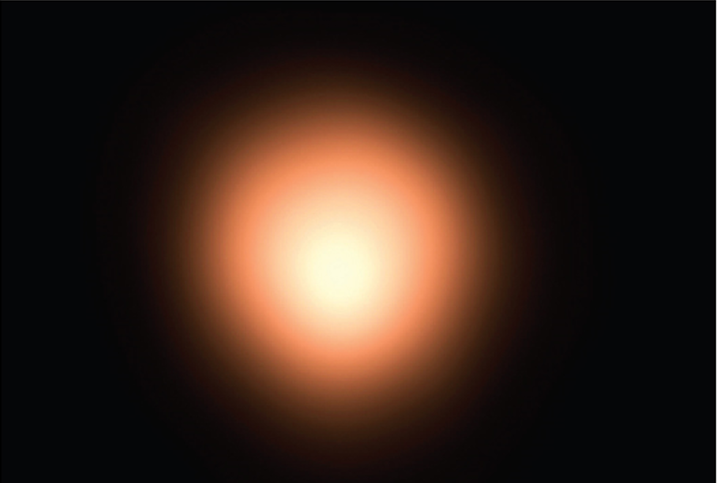
Infinite Sequences and Series
Chapter 11

Slide 2
11.9 Representations of Functions as Power Series

Slide 3
Representations of Functions as Power Series (1 of 2)
We start with an equation that we have seen before:
We have obtained it by observing that the series is a geometric series with a = 1 and r = x.
But here our point of view is different. We now regard Equation 1 as expressing
the function
as a sum of a power series.

Slide 4
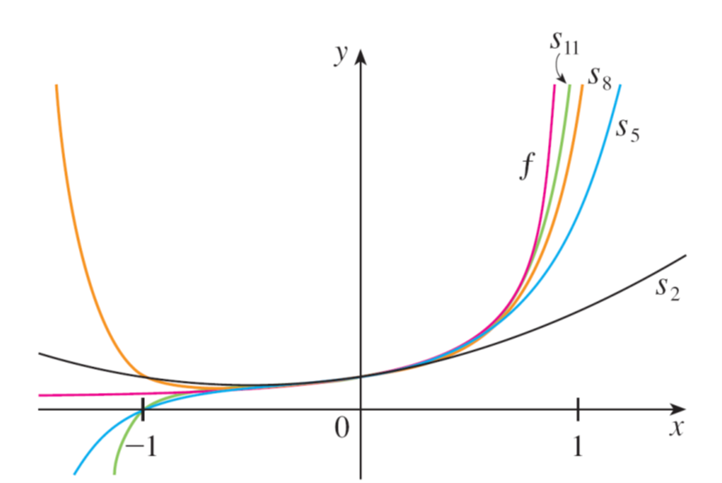
Representations of Functions as Power Series (2 of 2)
Figure 1

Slide 5
Example 1
Express
as the sum of a power series and find the interval of convergence.
Solution:
Replacing x by
in Equation 1, we have

Slide 6
Example 1 – Solution
Because this is a geometric series, it converges when
that is,
or
Therefore the interval of convergence is (−1, 1). (Of course, we could have determined the radius of convergence by applying the Ratio Test, but that much work is unnecessary here.)

Slide 7
Differentiation and Integration of Power Series

Slide 8
Differentiation and Integration of Power Series (1 of 2)
The sum of a power series is a function
whose domain
is the interval of convergence of the series.
We would like to be able to differentiate and integrate such functions, and the following theorem says that we can do so by differentiating or integrating each individual term in the series, just as we would for a polynomial.
This is called term-by-term differentiation and integration.

Slide 9
Differentiation and Integration of Power Series (2 of 2)
2 Theorem If the power series
has radius of convergence R > 0,
then the function f defined by
is differentiable (and therefore continuous) on the interval (a − R, a + R) and
(i)
(ii)
The radii of convergence of the power series in Equations (i) and (ii) are both R.

Slide 10
Example 4
We have seen the Bessel function
is defined for all x.
Thus, by Theorem 2, J₀ is differentiable for all x and its derivative is found by term-by-term differentiation as follows:

