Slide 1
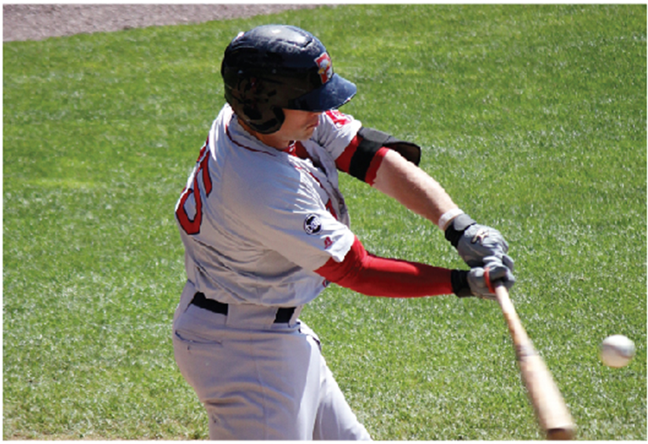
Applications of Integration
Chapter 5

Slide 2
5.3 Volumes by Cylindrical Shells

Slide 3
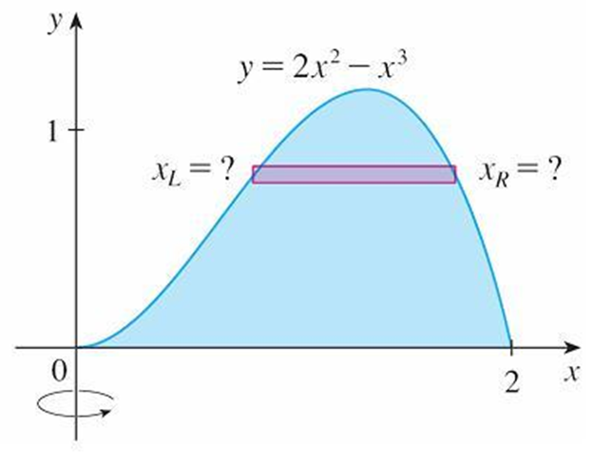
Volumes by Cylindrical Shells (1 of 9)
Let’s consider the problem of finding the volume of the solid obtained by
rotating about the y-axis the region bounded by
(See Figure 1.)
Figure 1
If we slice perpendicular to the y-axis, we get a washer.

Slide 4
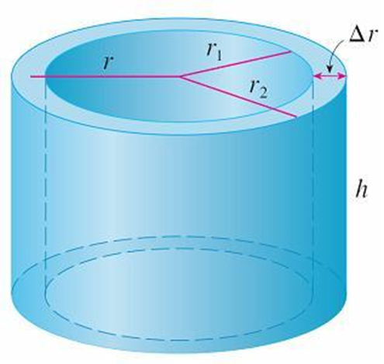
Volumes by Cylindrical Shells (2 of 9)
But to compute the inner radius and the outer radius of the washer, we’d have
to solve the cubic equation
for x in terms of y; that’s not easy.
Fortunately, there is a method, called the method of cylindrical shells, that is easier to use in such a case.
Figure 2 shows a cylindrical shell with inner radius r₁, outer radius r₂, and height h.
Figure 2

Slide 5
Volumes by Cylindrical Shells (3 of 9)
Its volume V is calculated by subtracting the volume V₁ of the inner cylinder from the volume V₂ of the outer cylinder:

Slide 6
Volumes by Cylindrical Shells (4 of 9)
If we let Δr = r₂ – r₁ (the thickness of the shell) and
(the average
radius of the shell), then this formula for the volume of a cylindrical shell becomes
and it can be remembered as
V = [circumference] [height] [thickness]

Slide 7
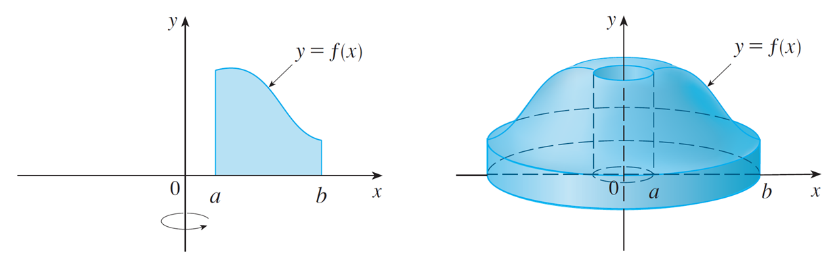
Volumes by Cylindrical Shells (5 of 9)
Now let S be the solid obtained by rotating about the y-axis the region bounded by y = f(x) [where f(x) ≥ 0], y = 0, x = a, and x = b, where b > a ≥ 0. (See Figure 3.)
Figure 3
We divide the interval [a, b] into n subintervals [x_{i} – ₁, x_{i}] of equal width Δx and let
be the midpoint of the ith subinterval.

Slide 8
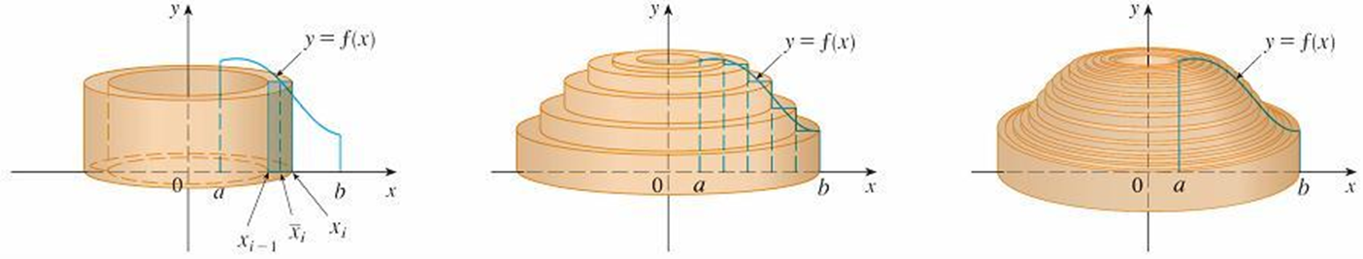
Volumes by Cylindrical Shells (6 of 9)
If the rectangle with base [x_{i} ₋ ₁, x_{i}] and height
is rotated about the y-axis,
then the result is a cylindrical shell with average radius
and thickness Δx (see Figure 4), so by Formula 1 its volume is
Figure 4

Slide 9
Volumes by Cylindrical Shells (7 of 9)
Therefore an approximation to the volume V of S is given by the sum of the volumes of these shells:
This approximation appears to become better as n → ∞.
But, from the definition of an integral, we know that

Slide 10
Volumes by Cylindrical Shells (8 of 9)
Thus the following appears plausible:
2 The volume of the solid in Figure 3, obtained by rotating about the y-axis the region under the curve y = f(x) from a to b, is

Slide 11
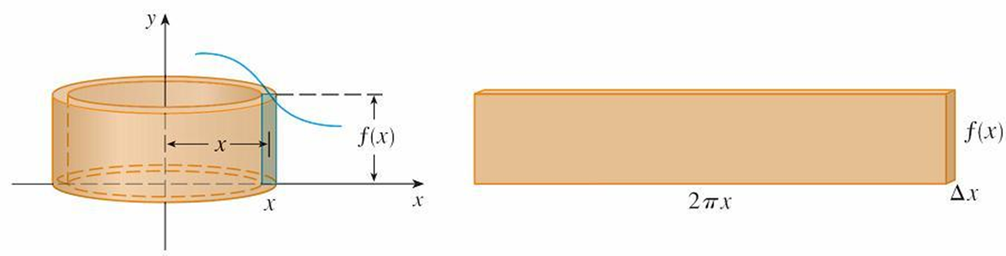
Volumes by Cylindrical Shells (9 of 9)
The best way to remember Formula 2 is to think of a typical shell, cut and flattened as in Figure 5, with radius x, circumference 2πx, height f(x), and thickness Δx or dx:
Figure 5
This type of reasoning will be helpful in other situations, such as when we rotate about lines other than the y-axis.

Slide 12
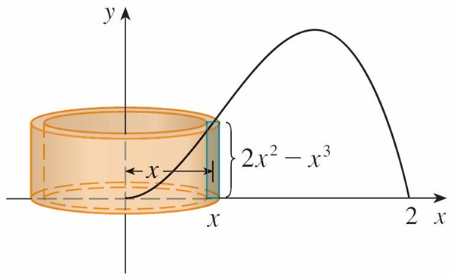
Example 1
Find the volume of the solid obtained by rotating about the y-axis the region
bounded by
Solution:
From the sketch in Figure 6 we see that a typical shell has radius x,
circumference 2πx, and height
Figure 6

Slide 13
Example 1 – Solution
So, by the shell method, the volume is
It can be verified that the shell method gives the same answer as slicing.

Slide 14
Disks and Washers versus Cylindrical Shells

Slide 15
Disks and Washers versus Cylindrical Shells (1 of 2)
When computing the volume of a solid of revolution, how do we know whether to use disks (or washers) or cylindrical shells? There are several considerations to take into account: Is the region more easily described by top and bottom boundary curves of the form y = f(x) or by left and right boundaries x = g(y)?
Which choice is easier to work with? Are the limits of integration easier to find for one variable versus the other? Does the region require two separate integrals when using x as the variable but only one integral in y? Are we able to evaluate the integral we set up with our choice of variable?

Slide 16
Disks and Washers versus Cylindrical Shells (2 of 2)
If we decide that one variable is easier to work with than the other, then this dictates which method to use. Draw a sample rectangle in the region, corresponding to a cross-section of the solid.
The thickness of the rectangle, either Δx or Δy, corresponds to the integration variable. If you imagine the rectangle revolving, it becomes either a disk (washer) or a shell.

