Slide 1
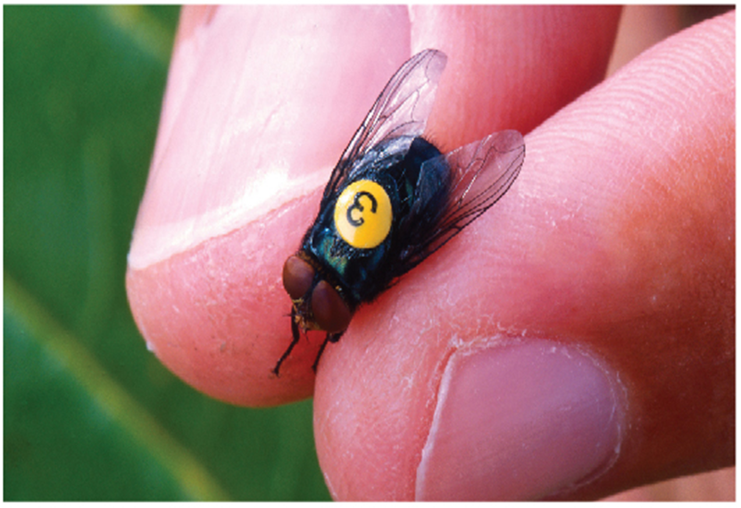
Techniques of Integration
Chapter 7

Slide 2
7.1 Integration by Parts

Slide 3
Integration by Parts (1 of 4)
Every differentiation rule has a corresponding integration rule. For instance, the Substitution Rule for integration corresponds to the Chain Rule for differentiation. The rule that corresponds to the Product Rule for differentiation is called the rule for integration by parts.
The Product Rule states that if f and g are differentiable functions, then

Slide 4
Integration by Parts (2 of 4)
In the notation for indefinite integrals this equation becomes
or
We can rearrange this equation as
Formula 1 is called the formula for integration by parts.

Slide 5
Integration by Parts (3 of 4)
It is perhaps easier to remember in the following notation.
Let u = f (x) and v = g (x). Then the differentials are
so, by the Substitution Rule, the formula for integration by parts becomes

Slide 6
Example 1
Find
Solution Using Formula 1:
Suppose we choose
(For g we can choose any antiderivative of
Thus, using Formula 1, we have

Slide 7
Example 1 – Solution (1 of 2)
It’s wise to check the answer by differentiating it. If we do so, we get x sin x, as expected.
Solution Using Formula 2:
Let
Then

Slide 8
Example 1 – Solution (2 of 2)
So

Slide 9
Integration by Parts (4 of 4)
If we combine the formula for integration by parts with Part 2 of the Fundamental Theorem of Calculus, we can evaluate definite integrals by parts.
Evaluating both sides of Formula 1 between a and b, assuming
continuous, and using the Fundamental Theorem, we obtain

