Slide 1
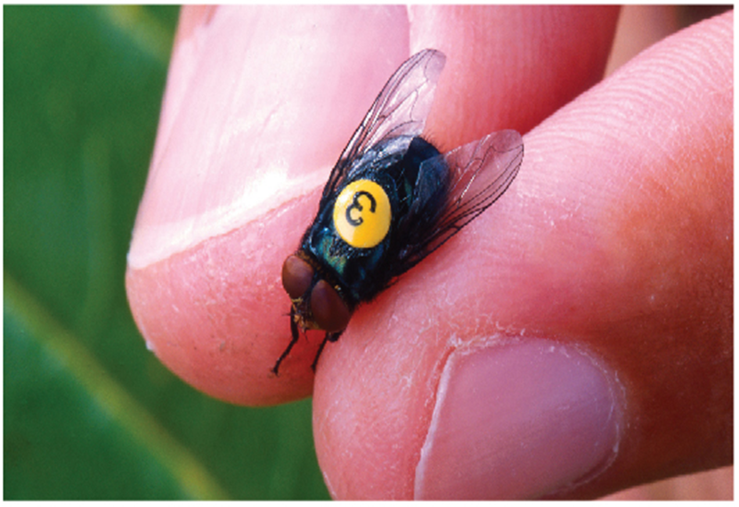
Techniques of Integration
Chapter 7

Slide 2
7.2 Trigonometric Integrals

Slide 3
Trigonometric Integrals (1 of 11)
In this section we use trigonometric identities to integrate certain combinations of trigonometric functions.
We start with powers of sine and cosine.

Slide 4
Example 2
Find
Solution:
We could convert
but we would be left with an expression
in terms of sin x with no extra cos x factor.
Instead, we separate a single sine factor and rewrite the remaining
factor in terms of cos x:

Slide 5
Example 2 – Solution
Substituting u = cos x, we have d u = −sin x dx and so

Slide 6
Example 3
Evaluate
Solution:
If we write
the integral is no simpler to evaluate. Using the
half-angle formula for
however, we have

Slide 7
Example 3 – Solution
Notice that we mentally made the substitution u = 2x when integrating cos 2x.

Slide 8
Trigonometric Integrals (2 of 11)
To summarize, we list guidelines to follow when evaluating integrals of the form
where m ≥ 0 and n ≥ 0 are integers.

Slide 9
Trigonometric Integrals (3 of 11)
Strategy for Evaluating
(a) If the power of cosine is odd (n = 2k + 1), save one cosine factor and use
to express the remaining factors in terms of sine:
Then substitute u = sin x.
(b) If the power of sine is odd (m = 2k + 1), save one sine factor and use
to express the remaining factors in terms of cosine:

Slide 10
Trigonometric Integrals (4 of 11)
Then substitute u = cos x. [Note that if the powers of both sine and cosine are odd, either (a) or (b) can be used.]
(c) If the powers of both sine and cosine are even, use the half-angle identities
It is sometimes helpful to use the identity

Slide 11
Trigonometric Integrals (5 of 11)
We can use a similar strategy to evaluate integrals of the form
Since
we can separate a
factor and convert the
remaining (even) power of secant to an expression involving tangent using the
identity
Or, since
we can separate a sec x tan x factor and convert
the remaining (even) power of tangent to secant.

Slide 12
Example 5
Evaluate
Solution:
If we separate one
factor, we can express the remaining
factor in terms of tangent using the identity
We can then evaluate the integral by substituting u = tan x so that

Slide 13
Example 5 – Solution

Slide 14
Trigonometric Integrals (6 of 11)
The preceding examples demonstrate strategies for evaluating integrals of the form
for two cases, which we summarize here.
Strategy for Evaluating
(a) If the power of secant is even (n = 2k, k ≥ 2), save a factor of
to express the remaining factors in terms of tan x:
Then substitute u = tan x.

Slide 15
Trigonometric Integrals (7 of 11)
(b) If the power of tangent is odd (m = 2k + 1), save a factor of sec x tan x and use
to express the remaining factors in terms of sec x:
Then substitute u = sec x.

Slide 16
Trigonometric Integrals (8 of 11)
For other cases, the guidelines are not as clear-cut. We may need to use identities, integration by parts, and occasionally a little ingenuity.
We will sometimes need to be able to integrate tan x by using the formula given below:

Slide 17
Trigonometric Integrals (9 of 11)
We will also need the indefinite integral of secant:
We could verify Formula 1 by differentiating the right side, or as follows. First we multiply numerator and denominator by sec x + tan x:

Slide 18
Trigonometric Integrals (10 of 11)
If we substitute u = sec x + tan x, then
so the integral becomes
Thus we have

Slide 19
Example 7
Find
Solution:
Here only tan x occurs, so we use
to rewrite a
factor in terms of

Slide 20
Example 7 – Solution
In the first integral we mentally substituted u = tan x so that

Slide 21
Trigonometric Integrals (11 of 11)
Finally, we can make use of another set of trigonometric identities:
2 To evaluate the integrals (a)
(b)
(c)
use the corresponding identity:
(a)
(b)
(c)

Slide 22
Example 9
Evaluate
Solution:
This integral could be evaluated using integration by parts, but it’s easier to use the identity in Equation 2(a) as follows:

