Slide 1
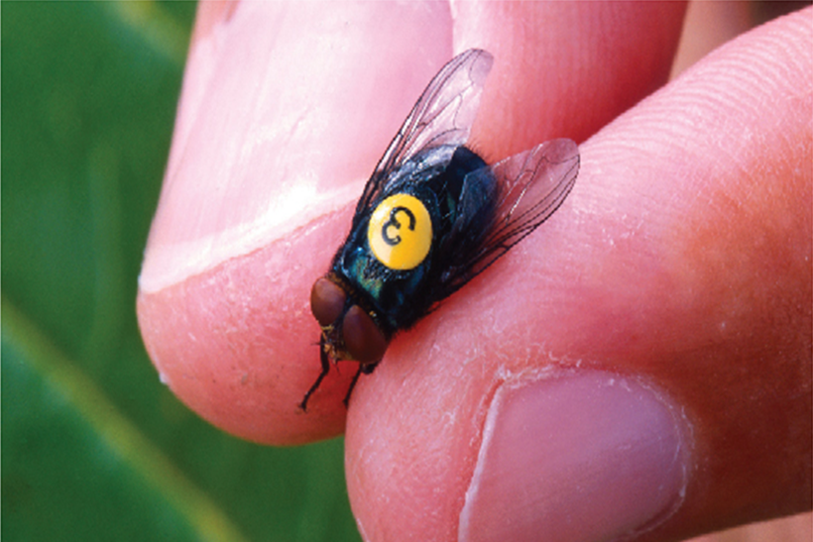
Techniques of Integration
Chapter 7

Slide 2
7.3 Trigonometric Substitution

Slide 3
Trigonometric Substitution (1 of 8)
In finding the area of a circle or an ellipse, an integral of the form
arises, where a > 0.
If it were
would be effective but, as
it stands,

Slide 4
Trigonometric Substitution (2 of 8)
If we change the variable from x to θ by the substitution x = a sin θ, then the
identity
allows us to get rid of the root sign because

Slide 5
Trigonometric Substitution (3 of 8)
Notice the difference between the substitution
(in which the new variable
is a function of the old one) and the substitution x = a sinθ (the old variable is a function of the new one).
In general, we can make a substitution of the form x = g(t) by using the Substitution Rule in reverse.
To make our calculations simpler, we assume that g has an inverse function; that is, g is one-to-one.

Slide 6
Trigonometric Substitution (4 of 8)
In this case, if we replace u by x and x by t in the Substitution Rule, we obtain
This kind of substitution is called inverse substitution.
We can make the inverse substitution x = a sin θ provided that it defines a one-to-one function.

Slide 7
Trigonometric Substitution (5 of 8)
This can be accomplished by restricting θ to lie in the interval
In the following table we list trigonometric substitutions that are effective for the given radical expressions because of the specified trigonometric identities.
Table of Trigonometric Substitutions
Expression | Substitution | Identity

Slide 8
Trigonometric Substitution (6 of 8)
In each case the restriction on θ is imposed to ensure that the function that defines the substitution is one-to-one.

Slide 9
Example 1
Evaluate
Solution:
Let x = 3 sin θ, where
Then dx = 3 cos θ dθand
(Note that cos θ ≥ 0 because

Slide 10
Example 1 – Solution (1 of 4)
Thus the Inverse Substitution Rule gives

Slide 11
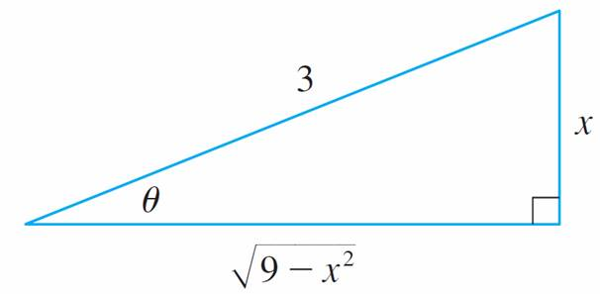
Example 1 – Solution (2 of 4)
Since this is an indefinite integral, we must return to the original variable x.
This can be done either by using trigonometric identities to express cot θ in terms of
or by drawing a diagram, as in Figure 1, where θ is interpreted as an
angle of a right triangle.
Figure 1

Slide 12
Example 1 – Solution (3 of 4)
Since
we label the opposite side and the hypotenuse as having
lengths x and 3.
Then the Pythagorean Theorem gives the length of the adjacent side as
so we can simply read the value of cot θ from the figure:
(Although θ > 0 in the diagram, this expression for cot θ is valid even when θ < 0.)

Slide 13
Example 1 – Solution (4 of 4)
Since
we have

Slide 14
Example 2
Find the area enclosed by the ellipse
Solution:
Solving the equation of the ellipse for y, we get

Slide 15
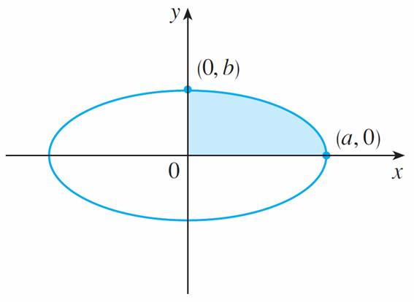
Example 2 – Solution (1 of 5)
Because the ellipse is symmetric with respect to both axes, the total area A is four times the area in the first quadrant (see Figure 2).
Figure 2

Slide 16
Example 2 – Solution (2 of 5)
The part of the ellipse in the first quadrant is given by the function
and so
To evaluate this integral we substitute x = a sin θ. Then dx = a cos θ dθ.

Slide 17
Example 2 – Solution (3 of 5)
To change the limits of integration we note that when x = 0, sin θ = 0, so θ = 0;
when x = a, sin θ = 1, so
Also
since

Slide 18
Example 2 – Solution (4 of 5)
Therefore

Slide 19
Example 2 – Solution (5 of 5)
We have shown that the area of an ellipse with semiaxes a and b is πab.
In particular, taking a = b = r, we have proved the famous formula that the area
of a circle with radius r is

Slide 20
Trigonometric Substitution (7 of 8)
Note:
Since the integral in Example 2 was a definite integral, we changed the limits of integration and did not have to convert back to the original variable x.

Slide 21
Example 3
Find
Solution:
Let x = 2

Slide 22
Example 3 – Solution (1 of 3)
So we have
To evaluate this trigonometric integral we put everything in terms of sin θ and cos θ :

Slide 23
Example 3 – Solution (2 of 3)
Therefore, making the substitution u = sin θ, we have

Slide 24
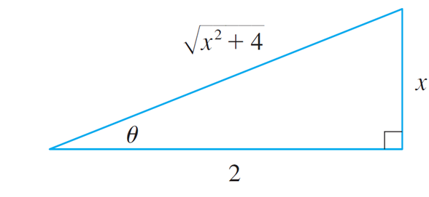
Example 3 – Solution (3 of 3)
We use Figure 3 to determine that
and so
Figure 3

Slide 25
Example 5
Evaluate
Solution 1:
We let x = a sec θ, where
Then dx = a sec θ tan θ dθ and

Slide 26
Example 5 – Solution 1 (1 of 3)
Therefore

Slide 27
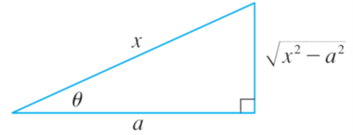
Example 5 – Solution 1 (2 of 3)
The triangle in Figure 4 gives
so we have
Figure 4

Slide 28
Example 5 – Solution 1 (3 of 3)
Writing C₁ = C − In a, we have

Slide 29
Example 5 – Solution 2 (1 of 2)
For x > 0 the hyperbolic substitution x = a cosh t can also be used.
Using the identity
we have

Slide 30
Example 5 – Solution 2 (2 of 2)
Since dx = a sinh t dt, we obtain
Since

Slide 31
Trigonometric Substitution (8 of 8)
Note:
As Example 5 illustrates, hyperbolic substitutions can be used in place of trigonometric substitutions and sometimes they lead to simpler answers.
But we usually use trigonometric substitutions because trigonometric identities are more familiar than hyperbolic identities.

Slide 32
Example 6
Find
Solution:
First we note that
so trigonometric substitution is
appropriate.
Although
is not quite one of the expressions in the table of trigonometric
substitutions, it becomes one of them if we make the preliminary substitution u = 2x.

Slide 33
Example 6 – Solution (1 of 3)
When we combine this with the tangent substitution, we have
which gives
When x = 0, tan θ = 0, so θ = 0; when

Slide 34
Example 6 – Solution (2 of 3)
Now we substitute u = cos θ so that du = –sin θ dθ. When θ = 0, u = 1; when

Slide 35
Example 6 – Solution (3 of 3)
Therefore

