Slide 1
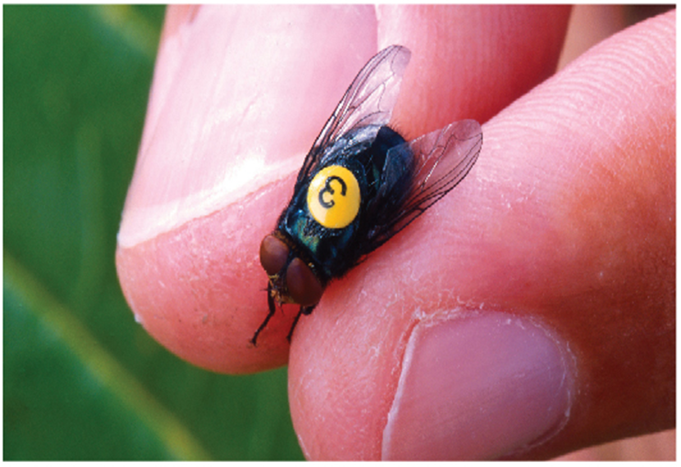
Techniques of Integration
Chapter 7

Slide 2
7.4 Integration of Rational Functions by Partial Fractions

Slide 3
Integration of Rational Functions by Partial Fractions (1 of 16)
In this section we show how to integrate any rational function (a ratio of polynomials) by expressing it as a sum of simpler fractions, called partial fractions, that we already know how to integrate.
To illustrate the method, observe that by taking the fractions
to a common denominator we obtain

Slide 4
Integration of Rational Functions by Partial Fractions (2 of 16)
If we now reverse the procedure, we see how to integrate the function on the right side of this equation:

Slide 5
Integration of Rational Functions by Partial Fractions (3 of 16)
To see how the method of partial fractions works in general, let’s consider a rational function
where P and Q are polynomials. It’s possible to express f as a sum of simpler fractions provided that the degree of P is less than the degree of Q. Such a rational function is called proper.

Slide 6
Integration of Rational Functions by Partial Fractions (4 of 16)
We know that if
where a_{n} ≠ 0, then the degree of P is n and we write deg(P) = n.
If f is improper, that is, deg(P) ≥ deg(Q), then we must take the preliminary step of dividing Q into P (by long division) until a remainder R (x) is obtained such that deg(R) < deg(Q).

Slide 7
Integration of Rational Functions by Partial Fractions (5 of 16)
The division statement is
where S and R are also polynomials.
As the next example illustrates, sometimes this preliminary step is all that is required.

Slide 8
Example 1
Find
Solution:
Since the degree of the numerator is greater than the degree of the denominator, we first perform the long division.
This enables us to write

Slide 9
Integration of Rational Functions by Partial Fractions (6 of 16)
The next step is to factor the denominator Q(x) as far as possible.
It can be shown that any polynomial Q can be factored as a product of linear factors (of the form ax + b) and irreducible quadratic factors (of the form
For instance, if
we could factor it as

Slide 10
Integration of Rational Functions by Partial Fractions (7 of 16)
The third step is to express the proper rational function
(from Equation 1)
as a sum of partial fractions of the form
A theorem in algebra guarantees that it is always possible to do this. We explain the details for the four cases that occur.

Slide 11
Integration of Rational Functions by Partial Fractions (8 of 16)
Case I The denominator Q(x) is a product of distinct linear factors.
This means that we can write
where no factor is repeated (and no factor is a constant multiple of another).

Slide 12
Integration of Rational Functions by Partial Fractions (9 of 16)
In this case the partial fraction theorem states that there exist constants A₁, A₂, . . . , A_{k} such that
These constants can be determined as in the following example.

Slide 13
Example 2
Evaluate
Solution:
Since the degree of the numerator is less than the degree of the denominator, we don’t need to divide.
We factor the denominator as

Slide 14
Example 2 – Solution (1 of 4)
Since the denominator has three distinct linear factors, the partial fraction decomposition of the integrand (2) has the form
To determine the values of A, B, and C, we multiply both sides of this equation by the product of the denominators, x(2x − 1)(x + 2), obtaining

Slide 15
Example 2 – Solution (2 of 4)
Expanding the right side of Equation 4 and writing it in the standard form for polynomials, we get
The polynomials in Equation 5 are identical, so their coefficients must be equal.
The coefficient of
on the right side, 2A + B + 2C, must equal the coefficient of
on the left side—namely, 1.
Likewise, the coefficients of x are equal and the constant terms are equal.

Slide 16
Example 2 – Solution (3 of 4)
This gives the following system of equations for A, B, and C:
Solving, we get,
and so

Slide 17
Example 2 – Solution (4 of 4)
In integrating the middle term we have made the mental substitution u = 2x − 1,
which gives d u = 2dx and

Slide 18
Integration of Rational Functions by Partial Fractions (10 of 16)
Note: We can use an alternative method to find the coefficients A, B, and C in Example 2. Equation 4 is an identity; it is true for every value of x. Let’s choose values of x that simplify the equation.
If we put x = 0 in Equation 4, then the second and third terms on the right side
vanish and the equation then becomes −2A = −1, or
Likewise,
gives 10C = −1, so

Slide 19
Integration of Rational Functions by Partial Fractions (11 of 16)
Case II Q(x) is a product of linear factors, some of which are repeated.
Suppose the first linear factor (a₁x + b₁) is repeated r times; that is,
occurs in the factorization of Q(x). Then instead of the single term
in Equation 2, we would use

Slide 20
Integration of Rational Functions by Partial Fractions (12 of 16)
By way of illustration, we could write
but we prefer to work out in detail a simpler example.

Slide 21
Example 4
Find
Solution:
The first step is to divide. The result of long division is

Slide 22
Example 4 – Solution (1 of 4)
The second step is to factor the denominator
Since Q(1) = 0, we know that x − 1 is a factor and we obtain

Slide 23
Example 4 – Solution (2 of 4)
Since the linear factor x − 1 occurs twice, the partial fraction decomposition is
Multiplying by the least common denominator,
we get

Slide 24
Example 4 – Solution (3 of 4)
Now we equate coefficients:

Slide 25
Example 4 – Solution (4 of 4)
Solving, we obtain A = 1, B = 2, and C = −1, so

Slide 26
Integration of Rational Functions by Partial Fractions (13 of 16)
Case III Q(x) contains irreducible quadratic factors, none of which is repeated.
If Q(x) has the factor
then, in addition
to the partial fractions in Equations 2 and 7, the expression for
will have a term of the form
where A and B are constants to be determined.

Slide 27
Integration of Rational Functions by Partial Fractions (14 of 16)
For instance, the function given by
has a partial fraction decomposition of the form
The term given in (9) can be integrated by completing the square (if necessary) and using the formula

Slide 28
Example 6
Evaluate
Solution:
Since the degree of the numerator is not less than the degree of the denominator, we first divide and obtain

Slide 29
Example 6 – Solution (1 of 3)
Notice that the quadratic
is irreducible because its discriminant is
This means it can’t be factored, so we don’t need to use the
partial fraction technique.
To integrate the given function we complete the square in the denominator:
This suggests that we make the substitution u = 2x − 1.

Slide 30
Example 6 – Solution (2 of 3)
Then d u = 2 dx and

Slide 31
Example 6 – Solution (3 of 3)

Slide 32
Integration of Rational Functions by Partial Fractions (15 of 16)
Note: Example 6 illustrates the general procedure for integrating a partial fraction of the form
We complete the square in the denominator and then make a substitution that brings the integral into the form
Then the first integral is a logarithm and the second is expressed in terms of

Slide 33
Integration of Rational Functions by Partial Fractions (16 of 16)
Case IV Q(x) contains a repeated irreducible quadratic factor.
If Q(x) has the factor
then instead of the
single partial fraction (9), the sum
occurs in the partial fraction decomposition of
Each of the terms in (11)
can be integrated by using a substitution or by first completing the square if necessary.

Slide 34
Example 8
Evaluate
Solution:
The form of the partial fraction decomposition is
Multiplying by
we have

Slide 35
Example 8 – Solution (1 of 2)
If we equate coefficients, we get the system
which has the solution A = 1, B = −1, C = −1, D = 1 and E = 0.

Slide 36
Example 8 – Solution (2 of 2)
Thus

Slide 37
Rationalizing Substitutions

Slide 38
Rationalizing Substitutions
Some nonrational functions can be changed into rational functions by means of appropriate substitutions.
In particular, when an integrand contains an expression of the form
then the substitution
may be effective. Other instances appear in the
exercises.

Slide 39
Example 9
Evaluate
Solution:
Let
Then
and dx = 2u d u. Therefore

Slide 40
Example 9 – Solution
We can evaluate this integral either by factoring
and using partial fractions or by using Formula 6 with a = 2:

