Slide 1
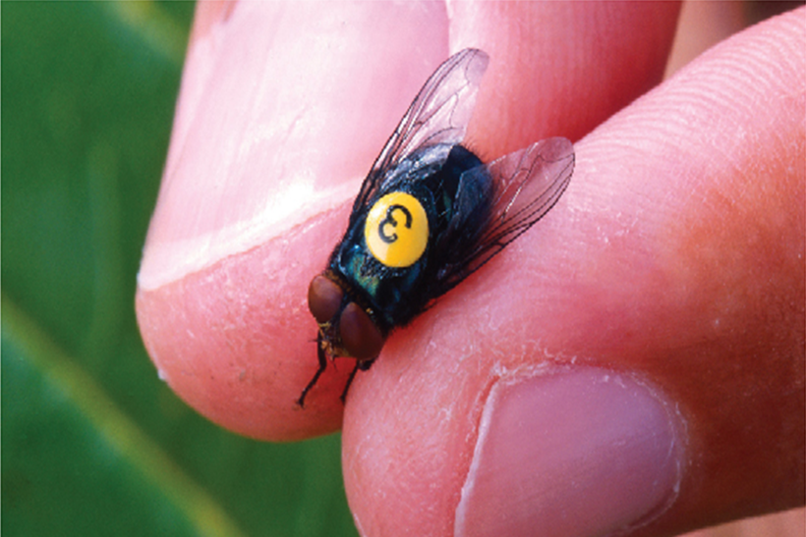
Techniques of Integration
Chapter 7

Slide 2
7.8 Improper Integrals

Slide 3
Improper Integrals
In this section we extend the concept of a definite integral to the case where the interval is infinite and also to the case where f has an infinite discontinuity in [a, b].
In either case the integral is called an improper integral.

Slide 4
Type 1: Infinite Intervals

Slide 5
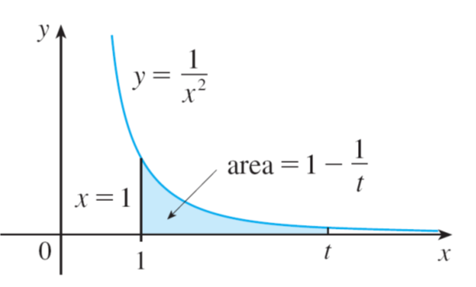
Type 1: Infinite Intervals (1 of 7)
Consider the infinite region S that lies under the curve
above the x-axis, and
to the right of the line x = 1.
You might think that, since S is infinite in extent, its area must be infinite, but let’s take a closer look.
The area of the part of S that lies to the left of the line x = t (shaded in Figure 1) is
Figure 1

Slide 6
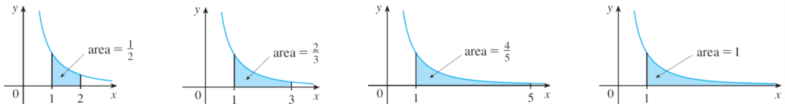
Type 1: Infinite Intervals (2 of 7)
Notice that A(t) < 1 no matter how large t is chosen. We also observe that
The area of the shaded region approaches 1 as t → ∞ (see Figure 2), so we say that the area of the infinite region S is equal to 1 and we write
Figure 2

Slide 7
Type 1: Infinite Intervals (3 of 7)
Using this example as a guide, we define the integral of f over an infinite interval as the limit of integrals over finite intervals.
1 Definition of an Improper Integral of Type 1
(a) If
exists for every number t ≥ a, then
provided this limit exists (as a finite number).
(b) If
exists for every number t ≤ b, then
provided this limit exists (as a finite number).

Slide 8
Type 1: Infinite Intervals (4 of 7)
The improper integrals
are called convergent if the
corresponding limit exists and divergent if the limit does not exist.
(c) If both
are convergent, then we define
In part (c) any real number a can be used (see Exercise 76).

Slide 9
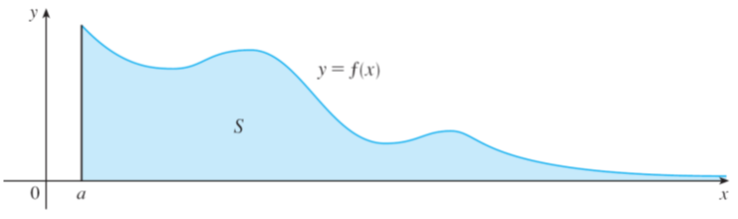
Type 1: Infinite Intervals (5 of 7)
Any of the improper integrals in Definition 1 can be interpreted as an area provided that f is a positive function.
For instance, in case (a) if f (x) ≥ 0 and the integral
is convergent, then
we define the area of the region
in Figure 3 to be
This is appropriate because
is the limit as t → ∞ of the area under
the graph of f from a to t.
Figure 3

Slide 10
Example 1
Determine whether the integral
is convergent or divergent.
Solution:
According to part (a) of Definition 1, we have
The limit does not exist as a finite number and so the improper integral
is divergent.

Slide 11
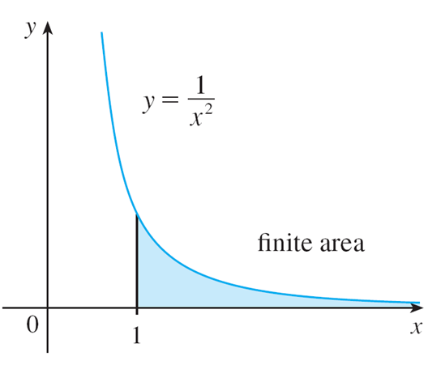
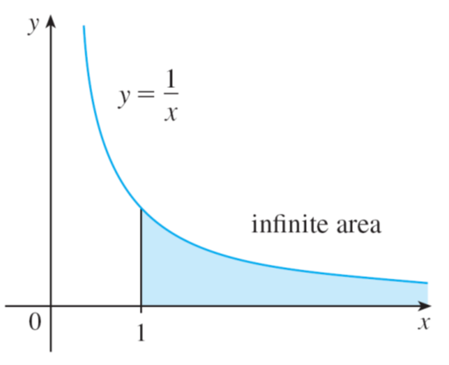
Type 1: Infinite Intervals (6 of 7)
Let’s compare the result of Example 1 with the example given at the beginning of this section:
Figure 4
Figure 5

Slide 12
Type 1: Infinite Intervals (7 of 7)
Geometrically, this says that although the curves
look very
similar for x > 0, the region under
to the right of x = 1 (the shaded region
in Figure 4) has finite area whereas the corresponding region under
(in Figure 5) has infinite area. Note that both
approaches 0 faster than
The values of
don’t decrease fast enough for
its integral to have a finite value.
We summarize this as follows:

Slide 13
Type 2: Discontinuous Integrands

Slide 14
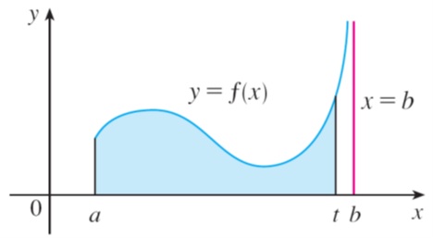
Type 2: Discontinuous Integrands (1 of 4)
Suppose that f is a positive continuous function defined on a finite interval
but has a vertical asymptote at b.
Let S be the unbounded region under the graph of f and above the x-axis between a and b. (For Type 1 integrals, the regions extended indefinitely in a horizontal direction. Here the region is infinite in a vertical direction.)
The area of the part of S between a and t (the shaded region in Figure 7) is
Figure 7

Slide 15
Type 2: Discontinuous Integrands (2 of 4)
If it happens that A(t) approaches a definite number A as
then we say
that the area of the region S is A and we write
We use this equation to define an improper integral of Type 2 even when f is not a positive function, no matter what type of discontinuity f has at b.

Slide 16
Type 2: Discontinuous Integrands (3 of 4)
3 Definition of an Improper Integral of Type 2
(a) If f is continuous on
and is discontinuous at b, then
if this limit exists (as a finite number).
(b) If f is continuous on
and is discontinuous at a, then
if this limit exists (as a finite number).

Slide 17
Type 2: Discontinuous Integrands (4 of 4)
The improper integral
is called convergent if the corresponding limit
exists and divergent if the limit does not exist.
(c) If f has a discontinuity at c, where a < c < b, and both
are convergent, then we define

Slide 18
Example 5
Find
Solution:
We note first that the given integral is improper because
has the vertical asymptote x = 2.
Since the infinite discontinuity occurs at the left endpoint of [2, 5], we use part (b) of Definition 3:

Slide 19
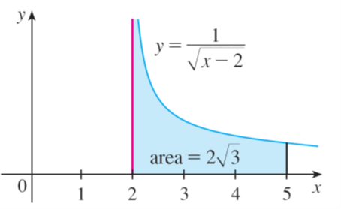
Example 5 – Solution
Thus the given improper integral is convergent and, since the integrand is positive, we can interpret the value of the integral as the area of the shaded region in Figure 10.
Figure 10

Slide 20
A Comparison Test for Improper Integrals

Slide 21
A Comparison Test for Improper Integrals (1 of 3)
Sometimes it is impossible to find the exact value of an improper integral and yet it is important to know whether it is convergent or divergent.
In such cases the following theorem is useful. Although we state it for Type 1 integrals, a similar theorem is true for Type 2 integrals.
Comparison Theorem Suppose that f and g are continuous functions with f(x) ≥ g(x) ≥ 0 for x ≥ a.
(a) If
(b) If

Slide 22
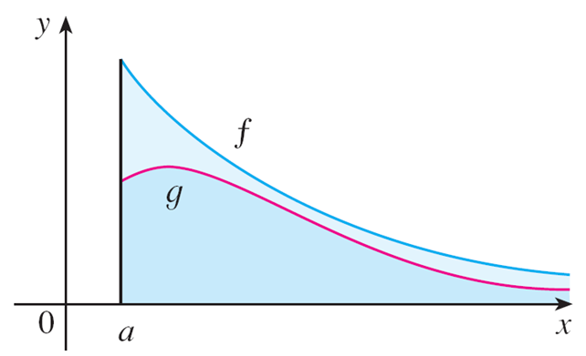
A Comparison Test for Improper Integrals (2 of 3)
We omit the proof of the Comparison Theorem, but Figure 12 makes it seem plausible.
Figure 12
If the area under the top curve y = f (x) is finite, then so is the area under the bottom curve y = g (x).

Slide 23
A Comparison Test for Improper Integrals (3 of 3)
If the area under y = g (x) is infinite, then so is the area under y = f (x). [Note that the reverse is not necessarily true:
If
is convergent,
may or may not be convergent, and if
is divergent,
may or may not be divergent.]

Slide 24
Example 9
Show that
is convergent.
Solution:
We can’t evaluate the integral directly because the antiderivative of
is not an elementary function.
We write
and observe that the first integral on the right-hand side is just an ordinary definite integral.

Slide 25
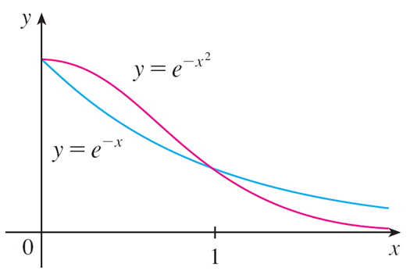
Example 9 – Solution (1 of 2)
In the second integral we use the fact that for x ≥ 1 we have
and therefore
(See Figure 13.)
The integral of
is easy to evaluate:
Figure 13

Slide 26
Example 9 – Solution (2 of 2)
Therefore, taking
in the Comparison Theorem, we see
that
is convergent.
It follows that
is convergent.

