Slide 1
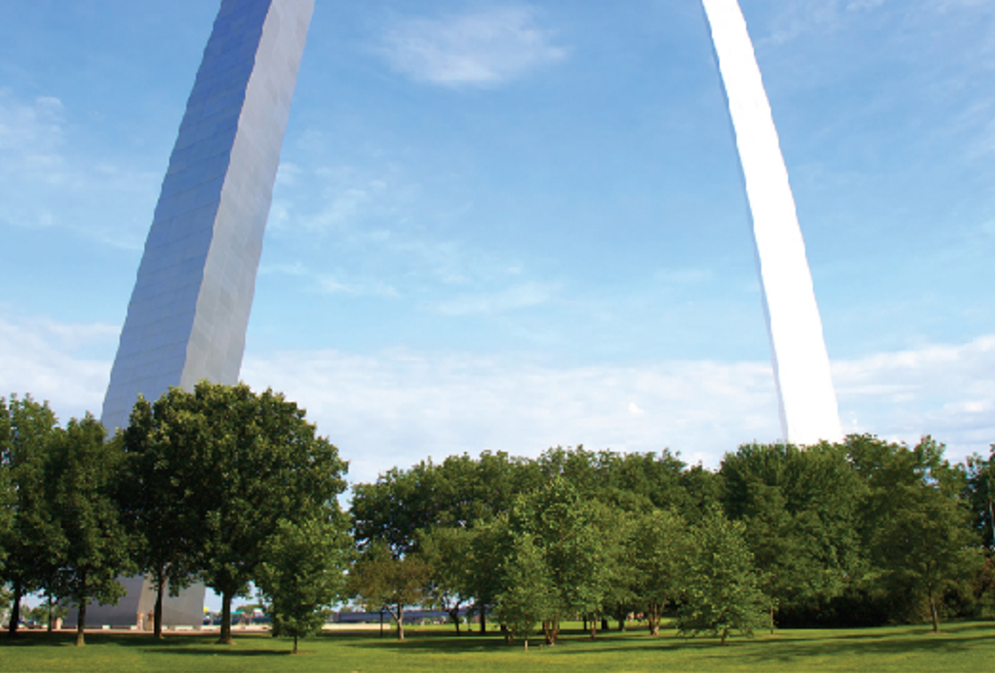
Further Applications of Integration
Chapter 8

Slide 2
8.1 Arc Length

Slide 3
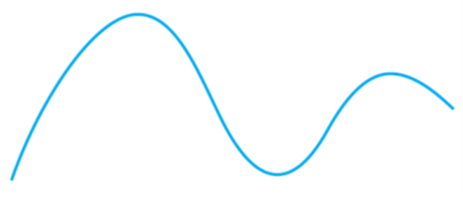
Arc Length (1 of 10)
What do we mean by the length of a curve? We might think of fitting a piece of string to the curve in Figure 1 and then measuring the string against a ruler. But that might be difficult to do with much accuracy if we have a complicated curve.
We need a precise definition for the length of an arc of a curve, in the same spirit as the definitions we developed for the concepts of area and volume.
Figure 1

Slide 4
Arc Length (2 of 10)
If the curve is a polygon, we can easily find its length; we just add the lengths of the line segments that form the polygon. (We can use the distance formula to find the distance between the endpoints of each segment).
We are going to define the length of a general curve by first approximating it by a polygon and then taking a limit as the number of segments of the polygon is increased.

Slide 5
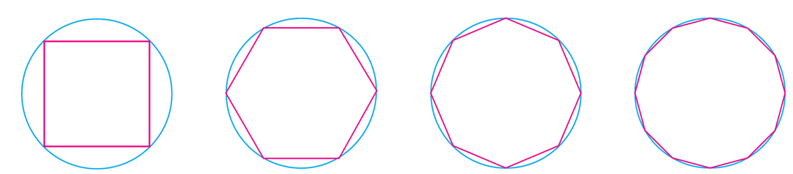
Arc Length (3 of 10)
This process is familiar for the case of a circle, where the circumference is the limit of lengths of inscribed polygons (see Figure 2).
Figure 2
Suppose that a curve C is defined by the equation y = f (x) where f is continuous and a ≤ x ≤ b.

Slide 6
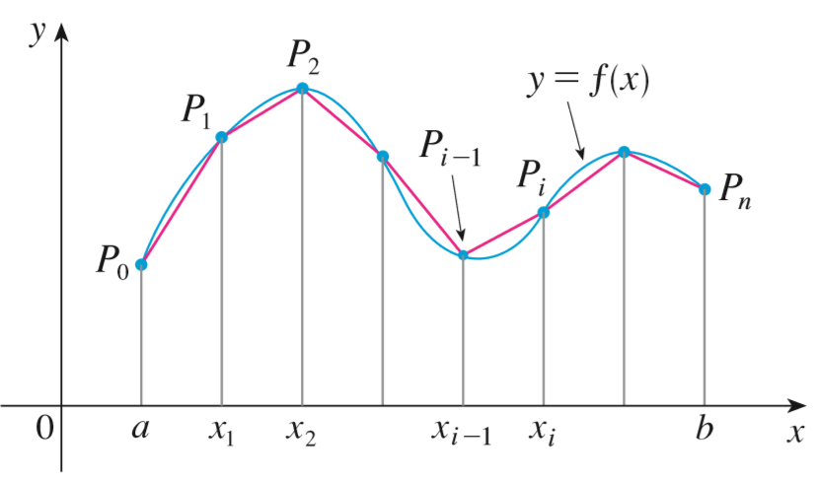
Arc Length (4 of 10)
We obtain a polygonal approximation to C by dividing the interval [a, b] into n subintervals with endpoints
and equal width Δx.
If y_{i} = f (x_{i}), then the point P_{i} (x_{i,} y_{i}) lies on C and the polygon with vertices
illustrated in Figure 3, is an approximation to C.
Figure 3

Slide 7
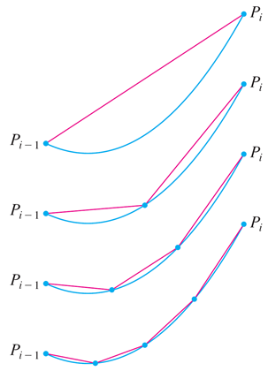
Arc Length (5 of 10)
The length L of C is approximately the length of this polygon and the approximation gets better as we let n increase. (See Figure 4, where the arc of the curve between P_{i −1} and P_{i} has been magnified and approximations with successively smaller values of Δx are shown.)
Figure 4

Slide 8
Arc Length (6 of 10)
Therefore we define the length L of the curve C with equation, y = f (x), a ≤ x ≤ b as the limit of the lengths of these inscribed polygons ( if the limit exists):
Notice that the procedure for defining arc length is very similar to the procedure we used for defining area and volume: We divided the curve into a large number of small parts. We then found the approximate lengths of the small parts and added them. Finally, we took the limit as n → ∞.

Slide 9
Arc Length (7 of 10)
The definition of arc length given by Equation 1 is not very convenient for computational purposes, but we can derive an integral formula for L in the case where f has a continuous derivative. [Such a function f is called smooth
because a small change in x produces a small change in
If we let Δy_{i} = y_{i} − y_{i −1}, then

Slide 10
Arc Length (8 of 10)
By applying the Mean Value Theorem to f on the interval [x_{i − 1}, x_{i} ], we find that there is a number x_{i}* between x_{i −1} and x_{i} such that
that is,
Thus we have

Slide 11
Arc Length (9 of 10)
Therefore, by Definition 1,
We recognize this expression as being equal to
by the definition of a definite integral. We know that this integral exists because
the function
is continuous.

Slide 12
Arc Length (10 of 10)
Thus we have proved the following theorem:
2 The Arc Length Formula If
is continuous on [a, b], then the length of the
curve y = f(x), a ≤ x ≤ is
If we use Leibniz notation for derivatives, we can write the arc length formula as follows:

Slide 13
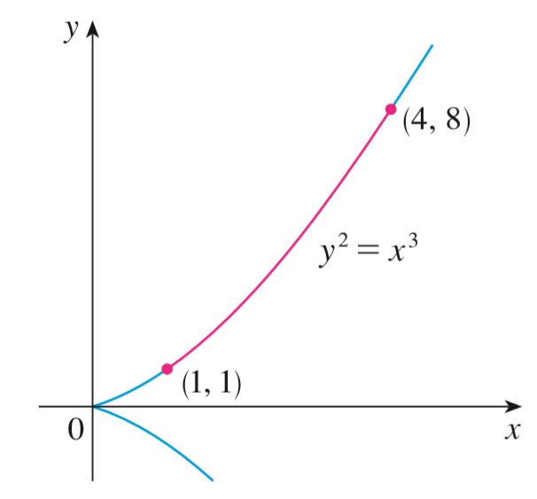
Example 1
Find the length of the arc of the semicubical parabola
between the points
(1, 1) and (4, 8). (See Figure 5.)
Figure 5

Slide 14
Example 1 – Solution (1 of 2)
For the top half of the curve we have
and so the arc length formula gives
If we substitute
When x = 1,
when x = 4, u = 10.

Slide 15
Example 1 – Solution (2 of 2)
Therefore

Slide 16
Arc Length (1 of 2)
If a curve has the equation x = g (y), c ≤ y ≤ d, and
is continuous, then by
interchanging the roles of x and y in Formula 2 or Equation 3, we obtain the following formula for its length:

Slide 17
The Arc Length Function

Slide 18
The Arc Length Function (1 of 4)
We will find it useful to have a function that measures the arc length of a curve from a particular starting point to any other point on the curve.
Thus if a smooth curve C has the equation, y = f (x), a ≤ x ≤ b let s (x) be the distance along C from the initial point P₀(a, f (a)) to the point Q (x, f (x)).
Then s is a function, called the arc length function, and, by Formula 2,

Slide 19
The Arc Length Function (2 of 4)
(We have replaced the variable of integration by t so that x does not have two meanings.) We can use Part 1 of the Fundamental Theorem of Calculus to differentiate Equation 5 (since the integrand is continuous):
Equation 6 shows that the rate of change of s with respect to x is always at
least 1 and is equal to 1 when
the slope of the curve, is 0.

Slide 20
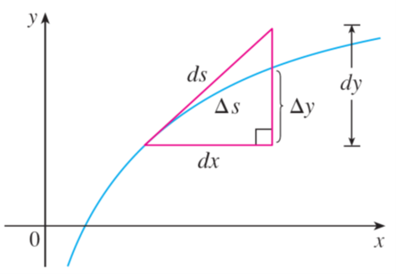
The Arc Length Function (3 of 4)
The differential of arc length is
and this equation is sometimes written in the symmetric form
The geometric interpretation of Equation 8 is shown in Figure 7. It can be used as a mnemonic device for remembering both of the Formulas 3 and 4.
Figure 7

Slide 21
The Arc Length Function (4 of 4)
If we write
then from Equation 8 either we can solve to get (7),
which gives (3), or we can solve to get
which gives (4).

Slide 22
Example 4
Find the arc length function for the curve
taking P₀(1, 1) as the
starting point.
Solution:
If

Slide 23
Example 4 – Solution
Thus the arc length function is given by
For instance, the arc length along the curve from (1, 1) to (3, f (3)) is

