Slide 1
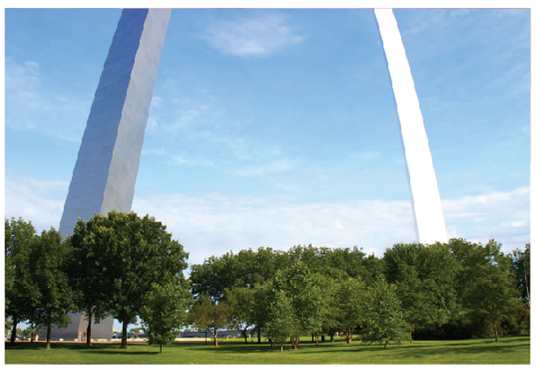
Further Applications of Integration
Chapter 8

Slide 2
8.2 Area of a Surface of Revolution

Slide 3
Area of a Surface of Revolution (1 of 16)
A surface of revolution is formed when a curve is rotated about a line. Such a surface is the lateral boundary of a solid of revolution.
We want to define the area of a surface of revolution in such a way that it corresponds to our intuition.
If the surface area is A, we can imagine that painting the surface would require the same amount of paint as does a flat region with area A.

Slide 4
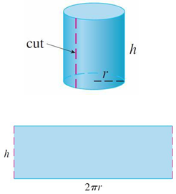
Area of a Surface of Revolution (2 of 16)
Let’s start with some simple surfaces. The lateral surface area of a circular cylinder with radius r and height h is taken to be A = 2πrh because we can imagine cutting the cylinder and unrolling it (as in Figure 1) to obtain a rectangle with dimensions 2πr and h.
Figure 1

Slide 5
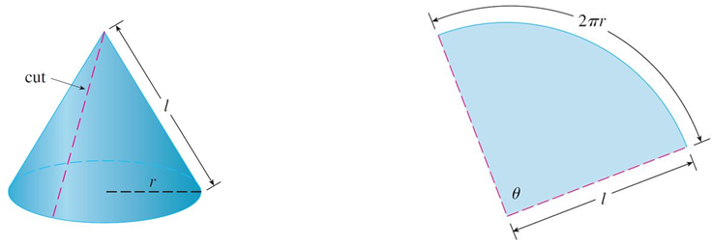
Area of a Surface of Revolution (3 of 16)
Likewise, we can take a circular cone with base radius r and slant height l, cut it along the dashed line in Figure 2, and flatten it to form a sector of a circle with
radius l and central angle
Figure 2

Slide 6
Area of a Surface of Revolution (4 of 16)
We know that, in general, the area of a sector of a circle with radius l and angle θ is
and so in this case the area is
Therefore we define the lateral surface area of a cone to be A = πrl.
What about more complicated surfaces of revolution? If we follow the strategy we used with arc length, we can approximate the original curve by a polygon.

Slide 7
Area of a Surface of Revolution (5 of 16)
When this polygon is rotated about an axis, it creates a simpler surface whose surface area approximates the actual surface area.
By taking a limit, we can determine the exact surface area.
The approximating surface, then, consists of a number of bands, each formed by rotating a line segment about an axis.

Slide 8
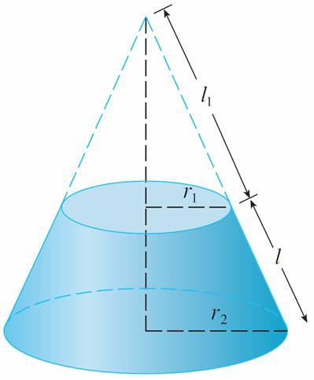
Area of a Surface of Revolution (6 of 16)
To find the surface area, each of these bands can be considered a portion of a circular cone, as shown in Figure 3.
Figure 3

Slide 9
Area of a Surface of Revolution (7 of 16)
The area of the band (or frustum of a cone) with slant height l and upper and lower radii r₁ and r₂ is found by subtracting the areas of two cones:
From similar triangles we have
which gives

Slide 10
Area of a Surface of Revolution (8 of 16)
Putting this in Equation 1, we get
or
where
is the average radius of the band.

Slide 11
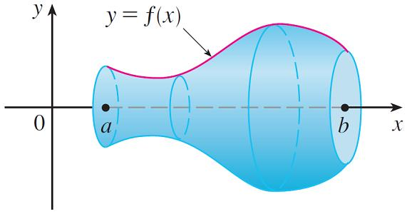
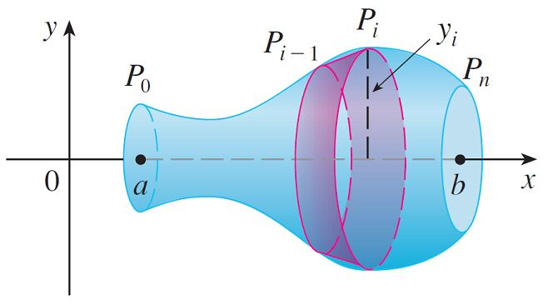
Area of a Surface of Revolution (9 of 16)
Now we apply this formula to our strategy. Consider the surface shown in Figure 4, which is obtained by rotating the curve y = f (x), a ≤ x ≤ b, about the x-axis, where f is positive and has a continuous derivative.
(a) Surface of revolution
(b) Approximating band
Figure 4

Slide 12
Area of a Surface of Revolution (10 of 16)
In order to define its surface area, we divide the interval [a, b] into n subintervals with endpoints x₀, x₁, . . . , x_{n} and equal width Δx, as we did in determining arc length.
If y_{i} = f (x_{i} ), then the point P_{i}(x_{i}, y_{i} ) lies on the curve.
The part of the surface between x_{i − 1} and x_{i} is approximated by taking the line segment P_{i} ₋ ₁P_{i} and rotating it about the x-axis.

Slide 13
Area of a Surface of Revolution (11 of 16)
The result is a band with slant height
and average radius
so, by Formula 2, its surface area is
As in the proof, We have
where x_{i}∗ is some number in [x_{i − 1}, x_{i}].

Slide 14
Area of a Surface of Revolution (12 of 16)
When Δx is small, we have y_{i} = f(x_{i}) ≈ f(x_{i}∗) and also y_{i − 1} = f(x_{i −} ₁) ≈ f(x_{i}∗), since f is continuous.
Therefore
and so an approximation to what we think of as the area of the complete surface of revolution is

Slide 15
Area of a Surface of Revolution (13 of 16)
This approximation appears to become better as n → ∞ and, recognizing (3) as
a Riemann sum for the function
we have
Therefore, in the case where f is positive and has a continuous derivative, we define the surface area of the surface obtained by rotating the curve y = f (x), a ≤ x ≤ b, about the x-axis as

Slide 16
Area of a Surface of Revolution (14 of 16)
With the Leibniz notation for derivatives, this formula becomes
If the curve is described as x = g(y), c ≤ y ≤ d, then the formula for surface area becomes

Slide 17
Area of a Surface of Revolution (15 of 16)
Now both Formulas 5 and 6 can be summarized symbolically, using the notation for arc length, as
For rotation about the y-axis, the surface area formula becomes
where, as before, we can use either

Slide 18
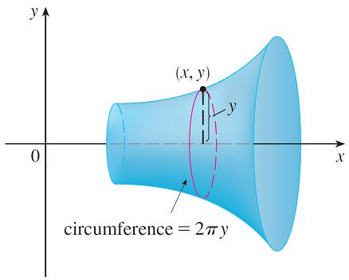
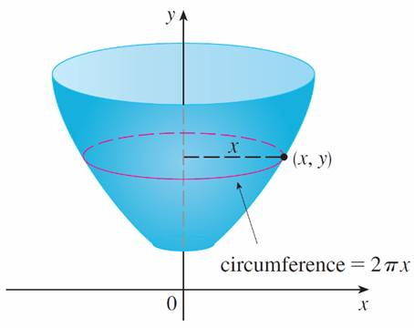
Area of a Surface of Revolution (16 of 16)
These formulas can be remembered by thinking of 2πy or 2πx as the circumference of a circle traced out by the point (x, y) on the curve as it is rotated about the x-axis or y-axis, respectively (see Figure 5).
Figure 5

Slide 19
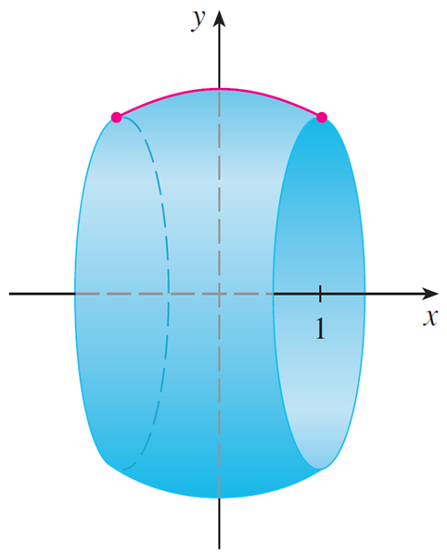
Example 1
The curve
is an arc of the circle
Find the area of the surface obtained by rotating this arc about the x-axis. (The surface is a portion of a sphere of radius 2. See Figure 6.)
Figure 6

Slide 20
Example 1 – Solution (1 of 2)
We have
and so, by Formula 5, the surface area is

Slide 21
Example 1 – Solution (2 of 2)

Slide 22
Example 3
Find the area of the surface generated by rotating the curve
about the x-axis.
Solution:
Using Formula 5 with
we have

Slide 23
Example 3 – Solution (1 of 2)

Slide 24
Example 3 – Solution (2 of 2)
Since tanα = e, we have

