Slide 1
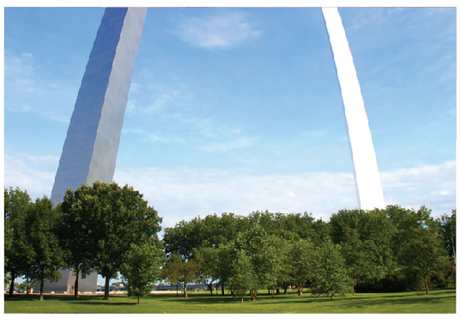
Further Applications of Integration
Chapter 8

Slide 2
8.3 Applications to Physics and Engineering

Slide 3
Applications to Physics and Engineering
Among the many applications of integral calculus to physics and engineering, we consider two here: force due to water pressure and centers of mass.

Slide 4
Hydrostatic Pressure and Force

Slide 5
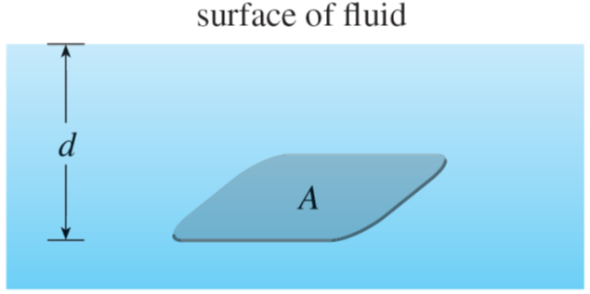
Hydrostatic Pressure and Force (1 of 5)
Deep-sea divers realize that water pressure increases as they dive deeper. This is because the weight of the water above them increases.
In general, suppose that a thin horizontal plate with area A square meters is submerged in a fluid of density ρ kilograms per cubic meter at a depth d meters below the surface of the fluid as in Figure 1.
Figure 1

Slide 6
Hydrostatic Pressure and Force (2 of 5)
The fluid directly above the plate has volume V = Ad, so its mass is m = ρV = ρAd. The force exerted by the fluid on the plate is therefore
where g is the acceleration due to gravity. The pressure P on the plate is defined to be the force per unit area:
The S I unit for measuring pressure is a newton per square meter, which is called a pascal

Slide 7
Hydrostatic Pressure and Force (3 of 5)
Since this is a small unit, the kilopascal (kPa) is often used.
For instance, because the density of water is
the pressure
at the bottom of a swimming pool 2 m deep is

Slide 8
Hydrostatic Pressure and Force (4 of 5)
An important principle of fluid pressure is the experimentally verified fact that at any point in a liquid the pressure is the same in all directions.
(A diver feels the same pressure on nose and both ears.)
Thus the pressure in any direction at a depth d in a fluid with mass density ρ is given by

Slide 9
Hydrostatic Pressure and Force (5 of 5)
This helps us determine the hydrostatic force against a vertical plate or wall or dam in a fluid.
This is not a straightforward problem because the pressure is not constant but increases as the depth increases

Slide 10
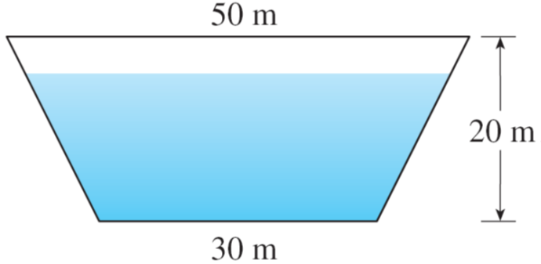
Example 1
A dam has the shape of the trapezoid shown in Figure 2. The height is 20 m and the width is 50 m at the top and 30 m at the bottom. Find the force on the dam due to hydrostatic pressure if the water level is 4 m from the top of the dam.
Figure 2

Slide 11
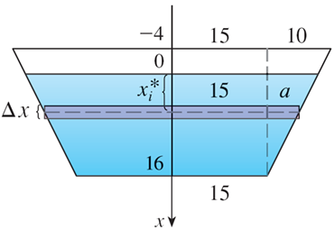
Example 1 – Solution (1 of 6)
We choose a vertical x-axis with origin at the surface of the water and directed downward as in Figure 3(a).
Figure 3(a)
The depth of the water is 16 m, so we divide the interval [0, 16] into
subintervals of equal length with endpoints x_{i} and we choose

Slide 12
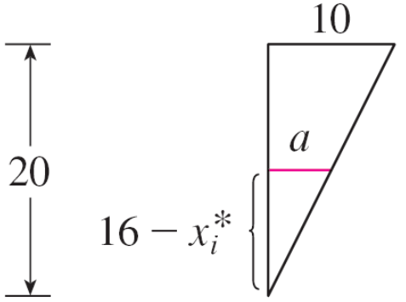
Example 1 – Solution (2 of 6)
The ith horizontal strip of the dam is approximated by a rectangle with height Δx and width w_{i}, where, from similar triangles in Figure 3(b),
or
and so
Figure 3(b)

Slide 13
Example 1 – Solution (3 of 6)
If A_{i} is the area of the i th strip, then

Slide 14
Example 1 – Solution (4 of 6)
If Δx is small, then the pressure P_{i} on the i th strip is almost constant and we can use Equation 1 to write
The hydrostatic force F_{i} acting on the i th strip is the product of the pressure and the area:

Slide 15
Example 1 – Solution (5 of 6)
Adding these forces and taking the limit as n →∞, we obtain the total hydrostatic force on the dam:

Slide 16
Example 1 – Solution (6 of 6)

Slide 17
Moments and Centers of Mass

Slide 18
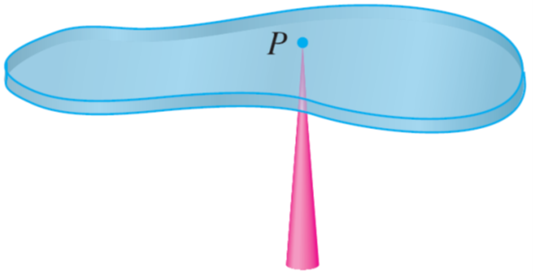
Moments and Centers of Mass (1 of 9)
Our main objective here is to find the point P on which a thin plate of any given shape balances horizontally as in Figure 5.
This point is called the center of mass (or center of gravity) of the plate.
Figure 5

Slide 19
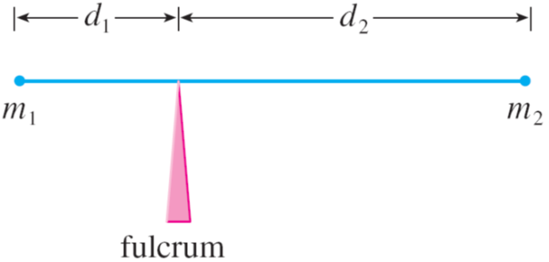
Moments and Centers of Mass (2 of 9)
We first consider the simpler situation illustrated in Figure 6, where two masses m₁ and m₂ are attached to a rod of negligible mass on opposite sides of a fulcrum and at distances d₁ and d₂ from the fulcrum.
Figure 6

Slide 20
Moments and Centers of Mass (3 of 9)
The rod will balance if
This is an experimental fact discovered by Archimedes and called the Law of the Lever. (Think of a lighter person balancing a heavier one on a seesaw by sitting farther away from the center.)
Now suppose that the rod lies along the x-axis with m₁ at x₁ and m₂ at x₂
and the center of mass at

Slide 21
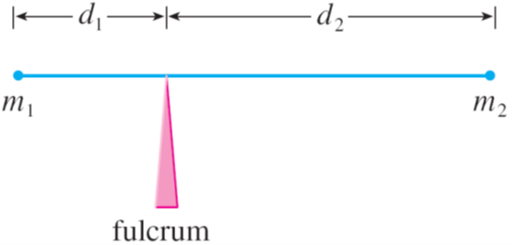
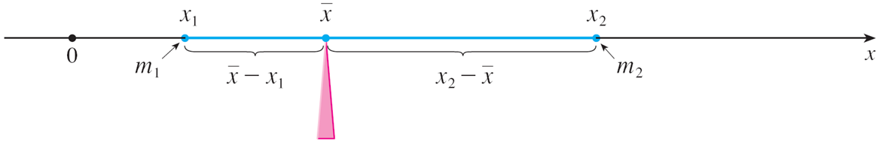
Moments and Centers of Mass (4 of 9)
If we compare Figures 6 and 7, we see that
and so Equation 2 gives
Figure 6
Figure 7

Slide 22
Moments and Centers of Mass (5 of 9)
The numbers m₁x₁ and m₂x₂ are called the moments of the masses m₁ and m₂
(with respect to the origin), and Equation 3 says that the center of mass
is obtained by adding the moments of the masses and dividing by the total mass m = m₁ + m₂

Slide 23
Moments and Centers of Mass (6 of 9)
In general, if we have a system of n particles with masses m₁, m₂, . . . , m_{n} located at the points x₁, x₂, . . . , x_{n} on the x-axis, it can be shown similarly that the center of mass of the system is located at
is the total mass of the system, and the sum of the individual
moments
is called the moment of the system about the origin.

Slide 24
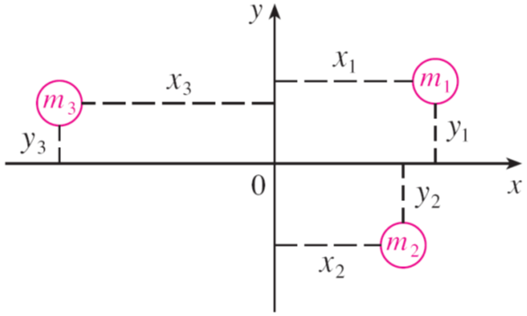
Moments and Centers of Mass (7 of 9)
Then Equation 4 could be rewritten as
which says that if the total
mass were considered as being concentrated at the center of mass
then its moment would be the same as the moment of the system.
Now we consider a system of n particles with masses m₁, m₂, . . . , m_{n} located at the points (x₁, y₁), (x₂, y₂), . . . , (x_{n}, y_{n}) in the xy-plane as shown in Figure 8.
Figure 8

Slide 25
Moments and Centers of Mass (8 of 9)
By analogy with the one-dimensional case, we define the moment of the system about the y-axis to be
and the moment of the system about the x-axis as
Then M_{y} measures the tendency of the system to rotate about the y-axis and M_{x} measures the tendency to rotate about the x-axis.

Slide 26
Moments and Centers of Mass (9 of 9)
As in the one-dimensional case, the coordinates
of the center of mass
are given in terms of the moments by the formulas
where m = Σm_{i} is the total mass. Since
the center of
mass
is the point where a single particle of mass m would have the
the same moments as the system.

Slide 27
Example 3
Find the moments and center of mass of the system of objects that have masses 3, 4, and 8 at the points (−1, 1), (2, −1), and (3, 2), respectively.
Solution:
We use Equations 5 and 6 to compute the moments:

Slide 28
Example 3 – Solution (1 of 2)
Since m = 3 + 4 + 8 = 15, we use Equations 7 to obtain

Slide 29
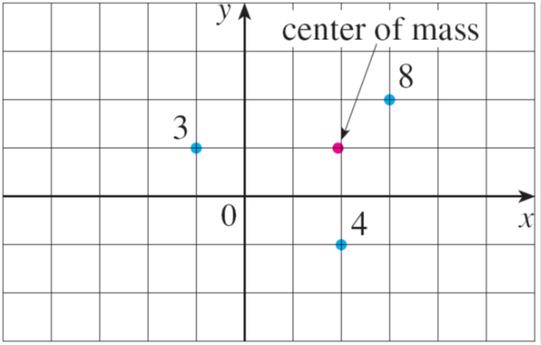
Example 3 – Solution (2 of 2)
Thus the center of mass is
(See Figure 9.)
Figure 9

Slide 30
Moments and Centers of Mass (1 of 10)
Next we consider a flat plate (called a lamina) with uniform density ρ that
occupies a region
of the plane.
We wish to locate the center of mass of the plate, which is called the centroid of
In doing so we use the following physical principles: The symmetry principle
says that if
is symmetric about a line l, then the centroid of
lies on l. (If
remains the same so its centroid remains fixed.
But the only fixed points lie on l.)
Thus the centroid of a rectangle is its center.

Slide 31
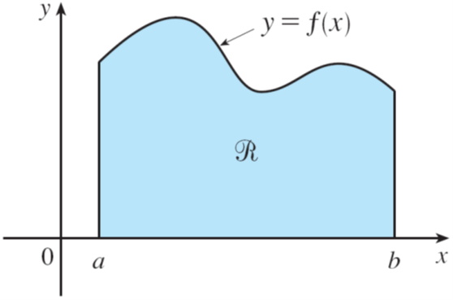
Moments and Centers of Mass (2 of 10)
Moments should be defined so that if the entire mass of a region is concentrated at the center of mass, then its moments remain unchanged.
Also, the moment of the union of two nonoverlapping regions should be the sum of the moments of the individual regions.
Suppose that the region
is of the type shown in Figure 10(a); that is,
lies between the lines x = a and x = b, above the x-axis, and beneath the graph of f, where f is a continuous function.
Figure 10(a)

Slide 32
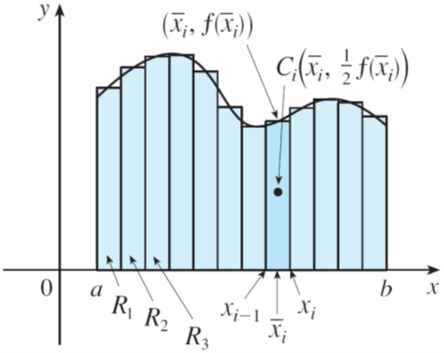
Moments and Centers of Mass (3 of 10)
We divide the interval [a, b] into n subintervals with endpoints x₀, x₁, . . . , x_{n}
and equal width Δx. We choose the sample point x_{i}* to be the midpoint
of the i th subinterval, that is,
This determines the polygonal approximation to
shown in Figure 10(b).
Figure 10(b)

Slide 33
Moments and Centers of Mass (4 of 10)
The centroid of the i th approximating rectangle R_{i} is its center
Its area is
so its mass is
The moment of R_{i} about the y-axis is the product of its mass and the distance
from C_{i} to the y-axis, which is
Thus

Slide 34
Moments and Centers of Mass (5 of 10)
Adding these moments, we obtain the moment of the polygonal approximation to
and then by taking the limit as n → ∞ we obtain the moment of
itself about the
y-axis:

Slide 35
Moments and Centers of Mass (6 of 10)
In a similar fashion we compute the moment of R_{i} about the x-axis as the product of its mass and the distance from C_{i} to the x-axis:
Again we add these moments and take the limit to obtain the moment of
about the x-axis:

Slide 36
Moments and Centers of Mass (7 of 10)
Just as for systems of particles, the center of mass of the plate is defined so that
But the mass of the plate is the product of its density
and its area:
and so

Slide 37
Moments and Centers of Mass (8 of 10)
Notice the cancellation of the ρ’s. The location of the center of mass is independent of the density.
In summary, the center of mass of the plate (or the centroid of
is located at the point

Slide 38
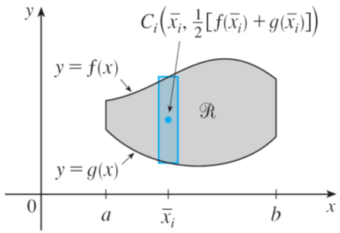
Moments and Centers of Mass (9 of 10)
If the region
lies between two curves y = f (x) and y = g (x), where f (x) ≥ g (x),
as illustrated in Figure 13, then the same sort of argument that led to Formulas
8 can be used to show that the centroid of
Figure 13

Slide 39
Moments and Centers of Mass (10 of 10)
We end this section by showing a surprising connection between centroids and volumes of revolution.
Theorem of Pappus Let
be a plane region that lies entirely on one side of a
line l in the plane. If
is rotated about l, then the volume of the resulting
solid is the product of the area A of
and the distance d traveled by the
centroid of

Slide 40
Example 7
A torus is formed by rotating a circle of radius r about a line in the plane of the circle that is a distance R (> r) from the center of the circle. Find the volume of the torus.
Solution:
The circle has area
By the symmetry principle, its centroid is
its center and so the distance traveled by the centroid during a rotation is d = 2πR.
Therefore, by the Theorem of Pappus, the volume of the torus is

