Slide 1
The Foundations: Logic and Proofs
Chapter 1, Part II
With Question/Answer Animations
Copyright © McGraw-Hill Education. All rights reserved. No reproduction or distribution without the prior written consent of McGraw-Hill Education.

Slide 2
Propositional Equivalences
Section 1.3

Slide 3
Section Summary
Tautologies, Contradictions, and Contingencies.
Logical Equivalence
  Important Logical Equivalences
  Showing Logical Equivalence
Normal Forms (optional, covered in exercises in text)
  Disjunctive Normal Form
  Conjunctive Normal Form
Propositional Satisfiability
  Sudoku Example

Slide 4
Tautologies, Contradictions, and Contingencies
A tautology is a proposition which is always true.
  Example: p ∨¬p
A contradiction is a proposition which is always false.
  Example: p ∧¬p
A contingency is a proposition which is neither a tautology nor a contradiction, such as p
P | ¬p | p ∨¬p | p ∧¬p
T | F | T | F
F | T | T | F

Slide 5
Logically Equivalent
Two compound propositions p and q are logically equivalent if p↔q is a tautology.
We write this as p⇔q or as p≡q where p and q are compound propositions.
Two compound propositions p and q are equivalent if and only if the columns in a truth table giving their truth values agree.
This truth table shows that ¬p ∨ q is equivalent to p → q.
p | q | ¬p | ¬p ∨ q | p→ q
T | T | F | T | T
T | F | F | F | F
F | T | T | T | T
F | F | T | T | T

Slide 6
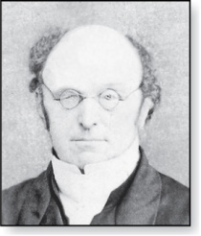
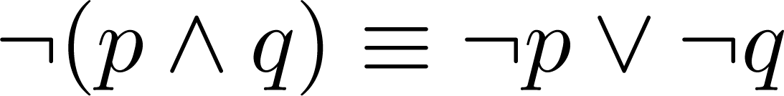
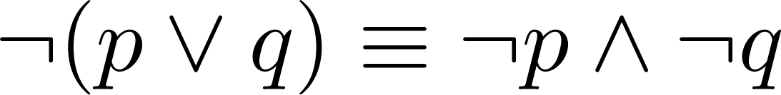
De Morgan’s Laws
Augustus De Morgan
1806-1871
This truth table shows that De Morgan’s Second Law holds.
p | q | ¬p | ¬q | (p∨q) | ¬(p∨q) | ¬p∧¬q
T | T | F | F | T | F | F
T | F | F | T | T | F | F
F | T | T | F | T | F | F
F | F | T | T | F | T | T

Slide 7
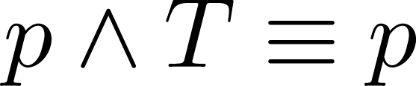
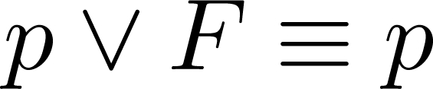
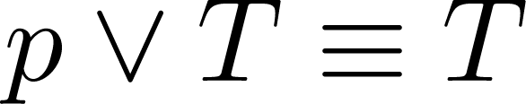
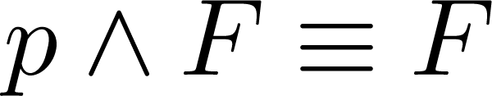
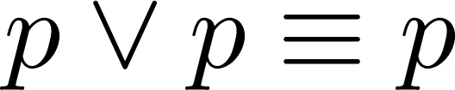
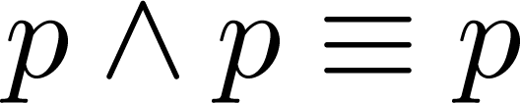
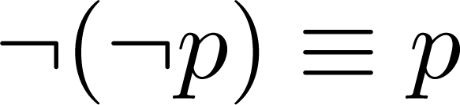
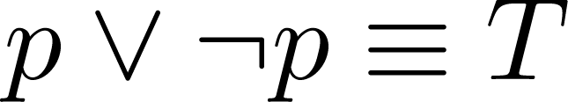
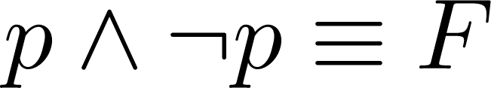
Key Logical Equivalences
Identity Laws: ,
Domination Laws: ,
Idempotent laws: ,
Double Negation Law:
Negation Laws: ,

Slide 8
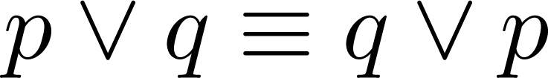
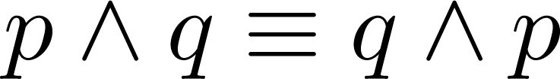
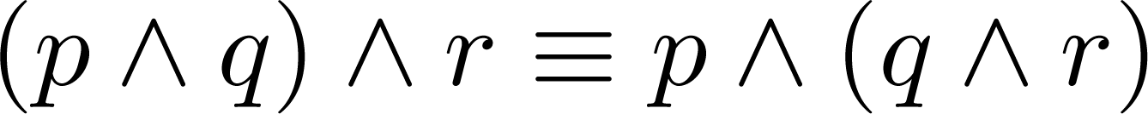
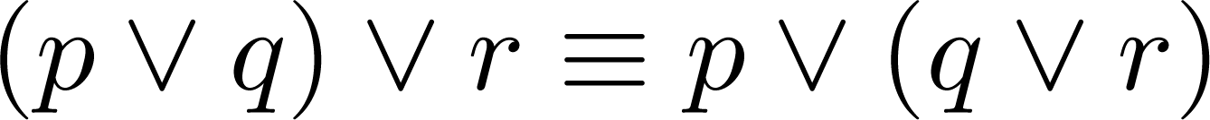
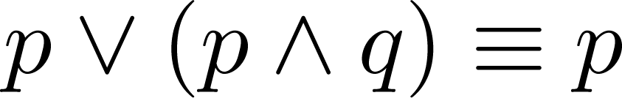
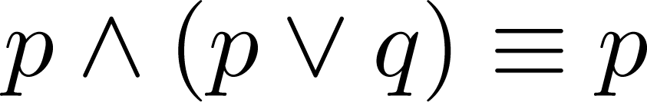
Key Logical Equivalences (cont)
Commutative Laws: ,
Associative Laws:
Distributive Laws:
Absorption Laws:

Slide 9
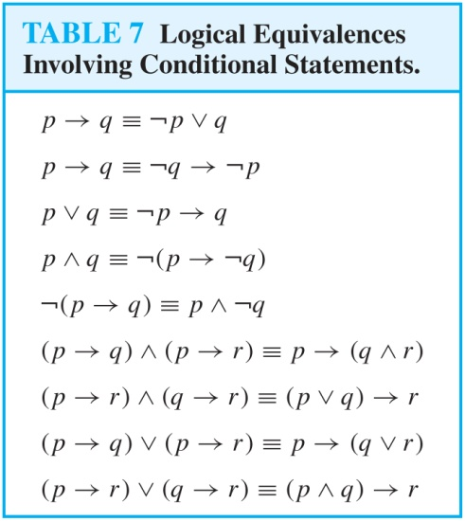
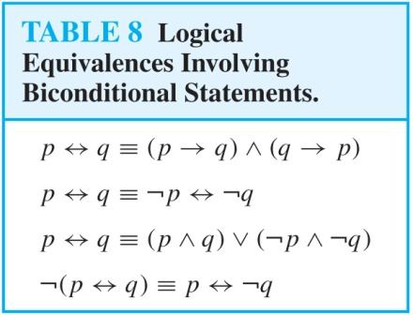
More Logical Equivalences

Slide 10

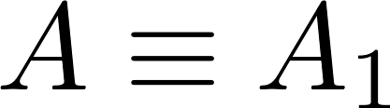
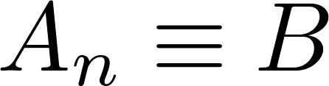
Constructing New Logical Equivalences
We can show that two expressions are logically equivalent by developing a series of logically equivalent statements.
To prove that we produce a series of equivalences beginning with A and ending with B.
Keep in mind that whenever a proposition (represented by a propositional variable) occurs in the equivalences listed earlier, it may be replaced by an arbitrarily complex compound proposition.

Slide 11
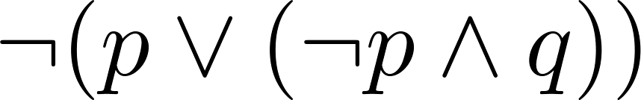
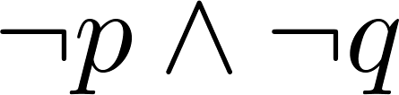
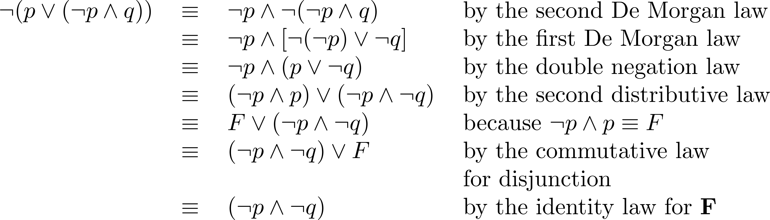
Equivalence Proofs
Example: Show that
is logically equivalent to
Solution:

Slide 12
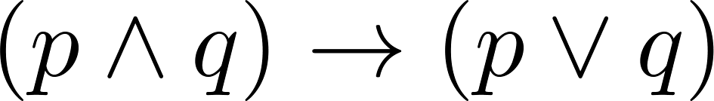
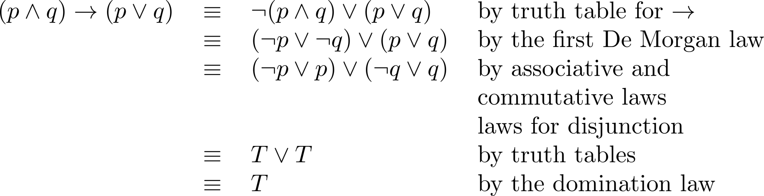
Equivalence Proofs
Example: Show that
is a tautology.
Solution:

Slide 13
Predicates and Quantifiers
Section 1.4

Slide 14
Section Summary
Predicates
Variables
Quantifiers
  Universal Quantifier
  Existential Quantifier
Negating Quantifiers
  De Morgan’s Laws for Quantifiers
Translating English to Logic
Logic Programming (optional)

Slide 15
Propositional Logic Not Enough
If we have:
  “All men are mortal.”
  “Socrates is a man.”
Does it follow that “Socrates is mortal?”
Can’t be represented in propositional logic. Need a language that talks about objects, their properties, and their relations.
Later we’ll see how to draw inferences.

Slide 16
Introducing Predicate Logic
Predicate logic uses the following new features:
  Variables: x, y, z
  Predicates: P(x), M(x)
  Quantifiers (to be covered in a few slides):
Propositional functions are a generalization of propositions.
  They contain variables and a predicate, e.g., P(x)
  Variables can be replaced by elements from their domain.

Slide 17
Propositional Functions
Propositional functions become propositions (and have truth values) when their variables are each replaced by a value from the domain (or bound by a quantifier, as we will see later).
The statement P(x) is said to be the value of the propositional function P at x.
For example, let P(x) denote “x > 0” and the domain be the integers. Then:
  P(-3) is false.
  P(0) is false.
  P(3) is true.
Often the domain is denoted by U. So in this example U is the integers.

Slide 18
Examples of Propositional Functions
Let “x + y = z” be denoted by R(x, y, z) and U (for all three variables) be the integers. Find these truth values:
  R(2,-1,5)
    Solution: F
  R(3,4,7)
    Solution: T
  R(x, 3, z)
    Solution: Not a Proposition
Now let “x - y = z” be denoted by Q(x, y, z), with U as the integers. Find these truth values:
  Q(2,-1,3)
    Solution: T
  Q(3,4,7)
    Solution: F
  Q(x, 3, z)
    Solution: Not a Proposition

Slide 19
Compound Expressions
Connectives from propositional logic carry over to predicate logic.
If P(x) denotes “x > 0,” find these truth values:
  P(3) ∨ P(-1) Solution: T
  P(3) ∧ P(-1) Solution: F
  P(3) → P(-1) Solution: F
  P(3) → ¬P(-1) Solution: T
Expressions with variables are not propositions and therefore do not have truth values. For example,
  P(3) ∧ P(y)
  P(x) → P(y)
When used with quantifiers (to be introduced next), these expressions (propositional functions) become propositions.

Slide 20
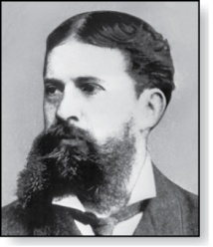
Quantifiers
Charles Peirce (1839-1914)
We need quantifiers to express the meaning of English words including all and some:
  “All men are Mortal.”
  “Some cats do not have fur.”
The two most important quantifiers are:
  Universal Quantifier, “For all,” symbol: ∀
  Existential Quantifier, “There exists,” symbol: ∃
We write as in ∀x P(x) and ∃x P(x).
∀x P(x) asserts P(x) is true for every x in the domain.
∃x P(x) asserts P(x) is true for some x in the domain.
The quantifiers are said to bind the variable x in these expressions.

Slide 21
Universal Quantifier
  ∀x P(x) is read as “For all x, P(x)” or “For every x, P(x)”
  Examples:
    If P(x) denotes “x > 0” and U is the integers, then ∀x P(x) is false.
    If P(x) denotes “x > 0” and U is the positive integers, then ∀x P(x) is true.
    If P(x) denotes “x is even” and U is the integers, then ∀ x P(x) is false.

Slide 22
Existential Quantifier
∃x P(x) is read as “For some x, P(x)”, or as “There is an x such that P(x),” or “For at least one x, P(x).”
  Examples:
    If P(x) denotes “x > 0” and U is the integers, then ∃x P(x) is true. It is also true if U is the positive integers.
    If P(x) denotes “x < 0” and U is the positive integers, then ∃x P(x) is false.
    If P(x) denotes “x is even” and U is the integers, then ∃x P(x) is true.

Slide 23
Uniqueness Quantifier (optional)
∃!x P(x) means that P(x) is true for one and only one x in the universe of discourse.
This is commonly expressed in English in the following equivalent ways:
  “There is a unique x such that P(x).”
  “There is one and only one x such that P(x)”
Examples:
  If P(x) denotes “x + 1 = 0” and U is the integers, then ∃!x P(x) is true.
  But if P(x) denotes “x > 0,” then ∃!x P(x) is false.
The uniqueness quantifier is not really needed as the restriction that there is a unique x such that P(x) can be expressed as:
∃x (P(x) ∧∀y (P(y) → y =x))

Slide 24
Thinking about Quantifiers
When the domain of discourse is finite, we can think of quantification as looping through the elements of the domain.
To evaluate ∀x P(x) loop through all x in the domain.
  If at every step P(x) is true, then ∀x P(x) is true.
  If at a step P(x) is false, then ∀x P(x) is false and the loop terminates.
To evaluate ∃x P(x) loop through all x in the domain.
  If at some step, P(x) is true, then ∃x P(x) is true and the loop terminates.
  If the loop ends without finding an x for which P(x) is true, then ∃x P(x) is false.
Even if the domains are infinite, we can still think of the quantifiers this fashion, but the loops will not terminate in some cases.

Slide 25
Properties of Quantifiers
The truth value of ∃x P(x) and ∀ x P(x) depend on both the propositional function P(x) and on the domain U.
Examples:
  If U is the positive integers and P(x) is the statement “x < 2”, then ∃x P(x) is true, but ∀ x P(x) is false.
  If U is the negative integers and P(x) is the statement “x < 2”, then both ∃x P(x) and ∀ x P(x) are true.
  If U consists of 3, 4, and 5, and P(x) is the statement “x > 2”, then both ∃x P(x) and ∀ x P(x) are true. But if P(x) is the statement “x < 2”, then both ∃x P(x) and ∀ x P(x) are false.

Slide 26
Precedence of Quantifiers
The quantifiers ∀ and ∃ have higher precedence than all the logical operators.
For example, ∀x P(x) ∨ Q(x) means (∀x P(x))∨ Q(x)
∀x (P(x) ∨ Q(x)) means something different.
Unfortunately, often people write ∀x P(x) ∨ Q(x) when they mean ∀ x (P(x) ∨ Q(x)).

Slide 27
Translating from English to Logic
Example 1: Translate the following sentence into predicate logic: “Every student in this class has taken a course in Java.”
Solution:
First decide on the domain U.
  Solution 1: If U is all students in this class, define a propositional function J(x) denoting “x has taken a course in Java” and translate as ∀x J(x).
  Solution 2: But if U is all people, also define a propositional function S(x) denoting “x is a student in this class” and translate as ∀x (S(x)→ J(x)).
    ∀x (S(x) ∧ J(x)) is not correct. What does it mean?

Slide 28
Translating from English to Logic
Example 2: Translate the following sentence into predicate logic: “Some student in this class has taken a course in Java.”
Solution:
First decide on the domain U.
  Solution 1: If U is all students in this class, translate as
  ∃x J(x)
  Solution 2: But if U is all people, then translate as ∃x (S(x) ∧ J(x))
    ∃x (S(x)→ J(x)) is not correct. What does it mean?

Slide 29
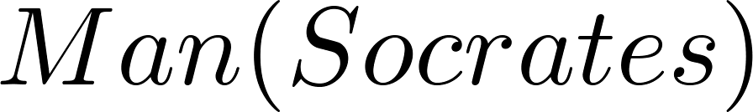
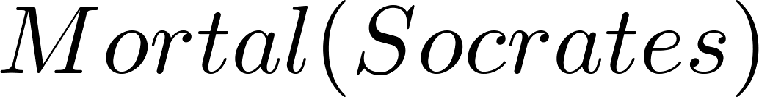
Returning to the Socrates Example
Introduce the propositional functions Man(x) denoting “x is a man” and Mortal(x) denoting “x is mortal.” Specify the domain as all people.
The two premises are:
The conclusion is:
Later we will show how to prove that the conclusion follows from the premises.

Slide 30
Equivalences in Predicate Logic
Statements involving predicates and quantifiers are logically equivalent if and only if they have the same truth value
  for every predicate substituted into these statements and
  for every domain of discourse used for the variables in the expressions.
The notation S ≡T indicates that S and T are logically equivalent.
Example: ∀x ¬¬S(x) ≡ ∀x S(x)

Slide 31
Thinking about Quantifiers as Conjunctions and Disjunctions
If the domain is finite, a universally quantified proposition is equivalent to a conjunction of propositions without quantifiers and an existentially quantified proposition is equivalent to a disjunction of propositions without quantifiers.
If U consists of the integers 1,2, and 3:
Even if the domains are infinite, you can still think of the quantifiers in this fashion, but the equivalent expressions without quantifiers will be infinitely long.

Slide 32
Negating Quantified Expressions
Consider ∀x J(x)
  “Every student in your class has taken a course in Java.”
  Here J(x) is “x has taken a course in Java” and
  the domain is students in your class.
Negating the original statement gives “It is not the case that every student in your class has taken Java.” This implies that “There is a student in your class who has not taken Java.”
Symbolically ¬∀x J(x) and ∃x ¬J(x) are equivalent

Slide 33
Negating Quantified Expressions (continued)
Now Consider ∃ x J(x)
  “There is a student in this class who has taken a course in Java.”
  Where J(x) is “x has taken a course in Java.”
Negating the original statement gives “It is not the case that there is a student in this class who has taken Java.” This implies that “Every student in this class has not taken Java”
Symbolically ¬∃ x J(x) and ∀ x ¬J(x) are equivalent

Slide 34
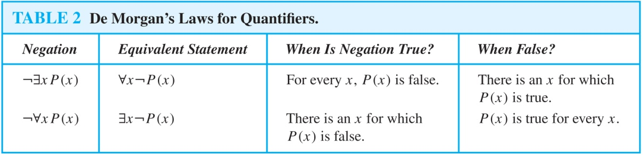
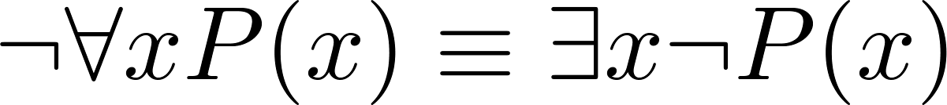
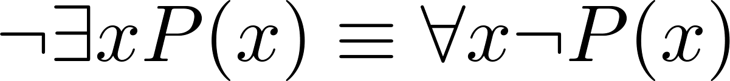
De Morgan’s Laws for Quantifiers
The rules for negating quantifiers are:
The reasoning in the table shows that:
These are important. You will use these.

Slide 35
Translation from English to Logic
Examples:
“Some student in this class has visited Mexico.”
  Solution: Let M(x) denote “x has visited Mexico” and S(x) denote “x is a student in this class,” and U be all people.
  ∃x (S(x) ∧ M(x))
“Every student in this class has visited Canada or Mexico.”
  Solution: Add C(x) denoting “x has visited Canada.”
  ∀x (S(x)→ (M(x)∨C(x)))

Slide 36
Some Fun with Translating from English into Logical Expressions
U = {fleegles, snurds, thingamabobs}
  F(x): x is a fleegle
  S(x): x is a snurd
  T(x): x is a thingamabob
Translate “Everything is a fleegle”
Solution: ∀x F(x)

Slide 37
Translation (cont)
U = {fleegles, snurds, thingamabobs}
  F(x): x is a fleegle
  S(x): x is a snurd
  T(x): x is a thingamabob
“Nothing is a snurd.”
Solution: ¬∃x S(x) What is this equivalent to?
Solution: ∀x ¬ S(x)

Slide 38
Translation (cont)
U = {fleegles, snurds, thingamabobs}
  F(x): x is a fleegle
  S(x): x is a snurd
  T(x): x is a thingamabob
“All fleegles are snurds.”
Solution: ∀x (F(x)→ S(x))

Slide 39
Translation (cont)
U = {fleegles, snurds, thingamabobs}
  F(x): x is a fleegle
  S(x): x is a snurd
  T(x): x is a thingamabob
“Some fleegles are thingamabobs.”
Solution: ∃x (F(x) ∧ T(x))

Slide 40
Translation (cont)
U = {fleegles, snurds, thingamabobs}
  F(x): x is a fleegle
  S(x): x is a snurd
  T(x): x is a thingamabob
“No snurd is a thingamabob.”
Solution: ¬∃x (S(x) ∧ T(x)) What is this equivalent to?
Solution: ∀x (¬S(x) ∨ ¬T(x))

Slide 41
Translation (cont)
U = {fleegles, snurds, thingamabobs}
  F(x): x is a fleegle
  S(x): x is a snurd
  T(x): x is a thingamabob
“If any fleegle is a snurd then it is also a thingamabob.”
Solution: ∀x ((F(x) ∧ S(x))→ T(x))

Slide 42
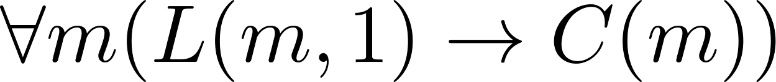
System Specification Example
Predicate logic is used for specifying properties that systems must satisfy.
For example, translate into predicate logic:
  “Every mail message larger than one megabyte will be compressed.”
  “If a user is active, at least one network link will be available.”
Decide on predicates and domains (left implicit here) for the variables:
  Let L(m, y) be “Mail message m is larger than y megabytes.”
  Let C(m) denote “Mail message m will be compressed.”
  Let A(u) represent “User u is active.”
  Let S(n, x) represent “Network link n is state x.
Now we have:

Slide 43
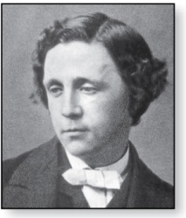
Lewis Carroll Example
Charles Lutwidge Dodgson
(AKA Lewis Caroll)
(1832-1898)
The first two are called premises and the third is called the conclusion.
  “All lions are fierce.”
  “Some lions do not drink coffee.”
  “Some fierce creatures do not drink coffee.”
Here is one way to translate these statements to predicate logic. Let P(x), Q(x), and R(x) be the propositional functions “x is a lion,” “x is fierce,” and “x drinks coffee,” respectively.
  ∀x (P(x)→ Q(x))
  ∃x (P(x) ∧ ¬R(x))
  ∃x (Q(x) ∧ ¬R(x))
Later we will see how to prove that the conclusion follows from the premises.

Slide 44
Nested Quantifiers
Section 1.5

Slide 45
Section Summary
Nested Quantifiers
Order of Quantifiers
Translating from Nested Quantifiers into English
Translating Mathematical Statements into Statements involving Nested Quantifiers.
Translated English Sentences into Logical Expressions.
Negating Nested Quantifiers.

Slide 46
Nested Quantifiers
Nested quantifiers are often necessary to express the meaning of sentences in English as well as important concepts in computer science and mathematics.
Example: “Every real number has an inverse” is
∀x ∃y(x + y = 0)
where the domains of x and y are the real numbers.
We can also think of nested propositional functions:
  ∀x ∃y(x + y = 0) can be viewed as ∀x Q(x) where Q(x) is ∃y P(x, y) where P(x, y) is (x + y = 0)

Slide 47
Thinking of Nested Quantification
Nested Loops
  To see if ∀x∀yP (x,y) is true, loop through the values of x :
    At each step, loop through the values for y.
    If for some pair of x andy, P(x,y) is false, then ∀x ∀yP(x,y) is false and both the outer and inner loop terminate.
  ∀x ∀y P(x,y) is true if the outer loop ends after stepping through each x.
  To see if ∀x ∃yP(x,y) is true, loop through the values of x:
    At each step, loop through the values for y.
    The inner loop ends when a pair x and y is found such that P(x, y) is true.
    If no y is found such that P(x, y) is true the outer loop terminates as ∀x ∃yP(x,y) has been shown to be false.
  ∀x ∃y P(x,y) is true if the outer loop ends after stepping through each x.
If the domains of the variables are infinite, then this process can not actually be carried out.

Slide 48
Order of Quantifiers
Examples:
Let P(x,y) be the statement “x + y = y + x.” Assume that U is the real numbers. Then ∀x ∀yP(x,y) and ∀y ∀xP(x,y) have the same truth value.
Let Q(x,y) be the statement “x + y = 0.” Assume that U is the real numbers. Then ∀x ∃yQ(x,y) is true, but ∃y ∀xQ(x,y) is false.

Slide 49
Questions on Order of Quantifiers
Example 1: Let U be the real numbers,
Define P(x,y) : x ∙ y = 0
What is the truth value of the following:
  ∀x∀yP(x,y)
    Answer: False
  ∀x∃yP(x,y)
    Answer: True
  ∃x∀y P(x,y)
    Answer: True
  ∃x ∃ y P(x,y)
  Answer: True

Slide 50
Questions on Order of Quantifiers
Example 2: Let U be the real numbers,
Define P(x,y) : x / y = 1
What is the truth value of the following:
  ∀x∀yP(x,y)
    Answer: False
  ∀x∃yP(x,y)
    Answer: False
  ∃x∀y P(x,y)
    Answer: False
  ∃x ∃ y P(x,y)
    Answer: True

Slide 51
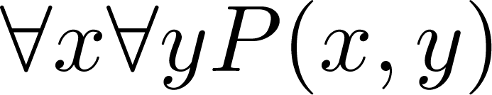
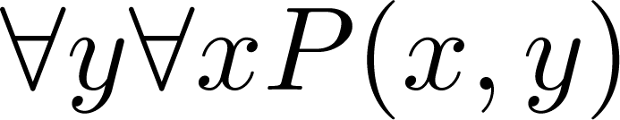
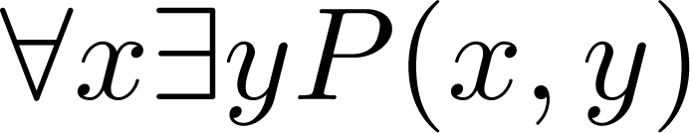
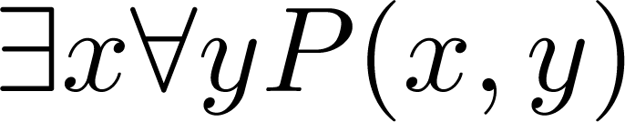
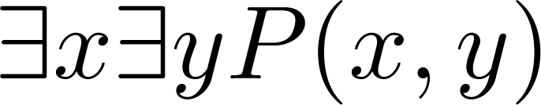
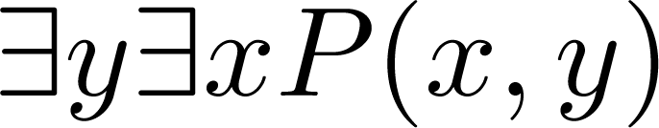
Quantifications of Two Variables
Statement | When True? | When False
 | P(x,y) is true for every pair x,y. | There is a pair x, y for which P(x,y) is false.
 | For every x there is a y for which P(x,y) is true. | There is an x such that P(x,y) is false for every y.
 | There is an x for which P(x,y) is true for every y. | For every x there is a y for which P(x,y) is false.
 | There is a pair x, y for which P(x,y) is true. | P(x,y) is false for every pair x,y

Slide 52
Translating Nested Quantifiers into English
  Example 1: Translate the statement
  ∀x (C(x )∨ ∃y (C(y ) ∧ F(x, y)))
  where C(x) is “x has a computer,” and F(x,y) is “x and y are friends,” and the domain for both x and y consists of all students in your school.
  Solution: Every student in your school has a computer or has a friend who has a computer.
  Example 2: Translate the statement
∃x∀y ∀z ((F(x, y)∧ F(x,z) ∧ (y ≠z))→¬F(y,z))
Solution: There is a student none of whose friends are also friends with each other.

Slide 53
Translating Mathematical Statements into Predicate Logic
Example : Translate “The sum of two positive integers is always positive” into a logical expression.
Solution:
  Rewrite the statement to make the implied quantifiers and domains explicit:
    “For every two integers, if these integers are both positive, then the sum of these integers is positive.”
  Introduce the variables x and y, and specify the domain, to obtain:
    “For all positive integers x and y, x + y is positive.”
  The result is:
    ∀x ∀ y ((x > 0)∧ (y > 0)→ (x + y > 0))
    where the domain of both variables consists of all integers

Slide 54
Translating English into Logical Expressions Example
Example: Use quantifiers to express the statement “There is a woman who has taken a flight on every airline in the world.”
Solution:
  Let P(w,f) be “w has taken f ” and Q(f,a) be “f is a flight on a .”
  The domain of w is all women, the domain of f is all flights, and the domain of a is all airlines.
  Then the statement can be expressed as:
  ∃w ∀a ∃f (P(w,f ) ∧ Q(f,a))

