Slide 1
Nested Quantifiers
Section 1.5

Slide 2
Section Summary
Nested Quantifiers
Order of Quantifiers
Translating from Nested Quantifiers into English
Translating Mathematical Statements into Statements involving Nested Quantifiers.
Translated English Sentences into Logical Expressions.
Negating Nested Quantifiers.

Slide 3
Nested Quantifiers
Nested quantifiers are often necessary to express the meaning of sentences in English as well as important concepts in computer science and mathematics.
Example: “Every real number has an inverse” is
∀x ∃y(x + y = 0)
where the domains of x and y are the real numbers.
We can also think of nested propositional functions:
  ∀x ∃y(x + y = 0) can be viewed as ∀x Q(x) where Q(x) is ∃y P(x, y) where P(x, y) is (x + y = 0)

Slide 4
Thinking of Nested Quantification
Nested Loops
  To see if ∀x∀yP (x,y) is true, loop through the values of x :
    At each step, loop through the values for y.
    If for some pair of x andy, P(x,y) is false, then ∀x ∀yP(x,y) is false and both the outer and inner loop terminate.
  ∀x ∀y P(x,y) is true if the outer loop ends after stepping through each x.
  To see if ∀x ∃yP(x,y) is true, loop through the values of x:
    At each step, loop through the values for y.
    The inner loop ends when a pair x and y is found such that P(x, y) is true.
    If no y is found such that P(x, y) is true the outer loop terminates as ∀x ∃yP(x,y) has been shown to be false.
  ∀x ∃y P(x,y) is true if the outer loop ends after stepping through each x.
If the domains of the variables are infinite, then this process can not actually be carried out.

Slide 5
Order of Quantifiers
Examples:
Let P(x,y) be the statement “x + y = y + x.” Assume that U is the real numbers. Then ∀x ∀yP(x,y) and ∀y ∀xP(x,y) have the same truth value.
Let Q(x,y) be the statement “x + y = 0.” Assume that U is the real numbers. Then ∀x ∃yQ(x,y) is true, but ∃y ∀xQ(x,y) is false.

Slide 6
Questions on Order of Quantifiers
Example 1: Let U be the real numbers,
Define P(x,y) : x ∙ y = 0
What is the truth value of the following:
  ∀x∀yP(x,y)
    Answer: False
  ∀x∃yP(x,y)
    Answer: True
  ∃x∀y P(x,y)
    Answer: True
  ∃x ∃ y P(x,y)
  Answer: True

Slide 7
Questions on Order of Quantifiers
Example 2: Let U be the real numbers,
Define P(x,y) : x / y = 1
What is the truth value of the following:
  ∀x∀yP(x,y)
    Answer: False
  ∀x∃yP(x,y)
    Answer: False
  ∃x∀y P(x,y)
    Answer: False
  ∃x ∃ y P(x,y)
    Answer: True

Slide 8
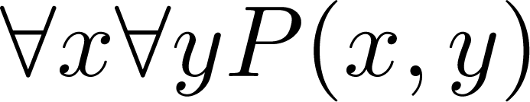
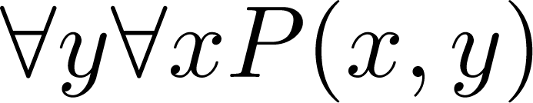
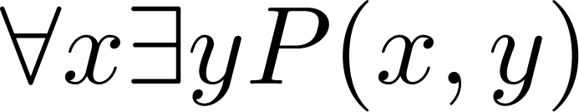
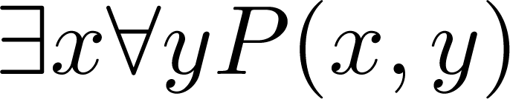
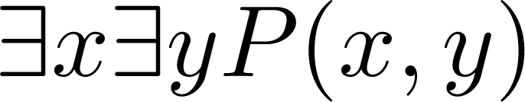
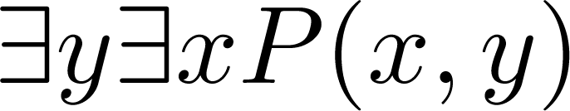
Quantifications of Two Variables
Statement | When True? | When False
 | P(x,y) is true for every pair x,y. | There is a pair x, y for which P(x,y) is false.
 | For every x there is a y for which P(x,y) is true. | There is an x such that P(x,y) is false for every y.
 | There is an x for which P(x,y) is true for every y. | For every x there is a y for which P(x,y) is false.
 | There is a pair x, y for which P(x,y) is true. | P(x,y) is false for every pair x,y

Slide 9
Translating Nested Quantifiers into English
  Example 1: Translate the statement
  ∀x (C(x )∨ ∃y (C(y ) ∧ F(x, y)))
  where C(x) is “x has a computer,” and F(x,y) is “x and y are friends,” and the domain for both x and y consists of all students in your school.
  Solution: Every student in your school has a computer or has a friend who has a computer.
  Example 2: Translate the statement
∃x∀y ∀z ((F(x, y)∧ F(x,z) ∧ (y ≠z))→¬F(y,z))
Solution: There is a student none of whose friends are also friends with each other.

Slide 10
Translating Mathematical Statements into Predicate Logic
Example : Translate “The sum of two positive integers is always positive” into a logical expression.
Solution:
  Rewrite the statement to make the implied quantifiers and domains explicit:
    “For every two integers, if these integers are both positive, then the sum of these integers is positive.”
  Introduce the variables x and y, and specify the domain, to obtain:
    “For all positive integers x and y, x + y is positive.”
  The result is:
    ∀x ∀ y ((x > 0)∧ (y > 0)→ (x + y > 0))
    where the domain of both variables consists of all integers

Slide 11
Translating English into Logical Expressions Example
Example: Use quantifiers to express the statement “There is a woman who has taken a flight on every airline in the world.”
Solution:
  Let P(w,f) be “w has taken f ” and Q(f,a) be “f is a flight on a .”
  The domain of w is all women, the domain of f is all flights, and the domain of a is all airlines.
  Then the statement can be expressed as:
  ∃w ∀a ∃f (P(w,f ) ∧ Q(f,a))

Slide 12
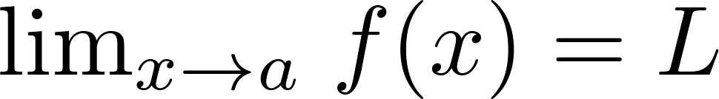
Calculus in Logic (optional)
Example: Use quantifiers to express the definition of the limit of a real-valued function f(x) of a real variable x at a point a in its domain.
Solution: Recall the definition of the statement
is “For every real number ε > 0, there exists a real number δ > 0 such that |f(x) – L| < ε whenever 0 < |x –a| < δ.”
Using quantifiers:
Where the domain for the variables ε and δ consists of all positive real numbers and the domain for x consists of all real numbers.

Slide 13
Questions on Translation from English
Choose the obvious predicates and express in predicate logic.
Example 1: “Brothers are siblings.”
Solution: ∀x ∀y (B(x,y) → S(x,y))
Example 2: “Siblinghood is symmetric.”
Solution: ∀x ∀y (S(x,y) → S(y,x))
Example 3: “Everybody loves somebody.”
Solution: ∀x ∃y L(x,y)
Example 4: “There is someone who is loved by everyone.”
Solution: ∃y ∀x L(x,y)
Example 5: “There is someone who loves someone.”
Solution: ∃x ∃y L(x,y)
Example 6: “Everyone loves himself”
Solution: ∀x L(x,x)

Slide 14
Negating Nested Quantifiers
Example 1: Recall the logical expression developed three slides back:
∃w ∀a ∃f (P(w,f ) ∧ Q(f,a))
Part 1: Use quantifiers to express the statement that “There does not exist a woman who has taken a flight on every airline in the world.”
Solution: ¬∃w ∀a ∃f (P(w,f ) ∧ Q(f,a))
Part 2: Now use De Morgan’s Laws to move the negation as far inwards as possible.
Solution:
¬∃w ∀a ∃f (P(w,f ) ∧ Q(f,a))
∀w ¬ ∀a ∃f (P(w,f ) ∧ Q(f,a)) by De Morgan’s for ∃
∀w ∃ a ¬ ∃f (P(w,f ) ∧ Q(f,a)) by De Morgan’s for ∀
∀w ∃ a ∀f ¬ (P(w,f ) ∧ Q(f,a)) by De Morgan’s for ∃
∀w ∃ a ∀f (¬ P(w,f ) ∨ ¬ Q(f,a)) by De Morgan’s for ∧.
Part 3: Can you translate the result back into English?
Solution:
“For every woman there is an airline such that for all flights, this woman has not taken that flight or that flight is not on this airline”

Slide 15


Return to Calculus and Logic (Opt)
Example : Recall the logical expression developed in the calculus example three slides back.
Use quantifiers and predicates to express that does not exist.
We need to say that for all real numbers L,
The result from the previous example can be negated to yield:
Now we can repeatedly apply the rules for negating quantified expressions:
The last step uses the equivalence ¬(p→q) ≡ p∧¬q

Slide 16
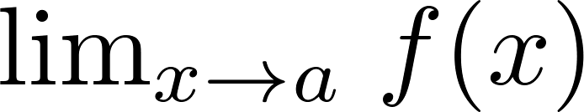

Calculus in Predicate Logic (optional)
Therefore, to say that does not exist means that for all real numbers L, can be expressed as:
Remember that ε and δ range over all positive real numbers and x over all real numbers.
Translating back into English we have, for every real number L, there is a real number ε > 0, such that for every real number δ > 0, there exists a real number x such that 0 < | x – a | < δ and |f(x) – L | ≥ ε .

Slide 17
Some Questions about Quantifiers (optional)
Can you switch the order of quantifiers?
  Is this a valid equivalence?
  Solution: Yes! The left and the right side will always have the same truth value. The order in which x and y are picked does not matter.
  Is this a valid equivalence?
  Solution: No! The left and the right side may have different truth values for some propositional functions for P. Try “x + y = 0” for P(x,y) with U being the integers. The order in which the values of x and y are picked does matter.
Can you distribute quantifiers over logical connectives?
  Is this a valid equivalence?
  Solution: Yes! The left and the right side will always have the same truth value no matter what propositional functions are denoted by P(x) and Q(x).
  Is this a valid equivalence?
  Solution: No! The left and the right side may have different truth values. Pick “x is a fish” for P(x) and “x has scales” for Q(x) with the domain of discourse being all animals. Then the left side is false, because there are some fish that do not have scales. But the right side is true since not all animals are fish.

Slide 18
Rules of Inference
Section 1.6

Slide 19
Section Summary
Valid Arguments
Inference Rules for Propositional Logic
Using Rules of Inference to Build Arguments
Rules of Inference for Quantified Statements
Building Arguments for Quantified Statements

Slide 20
Revisiting the Socrates Example
We have the two premises:
  “All men are mortal.”
  “Socrates is a man.”
And the conclusion:
  “Socrates is mortal.”
How do we get the conclusion from the premises?

Slide 21
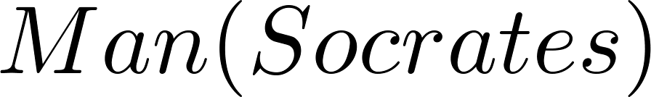
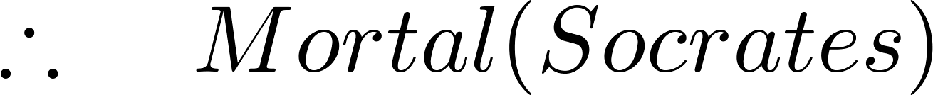
The Argument
We can express the premises (above the line) and the conclusion (below the line) in predicate logic as an argument:
We will see shortly that this is a valid argument.

Slide 22
Valid Arguments
We will show how to construct valid arguments in two stages; first for propositional logic and then for predicate logic. The rules of inference are the essential building block in the construction of valid arguments.
  Propositional Logic
    Inference Rules
  Predicate Logic
    Inference rules for propositional logic plus additional inference rules to handle variables and quantifiers.

Slide 23
Arguments in Propositional Logic
A argument in propositional logic is a sequence of propositions. All but the final proposition are called premises. The last statement is the conclusion.
The argument is valid if the premises imply the conclusion. An argument form is an argument that is valid no matter what propositions are substituted into its propositional variables.
If the premises are p₁ ,p₂, …,p_{n} and the conclusion is q then
(p₁ ∧ p₂ ∧ … ∧ p_{n} ) → q is a tautology.
Inference rules are all argument simple argument forms that will be used to construct more complex argument forms.

Slide 24
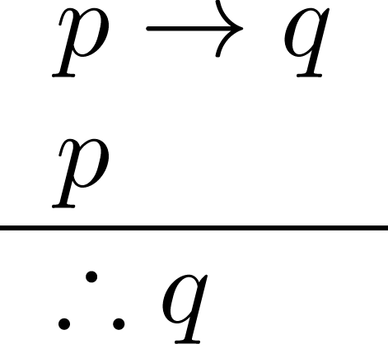
Rules of Inference for Propositional Logic: Modus Ponens
Corresponding Tautology:
(p ∧ (p →q)) → q
Example:
Let p be “It is snowing.”
Let q be “I will study discrete math.”
“If it is snowing, then I will study discrete math.”
“It is snowing.”
“Therefore , I will study discrete math.”

Slide 25
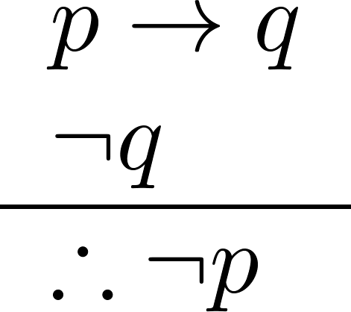
Modus Tollens
Corresponding Tautology:
(¬q∧(p →q))→¬p
Example:
Let p be “it is snowing.”
Let q be “I will study discrete math.”
“If it is snowing, then I will study discrete math.”
“I will not study discrete math.”
“Therefore , it is not snowing.”

Slide 26
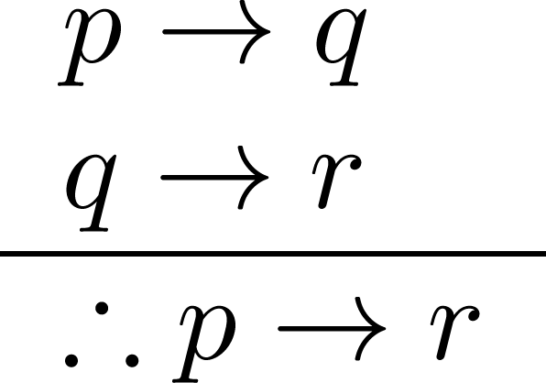
Hypothetical Syllogism
Corresponding Tautology:
((p →q) ∧ (q→r))→(p→ r)
Example:
Let p be “it snows.”
Let q be “I will study discrete math.”
Let r be “I will get an A.”
“If it snows, then I will study discrete math.”
“If I study discrete math, I will get an A.”
“Therefore , If it snows, I will get an A.”

Slide 27
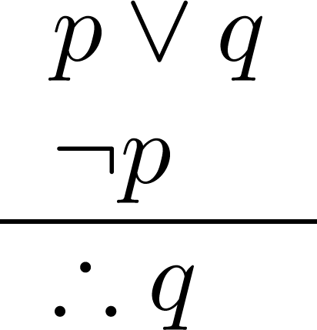
Disjunctive Syllogism
Corresponding Tautology:
(¬p∧(p ∨q))→q
Example:
Let p be “I will study discrete math.”
Let q be “I will study English literature.”
“I will study discrete math or I will study English literature.”
“I will not study discrete math.”
“Therefore , I will study English literature.”

Slide 28
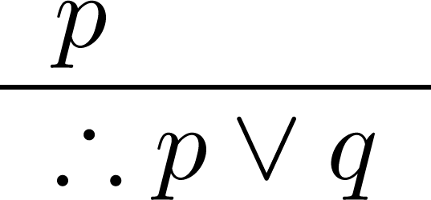
Addition
Corresponding Tautology:
p →(p ∨q)
Example:
Let p be “I will study discrete math.”
Let q be “I will visit Las Vegas.”
“I will study discrete math.”
“Therefore, I will study discrete math or I will visit
Las Vegas.”

Slide 29
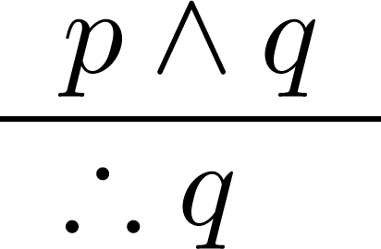
Simplification
Corresponding Tautology:
(p∧q) →p
Example:
Let p be “I will study discrete math.”
Let q be “I will study English literature.”
“I will study discrete math and English literature”
“Therefore, I will study discrete math.”

Slide 30
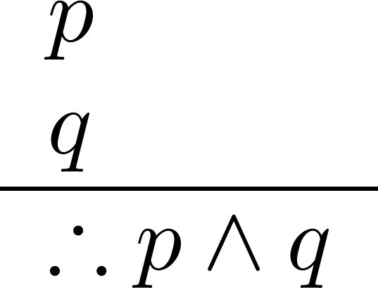
Conjunction
Corresponding Tautology:
((p) ∧ (q)) →(p ∧ q)
Example:
Let p be “I will study discrete math.”
Let q be “I will study English literature.”
“I will study discrete math.”
“I will study English literature.”
“Therefore, I will study discrete math and I will study English literature.”

Slide 31
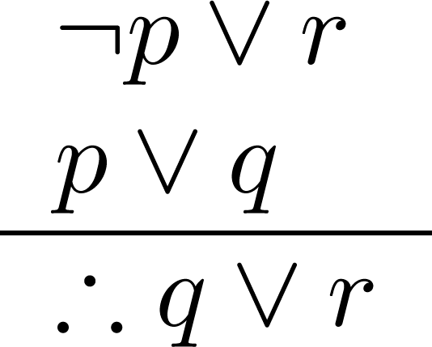
Resolution
Resolution plays an important role in AI and is used in Prolog.
Corresponding Tautology:
((¬p ∨ r ) ∧ (p ∨ q)) →(q ∨ r)
Example:
Let p be “I will study discrete math.”
Let r be “I will study English literature.”
Let q be “I will study databases.”
“I will not study discrete math or I will study English literature.”
“I will study discrete math or I will study databases.”
“Therefore, I will study databases or I will study English literature.”

Slide 32

Using the Rules of Inference to Build Valid Arguments
A valid argument is a sequence of statements. Each statement is either a premise or follows from previous statements by rules of inference. The last statement is called conclusion.
A valid argument takes the following form:
S₁
S₂
.
.
.
S_{n}
C

Slide 33
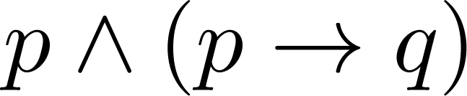
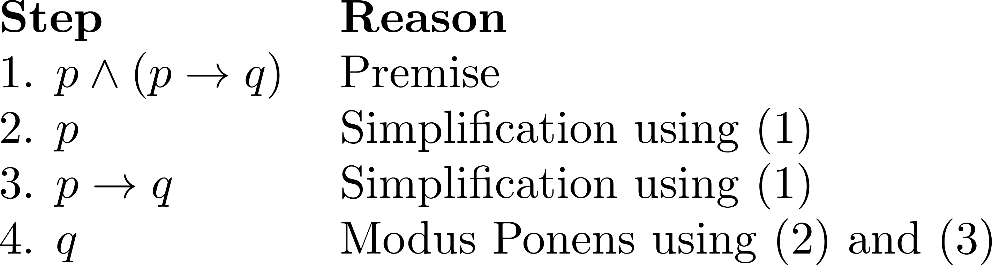
Valid Arguments
Example 1: From the single proposition
Show that q is a conclusion.
Solution:

Slide 34
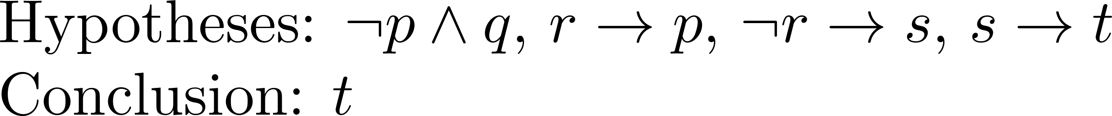
Valid Arguments
Example 2:
With these hypotheses:
  “It is not sunny this afternoon and it is colder than yesterday.”
  “We will go swimming only if it is sunny.”
  “If we do not go swimming, then we will take a canoe trip.”
  “If we take a canoe trip, then we will be home by sunset.”
Using the inference rules, construct a valid argument for the conclusion:
  “We will be home by sunset.”
Solution:
Choose propositional variables:
  p : “It is sunny this afternoon.” r : “We will go swimming.” t : “We will be home by sunset.”
  q : “It is colder than yesterday.” s : “We will take a canoe trip.”
Translation into propositional logic:
Continued on next slide →

Slide 35
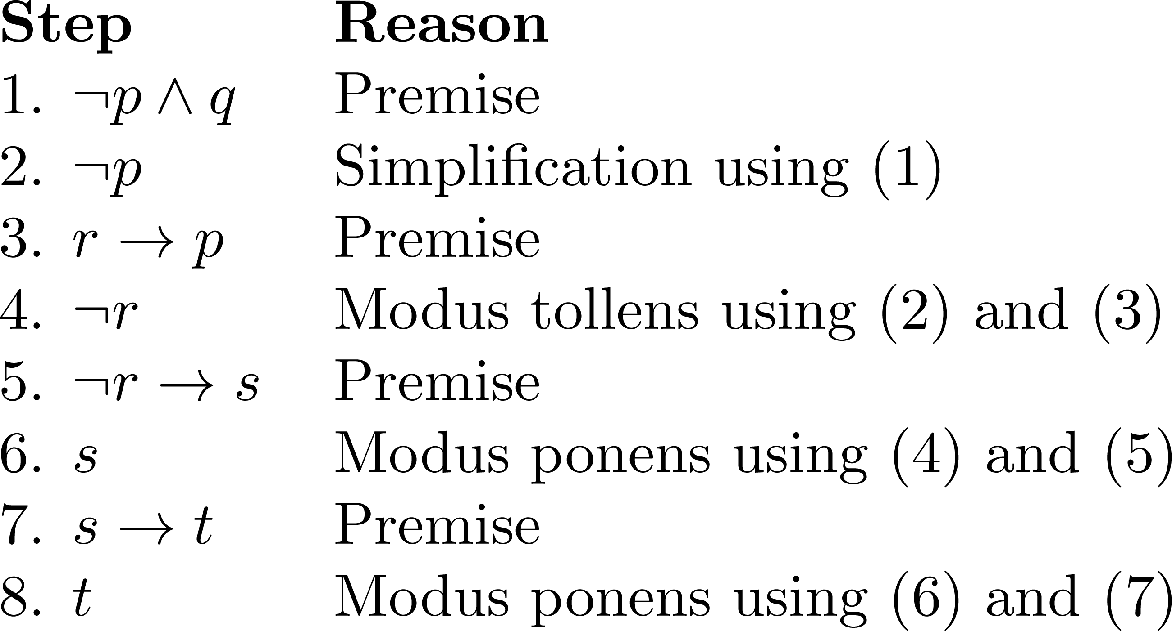
Valid Arguments
3. Construct the Valid Argument
Notes:
Note that a truth table would have 32 rows since we have 5 propositional variables.

Slide 36
Handling Quantified Statements
Valid arguments for quantified statements are a sequence of statements. Each statement is either a premise or follows from previous statements by rules of inference which include:
  Rules of Inference for Propositional Logic
  Rules of Inference for Quantified Statements
The rules of inference for quantified statements are introduced in the next several slides.

Slide 37
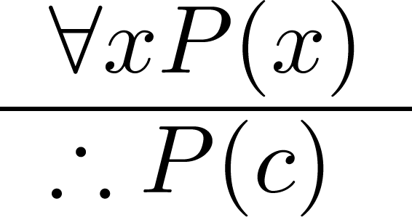
Universal Instantiation (UI)
Example:
Our domain consists of all dogs and Fido is a dog.
“All dogs are cuddly.”
“Therefore, Fido is cuddly.”

Slide 38
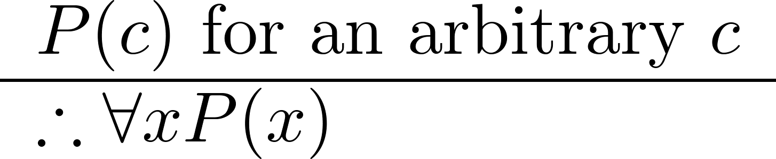
Universal Generalization (UG)
Used often implicitly in Mathematical Proofs.

Slide 39
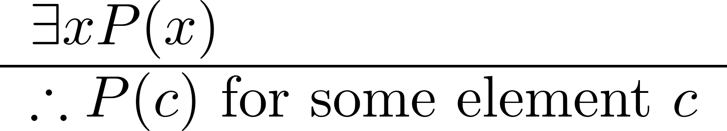
Existential Instantiation (EI)
Example:
“There is someone who got an A in the course.”
“Let’s call her a and say that a got an A”

Slide 40
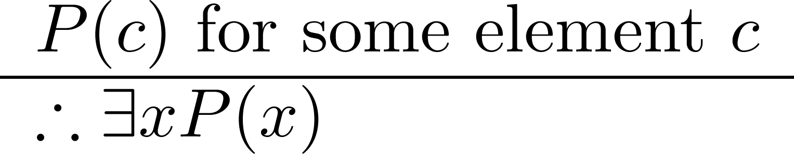
Existential Generalization (EG)
Example:
“Michelle got an A in the class.”
“Therefore, someone got an A in the class.”

Slide 41
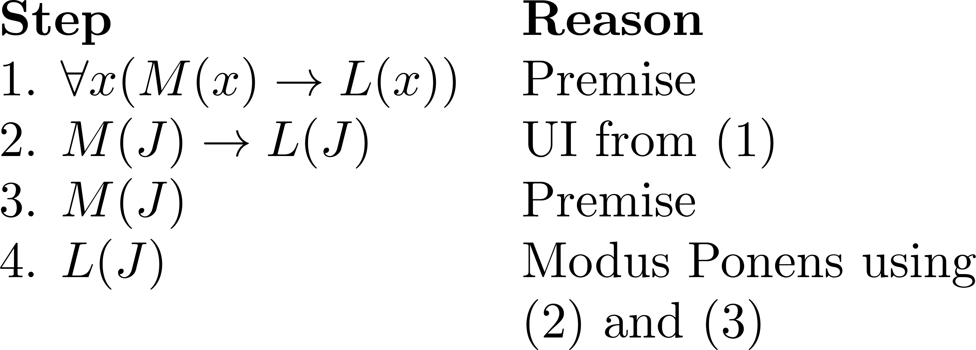
Using Rules of Inference
Example 1: Using the rules of inference, construct a valid argument to show that
  “John Smith has two legs”
is a consequence of the premises:
  “Every man has two legs.” “John Smith is a man.”
Solution: Let M(x) denote “x is a man” and L(x) “ x has two legs” and let John Smith be a member of the domain.
  Valid Argument:

Slide 42
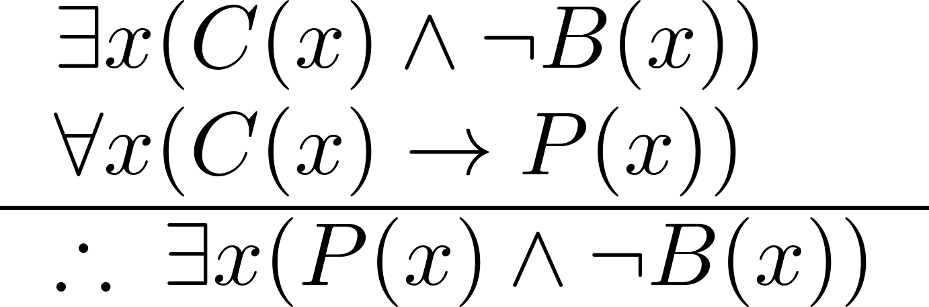
Using Rules of Inference
Example 2: Use the rules of inference to construct a valid argument showing that the conclusion
  “Someone who passed the first exam has not read the book.”
follows from the premises
  “A student in this class has not read the book.”
  “Everyone in this class passed the first exam.”
Solution: Let C(x) denote “x is in this class,” B(x) denote “ x has read the book,” and P(x) denote “x passed the first exam.”
  First we translate the
  premises and conclusion
  into symbolic form.
Continued on next slide →

Slide 43
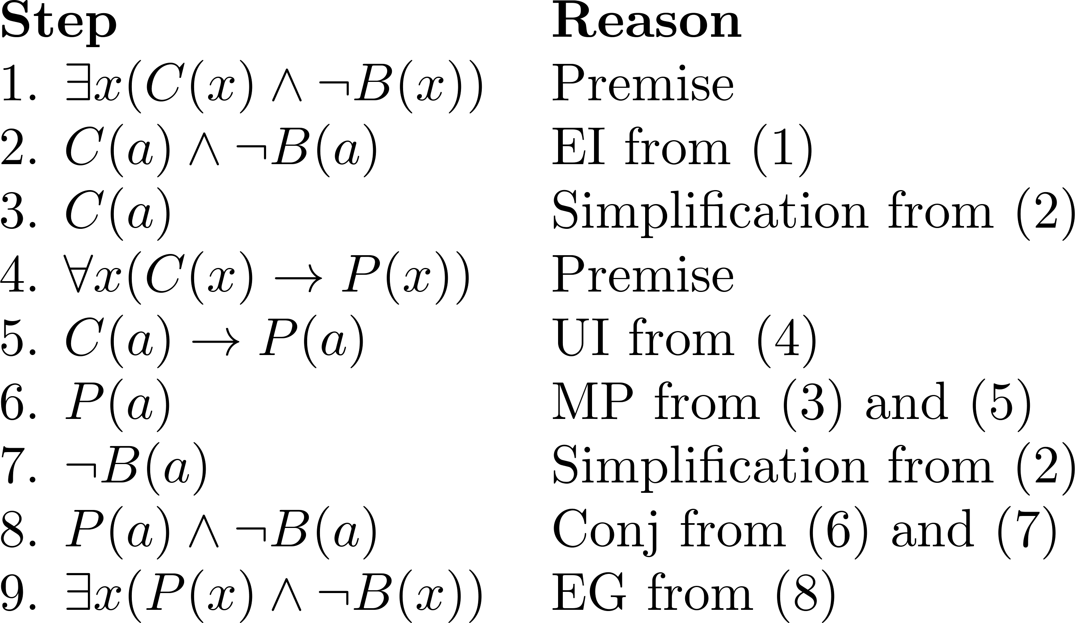
Using Rules of Inference
  Valid Argument:

Slide 44
Returning to the Socrates Example

Slide 45
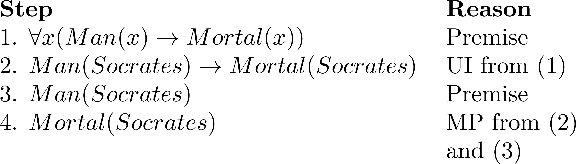
Solution for Socrates Example
Valid Argument

Slide 46
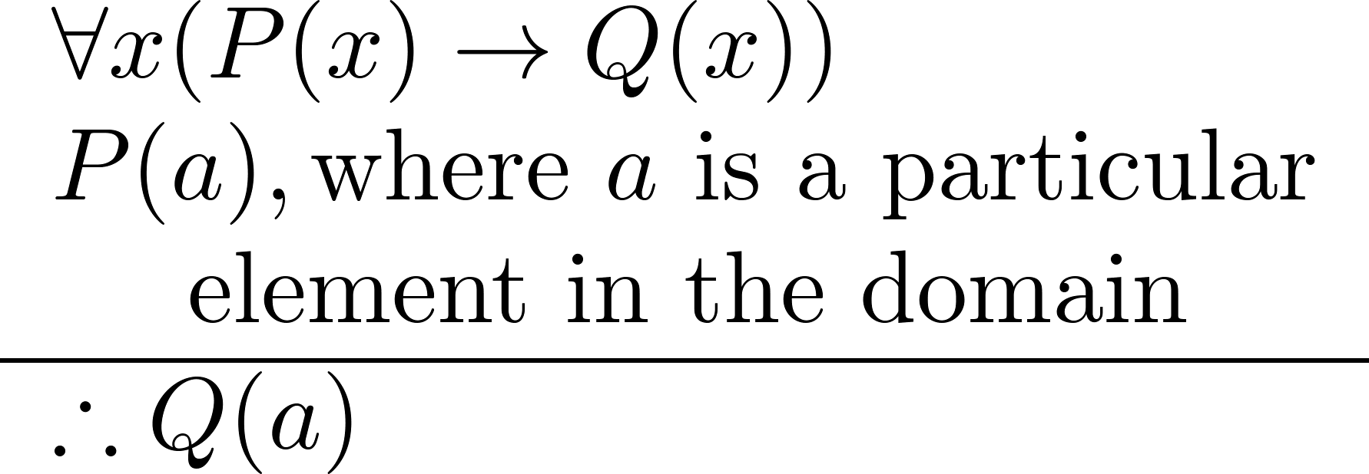
Universal Modus Ponens
Universal Modus Ponens combines universal instantiation and modus ponens into one rule.
This rule could be used in the Socrates example.

