Slide 1
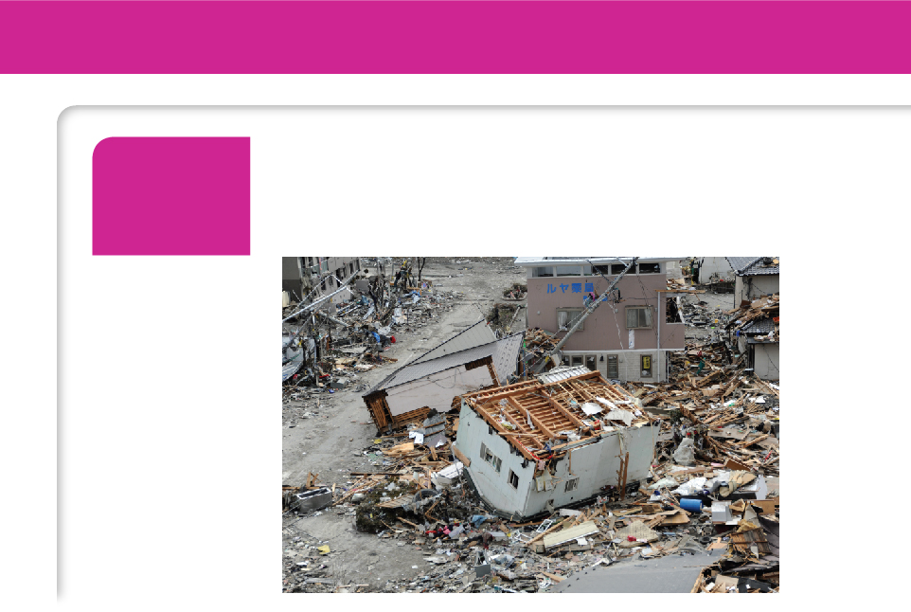
1
Functions and Models
Copyright © Cengage Learning. All rights reserved.

Slide 2

Four Ways to Represent a Function
1.1
Copyright © Cengage Learning. All rights reserved.

Slide 3
Four Ways to Represent a Function
Functions arise whenever one quantity depends on another. Consider the following four situations.
A. The area A of a circle depends on the radius r of the circle. The rule that connects r and A is given by the equation A = π r ². With each positive number r there is associated one value of A, and we say that A is a function of r.

Slide 4
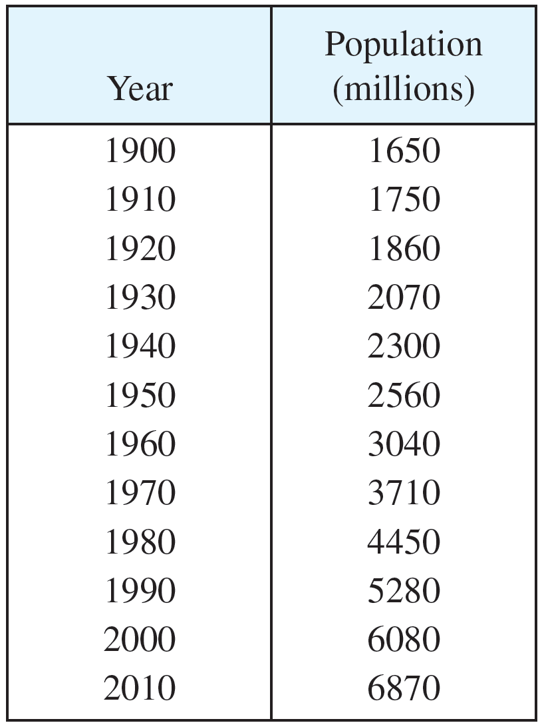
Four Ways to Represent a Function
B. The human population of the world P depends on the time t. The table gives estimates of the world population P (t) at time t, for certain years. For instance,
P(1950) ≈ 2,560,000,000
But for each value of the time t
there is a corresponding value
of P, and we say that P is a function of t.

Slide 5
Four Ways to Represent a Function
C. The cost C of mailing an envelope depends on its weight w. Although there is no simple formula that connects w and C, the post office has a rule for determining C when w is known.
D. The vertical acceleration a of the ground as measured by a seismograph during an earthquake is a function of the elapsed time t.

Slide 6
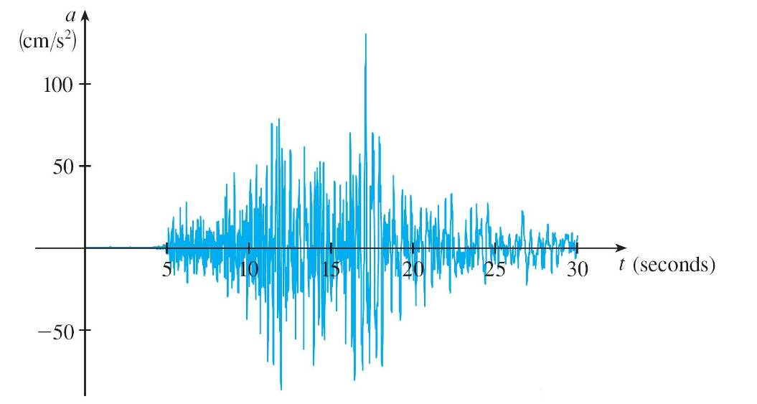
Four Ways to Represent a Function
Figure 1 shows a graph generated by seismic activity during the Northridge earthquake that shook Los Angeles in 1994. For a given value of t, the graph provides a corresponding value of a.
Vertical ground acceleration during the Northridge earthquake
Figure 1

Slide 7
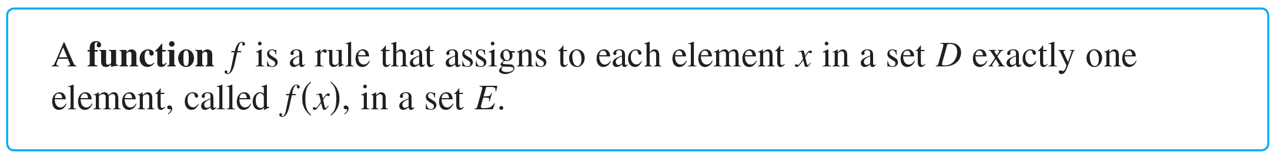
Four Ways to Represent a Function
We usually consider functions for which the sets D and E are sets of real numbers. The set D is called the domain of the function.
The number f (x) is the value of f at x and is read “f of x.” The range of f is the set of all possible values of f (x) as x varies throughout the domain.
A symbol that represents an arbitrary number in the domain of a function f is called an independent variable.

Slide 8
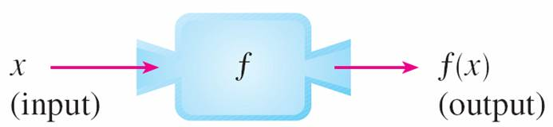
Four Ways to Represent a Function
A symbol that represents a number in the range of f is called a dependent variable. In Example A, for instance, r is the independent variable and A is the dependent variable.
It’s helpful to think of a function as a machine (see Figure 2).
Machine diagram for a function f
Figure 2

Slide 9
Four Ways to Represent a Function
If x is in the domain of the function f, then when x enters the machine, it’s accepted as an input and the machine produces an output f (x) according to the rule of the function.
Thus we can think of the domain as the set of all possible inputs and the range as the set of all possible outputs.

Slide 10
Four Ways to Represent a Function
Another way to picture a function is by an arrow diagram as in Figure 3.
Each arrow connects an element of D to an element of E. The arrow indicates that f (x) is associated with x, f (a) is associated with a, and so on.
Arrow diagram for f
Figure 3

Slide 11
Four Ways to Represent a Function
The most common method for visualizing a function is its graph. If f is a function with domain D, then its graph is the set of ordered pairs
{(x, f (x)) | x ∈ D}
In other words, the graph of f consists of all points (x, y) in the coordinate plane such that y = f (x) and x is in the domain of f.
The graph of a function f gives us a useful picture of the behavior or “life history” of a function.

Slide 12
Four Ways to Represent a Function
Since the y-coordinate of any point (x, y) on the graph is y = f (x), we can read the value of f (x) from the graph as being the height of the graph above the point x (see Figure 4).
Figure 4

Slide 13
Four Ways to Represent a Function
The graph of f also allows us to picture the domain of f on the x-axis and its range on the y-axis as in Figure 5.
Figure 5

Slide 14
Example 1
The graph of a function f is shown in Figure 6.
(a) Find the values of f (1) and f (5).
(b) What are the domain and range of f ?
Figure 6

Slide 15
Example 1 – Solution
(a) We see from Figure 6 that the point (1, 3) lies on the graph of f, so the value of f at 1 is f (1) = 3. (In other words, the point on the graph that lies above x = 1 is 3 units above the x-axis.)
When x = 5, the graph lies about 0.7 unit below the x-axis, so we estimate that f(5) ≈ –0.7.
(b) We see that f (x) is defined when 0 ≤ x ≤ 7, so the domain of f is the closed interval [0, 7]. Notice that f takes on all values from –2 to 4, so the range of f is
{y | –2 ≤ y ≤ 4} = [–2, 4]

Slide 16
Representations of Functions

Slide 17
Representations of Functions
There are four possible ways to represent a function:
verbally (by a description in words)
numerically (by a table of values)
visually (by a graph)
algebraically (by an explicit formula)

Slide 18
Example 4
When you turn on a hot-water faucet, the temperature T of the water depends on how long the water has been running. Draw a rough graph of T as a function of the time t that has elapsed since the faucet was turned on.
Solution:
The initial temperature of the running water is close to room temperature because the water has been sitting in the pipes.
When the water from the hot-water tank starts flowing from the faucet, T increases quickly. In the next phase, T is constant at the temperature of the heated water in the tank.

Slide 19
Example 4 – Solution
cont’d
When the tank is drained, T decreases to the temperature of the water supply.
This enables us to make the rough sketch of T as a function of t in Figure 11.
Figure 11

Slide 20
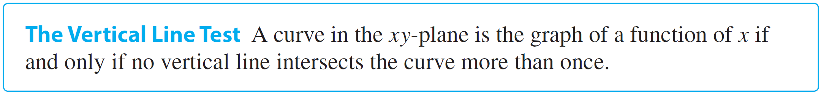
Representations of Functions
The graph of a function is a curve in the xy-plane.
But the question arises: Which curves in the xy-plane are graphs of functions?
This is answered by the following test.

Slide 21
Representations of Functions
The reason for the truth of the Vertical Line Test can be seen in Figure 13.
(a) This curve represents a function.
(b) This curve doesn’t represent
a function.
Figure 13

Slide 22
Representations of Functions
If each vertical line x = a intersects a curve only once, at (a, b), then exactly one functional value is defined by f (a) = b.
But if a line x = a intersects the curve twice, at (a, b) and (a, c), then the curve can’t represent a function because a function can’t assign two different values to a.

Slide 23
Representations of Functions
For example, the parabola x = y² – 2 shown in Figure 14(a) is not the graph of a function of x because, as you can see, there are vertical lines that intersect the parabola twice. The parabola, however, does contain the graphs of two functions of x.
x = y² – 2
Figure 14(a)

Slide 24

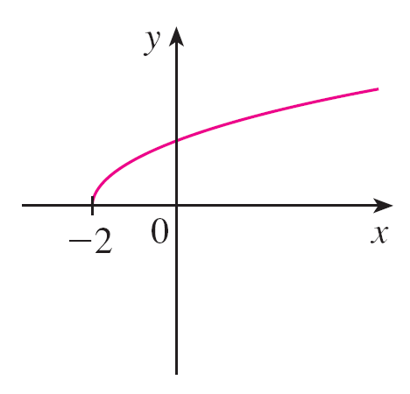
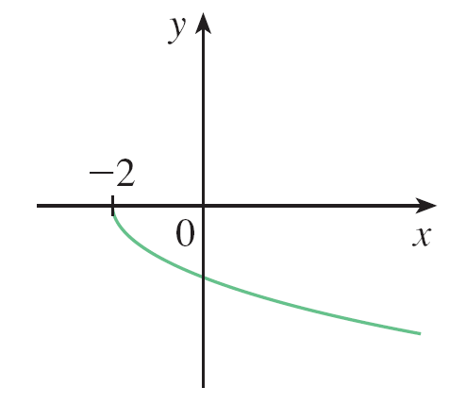

Representations of Functions
Notice that the equation x = y² – 2 implies y² = x + 2, so .
Thus the upper and lower halves of the parabola are the graphs of the functions and [See Figures 14(b) and (c).]
Figure 14(b)
Figure 14(c)

Slide 25
Representations of Functions
We observe that if we reverse the roles of x and y, then the equation x = h (y) = y² – 2 does define x as a function of y (with y as the independent variable and x as the dependent variable) and the parabola now appears as the graph of the function h.

Slide 26
Piecewise Defined Functions

Slide 27

Example 7
A function f is defined by
1 – x if x ≤ –1
x² if x > –1
Evaluate f (–2), f (–1), and f (0) and sketch the graph.
Solution:
Remember that a function is a rule. For this particular function the rule is the following:
First look at the value of the input x. If it happens that x ≤ –1, then the value of f (x) is 1 – x.
f (x) =

Slide 28
Example 7 – Solution
cont’d
On the other hand, if x > –1, then the value of f (x) is x².
Since –2 ≤ –1, we have f (–2) = 1 – (–2) = 3.
Since –1 ≤ –1, we have f (–1) = 1 – (–1) = 2.
Since 0 > –1, we have f (0) = 0² = 0.
How do we draw the graph of f ? We observe that if x ≤ –1, then f (x) = 1 – x, so the part of the graph of f that lies to the left of the vertical line x = –1 must coincide with the line y = 1 – x, which has slope –1 and y-intercept 1.

Slide 29
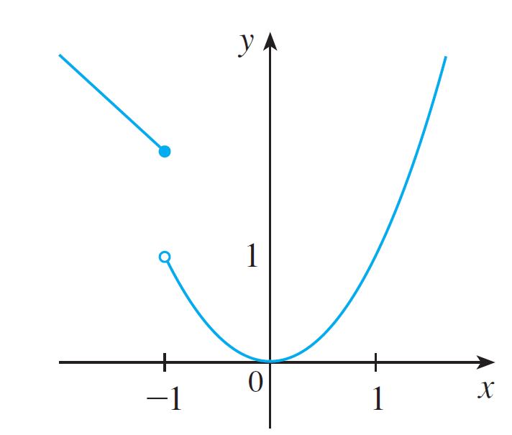
Example 7 – Solution
cont’d
If x > –1, then f (x) = x², so the part of the graph of f that lies to the right of the line x = –1 must coincide with the graph of y = x², which is a parabola. This enables us to sketch the graph in Figure 15.
The solid dot indicates that the point (–1, 2) is included on the graph; the open dot indicates that the point (–1, 1) is excluded from the graph.
Figure 15

Slide 30

Piecewise Defined Functions
The next example of a piecewise defined function is the absolute value function. Recall that the absolute value of a number a, denoted by | a |, is the distance from a to 0 on the real number line. Distances are always positive or 0, so we have
| a | ≥ 0 for every number a
For example,
| 3 | = 3 | – 3 | = 3 | 0 | = 0 | – 1 | = – 1
| 3 – π | = π – 3

Slide 31
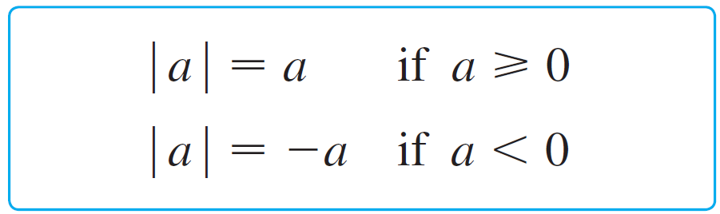
Piecewise Defined Functions
In general, we have
(Remember that if a is negative, then –a is positive.)

Slide 32
Example 8
Sketch the graph of the absolute value function f (x) = | x |.
Solution:
From the preceding discussion we know that
x if x ≥ 0
| x | =
–x if x < 0

Slide 33
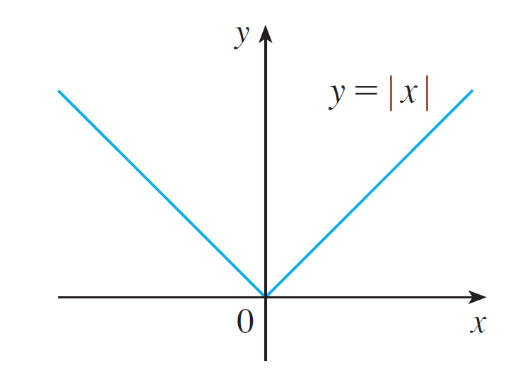
Example 8 – Solution
cont’d
Using the same method as in Example 7, we see that the graph of f coincides with the line y = x to the right of the y-axis and coincides with the line y = –x to the left of the y-axis (see Figure 16).
Figure 16

Slide 34
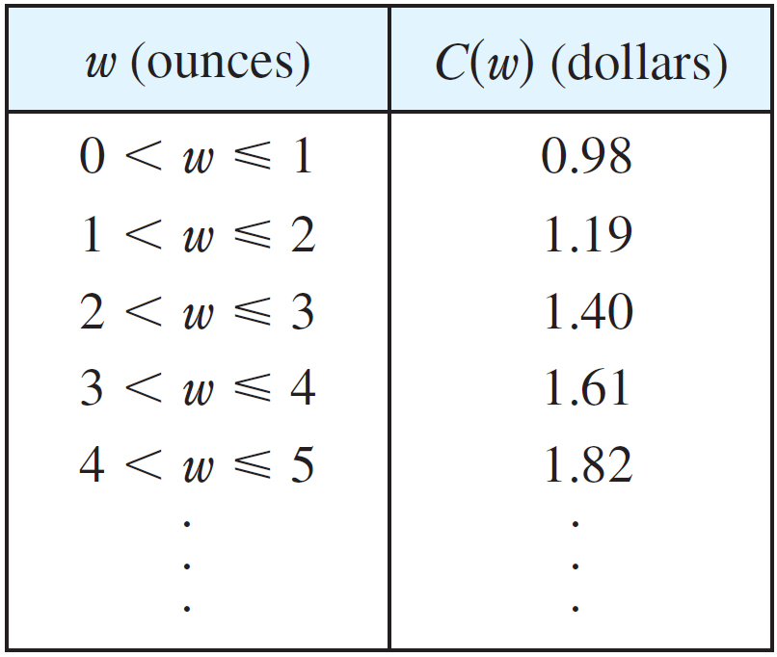
Example 10
In Example C at the beginning of this section we considered the cost C (w) of mailing a large envelope with weight w.
In effect, this is a piecewise defined function because, from the table shown in the right side, we have
0.98 if 0 < w ≤ 1
1.19 if 1 < w ≤ 2
C (w) = 1.40 if 2 < w ≤ 3
1.61 if 3 < w ≤ 4

Slide 35
Example 10
cont’d
The graph is shown in Figure 18.
You can see why functions similar to this one are called step functions—they jump from one value to the next.
Figure 18

Slide 36
Symmetry

Slide 37
Symmetry
If a function f satisfies f (–x) = f (x) for every number x in its domain, then f is called an even function. For instance, the function f (x) = x² is even because
f (–x) = (–x)² = x² = f (x)
The geometric significance of an even function is that its graph is symmetric with respect to the y-axis (see Figure 19).
An even function
Figure 19

Slide 38
Symmetry
This means that if we have plotted the graph of f for x ≥ 0, we obtain the entire graph simply by reflecting this portion about the y-axis.
If f satisfies f (–x) = –f (x) for every number x in its domain, then f is called an odd function. For example, the function f (x) = x³ is odd because
f (–x) = (–x)³ = –x³ = –f (x)

Slide 39
Symmetry
The graph of an odd function is symmetric about the origin (see Figure 20).
If we already have the graph of f for x ≥ 0, we can obtain the entire graph by rotating this portion through 180° about the origin.
An odd function
Figure 20

Slide 40
Example 11
Determine whether each of the following functions is even, odd, or neither even nor odd.
(a) f (x) = x⁵ + x (b) g (x) = 1 – x⁴ (c) h (x) = 2x – x²
Solution:
(a) f (–x) = (–x)⁵ + (–x) = (–1)⁵x⁵ + (–x)
= –x⁵ – x = –(x⁵ + x)
= –f (x)
Therefore f is an odd function.

Slide 41
Example 11 – Solution
cont’d
(b) g (–x) = 1 – (–x)⁴ = 1 – x⁴ = g (x)
So g is even.
(c) h(–x) = 2(–x) – (–x)² = –2x – x²
Since h(–x) ≠ h (x) and h(–x) ≠ –h (x), we conclude that h is neither even nor odd.

Slide 42
Symmetry
The graphs of the functions in Example 11 are shown in Figure 21. Notice that the graph of h is symmetric neither about the y-axis nor about the origin.
(a)
(b)
(c)
Figure 21

Slide 43
Increasing and Decreasing Functions

Slide 44
Increasing and Decreasing Functions
The graph shown in Figure 22 rises from A to B, falls from B to C, and rises again from C to D. The function f is said to be increasing on the interval [a, b], decreasing on [b, c], and increasing again on [c, d ].
Figure 22

Slide 45
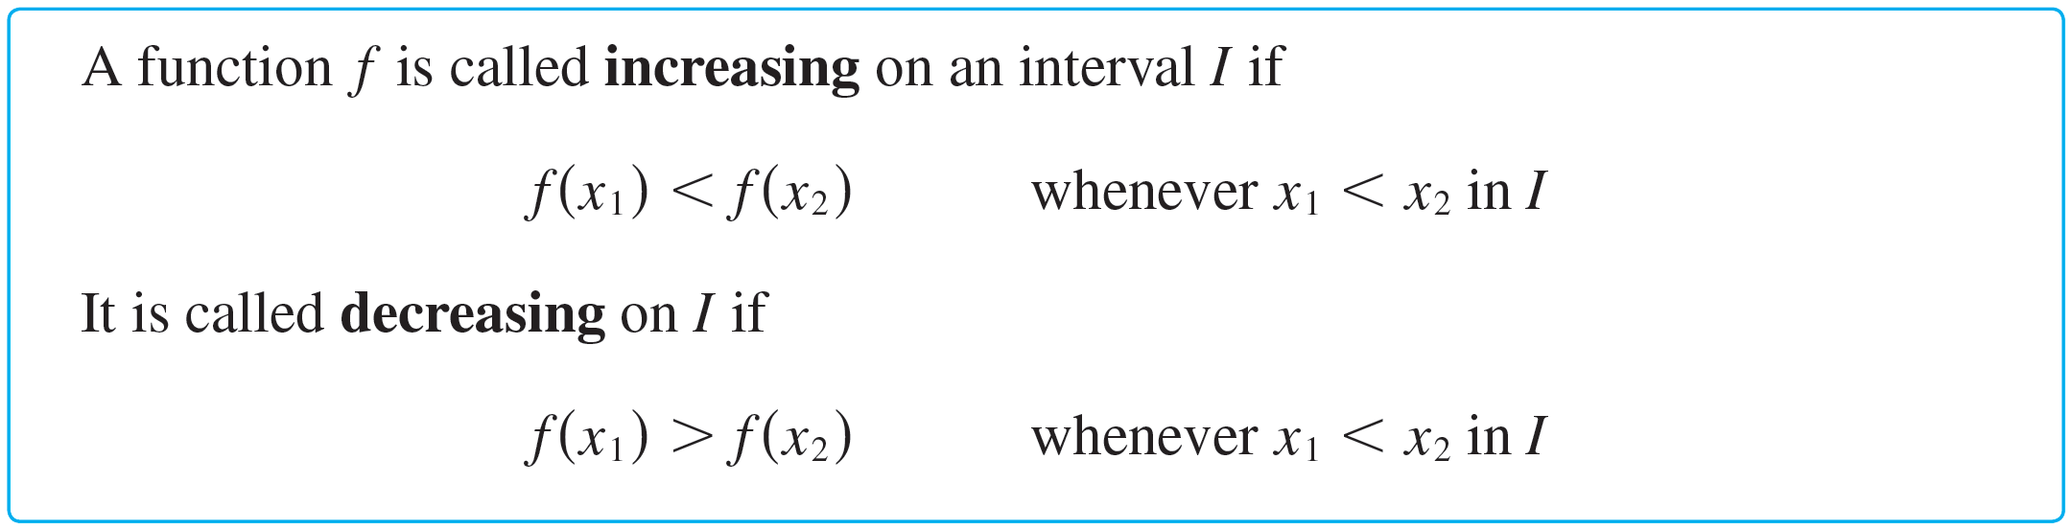
Increasing and Decreasing Functions
Notice that if x₁ and x₂ are any two numbers between a and b with x₁ < x₂, then f (x₁) < f (x₂).
We use this as the defining property of an increasing function.

Slide 46

Increasing and Decreasing Functions
In the definition of an increasing function it is important to realize that the inequality f (x₁) < f (x₂) must be satisfied for every pair of numbers x₁ and x₂ in I with x₁ < x₂.
You can see from Figure 23 that the function f (x) = x² is decreasing on the interval (– , 0] and increasing on the interval [0, ).
Figure 23

Slide 47
Mathematical Models: A Catalog of Essential Functions
1.2
Copyright © Cengage Learning. All rights reserved.

Slide 48
Mathematical Models: A Catalog of Essential Functions
A mathematical model is a mathematical description (often by means of a function or an equation) of a real-world phenomenon such as the size of a population, the demand for a product, the speed of a falling object, the concentration of a product in a chemical reaction, the life expectancy of a person at birth, or the cost of emission reductions.
The purpose of the model is to understand the phenomenon and perhaps to make predictions about future behavior.

Slide 49
Mathematical Models: A Catalog of Essential Functions
Figure 1 illustrates the process of mathematical modeling.
The modeling process
Figure 1

Slide 50
Mathematical Models: A Catalog of Essential Functions
A mathematical model is never a completely accurate representation of a physical situation—it is an idealization. A good model simplifies reality enough to permit mathematical calculations but is accurate enough to provide valuable conclusions.
It is important to realize the limitations of the model. In the end, Mother Nature has the final say.
There are many different types of functions that can be used to model relationships observed in the real world. In what follows, we discuss the behavior and graphs of these functions and give examples of situations appropriately modeled by such functions.

Slide 51
Linear Models

Slide 52
Linear Models
When we say that y is a linear function of x, we mean that
the graph of the function is a line, so we can use the
slope-intercept form of the equation of a line to write a
formula for the function as
y = f (x) = mx + b
where m is the slope of the line and b is the y-intercept.

Slide 53
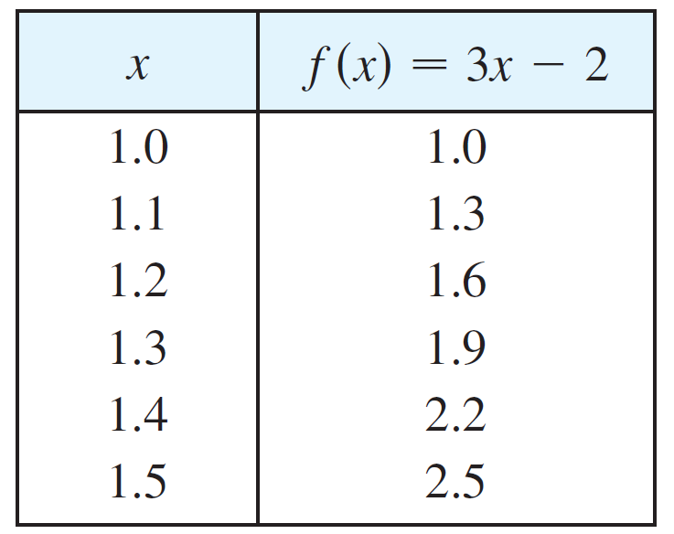
Linear Models
A characteristic feature of linear functions is that they grow at a constant rate.
For instance, Figure 2 shows a graph of the linear function
f (x) = 3x – 2 and a table of sample values.
Figure 2

Slide 54
Linear Models
Notice that whenever x increases by 0.1, the value of f (x) increases by 0.3.
So f (x) increases three times as fast as x. Thus the slope of the graph y = 3x – 2, namely 3, can be interpreted as the rate of change of y with respect to x.

Slide 55
Example 1
(a) As dry air moves upward, it expands and cools. If the ground temperature is 20°C and the temperature at a height of 1 km is 10°C, express the temperature T (in °C) as a function of the height h (in kilometers), assuming that a linear model is appropriate.
(b) Draw the graph of the function in part (a). What does the slope represent?
(c) What is the temperature at a height of 2.5 km?

Slide 56
Example 1(a) – Solution
Because we are assuming that T is a linear function of h, we can write
T = mh + b
We are given that T = 20 when h = 0, so
20 = m • 0 + b = b
In other words, the y-intercept is b = 20.
We are also given that T = 10 when h = 1, so
10 = m • 1 + 20
The slope of the line is therefore m = 10 – 20 = –10 and the required linear function is
T = –10h + 20

Slide 57
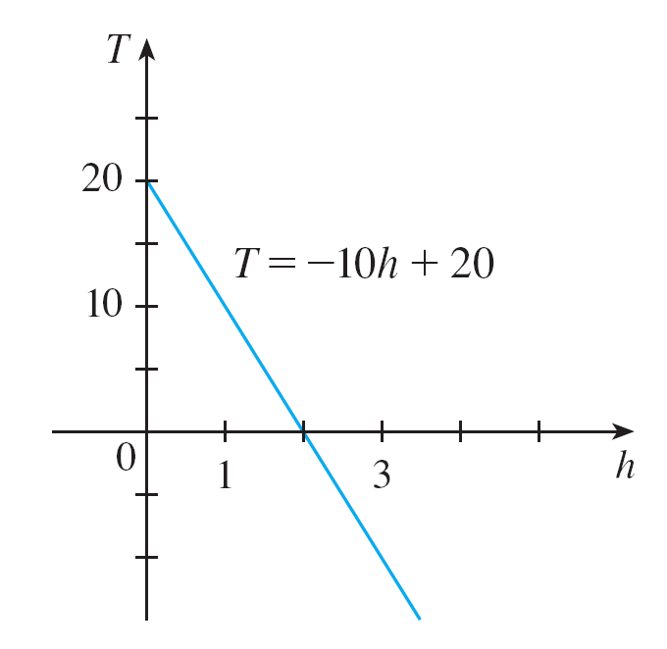
Example 1(b) – Solution
cont’d
The graph is sketched in Figure 3.
The slope is m = –10°C/km, and this represents the rate of change of temperature with respect to height.
Figure 3

Slide 58
Example 1(c) – Solution
cont’d
At a height of h = 2.5 km, the temperature is
T = –10(2.5) + 20 = –5°C

Slide 59
Linear Models
If there is no physical law or principle to help us formulate a model, we construct an empirical model, which is based entirely on collected data.
We seek a curve that “fits” the data in the sense that it captures the basic trend of the data points.

Slide 60
Polynomials

Slide 61

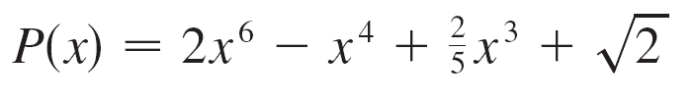
Polynomials
A function P is called a polynomial if
P (x) = a_{n}x^{n} + a_{n –1}x^{n –1} + . . . + a₂x² + a₁x + a₀
where n is a nonnegative integer and the numbers a₀, a₁, a₂, . . ., a_{n} are constants called the coefficients of the polynomial.
The domain of any polynomial is If the leading coefficient a_{n} ≠ 0, then the degree of the polynomial is n. For example, the function
is a polynomial of degree 6.

Slide 62
Polynomials
A polynomial of degree 1 is of the form P (x) = mx + b and so it is a linear function.
A polynomial of degree 2 is of the form P (x) = ax² + bx + c and is called a quadratic function.

Slide 63
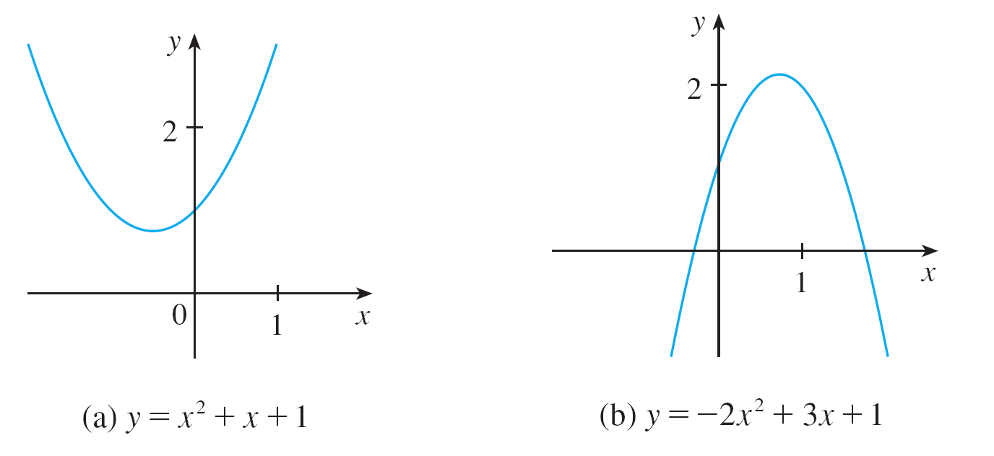
Polynomials
Its graph is always a parabola obtained by shifting the parabola y = ax². The parabola opens upward if a > 0 and downward if a < 0. (See Figure 7.)
The graphs of quadratic functions are parabolas.
Figure 7

Slide 64
Polynomials
A polynomial of degree 3 is of the form
P (x) = ax³ + bx² + cx + d a ≠ 0
and is called a cubic function. Figure 8 shows the graph of a cubic function in part (a) and graphs of polynomials of degrees 4 and 5 in parts (b) and (c).
Figure 8

Slide 65
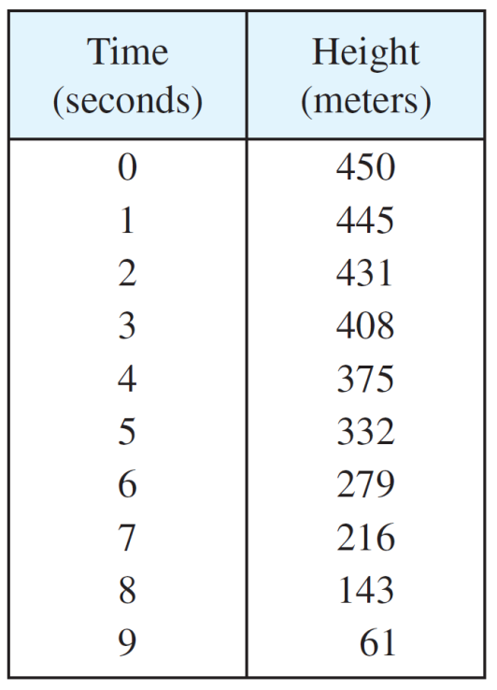
Example 4
A ball is dropped from the upper observation deck of the CN Tower, 450 m above the ground, and its height h above the ground is recorded at 1-second intervals in Table 2.
Find a model to fit the data
and use the model to predict
the time at which the ball hits
the ground.
Table 2

Slide 66
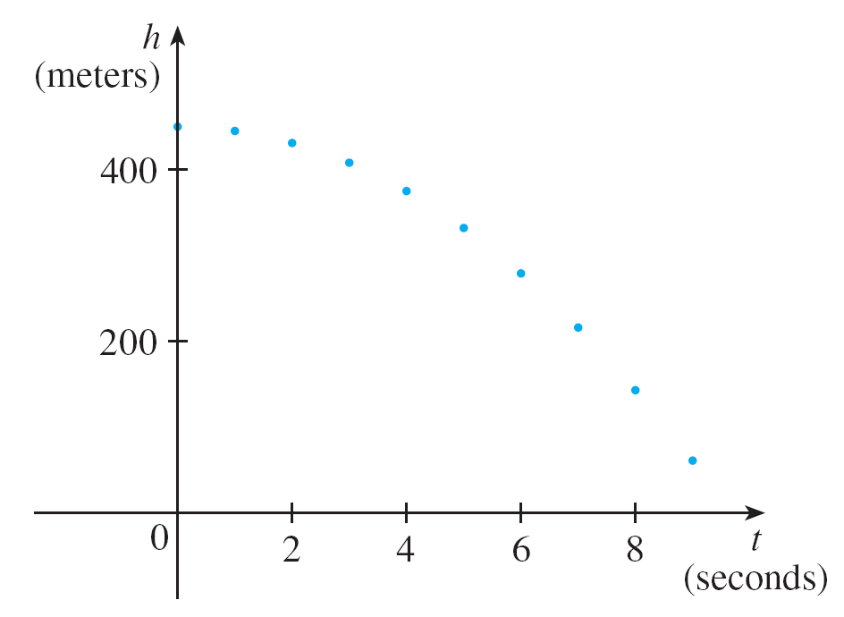
Example 4 – Solution
We draw a scatter plot of the data in Figure 9 and observe that a linear model is inappropriate.
Scatter plot for a falling ball
Figure 9

Slide 67

Example 4 – Solution
cont’d
But it looks as if the data points might lie on a parabola, so we try a quadratic model instead.
Using a graphing calculator or computer algebra system (which uses the least squares method), we obtain the following quadratic model:
h = 449.36 + 0.96t – 4.90t²

Slide 68
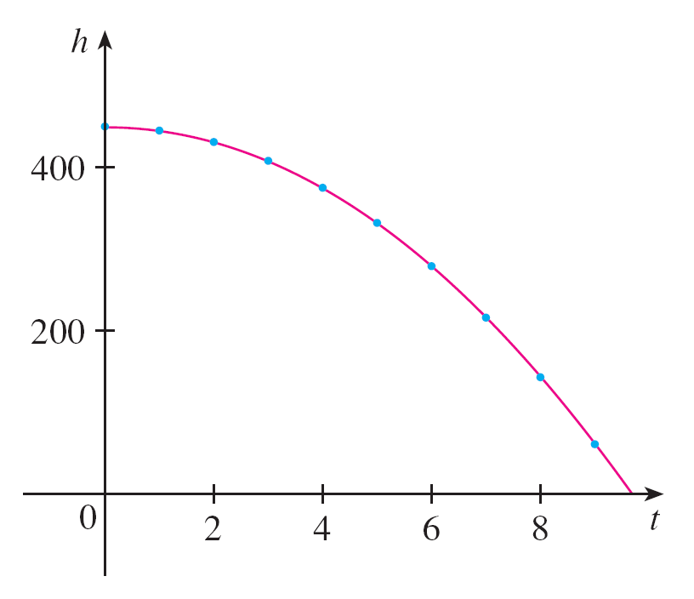
Example 4 – Solution
cont’d
In Figure 10 we plot the graph of Equation 3 together with the data points and see that the quadratic model gives a very good fit.
The ball hits the ground when h = 0, so we solve the quadratic equation
–4.90t² + 0.96t + 449.36 = 0
Quadratic model for a falling ball
Figure 10

Slide 69
Example 4 – Solution
cont’d
The quadratic formula gives
The positive root is t ≈ 9.67, so we predict that the ball will hit the ground after about 9.7 seconds.

Slide 70
Power Functions

Slide 71
Power Functions
A function of the form f (x) = xª, where a is a constant, is called a power function. We consider several cases.
(i) a = n, where n is a positive integer
The graphs of f (x) = x^{n} for n = 1, 2, 3, 4, and 5 are shown in Figure 11. (These are polynomials with only one term.)
We already know the shape of the graphs of y = x (a line through the origin with slope 1) and y = x² (a parabola).

Slide 72
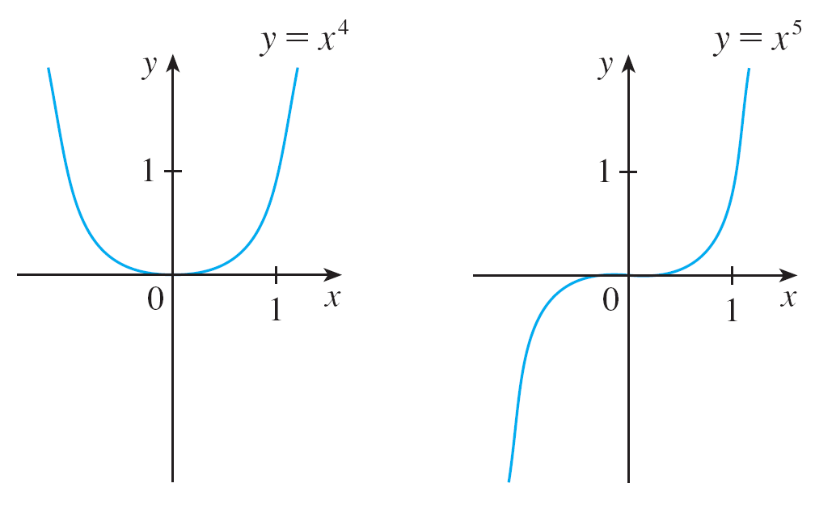
Power Functions
Graphs of f (x) = x^{n} for n = 1, 2, 3, 4, 5
Figure 11

Slide 73
Power Functions
The general shape of the graph of f (x) = x^{n} depends on whether n is even or odd.
If n is even, then f (x) = x^{n} is an even function and its graph is similar to the parabola y = x².
If n is odd, then f (x) = x^{n} is an odd function and its graph is similar to that of y = x³.

Slide 74
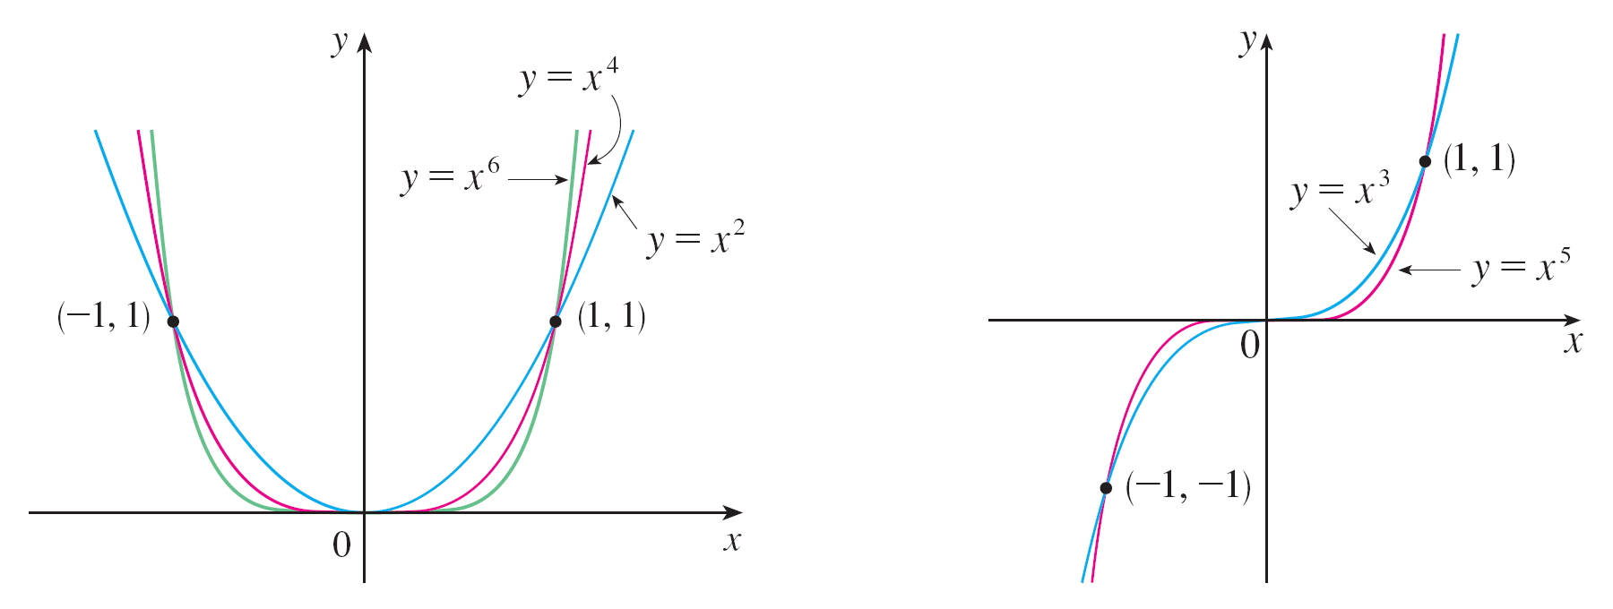
Power Functions
Notice from Figure 12, however, that as n increases, the graph of y = x^{n} becomes flatter near 0 and steeper when | x | ≥ 1. (If x is small, then x² is smaller, x³ is even smaller, x⁴ is smaller still, and so on.)
Families of power functions
Figure 12

Slide 75


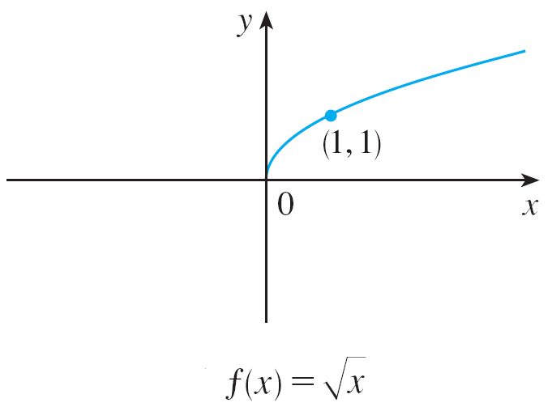
Power Functions
(ii) a = 1/n, where n is a positive integer
The function is a root function. For n = 2 it is the square root function whose domain is [0, ) and whose graph is the upper half of the
parabola x = y². [See Figure 13(a).]
Graph of root function
Figure 13(a)

Slide 76




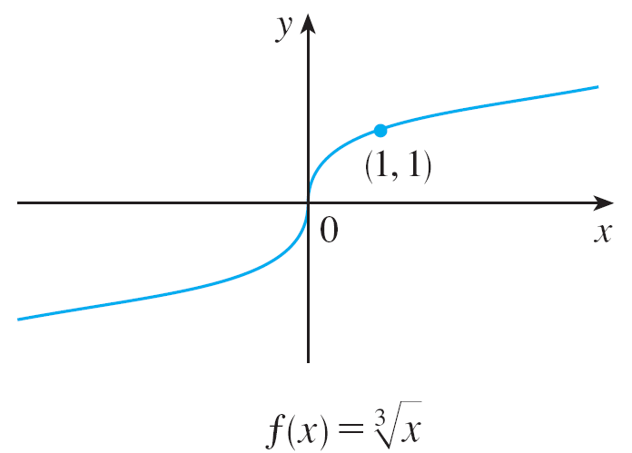
Power Functions
For other even values of n, the graph of is similar to that of
For n = 3 we have the cube root function whose domain is (recall that every real number has a cube root) and whose graph is shown in Figure 13(b). The graph of
for n odd (n > 3) is similar to that of
Graph of root function
Figure 13(b)

Slide 77
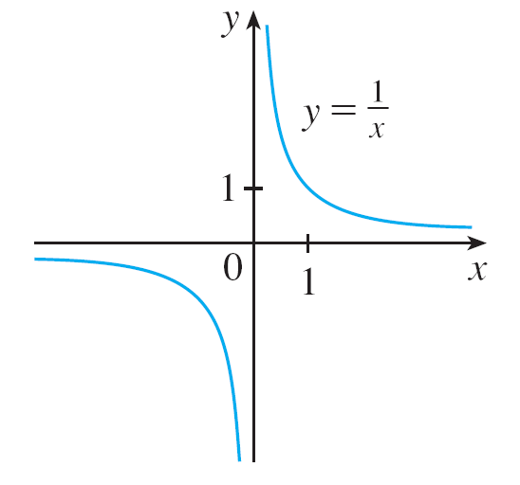
Power Functions
(iii) a = –1
The graph of the reciprocal function f (x) = x ^{–1} = 1/x is shown in Figure 14. Its graph has the equation y = 1/x, or xy = 1, and is a hyperbola with the coordinate axes as its asymptotes.
The reciprocal function
Figure 14

Slide 78
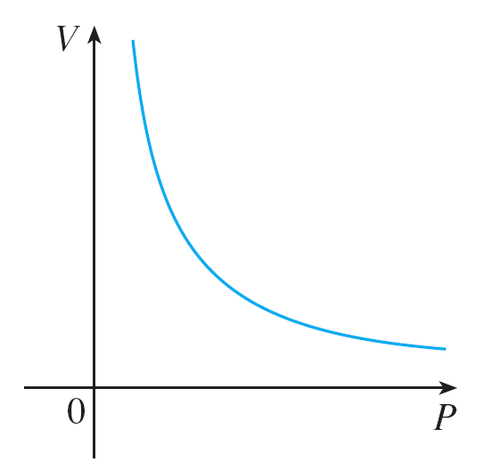
Power Functions
This function arises in physics and chemistry in connection with Boyle’s Law, which says that, when the temperature is constant, the volume V of a gas is inversely proportional to the pressure P:
where C is a constant.
Thus the graph of V as a
function of P (see Figure 15)
has the same general shape
as the right half of Figure 14.
Volume as a function of pressure
at constant temperature
Figure 15

Slide 79
Rational Functions

Slide 80
Rational Functions
A rational function f is a ratio of two polynomials:
where P and Q are polynomials. The domain consists of all values of x such that Q(x) ≠ 0.
A simple example of a rational
function is the function f (x) = 1/x,
whose domain is {x | x ≠ 0}; this
is the reciprocal function graphed
in Figure 14.
The reciprocal function
Figure 14

Slide 81
Rational Functions
The function
is a rational function with domain {x | x ≠ ±2}. Its graph is shown in Figure 16.
Figure 16

Slide 82
Algebraic Functions

Slide 83
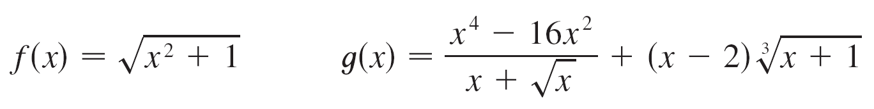
Algebraic Functions
A function f is called an algebraic function if it can be constructed using algebraic operations (such as addition, subtraction, multiplication, division, and taking roots) starting with polynomials. Any rational function is automatically an algebraic function.
Here are two more examples:

Slide 84
Algebraic Functions
The graphs of algebraic functions can assume a variety of shapes. Figure 17 illustrates some of the possibilities.
Figure 17

Slide 85
Algebraic Functions
An example of an algebraic function occurs in the theory of relativity. The mass of a particle with velocity v is
where m₀ is the rest mass of the particle and
c = 3.0 x 10⁵ km/s is the speed of light in a vacuum.

Slide 86
Trigonometric Functions

Slide 87
Trigonometric Functions
In calculus the convention is that radian measure is always used (except when otherwise indicated).
For example, when we use the function f (x) = sin x, it is understood that sin x means the sine of the angle whose radian measure is x.

Slide 88
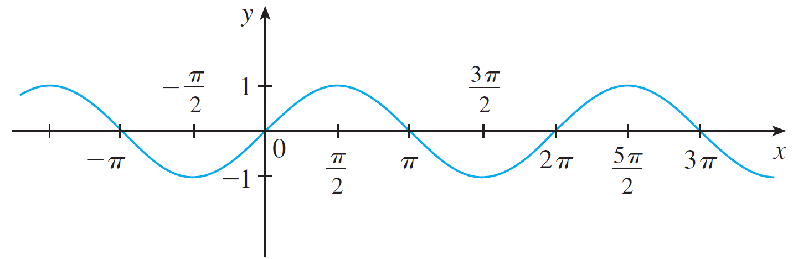
Trigonometric Functions
Thus the graphs of the sine and cosine functions are as shown in Figure 18.
(a) f (x) = sin x
(b) g (x) = cos x
Figure 18

Slide 89

Trigonometric Functions
Notice that for both the sine and cosine functions the domain
is ( , ) and the range is the closed interval [–1, 1].
Thus, for all values of x, we have
or, in terms of absolute values,
| sin x | ≤ 1 | cos x | ≤ 1

Slide 90

Trigonometric Functions
Also, the zeros of the sine function occur at the integer
multiples of π ; that is,
sin x = 0 when x = nπ n an integer
An important property of the sine and cosine functions is
that they are periodic functions and have period 2π.
This means that, for all values of x,

Slide 91
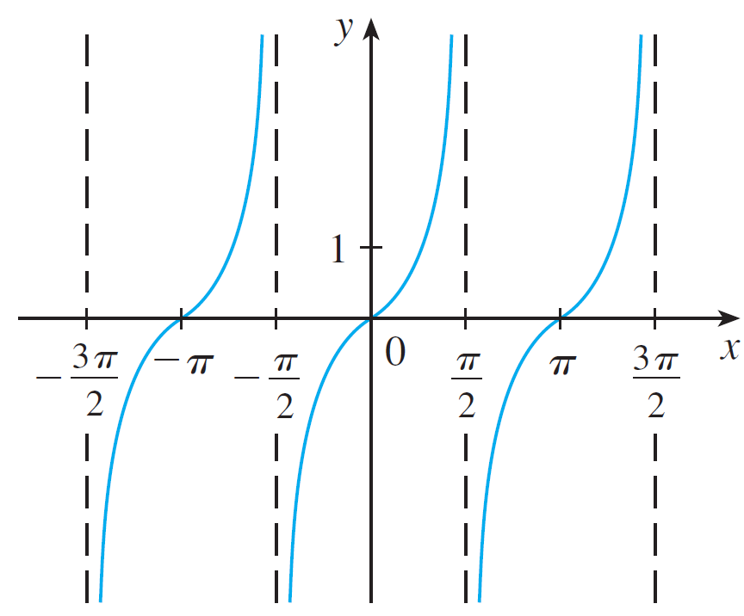
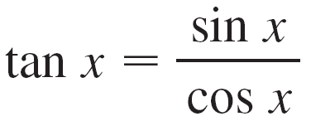
Trigonometric Functions
The tangent function is related to the sine and cosine
functions by the equation
and its graph is shown in
Figure 19. It is undefined
whenever cos x = 0, that is,
when x = ±π /2, ±3π /2, . . . .
Its range is ( , ).
y = tan x
Figure 19

Slide 92
Trigonometric Functions
Notice that the tangent function has period π :
tan (x + π) = tan x for all x
The remaining three trigonometric functions (cosecant,
secant, and cotangent) are the reciprocals of the sine,
cosine, and tangent functions.

Slide 93
Exponential Functions

Slide 94
Exponential Functions
The exponential functions are the functions of the form
f (x) = b^{x}, where the base b is a positive constant.
The graphs of y = 2^{x} and y = (0.5)^{x} are shown in Figure 20. In both cases the domain is ( , ) and the range is (0, ).
(a) y = 2^{x}
(b) y = (0.5)^{x}
Figure 20

Slide 95
Exponential Functions
Exponential functions are useful for modeling many natural
phenomena, such as population growth (if b > 1) and
radioactive decay (if b < 1).

Slide 96
Logarithmic Functions

Slide 97
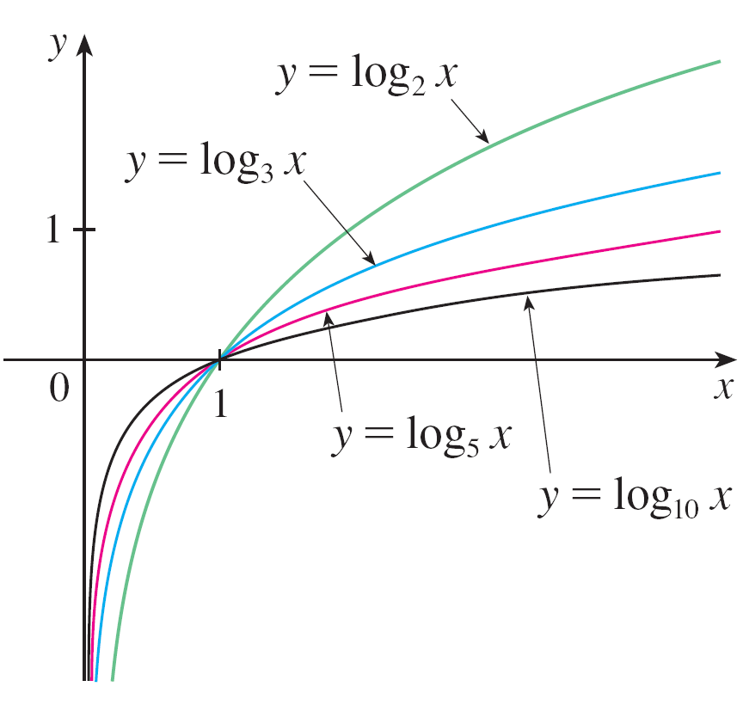
Logarithmic Functions
The logarithmic functions f (x) = log_{b}x, where the base b is a positive constant, are the inverse functions of the exponential functions. Figure 21 shows the graphs of four logarithmic functions with various bases.
In each case the domain is
(0, ), the range is ( , ),
and the function increases
slowly when x > 1.
Figure 21

Slide 98
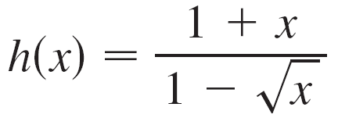
Example 6
Classify the following functions as one of the types of
functions that we have discussed.
(a) f (x) = 5^{x}
(b) g (x) = x⁵
(c)
(d) u (t) = 1 – t + 5t ⁴

Slide 99
Example 6 – Solution
(a) f (x) = 5^{x} is an exponential function. (The x is the exponent.)
(b) g (x) = x⁵ is a power function. (The x is the base.) We could also consider it to be a polynomial of degree 5.
(c) is an algebraic function.
(d) u (t) = 1 – t + 5t ⁴ is a polynomial of degree 4.

Slide 100
New Functions from Old Functions
1.3
Copyright © Cengage Learning. All rights reserved.

Slide 101
Transformations of Functions

Slide 102
Transformations of Functions
By applying certain transformations to the graph of a given function we can obtain the graphs of related functions.
This will give us the ability to sketch the graphs of many
functions quickly by hand. It will also enable us to write
equations for given graphs.
Let’s first consider translations. If c is a positive number,
then the graph of y = f (x) + c is just the graph of y = f (x)
shifted upward a distance of c units (because each
y-coordinate is increased by the same number c).

Slide 103
Transformations of Functions
Likewise, if g(x) = f (x – c), where c > 0, then the value of g at x is the same as the value of f at x – c (c units to the left of x).
Therefore the graph of y = f (x – c) is just the
graph of y = f (x) shifted
c units to the right
(see Figure 1).
Translating the graph of f
Figure 1

Slide 104
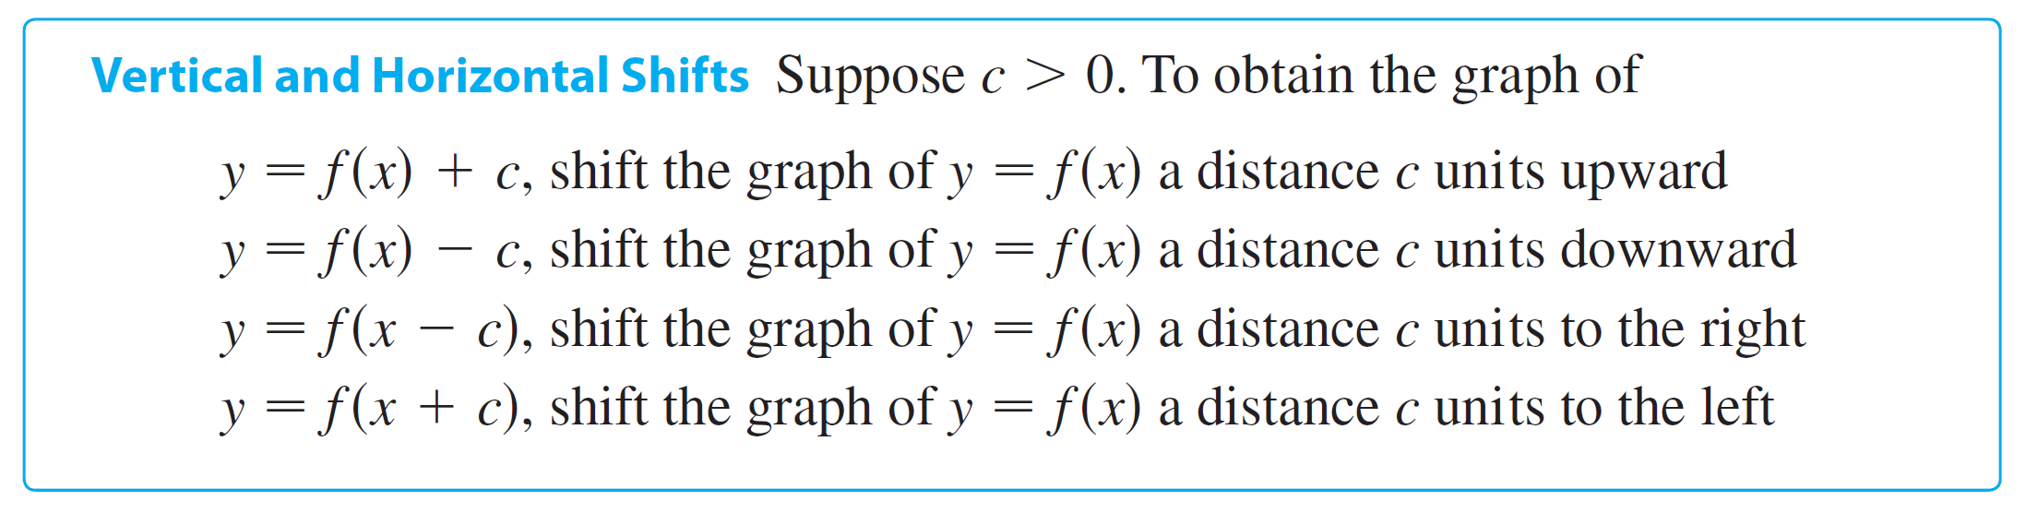
Transformations of Functions
Now let’s consider the stretching and reflecting
transformations. If c > 1, then the graph of y = cf (x) is the
graph of y = f (x) stretched by a factor of c in the vertical
direction (because each y-coordinate is multiplied by the
same number c).

Slide 105
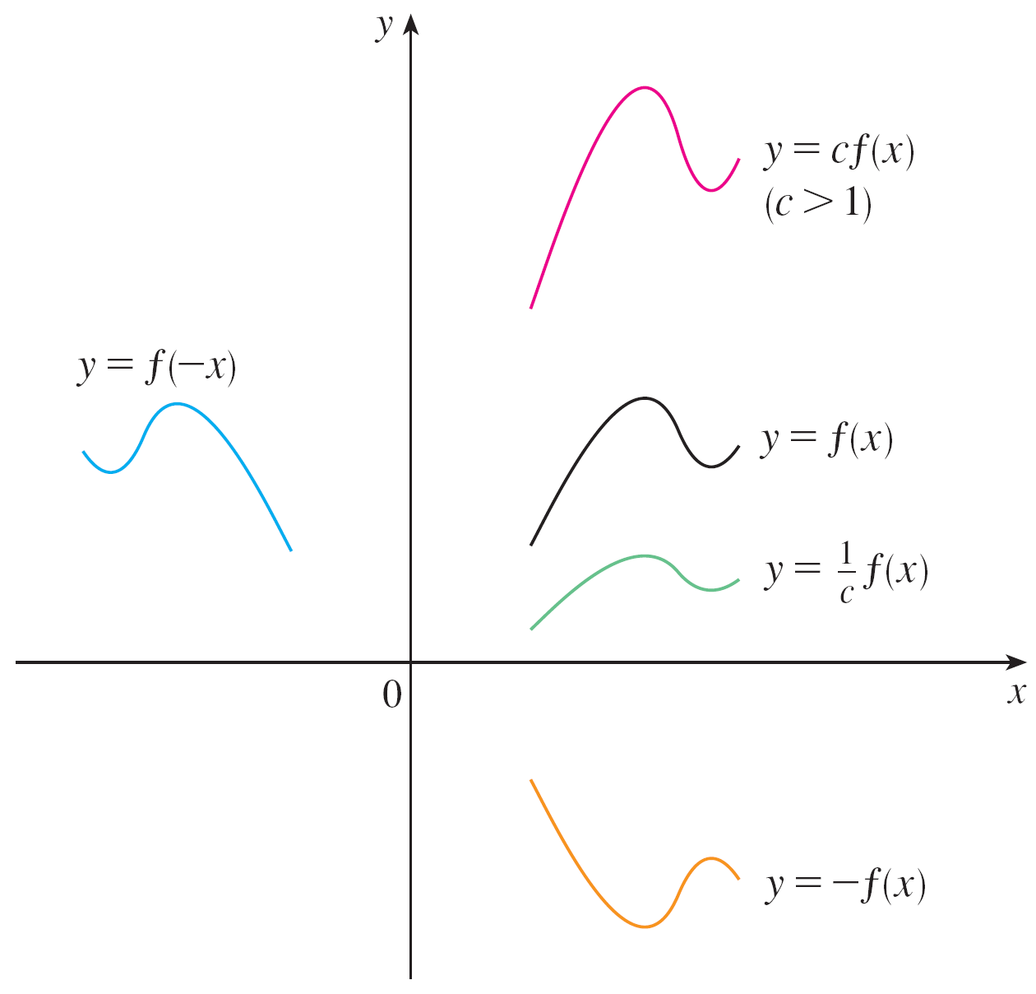
Transformations of Functions
The graph of y = –f (x) is the graph of y = f (x) reflected about
the x-axis because the point (x, y) is replaced by the
point (x, –y).
(See Figure 2 and the
following chart, where the
results of other stretching,
shrinking, and reflecting
transformations are also
given.)
Stretching and reflecting the graph of f
Figure 2

Slide 106
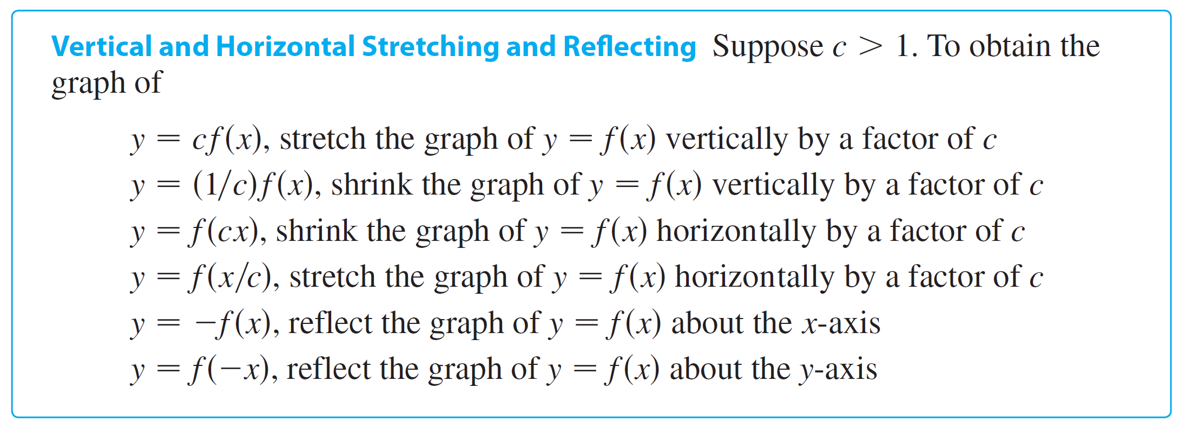
Transformations of Functions

Slide 107
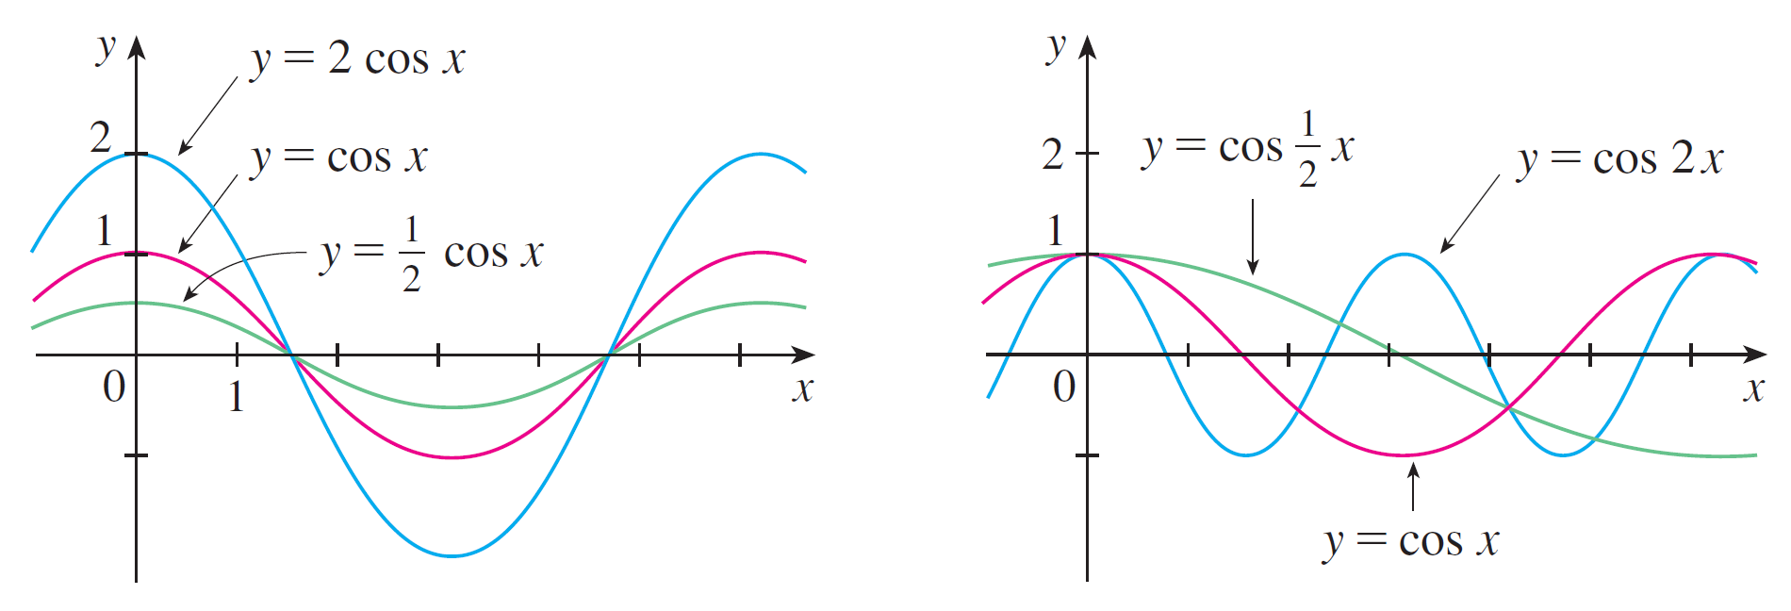
Transformations of Functions
Figure 3 illustrates these stretching transformations when
applied to the cosine function with c = 2.
Figure 3

Slide 108
Transformations of Functions
For instance, in order to get the graph of y = 2 cos x we
multiply the y-coordinate of each point on the graph of
y = cos x by 2.
This means that the graph of y = cos x gets stretched
vertically by a factor of 2.

Slide 109


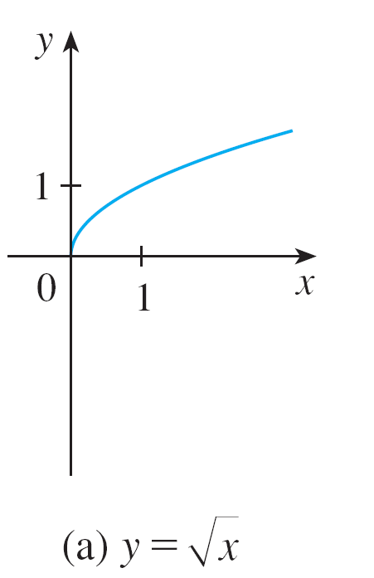
Example 1
Given the graph of use transformations to graph
and
Solution:
The graph of the square root function , is shown in Figure 4(a).
Figure 4

Slide 110
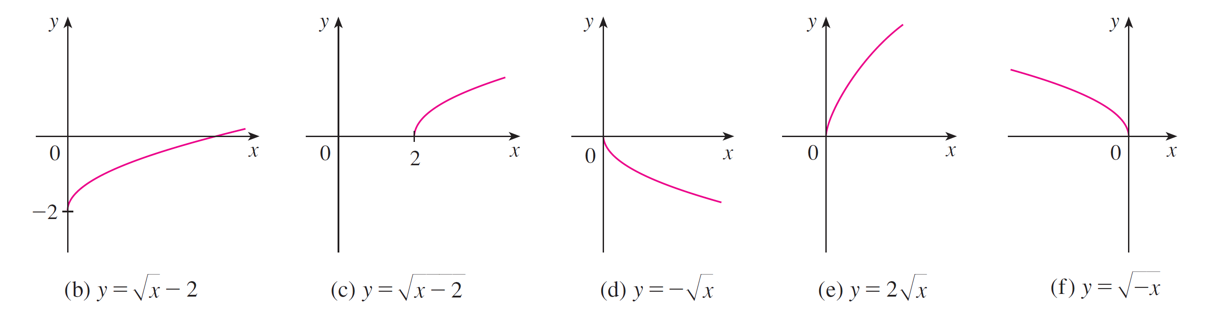



Example 1 – Solution
cont’d
In the other parts of the figure we sketch by
shifting 2 units downward, by shifting 2 units to
the right, by reflecting about the x-axis,
by stretching vertically by a factor of 2, and by
reflecting about the y-axis.
Figure 4

Slide 111
Transformations of Functions
Another transformation of some interest is taking the
absolute value of a function. If y = | f (x) |, then according to
the definition of absolute value, y = f (x) when f (x) ≥ 0 and
y = –f (x) when f (x) < 0.
This tells us how to get the graph of y = | f (x) | from the graph
of y = f (x) : The part of the graph that lies above the x-axis
remains the same; the part that lies below the x-axis is
reflected about the x-axis.

Slide 112
Combinations of Functions

Slide 113



Combinations of Functions
Two functions f and g can be combined to form new functions f + g, f – g, fg, and f/g in a manner similar to the way we add, subtract, multiply, and divide real numbers. The sum and difference functions are defined by
(f + g)(x) = f (x) + g (x) (f – g)(x) = f (x) – g (x)
If the domain of f is A and the domain of g is B, then the
domain of f + g is the intersection A ∩ B because both
f (x) and g(x) have to be defined.
For example, the domain of is A = [0, ) and the
domain of is B = ( , 2], so the domain of
is A ∩ B = [0, 2].

Slide 114
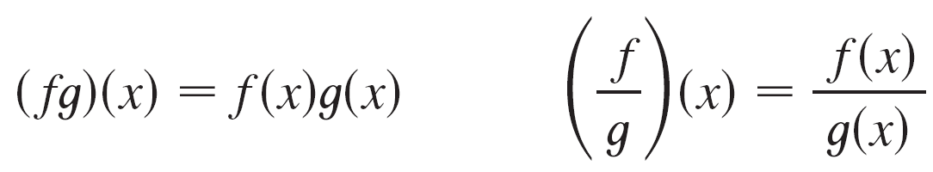
Combinations of Functions
Similarly, the product and quotient functions are defined by
The domain of f g is A ∩ B, but we can’t divide by 0 and so
the domain of f /g is {x ∈ A ∩ B | g(x) ≠ 0}.
For instance, if f (x) = x² and g (x) = x – 1, then the domain of
the rational function (f /g)(x) = x²/(x – 1) is {x | x ≠ 1},
or ( , 1) U (1, ).

Slide 115


Combinations of Functions
There is another way of combining two functions to obtain a
new function. For example, suppose that y = f (u) =
and u = g (x) = x² + 1.
Since y is a function of u and u is, in turn, a function of x, it
follows that y is ultimately a function of x. We compute
this by substitution:
y = f (u) = f (g (x)) = f (x² + 1) =
The procedure is called composition because the new
function is composed of the two given functions f and g.

Slide 116
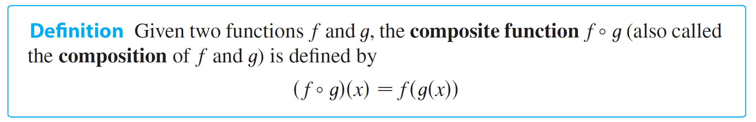
Combinations of Functions
In general, given any two functions f and g, we start with a
number x in the domain of g and calculate g (x). If this
number g (x) is in the domain of f, then we can calculate the
value of f (g (x)).
The result is a new function h (x) = f (g (x)) obtained by substituting g into f. It is called the composition (or composite) of f and g and is denoted by f ° g (“f circle g ”).

Slide 117
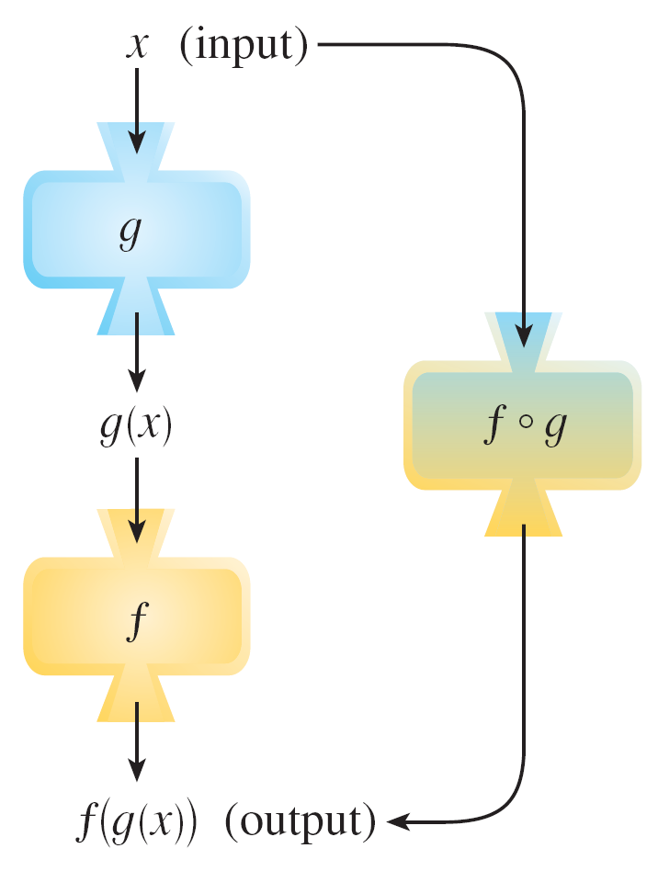
Combinations of Functions
The domain of f ° g is the set of all x in the domain of g such
that g (x) is in the domain of f.
In other words, (f ° g)(x) is
defined whenever both
g (x) and f (g (x)) are defined.
Figure 11 shows how to
picture f ° g in terms of machines.
The f ° g machine is composed of
the g machine (first) and then
the f machine.
Figure 11

Slide 118
Example 6
If f (x) = x² and g (x) = x – 3, find the composite functions
f ° g and g ° f.
Solution:
We have
(f ° g)(x) = f (g (x))
(g ° f)(x) = g (f (x))
= f (x – 3)
= (x – 3)²
= g (x²)
= x² – 3

Slide 119
Combinations of Functions
We know that, the notation f ° g means that the function g is
applied first and then f is applied second. In Example 6, f ° g is the function that first subtracts 3 and then squares; g ° f is the function that first squares and then subtracts 3.
It is possible to take the composition of three or more
functions. For instance, the composite function f ° g ° h is
found by first applying h, then g, and then f as follows:
(f ° g ° h)(x) = f (g (h (x)))

Slide 120
Inverse Functions and Logarithms
1.5
Copyright © Cengage Learning. All rights reserved.

Slide 121
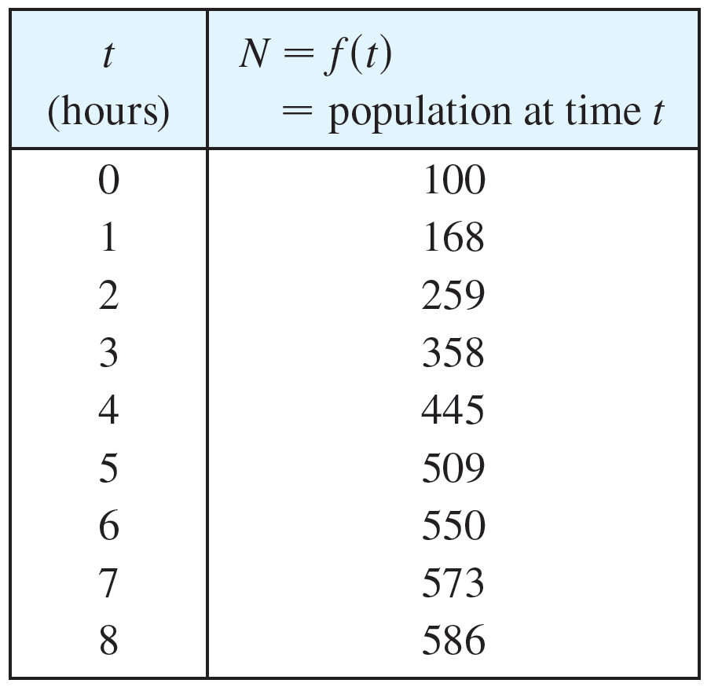
Inverse Functions and Logarithms
Table 1 gives data from an experiment in which a bacteria culture started with 100 bacteria in a limited nutrient medium; the size of the bacteria population was recorded at hourly intervals.
The number of bacteria N is
a function of the time t: N = f (t).
Suppose, however, that the
biologist changes her point of
view and becomes interested
in the time required for the
population to reach various
levels. In other words, she is
thinking of t as a function of N.
N as a function of t
Table 1

Slide 122
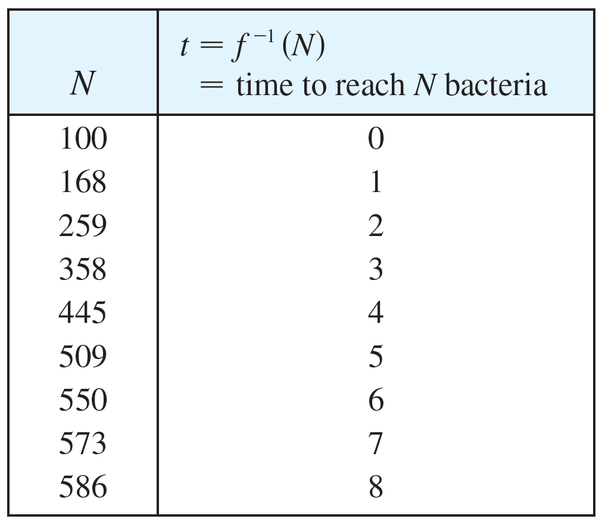
Inverse Functions and Logarithms
This function is called the inverse function of f, denoted
by f ^{–1}, and read “f inverse.” Thus t = f ^{–1}(N) is the time required for the population level to reach N.
The values of f ^{–1} can be found
by reading Table 1 from right
to left or by consulting Table 2.
For instance, f ^{–1}(550) = 6
because f (6) = 550.
Not all functions possess
inverses.
t as a function of N
Table 2

Slide 123
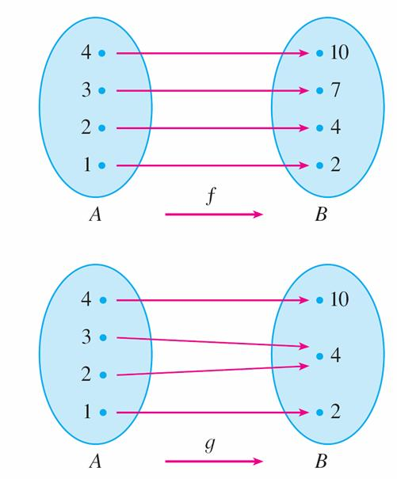
Inverse Functions and Logarithms
Let’s compare the functions f and g whose arrow diagrams are shown in Figure 1.
Note that f never takes on
the same value twice (any two
inputs in A have different outputs),
whereas g does take on the same
value twice (both 2 and 3 have
the same output, 4).
In symbols,
g (2) = g (3)
but f (x₁) ≠ f (x₂) whenever x₁ ≠ x₂
f is one-to-one; g is not.
Figure 1

Slide 124
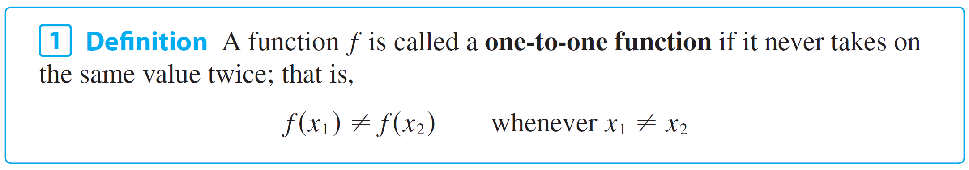
Inverse Functions and Logarithms
Functions that share this property with f are called one-to-one functions.

Slide 125
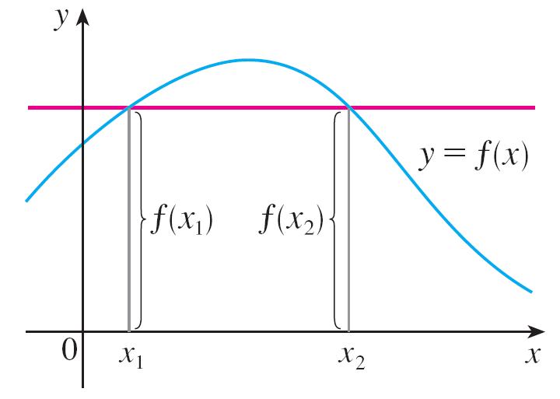
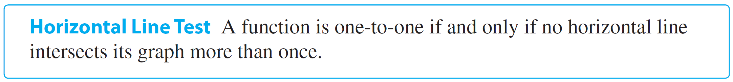
Inverse Functions and Logarithms
If a horizontal line intersects the
graph of f in more than one point,
then we see from Figure 2 that
there are numbers x₁ and x₂
such that f (x₁) = f (x₂).
This means that f is not one-to-one.
Therefore we have the following geometric method for determining whether a function is one-to-one.
This function is not one-to-one
because f (x₁) = f (x₂).
Figure 2

Slide 126
Example 1
Is the function f (x) = x³ one-to-one?
Solution 1:
If x₁ ≠ x₂, then x₁³ ≠ x₂³ (two different numbers can’t have
the same cube).
Therefore, by Definition 1, f (x) = x³ is one-to-one.
Solution 2:
From Figure 3 we see that no
horizontal line intersects the
graph of f (x) = x³ more than once.
Therefore, by the Horizontal
Line Test, f is one-to-one.
f (x) = x³ is one-to-one.
Figure 3

Slide 127
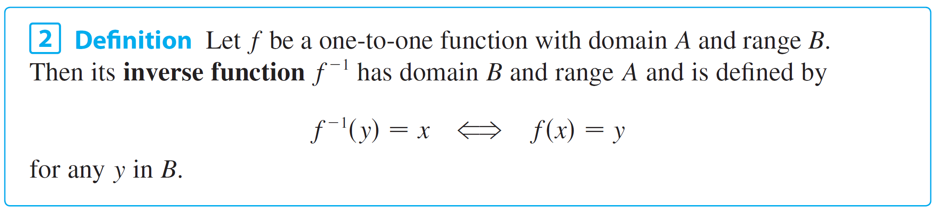
Inverse Functions and Logarithms
One-to-one functions are important because they are precisely the functions that possess inverse functions according to the following definition.
This definition says that if f maps x into y, then f ^{–1} maps y back into x. (If f were not one-to-one, then f ^{–1} would not be uniquely defined.)

Slide 128
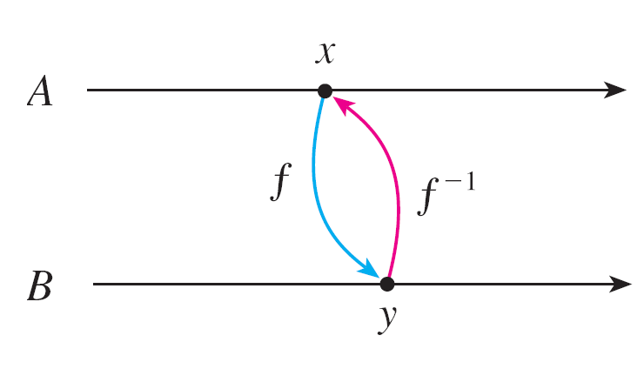
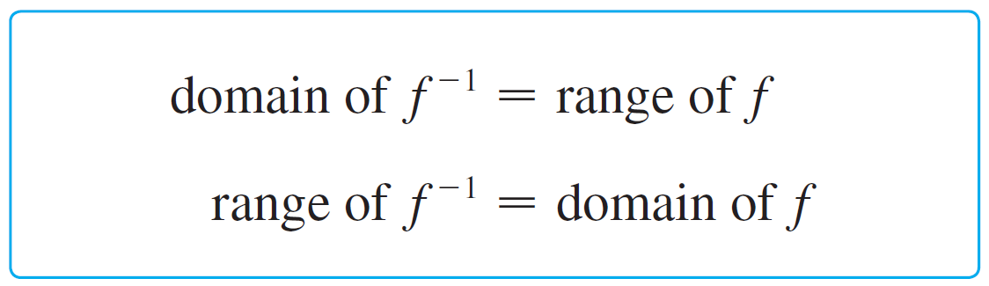
Inverse Functions and Logarithms
The arrow diagram in Figure 5 indicates that f ^{–1} reverses the effect of f.
Note that
Figure 5

Slide 129
Inverse Functions and Logarithms
For example, the inverse function of f (x) = x³ is f ^{–1}(x) = x^{1/3} because if y = x³, then
f ^{–1}(y) = f ^{–1}(x³) = (x³)^{1/3} = x
Caution
Do not mistake the –1 in f ^{–1} for an exponent. Thus
f ^{–1}(x) does not mean
The reciprocal 1/f (x) could, however, be written as [f (x)] ^{–1}.

Slide 130
Example 3
If f (1) = 5, f (3) = 7, and f (8) = –10, find f ^{–1}(7), f ^{–1}(5), and
f ^{–1}(–10).
Solution:
From the definition of f ^{–1} we have
f ^{–1}(7) = 3 because f (3) = 7
f ^{–1}(5) = 1 because f (1) = 5
f ^{–1}(–10) = 8 because f (8) = –10

Slide 131

Example 3 – Solution
cont’d
The diagram in Figure 6 makes it clear how f ^{–1} reverses the effect of f in this case.
The inverse function reverses inputs and outputs.
Figure 6

Slide 132


Inverse Functions and Logarithms
The letter x is traditionally used as the independent variable, so when we concentrate on f ^{–1} rather than on f, we usually reverse the roles of x and y in Definition 2 and write
By substituting for y in Definition 2 and substituting for x in (3), we get the following cancellation equations:

Slide 133

Inverse Functions and Logarithms
The first cancellation equation says that if we start with x, apply f, and then apply f ^{–1}, we arrive back at x, where we started (see the machine diagram in Figure 7).
Thus f ^{–1} undoes what f does.
The second equation says that f undoes what f ^{–1} does.
Figure 7

Slide 134
Inverse Functions and Logarithms
For example, if f (x) = x³, then f ^{–1}(x) = x^{1/3} and so the cancellation equations become
f ^{–1}(f (x)) = (x³)^{1/3} = x
f (f ^{–1}(x)) = (x^{1/3})³ = x
These equations simply say that the cube function and the cube root function cancel each other when applied in succession.

Slide 135

Inverse Functions and Logarithms
Now let’s see how to compute inverse functions.
If we have a function y = f (x) and are able to solve this equation for x in terms of y, then according to Definition 2 we must have x = f ^{–1}(y).
If we want to call the independent variable x, we then interchange x and y and arrive at the equation y = f ^{–1}(x).

Slide 136

Inverse Functions and Logarithms
The principle of interchanging x and y to find the inverse function also gives us the method for obtaining the graph of f ^{–1} from the graph of f.
Since f (a) = b if and only if f ^{–1}(b) = a, the point (a, b) is on the graph of f if and only if the point (b, a) is on the graph
of f ^{–1}.
But we get the point (b, a)
from (a, b) by reflecting about
the line y = x. (See Figure 8.)
Figure 8

Slide 137

Inverse Functions and Logarithms
Therefore, as illustrated by Figure 9:
Figure 9

Slide 138
Logarithmic Functions

Slide 139


Logarithmic Functions
If b > 0 and b ≠ 1, the exponential function f (x) = b^{x} is either increasing or decreasing and so it is one-to-one by the Horizontal Line Test. It therefore has an inverse function f ^{–1}, which is called the logarithmic function with base b and is denoted by log_{b}.
If we use the formulation of an inverse function given by ,
f ^{–1}(x) = y f (y) = x
then we have

Slide 140

Logarithmic Functions
Thus, if x > 0, then log_{b} x is the exponent to which the base b must be raised to give x.
For example, log₁₀ 0.001 = –3 because 10^{–3} = 0.001.
The cancellation equations (4), when applied to the functions f (x) = b^{x} and f ^{–1}(x) = log_{b} x, become

Slide 141


Logarithmic Functions
The logarithmic function log_{b} has domain (0, ) and
range . Its graph is the reflection of the graph of y = b^{x} about the line y = x.
Figure 11 shows the case
where b > 1. (The most
important logarithmic functions
have base b > 1.)
The fact that y = b^{x} is a very
rapidly increasing function
for x > 0 is reflected in the fact
that y = log_{b} x is a very slowly
increasing function for x > 1.
Figure 11

Slide 142

Logarithmic Functions
Figure 12 shows the graphs of y = log_{b} x with various values of the base b > 1.
Since log_{b} 1 = 0, the graphs of all logarithmic functions pass through the point (1, 0).
Figure 12

Slide 143

Logarithmic Functions
The following properties of logarithmic functions follow from the corresponding properties of exponential functions.

Slide 144

Example 6
Use the laws of logarithms to evaluate log₂ 80 – log₂ 5.
Solution:
Using Law 2, we have
log₂ 80 – log₂ 5 = log₂
= log₂ 16
= 4
because 2⁴ = 16.

Slide 145
Natural Logarithms

Slide 146


Natural Logarithms
Of all possible bases b for logarithms, we will see that the most convenient choice of a base is the number e.
The logarithm with base e is called the natural logarithm and has a special notation:
If we put b = e and replace log_{e} with “ln” in (6) and (7), then the defining properties of the natural logarithm function become

Slide 147


Natural Logarithms
In particular, if we set x = 1, we get

Slide 148
Example 7
Find x if ln x = 5.
Solution 1:
From (8) we see that
ln x = 5 means e ⁵ = x
Therefore x = e ⁵.
(If you have trouble working with the “ln” notation, just replace it by log_{e}. Then the equation becomes log_{e} x = 5; so, by the definition of logarithm, e⁵ = x.)

Slide 149
Example 7 – Solution
cont’d
Solution 2:
Start with the equation
ln x = 5
and apply the exponential function to both sides of the equation:
e ^{ln x} = e⁵
But the second cancellation equation in (9) says
that e ^{ln x} = x.
Therefore x = e ⁵.

Slide 150

Natural Logarithms
The following formula shows that logarithms with any base can be expressed in terms of the natural logarithm.

Slide 151
Example 10
Evaluate log₈ 5 correct to six decimal places.
Solution:
Formula 10 gives
log₈ 5 =
≈ 0.773976

Slide 152
Graph and Growth of the Natural Logarithm

Slide 153

Graph and Growth of the Natural Logarithm
The graphs of the exponential function y = e^{x} and its inverse function, the natural logarithm function, are shown in Figure 13.
Because the curve y = e ^{x}
crosses the y-axis with a slope
of 1, it follows that the reflected
curve y = ln x crosses the x-axis
with a slope of 1.
The graph of y = ln x is the reflection
of the graph of y = e^{x} about the line y = x.
Figure 13

Slide 154
Graph and Growth of the Natural Logarithm
In common with all other logarithmic functions with base greater than 1, the natural logarithm is an increasing function defined on (0, ) and the y-axis is a vertical asymptote. (This means that the values of ln x become very large negative as x approaches 0.)

Slide 155

Example 11
Sketch the graph of the function y = ln(x – 2) – 1.
Solution:
We start with the graph of y = ln x as given in Figure 13.
We shift it 2 units to the right to get the graph of y = ln(x – 2) and then we shift it 1 unit downward to get the graph of y = ln(x – 2) – 1. (See Figure 14.)
Figure 14

Slide 156

Graph and Growth of the Natural Logarithm
Although ln x is an increasing function, it grows very slowly when x > 1. In fact, ln x grows more slowly than any positive power of x.
To illustrate this fact, we compare approximate values of the functions y = ln x and y = x^{1/2} = in the following table.

Slide 157

Graph and Growth of the Natural Logarithm
We graph them in Figures 15 and 16.
You can see that initially the graphs of y = and y = ln x grow at comparable rates, but eventually the root function far surpasses the logarithm.
Figure 15
Figure 16

Slide 158
Inverse Trigonometric Functions

Slide 159
Inverse Trigonometric Functions
When we try to find the inverse trigonometric functions, we have a slight difficulty: Because the trigonometric functions are not one-to-one, they don’t have inverse functions.
The difficulty is overcome by restricting the domains of these functions so that they become one-to-one.

Slide 160



Inverse Trigonometric Functions
You can see from Figure 17 that the sine function y = sin x is not one-to-one (use the Horizontal Line Test).
But the function f (x) = sin x, –π/2 ≤ x ≤ π/2, is one-to-one
(see Figure 18).
Figure 17
y = sin x, ≤ x ≤
Figure 18

Slide 161

Inverse Trigonometric Functions
The inverse function of this restricted sine function f exists and is denoted by sin^{–1} or arcsin. It is called the inverse sine function or the arcsine function.
Since the definition of an inverse function says that
f ^{–1}(x) = y f (y) = x
we have

Slide 162
Inverse Trigonometric Functions
Thus, if –1 ≤ x ≤ 1, sin^{–1}x is the number between –π/2 and π/2 whose sine is x.

Slide 163



Example 12
Evaluate (a) sin^{–1} and (b) tan(arcsin ).
Solution:
(a) We have
because sin(π/6) = and π/6 lies between –π/2 and π/2.

Slide 164



Example 12 – Solution
cont’d
(b) Let θ = arcsin , so sin θ = .
Then we can draw a right triangle with angle θ as in Figure 19 and deduce from the Pythagorean Theorem that the third side has length .
This enables us to read from the triangle that
Figure 19

Slide 165

Inverse Trigonometric Functions
The cancellation equations for inverse functions become, in this case,

Slide 166

Inverse Trigonometric Functions
The inverse sine function, sin^{–1}, has domain [–1, 1] and range [–π/2, π/2], and its graph, shown in Figure 20, is obtained from that of the restricted sine function (Figure 18) by reflection about the line y = x.
y = sin x, ≤ x ≤
y = sin^{–1} x = arcsin x
Figure 18
Figure 20

Slide 167


Inverse Trigonometric Functions
The inverse cosine function is handled similarly. The restricted cosine function f (x) = cos x, 0 ≤ x ≤ π , is one-to-one (see Figure 21) and so it has an inverse function denoted by cos^{–1} or arccos.
y = cos x, 0 ≤ x ≤ π
Figure 21

Slide 168


Inverse Trigonometric Functions
The cancellation equations are
The inverse cosine function, cos^{–1}, has domain [–1, 1] and range [0, π]. Its graph is shown in Figure 22.
y = cos ^{–1} x = arccos x
Figure 22

Slide 169



Inverse Trigonometric Functions
The tangent function can be made one-to-one by restricting it to the interval (–π/2, π/2). Thus the inverse tangent function is defined as the inverse of the function f (x) = tan x, –π/2 < x < π/2. (See Figure 23.) It is denoted by tan^{–1} or arctan.
y = tan x,
Figure 23

Slide 170

Inverse Trigonometric Functions
The remaining inverse trigonometric functions are summarized here.

