Slide 1
2024 CITY OF SANTA ANA FIREWORKS PROGRAM
SAFE AND SANE FIREWORKS
BOOTH REGULATIONS

Slide 2
WELCOME & OVERVIEW
CITY OF SANTA ANA POLICE DEPARTMENT REQUIREMENTS
CONTACTS
JOSE De SOTO – CITY OF SANTA ANA SUPERVISOR OF INSPECTIONS
EVELYN LAROCCA – CITY OF SANTA ANA PERMIT SERVICES PRINCIPAL
Eric Evans– ORANGE COUNTY FIRE AUTHORITY (OCFA)

Slide 3
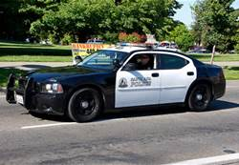
POLICE DEPARTMENT REQUIREMENTS
THERE SHALL BE NO LIVE MUSIC OR AMPLIFIED SOUND IN OR ADJACENT TO FIREWORKS BOOTHS, USED IN AN ATTEMPT TO DRAW ADDITIONAL CUSTOMERS TO BOOTH LOCATIONS.
DISPATCH CONTACT 714-834-4211
SAFE AND SANE FIREWORKS SHALL BE SECURED INSIDE STANDS AFTERHOURS AT ALL TIMES IN ORDER TO REDUCE POTENTIAL THEFT.

Slide 4
POLICE DEPARTMENT REQUIREMENTS
PLEASE POST ILLEGAL FIREWORKS NOTICE (ENGLISH & SPANISH) IN ALL FIREWORKS BOOTHS STATING THAT THE POSSESSION OR USE OF ILLEGAL FIREWORKS IS A CRIME PUNISHABLE BY UP TO ONE YEAR IN JAIL AND $1,000 FINE MINIMUM
ONLY SAFE AND SANE FIREWORKS ARE
LEGAL IN SANTA ANA!

Slide 5
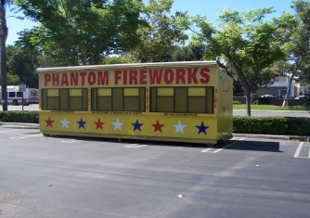
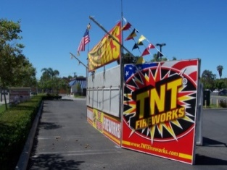
CITY ORDINANCE REQUIREMENTS
ONLY SAFE AND SANE FIREWORKS ARE PERMITTED
NO PERSON SHALL SELL ANY TYPE OF FIREWORKS AT ANY TIME EXCEPT FROM:
12:00 NOON THROUGH 10:00 P.M. ON JULY 1
10:00A.M. THROUGH 10:00 P.M. ON JULY 2, 3
10:00A.M. THROUGH 9:00 P.M. ON JULY 4
APPROVALS ARE REQUIRED THROUGH CITY OF SANTA ANA AND OCFA

Slide 6
CITY ORDINANCE REQUIREMENTS
FIREWORKS STANDS, EQUIPMENT, MATERIALS AND ALL RUBBISH SHALL BE REMOVED FROM THE PREMISES UPON WHICH THE STAND IS LOCATED BEFORE MIDNIGHT JULY 11

Slide 7
BUILDING DIVISION REQUIREMENTS
ELECTRICAL REQUIREMENTS FOR SPECIAL EVENTS:
1. ELECTRICAL PERMITS AND INSPECTIONS ARE REQUIRED.
2. ELECTRICAL POWER SUPPLY:
TEMPORARY APPROVED POWER POLES (USUALLY UNDER SEPARATE PERMIT)
RECEPTACLE ON OUTSIDE OF LOCAL MERCHANT (WITH PERMISSION OF MERCHANT)
RECEPTACLE IN POLE OR MONUMENT SIGN J-BOX (WITH PERMISSION OF MERCHANT)
PORTABLE GENERATOR. BOTH GENERATOR AND FUEL SHALL BE AT LEAST 20’ AWAY FROM STAND.
PORTABLE BATTERIES (NO PERMIT REQUIRED)
3. ELECTRICAL CORD FOR SUPPLY:
ALL EXTENSION CORDS SHALL BE HEAVY DUTY, THREE WIRE, WITH APPROVED FOUNDED PLUGS.
ALL EXTENSION CORDS SHALL BE IN GOOD REPAIR, FREE OF CUTS OR SPLICES
EXTENSION CORDS ON THE GROUND (ANY FOOT OR VEHICLE TRAFFIC AREAS) SHALL BE COVERED OR SHIELDED TO PREVENT INJURY TO THE CORD OR PEOPLE.

Slide 8
BUILDING DIVISION REQUIREMENTS
4. ELECTRICAL DISCONNECT FOR STANDS:
TO BE LOCATED EITHER JUST INSIDE, OR IMMEDIATELY OUTSIDE OF EXIT
MAY BE CIRCUIT BREAKER, SWITCH OR CORD CAP
5. ELECTRICAL WIRING INSIDE STANDS:
NO OPEN WIRING ALLOWED
LIGHTING FIXTURES REQUIRE PROTECTION OF LAMPS. LAMP GUARDS, PLASTIC LENSES OR WIRE CAGES ARE REQUIRED
WIRING SHALL BE ENCLOSED IN APPROVED RACEWAYS, FITTING AND BOXES
-EXCEPTION: MAY USE MODED TEMPORARY LIGHTING CORDS WITH LAMP GUARDS
6. ELECTRICAL WIRING OUTSIDE STANDS:
SHALL BE IN APRPOVED RAIN-TIGHT CONDUIT AND BOXES
FESTOON LIGHTING SHALL BE SUPPORTED BY APPROVED INSULATORS, ELEVATED ABOVE THE GROUND AT LEASE 10’ FOR FOOT TRAFFIC AND 18’ FOR VEHICLE TRAFFIC
7. CARNIVAL RIDES AND LICENSED EQUIPMENT:
SHALL HAVE CURRENT STATE OF CALIFORNIA SAFETY INSPECTION APPROVAL DECALS.
SHALL BE GROUNDED IN AN APPROVED MANNER
ALL ELECTRICAL COVERS SHALL BE IN PLACE AND IN GOOD

Slide 9
SAFETY REQUIREMENTS
30” min.

Slide 10
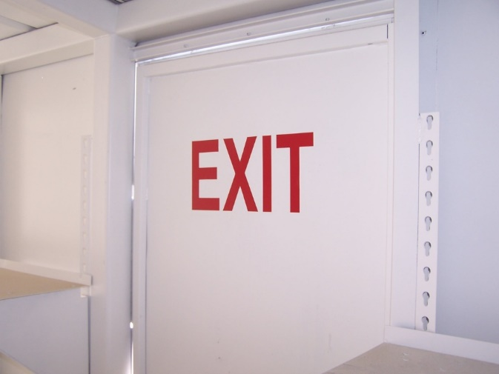
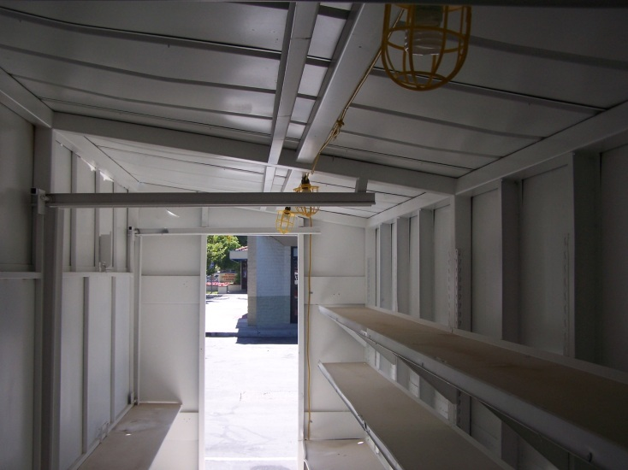
SAFETY REQUIREMENTS
Minimum of 2 exits
Unobstructed aisle connecting them

Slide 11
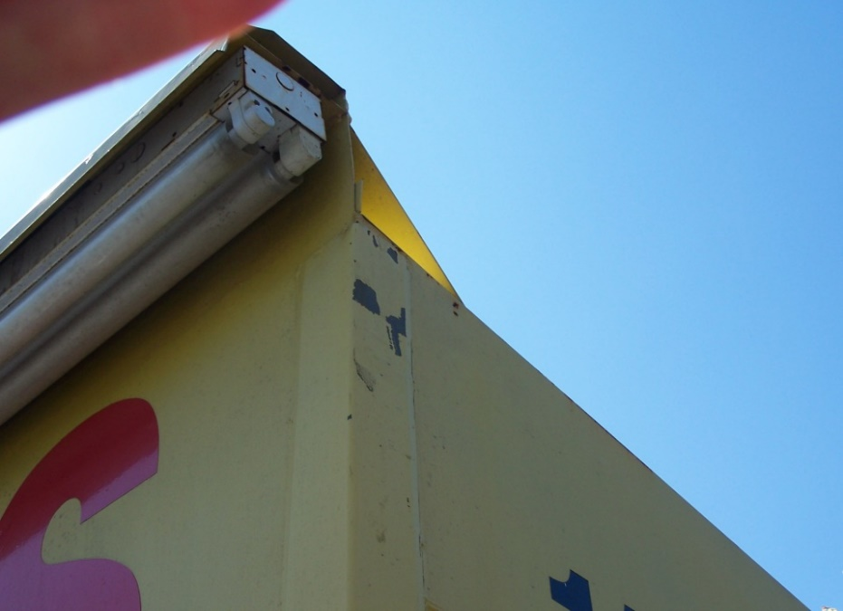
SAFETY REQUIREMENTS
Lighting Fixtures Require Protection of Lamps.
Lamp Guards, Plastic Lenses or Wire Cages ARE REQUIRED

Slide 12
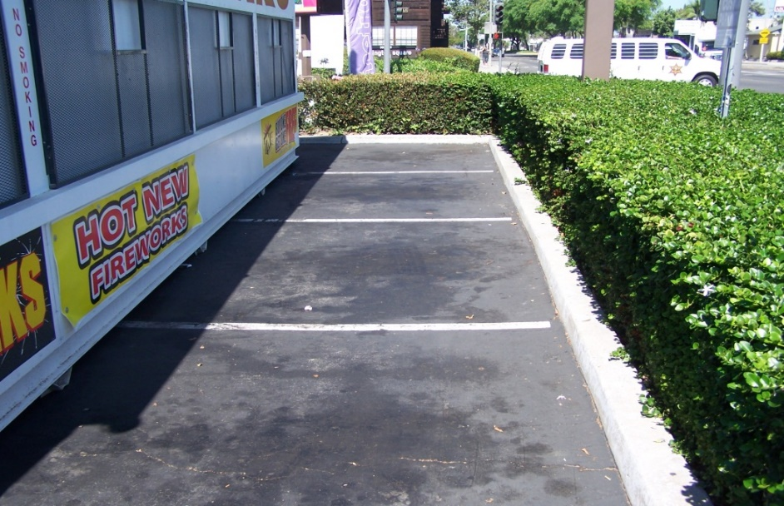
SAFETY REQUIREMENTS
Minimum of 6 feet from inside edge.
Minimum of 20 feet from motor vehicles, gas generators, or flammable liquid containers

Slide 13
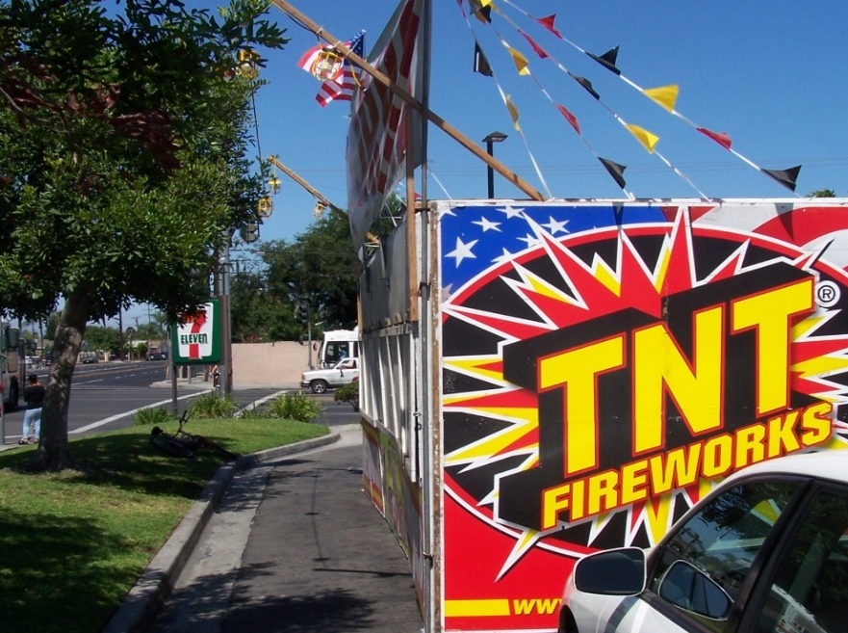
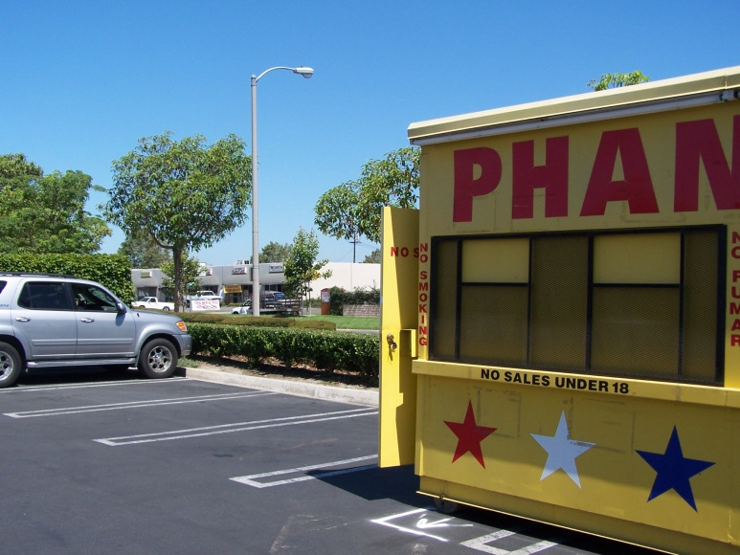
SAFETY REQUIREMENTS
Minimum of 10 feet from curb face and a minimum of 6 feet from inside edge.
Minimum of 20 feet from motor vehicles, gas generators, or flammable liquid containers

Slide 14
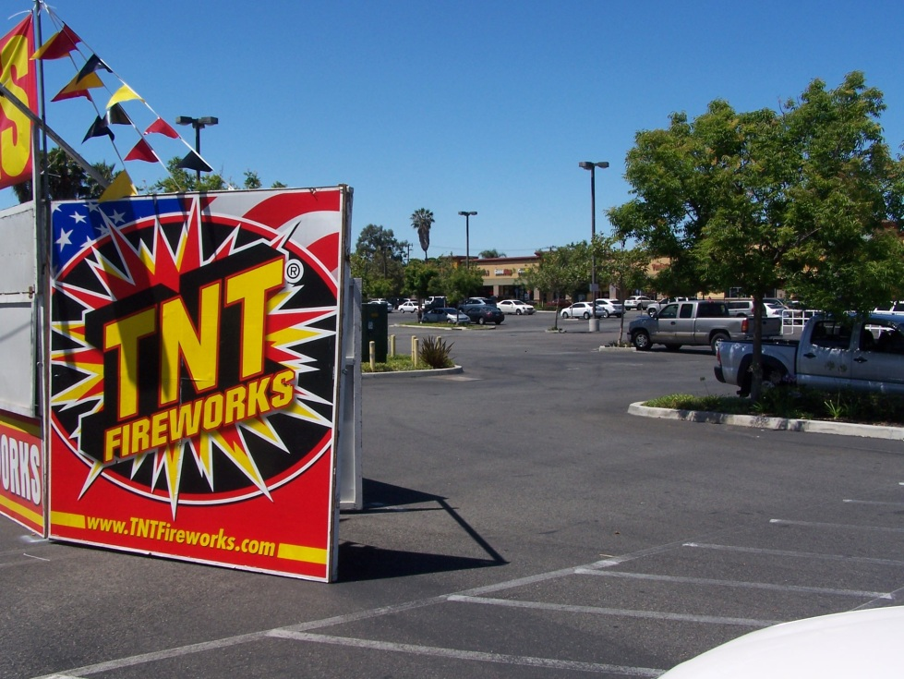
SAFETY REQUIREMENTS
Minimum of 40 feet from any structure and a minimum of 100 feet from gas stations or commercial garages.

Slide 15
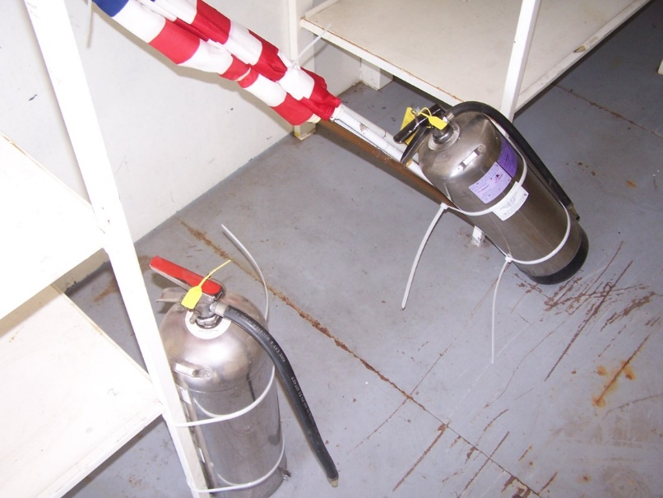
SAFETY REQUIREMENTS
Lighting Fixtures Require Protection of Lamps.
2 Fire Extinguishers per Orange County Fire Authority Requirements

Slide 16
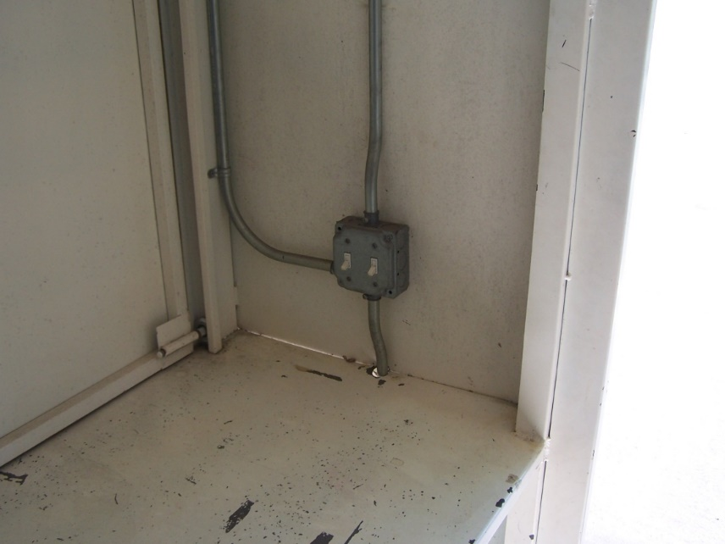
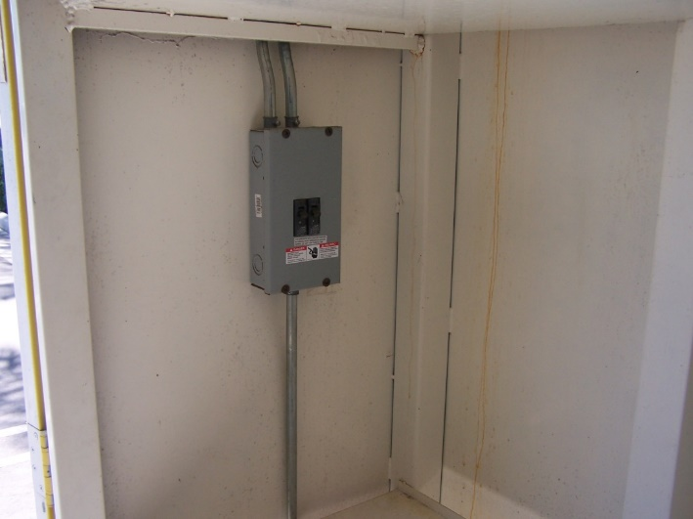
SAFETY REQUIREMENTS
Wiring shall be enclosed in approved raceways, fittings, or boxes
Means of disconnect either just inside or immediately outside of booth

Slide 17
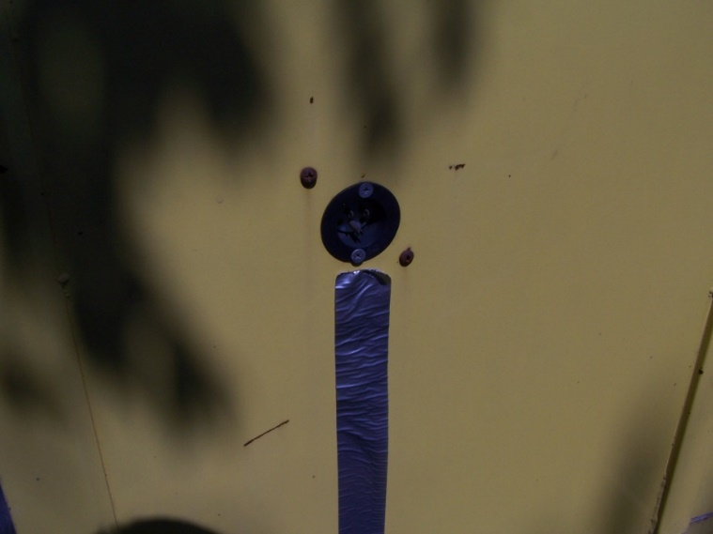
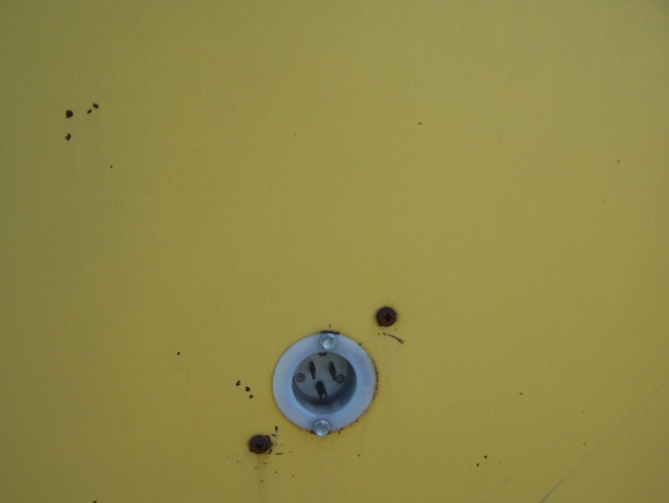
SAFETY REQUIREMENTS
Means of disconnect either just inside or immediately outside of booth
It may be a circuit breaker, switch, or cord cap.

Slide 18
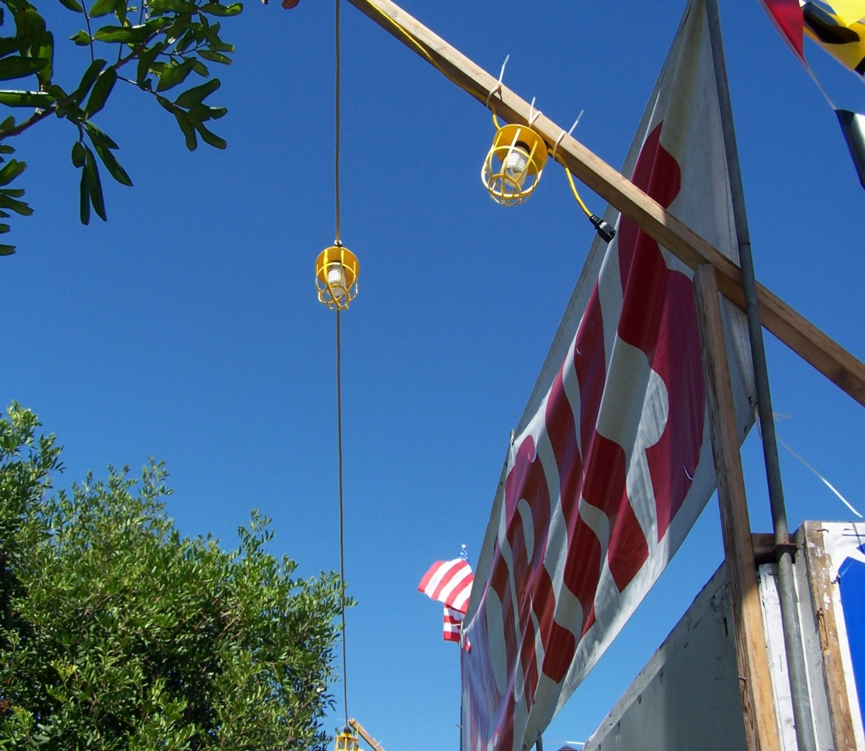
SAFETY REQUIREMENTS
Festoon lights shall be supported and elevated a minimum of 10 feet above foot traffic and a min. of 18 feet above vehicle traffic.

Slide 19
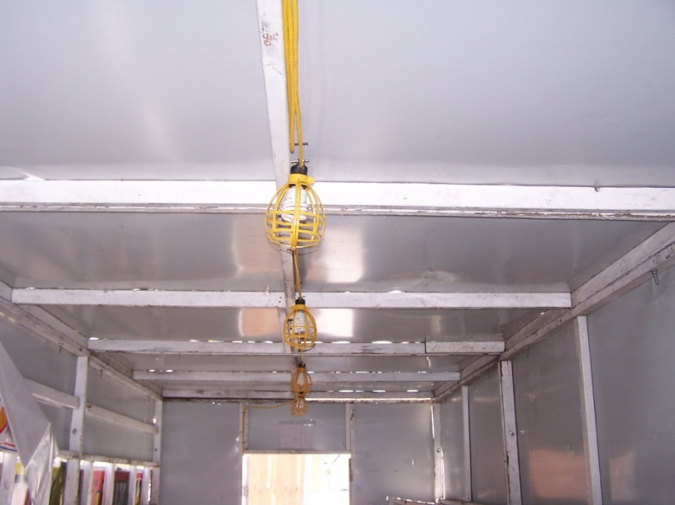
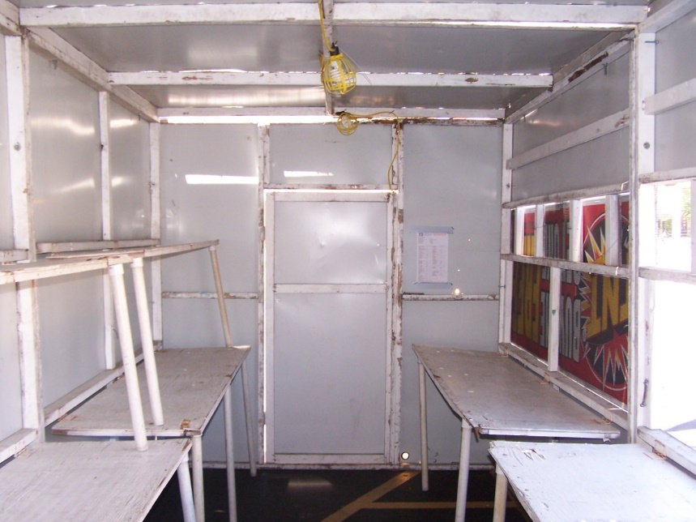
SAFETY REQUIREMENTS
More examples of lighting protection

Slide 20
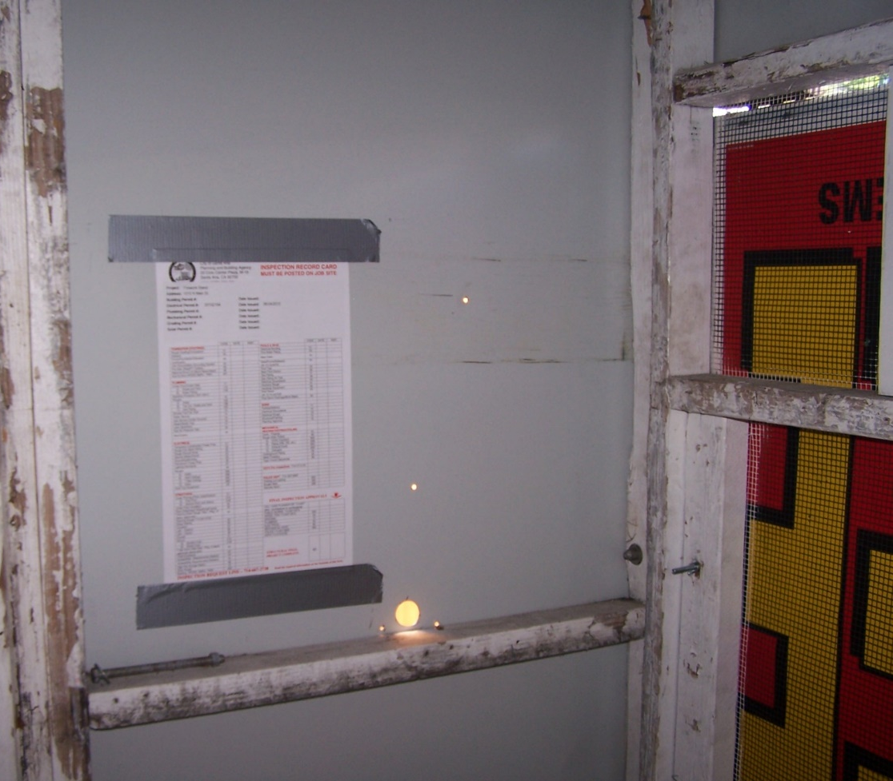
SAFETY REQUIREMENTS
Post Inspection Job Card Inside of Booth.
Inspectors will sign lower right of card when approved. Keep card posted at all times.

Slide 21
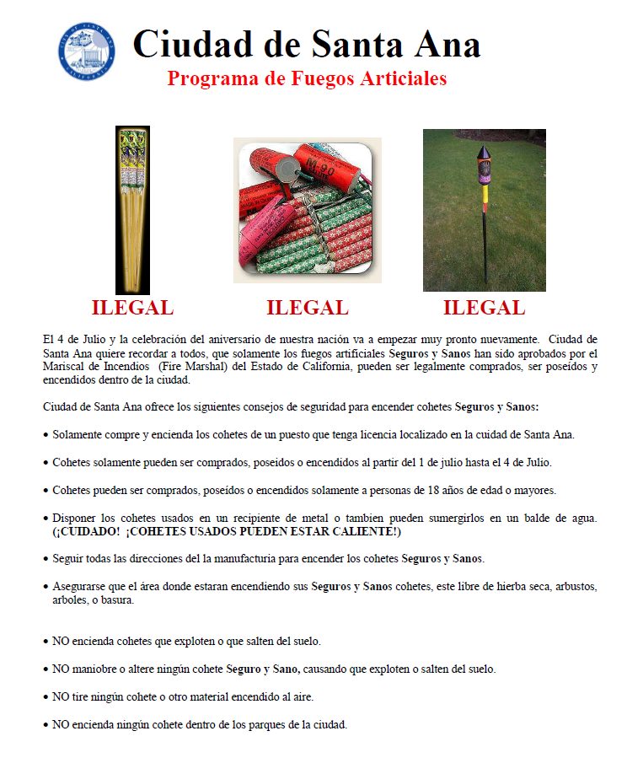
SAFETY REQUIREMENTS

Slide 22
HOW TO CALL FOR INSPECTION
TO CALL FOR INSPECTIONS, CALL THE FIREWORKS INSPECTIONS REQUEST LINE
714-667-2738

