Slide 1
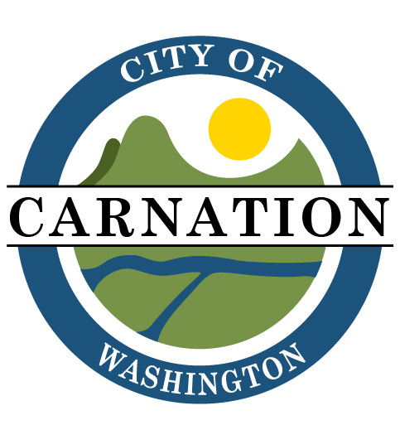
Comprehensive Planning
Carnation
Periodic Update due December 30, 2024

Slide 2
Growth Management
Growth Management Act (GMA)
GMA was adopted to address ways to accommodate growth. It requires cities and counties to complete comprehensive plans and development regulations to guide future growth.
The GMA calls for communities to review and, if necessary, revise their plans and regulations every ten years to ensure they remain up-to-date.

Slide 3
Updating GMA Housing & Land Use Elements
Scope
Consistency
01
02
Element should be consistent with Regional Growth Strategy.
Washington will need 1.1 million new homes in the next 20 years. Half of the new housing must be made for households making less than 50% of area median income.
Location
HB 1220
03
04
Focused growth within cities and Potential Annexation Areas (PAA).
Housing elements now require housing projections based on population and income bracket, a review of racially disparate impacts and displacement, and adequate land capacity.

Slide 4
Puget Sound Regional Council (PSRC)
PSRC works with local governments and agencies to coordinate long-range planning efforts. State law requires PSRC to review and certify countywide planning policies, local comprehensive plans, and Sound Transit’s long-range plans.

Slide 5
Countywide Planning Policies (CPPs)
The CPPs create a shared framework for growth management planning for all jurisdictions in King County. The CPPs are overseen by the Growth Management Planning Council (GMPC).

Slide 6
Housing Targets
The Growth Management Planning Council (GMPC) allocates housing and employment growth to each city and urban unincorporated area in the county.
This allocation is predicated on:
Accommodating the most recent 20-year population projection from the state Office of Financial Management
Thing to do at home
The most recent 20-year regional employment forecast from the Puget Sound Regional Council informed by the 20-year projection of housing units from the State Department of Commerce.

Slide 7
Carnation 2044 Housing Targets
799
704
GMA
King County Buildable Lands Capacity

Slide 8
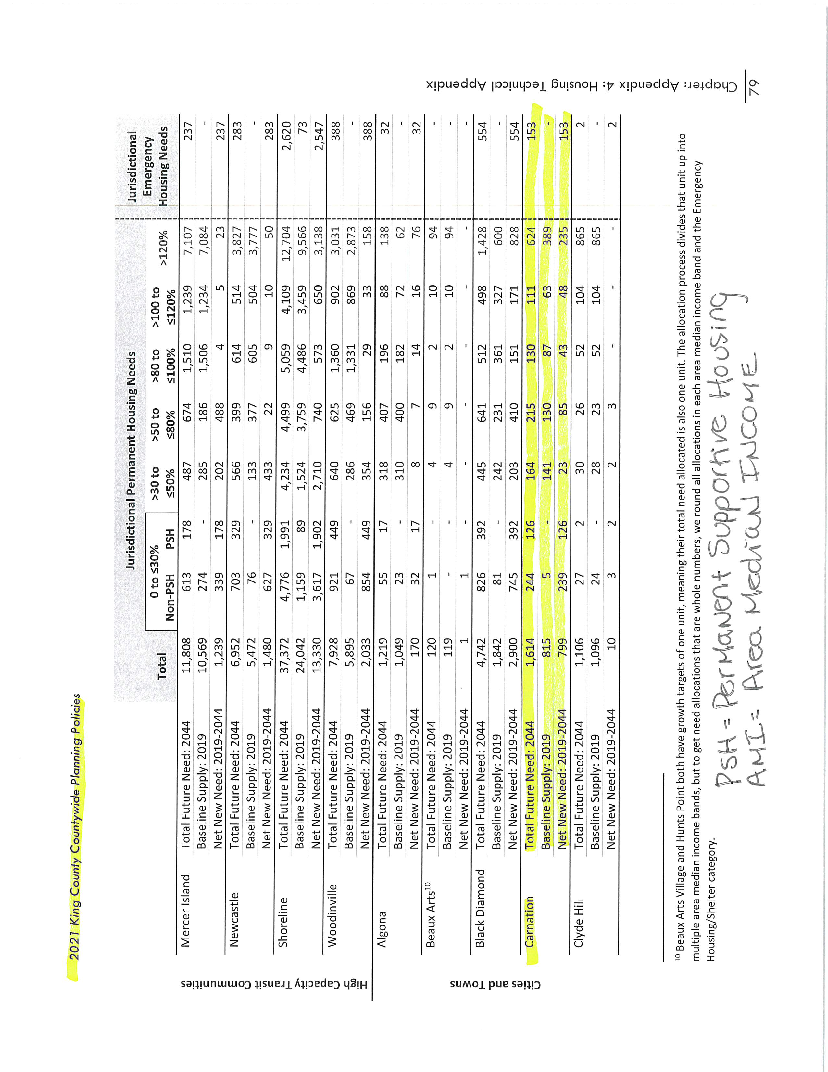
Breaking Down the Numbers

Slide 9
Utilities
Water Capacity
Sewer Capacity
Designed to accommodate a population of 4,974
Designed to accommodate future population growth

Slide 10
How do you meet your housing target?
Zoning! Each city needs to plan for available housing through its zoning. The housing units don’t need to be built, just planned for.
There will be a 5-year check-in with GMPC, Affordable Housing Committee and King County to evaluate how we are meeting our targets. GMPC can take “reasonable measures” to address shortfalls.
Plans must address housing target, diversity of housing and housing by income level.

Slide 11
Meet the Targets
Increases capacity
Doesn’t change current use
In most cases, property taxes do not increase until there is action (i.e. new building, sale or development)
Rezoning
“The annexation issue facing cities in GMA counties will not be so much whether to annex as when to annex. The timing of a city’s expansion will depend on a number of factors, including population growth within the urban growth area and the city’s ability to provide urban-type services in that area.”
Potential Annexation Area

Slide 12
Getting to 799
Units currently in progress: 234
Deficit: 338
Potential: 50
ADUs: 50
Rezone: 177
PAA: 288
Subtotal: 461
Subtotal: 799

Slide 13
Annexation
Legislative Approval
Annexations are legislative actions, and every annexation method requires city council approval as a pre-requisite to moving forward with annexation.
City Council’s Role
Once an annexation proposal is recievied, the City Council will decide within 60 days after filing…
Whether the city will accept, reject, or geographically modify the proposed annexation.
Whether it will require the simultaneous adoption of a proposed zoning regulation.
Whether is will require the assumption of all or any portion of existing city indebtedness by the area to be annexed.

Slide 14
What happens if you don’t reach your targets?
01
Loss of eligibility for state grants.
02
Lose eligibility for PSRC-managed federal transportation funds and for adding projects to the Regional Transportation Improvement Program (TIP)

Slide 15
What We Would of Lost in the Last 5 Years
WSDOT
$1,604,175
Federal Funds
PSRC
Rural Town Centers & Corridors
$ 423,262
PSRC
$1,185,000
TAP & TCC
TIB
$3,323,269
Tolt Avenue, E Bird, McKinley, Crack Seal & More

Slide 16
Community Outreach
Open Houses
December 12, 2023
March 13, 2024
City Council
Planning & Parks Board
Land Use & Housing
Community Events
Coffee with Council
Donuts with the City Manager

Slide 17
Questions?

