Slide 1
Upper Darby Middle School
Construction
Approved by the Delaware County Common Pleas Court
March 16, 2022
Plan Dated
05/19/2023

Slide 2

Agreement Status
John McBlain, Esq. Solicitor

Slide 3
Storm Water Management
Continued
The Contractor will install a storm water pipe with inlets from Baltimore Pike to the discharge of the onsite water detention at Sycamore Road and Springfield Road .
The pipe will be located on the east side of Springfield Road with inlets installed on both sides of Springfield Road. Curbs and sidewalks will also be required on the east side .
The borough has applied and been awarded two Multi Modal Grants for borough improvements along the west side of Springfield Road. The grants will be utilized for the installation of curbs, sidewalks and improvements from Baltimore Pike though the corridor to the Upper Darby border at Westbrook Market.

Slide 4
Phase 1 Begins July 1, 2024
Secure site with fencing and entrance gates :
  Contractor exterminator services begin outer limits of project along Springfield Road, Wyncliffe Avenue, Oak Avenue, Revere Road.
  Clifton Heights Borough continues to monitor and bait the sewers and open field areas. Monitor and continue enforcement of high grass, debris, wood piles to assist in rodent control.
  Off Oak Avenue (Construction Workers) entrance and parking lot.
  Off Springfield Road ( PA. PennDOT Permit Trucks) and deliveries.
  Begin cuts into lower field and into upper field earth moving .
  Establish outer burlap and socks erosion control along with temporary swales and storm water control on site.

Slide 5
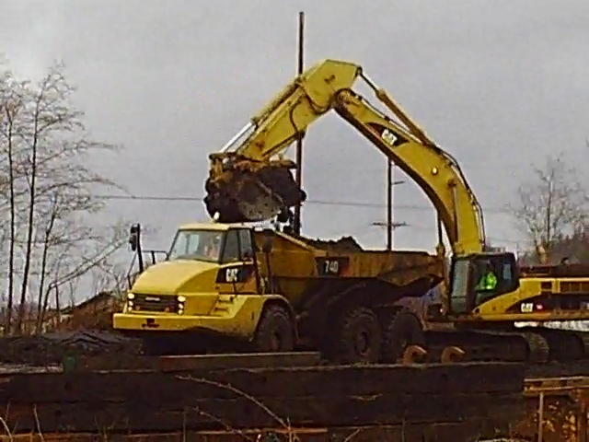
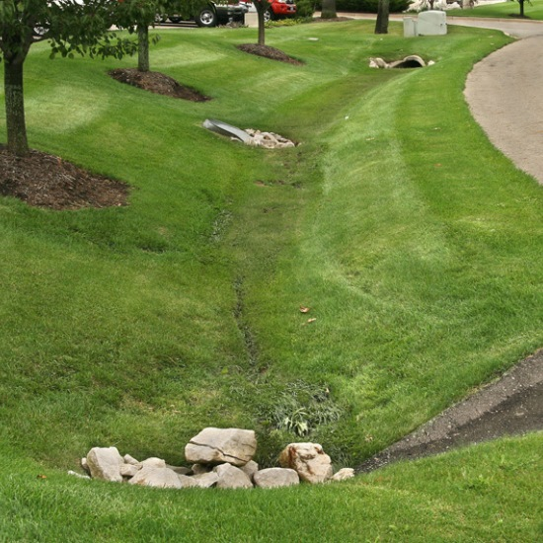
Storm Water Management Provisions:
J.P. Kelly, P.E. Borough Engineer
This Photo by Unknown Author is licensed under CC BY
This Photo by Unknown Author is licensed under CC BY-NC-ND

Slide 6
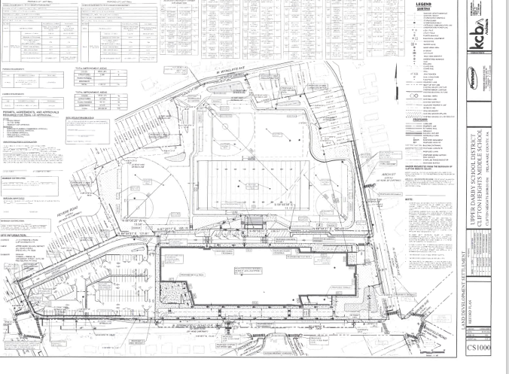

Slide 7
Phase 2
Off site work on Springfield Road from Baltimore Pike to Sycamore Avenue begins on the East side. Storm water pipe installation. Expect lane closures .
Work includes inlets, sidewalks and curbing. Residents along this corridor will be notified by contractor.
Springfield Road traffic light modifications and intersection configuration may begin this phase.
As of this date there has been no final PennDOT approvals for this work. Plans for Springfield Road drainage and Sycamore Avenue and Church Street intersections have been reviewed with no changes.
Oak Avenue intersection left hand turning lane and traffic light north bound appears to be acceptable by PennDOT to be eliminated. We are awaiting a communication.

Slide 8
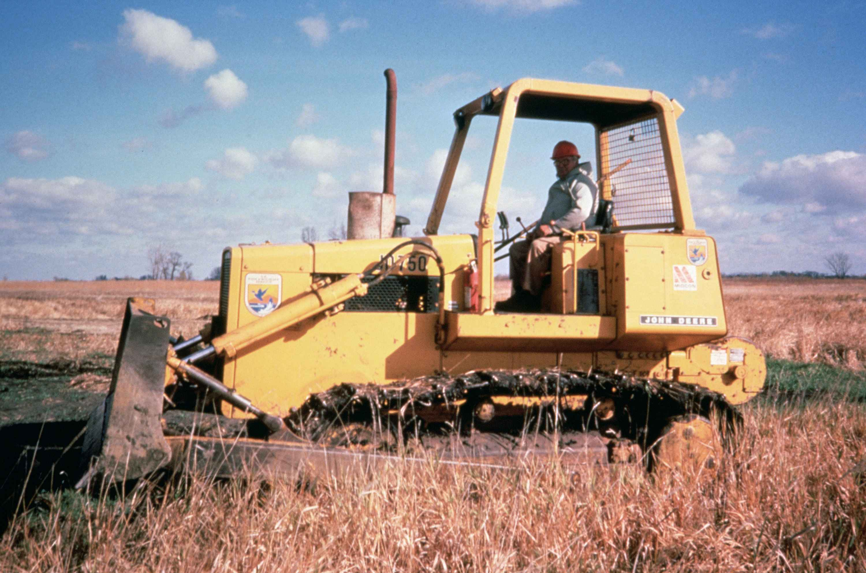
Dust and Dirt
Construction projects are inevitable to cause dust and dirt. The Contractor is required to provide means and methods to curtail this concern. They are addressed in the Upper Darby Middle School construction contract, D.E.P. regulations, County soil Conservation and Clifton Heights Local Ordinances .

Slide 9
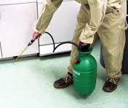
Rodents
The Contractor is required to bait and provide bait boxes for the entire site prior to any start of work and throughout the project.
The borough has been providing rat and mice abatement measures in selected areas particularly in storm inlets and sewer manholes.
The borough will continue this abatement measure throughout the construction activities.
It is suggested that homeowners either continue with their exterminator or contract with one for own site private property protection.
The borough continues to inspect areas for high grass, wood piles, debris and provide notice to property owners up to and including enforcement notice.
This Photo by Unknown Author is licensed under CC BY-NC-ND

Slide 10

Traffic:
Routine and Detour
Routine traffic flow may be interrupted however we do not anticipate any road closures .
Examples would be flaggers in area to redirect lane work .
All lane closures and work requires approval by PennDOT and Clifton Heights Police Chief in coordination with Manager’s Office.

Slide 11

Security
School District is providing cameras throughout the site 24/7
Borough is adding camera locations from exterior pole locations to cover all locations along :
  Sycamore Avenue
  Wyncliffe Road
  Springfield Road
  Revere Road
  Oak Avenue

Slide 12
Security Continued:
Obviously, increased activity at the School will also increase the police activity and calls for service.
To enhance the boroughs efforts in this regard a grant application was applied for through The Federal C.O.P.S. Grant Program. This program provided funds for a three- year period for police officers.
The borough has been awarded $519,000.00 to hire two full time police officers. Council will allocate in future budgets to assure funding will be allocated over four years.

Slide 13
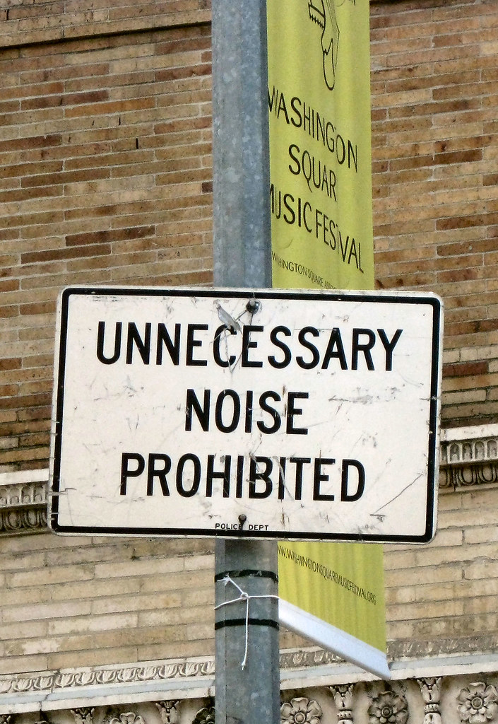
Noise Ordinance
Clifton Heights Borough
Building Construction
Chapter 210 Noise Ordinance
The erection, including excavation, demolition, alteration, construction or repair of any building other than between 7:00 A.M. and 8:00 P.M., except in the case of urgent necessity in the interest of public health and safety is prohibited.
This Photo by Unknown Author is licensed under CC BY-NC-ND

Slide 14

Damages:
Residents have expressed concern over the risk associated with heavy equipment and work.
Take Photos of foundations, area of concerns with dated evidence.
Contact Upper Darby School District at 610-789-7200 and they will direct to the proper person.
This Photo by Unknown Author is licensed under CC BY-SA
This Photo by Unknown Author is licensed under CC BY-SA

