Slide 1


How to start a business & obtain a license

Slide 2

DO YOU HAVE A BUSINESS PLAN?
What is a Business Plan? A business plan is a blueprint of every aspect of your business sales, marketing, advertising, promotion and location are just some of the categories to consider when creating a plan.
SBA Business Plan Templates

Slide 3

Before applying for a Business License
What will be the activities of the business?
Business activities include any activity engaged in whether for profit or not
Selling Goods
Performing a Service
Manufacturing a Product
Operating activities are specific to a company’s core. Business activities may include manufacturing, distributing, marketing, selling a product or providing a service.

Slide 4


Before applying for a Business License
CHOOSE YOUR BUSINESS STRUCTURE
Corporation
S Corporation
Limited Liability Company (LLC)
Sole Proprietorship
Partnership
Have you filed your Tax and Employer Identification documents ?

Slide 5
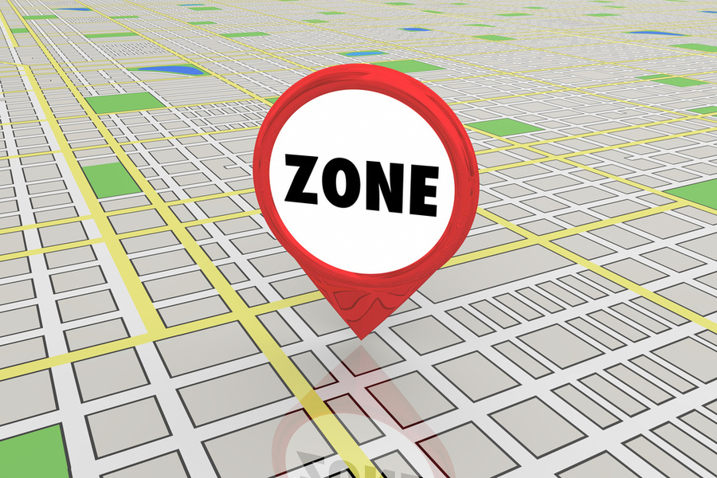
Contact the
Planning Department
STEP 1
* Do this BEFORE you decide to buy a building or sign a lease!
Check the zoning of the property to make sure it is zoned to support your business

Slide 6

Now the you created a business plan and your business activities,
you can apply for a City business license
STEP 2
Be prepared to tell the business license office:
Your business plan
Your business activities with a detailed description
Address of where you are locating your business.
Complete a Business License Application .
Complete an application for a Certificate of Occupancy (if your business will have a storefront).
Complete a Home Occupation Permit Application (if you are applying for a home-based business).

Slide 7








Flow Chart to Open a Business with a Storefront
Are you starting a business with a storefront? If yes, proceed.
To Obtain Required Approvals, complete application for Business License and Certificate of Occupancy.
City Departments will review applications. Call to Schedule the Certificate of Occupancy inspection.
1
Complete a Business License Application
City Engineer
City Utilities
Then go directly to the Planning Department
YES
City Fire Chief
Is the location zoned for this purpose?
Once all Departments have approved, the City will issue the Business License and Certificate of Occupancy
Find another location
or apply for a rezone
NO
City Building Official

Slide 8


Food (no Alcohol) business license flow chart
Applying for a storefront business license
Obtain Required Approvals for Business License and Certificate of Occupancy
1
2
APPROVALS
Business License Office
City Utilities
City Engineer
Planning Department
County Health Dept.
Find another location
Or seek rezoning
City Fire Chief
YES
Is the location zoned for this purpose
Obtain your Business Lic. and Certificate of Occupancy
NO
City Building Official
Check Alert page for further information

Slide 9
CONTACT NUMBERS
City Utilities
530-824-7020
530-824-7029
530-527-8020
Planning Department
530-824-7036
Fire Chief
530-824-7044
City Engineer 530-824-7029
Building Official
530-824-7027

Slide 10
OPENING A BUINESS PRIOR TO OBTAINING A CITY BUSINESS LICENSE OR CERTIFICATE OF OCCUPANCY WILL RESULT IN CITATIONS AND BUSINESS CLOSURE.
ALERT PAGE
This is the general process for obtaining your Business License and Certificate of Occupancy. Some uses may require additional permitting before your Business License or Certificate can be issued.

