Slide 1
RETAINING TOP TALENT
Brian J. Valentino, MPA, CEAS, ICMA-CM
Executive Director | Western Monmouth Utilities Authority
Director | Environmental Professional Development Academy

Slide 2
Notes:
I was asked to do this presentation several months ago
Saturday, meeting in Washington, DC raised my concern for this topic from IMPORTANT to CRITICAL
Update on Legislative, and Regulatory Issues Impacting Local Governments
ICMA
National Association of Counties
National League of Cities
Government Finance Officers of America
Number One Risk to Local Governments in 2018? Preemption of Local Government Authority by State & Federal Government
Number Two? The loss and general lack of qualified environmental sector leadership, with a particular concern in the WATER WORKFORCE.
Number Three? Federal Focus on Privatization and preference of Private over Public Environmental Management (A GENERAL REFLECTION - Regulatory Rollback)
And to judge from the condition of our own house in NJ as well as across the country, one would think that a lot of people in our industry have either been asleep at the switch or just fat, dumb and happy. Maybe that is why Peggy asked me to provide my expert opinion on this topic.
But as I rode home on Amtrak, I did some thinking: Where does that responsibility really belong?
Why are we even discussing the need to collect, develop and protect our top talen in 2018 instead of sounding the alarm 5, 10 or even 15 years ago?
The fact is that we are standing on the bridge at the outbreak of a bona fide national emergency
CONSIDER THIS -- Joseph Kane, Associate Fellow, Metropolitan Policy Program
The Brookings InstitutionMarch 7, 2018

Slide 3
A MATTER OF CRITICAL NATIONAL IMPORTANCE
“The country’s
water workforce is
undergoing change.”
-- Joseph Kane, Associate Fellow
Senior Research Associate
Metropolitan Policy Program
The Brookings Institution
March 7, 2018
Notes:
JUST LAS T WEDNESDAY, at the height of our second Nor’easter of the week. . .
-- Joseph Kane, Associate Fellow, Metropolitan Policy Program
The Brookings Institution
Published this article which really boils the thesis of my presentation down to brass tacks

Slide 4
A matter of critical national importance
“Similar to millions of other workers involved in infrastructure nationwide, the water workforce is aging, experiencing rapid turnover, and facing a huge gap to fill in terms of hiring, training, and retention. . .

Slide 5
A matter of critical national importance
“. . . from operators and engineers to accountants and office clerks.

Slide 6
A matter of critical national importance
“At the same time, these jobs offer competitive wages, have lower educational barriers to entry, and consequently. . .

Slide 7
A matter of critical national importance
. . . provide a pathway to
greater economic opportunity
for ALL TYPES OF WORKERS,
across ALL SKILL LEVELS.”
Notes:
Begs the question: If this is such a great damn place to be, why are we having this conversation? Lets come back to that. . .

Slide 8
The generational challenge
THE CLEAN WATER ACT
GENERATIONAL CAREERSPAN
1960’s
1970’s
1980’s
1990’s
2000’s
2010’s
2020’s
2030’s
2040’s
2050’s
2060’s
GEN Y & MILLENNIALS
GEN X
BABY BOOMERS
Notes:
Each generation of workers has a career span of roughly 50 years – that is, from the earliest members of that generation entering the workforce until the last members leaving the workforce we see a span of a bit more than 5 decades.
Here in 2018, we are about four years from the end of the Clean Water Act Generational Careerspan—the five decades from the passage of the Clean Water Act. The Baby Boom employees who joined the water workforce at the same general time of the adoption or implementation of the Clean Water Act are just about all retired—leaving another 15 years or so of Generation Xers and another 30 years of Generation Y and Millennials.
Or to put it plainly, we are in the final working years of the Baby Boomers, who have largely retired.
We are just past the peak of “Prime Time” for our Generation X workers,
We are entering Prime Time for our Generation Y and Millennial workers.
If we are looking to identify our top talent for the future of Environmental Leadership is there any question where we should be focusing our efforts?

Slide 9
Managing versus Leading
“Managing”
Make Trains Run on Time
Keep things Moving
Day-to-Day Operations
People, Paper, Programs
“Leading”
Establish Direction
Develop & Deploy Resources
Motivate & Inspire
Strategic
“TODAY”
“FUTURE”
Notes:
Lets get in the right frame of mind. . .
A study by the Environmental Protection Agency in 2010 and updated in 2014 showed that the waning years of what they called “the Implementation Generation” would be a period of extreme generational change in terms of management approach and resource allocation.
The days of “getting thing moving” and punching the ticket on design, mobilization and deployment of our response to the CWA are ending.
The EPA sounded the warning gong on our ability to transition to the future needs of our industry which lay less and less in figuring out what and how to meet our regulatory goals and more and more on what to do about strategic planning in the post 9/11 and post-2008 financial meltdown years of lean and mean.

Slide 10
Are we too late?
Don’t Wait!
Succession can be unpredictable
Must be ready for opportunities
More than operational considerations
BE PROACTIVE
Notes:
Yes, we have had a bit of scrambling in our industry lately. Even my own entry into the environmental sector is evidence of this. No leadership. . . Need a leader. Experience in the planning, design and operation of our facilities was a distant second to Experience in Strategic Management and public accountability.
So in short, as an industry, we aren’t too late. . .yet. But we can no longer wait for the “next guy” to step up and figure it out. The time to act may have been 10 years ago, but we have to now *ensure*, as Mr. Kane suggests, that “our efforts begin with individual utilities and public agencies that depend on forward-looking leadership to implement more purposeful, long-term programming.”
In short, our organizations must be looking to the future in more ways than just deciding questions of engineering and process control.

Slide 11
tend your flock
Modern Leaders. . .
TRAIN potential success stories
MENTOR protégés
RETAIN top talent

Slide 12
Who is the target audience
Boomers
Generation X
Generation Y
Millennials

Slide 13
Boomer retention & motivation. . .
Mentoring & Training
“These Kids Today” Issues
Workplace Issues
Retirement Issues
Flexibility
Benefits
Notes:
With the end of the Boomer working years upon us, Boomer Brain Drain is a real threat to our industry. We are literally losing the knowledge of our “Clean Water Act Founders” so what can we do to keep them motivated and engaged in a meaningful way?
For starters, don’t kick them to the curb, right? Its important to reinforce their role as respected and valued mentors with irreplaceable knowledge.
So lets make sure to include them as mentors but lets also include them in training opportunities with their younger colleagues who might be able to teach technology and other “foreign” subjects to their Boomer colleagues.
Then there is the “These Kids today” issues.
As our Boomer colleagues approach retirement, they may need us to consider their age and health which may require special chairs, equipment, materials and facilities to make their workplaces more supportive. When we talk about retirements, especially those of us operating in the post Christie-era PERS world,

Slide 14
X: the next generation
Entrepreneurs
Value & Recognition
Flexibility
Leadership
Purpose
Notes:
Gen X want to invent and develop solutions to the problems before them as they put their “idealist” values to work in search of the “perfect” solution to their unique problem.
They seek to feel valued and are anxious to make their supervisors proud of their efforts. As such, formal public recognition before their peers and customers is an important motivator.
As the “Middle” generation, Gen Xers seek the flexibility that allows them to be good employees and good managers at the same time that they have to be good parents and children of aging parents.
The good news is Gen X employees are anxious to lead. They know they are the generation that holds what Heidi Sullivan calls “the coveted “Bridge” seat on the generational spectrum. They understand the strengths of Boomers and the Millennials alike. They are most comfortable being the leader of their own destinies and those around them.
Finally, Gen Xers seek importance in their work—a sense of purpose to themselves and to the wider world. A perfect scenario for those of use charged with protecting the health of our fellow citizens and the environment where we live.

Slide 15
Millennials: Here’s your trophy
No Traditional Career Path
Introspective
Unorthodox Goals & Motivations
Notes:
No Traditional Career Path
Introspective
Productive relationship with managers – 65%
Opportunities to develop skills – 57%
Flexible Work Assignments – 47%
Unorthodox Goals & Motivations
So what do millennials want from their employers? When asked about the relative appeal of potential employer benefits, 401(k) savings plans and employer-subsidized health insurance crushed the competition. However, coming in at No. 3 on the list was a paid two-month sabbatical after five years of employment, which beat out regular telework and transit benefits as a top choice for millennials.

Slide 16
Millennials: the undiscovered country
Purpose
Mentoring & Coaching
Reverse Mentoring
Training
Perks & Benefits
Notes:
Millennials are ANXIOUS to take on greater leadership opportunities
Why don’t they?
Purpose
Heidi suillivan, “29% of Millenials are engaged at their jobs.”
Why? Lack of Meaning and purpose in their work, dissatisfaction with management style and culture, limited leadership opportunities, not enough mobility.
Employees who strongly agree that they can link their goals to the organizational vision/mission/values are 2.5 times more likely to be engaged”
Mentoring & Coaching
“show me how to do it” “work through it with me”
Reverse Mentoring
Let me show you how to use Social Media or Microsoft Applications
Training
Gallup Poll: Millennials are more likely than all other generaations to say that a job that accellerates their career develolpment is “very important” to them.
Offer them team-oriented projects to hone their leadership skills
Perks and Benefits
Gallup Poll “State of the American Workforce 2017 Report” “In all cases, millennials are more likely than Gen x or Baby Boomers to say they would change jobs for a particular benefit or perk. The differences are most evident for items relating to children, professional development, education and flexibility.”

Slide 17
When all else fails, read the directions
Partnerships & Shared Strategies
Work Family Balance
Special Projects & Ownership
Recognition
Employee Engagement from the Top
Notes:
Mr. Kane: “Coalitions of partnerships and the emergence of shared strategies. . . Deserve closer attention.”
In fact, the National League of Cities, the Government Finance Officers of America and The Brookings Institution cites a string of evidence and actions coming out of Official Washington that all point to a significant if not total elimination of federal dollars to public environmental utilities and a redirection of those funds to the benefit of private, investor-owned businesses. Assuming that we choose to think in a strategic rather than a protectionist mode, we must therefore seek to develop new and innovative public-private partnerships that will allow us to continue to access the federal funds that are the backbone of our national environmental infrastructure development.
Even if we choose to abandon federal funding, the so-called “Tax Reform Bill” has so dramatically changed the valuation of Municipal Bonds that we cannot confidently predict the impact on our ability to economically forecast the financial options available to us. What better time to call on those entreprenurial Gen Xers and Outside the Box thinking Millennials?

Slide 18
interviews
Entrance Interview
Interventional Interview
Exit Interview
STAY Interview

Slide 19
The stay interview
Culture of Open Communication?
Be Ready to Make Changes
“Money Where Your Mouth is”
Actively Listen and Participate
Ask the Questions the Employee Needs to Hear

Slide 20
setting
Informal but “Important”
Open body language
Lunch, breakfast, coffee, drive
“Teach me something”

Slide 21
The stay interview questions
“What do you like most/least about your job and work
in our organization?”

Slide 22
The stay interview questions
“On a scale of ‘1 to 10’ how happy are you working here”
“What would have to happen for that number to become a 10?”

Slide 23
The stay interview questions
“On a scale of ‘1 to 10’
how does our organization
rate as an employer?”
“What would have to happen for that number to become a 10?”

Slide 24
The stay interview questions
“If you could work on a special project or idea that was just your own, knowing it wouldn’t create more work for yourself or others, what would it be and why?”

Slide 25
The stay interview questions
“Do your colleagues (or managers) listen to you and do they value your ideas, inputs, and decisions?
“How can that area be improved?”

Slide 26
The stay interview questions
“Where do you see yourself in five years? Ten years?”
“What can I do to help you get there?”
or
“What can I do to change your mind?”

Slide 27
The stay interview questions
#2
“Do you feel that your work makes a difference in the organization and that it has a noticeable impact on customers and the world?”

Slide 28
The stay interview questions
#1
“Do you feel that you are currently doing “the best work of your life?”
“Can you list the factors that could contribute to you ‘doing the best of your life’?”

Slide 29
Think about it. . .
“. . .these jobs offer competitive wages, have lower educational barriers to entry, and consequently provide a pathway to greater economic opportunity for all types of workers, across all skill levels.”
Notes:
Kane: “Recruitment, for instance, must touch all corners of a community to attract more workers and achieve greater diversity, which depends on gaining traction among a broad set of regional players.”

Slide 30
The Future of
America’s Environmental Leadership
is in your hands. . .
and it is in your agencies. . .
R I G H T N O W

Slide 31
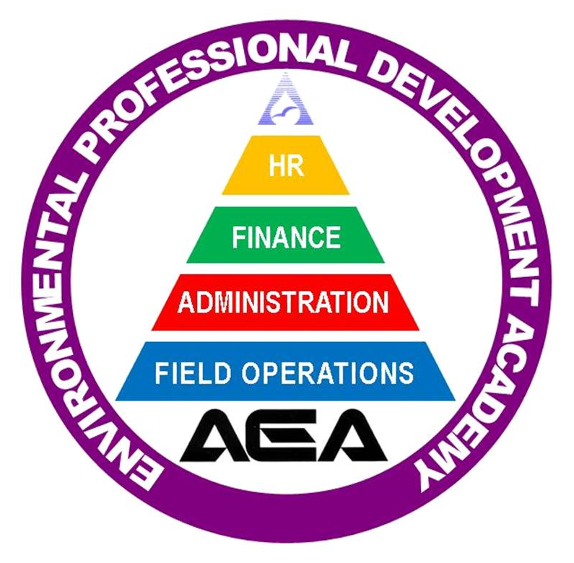
RETAINING TOP TALENT
BRIAN J. VALENTINO, MPA, CEAS, ICMA-CM
Executive Director | Western Monmouth Utilities Authority
Director | Environmental Professional Development Academy
bvalentino@wmua.manalapan.nj.us
732-446-9300
@brianjvalentino

