Slide 1
Inequities within Planning… and what we can do
Matt Hirschinger, MPA
Jennifer Woods, AICP
2022

Slide 2
What we’ll cover
Current perceptions among Colorado Planners
Defining “equity” and “progress”
Realities of our current situation
Simplified walkthrough to “move the needle”
Spur to action

Slide 3
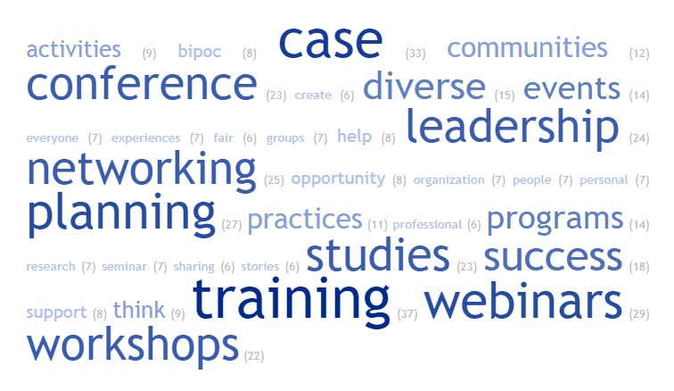
APA Colorado survey results

Slide 4
Defining equity and progress
“Social equity has evolved from a philosophical issue concerned with the social contract, to a structural issue concerned with real impacts on real people’s lives. In today’s parlance, it is an activist notion that requires government to be a lever for change…”
-“Achieving Social Justice Equity: From Problems to Solutions” by Mary E. Guy & Sean A. McCandless
Do we define progress by the past or the future?
(Richard P. Eibach & Joyce Ehrlinger)
Notes:
Author for both

Slide 5
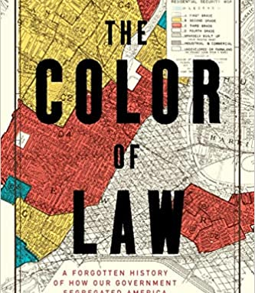
Reality (Roots/History)
Scott v. Sandford (1857)
Plessy v. Ferguson (1896)
Brown v. Board of Education (1954)
Brown v. Board of Education II (1955)
End of explicit segregation (1970s)
Austerity (also the 1970s)
Notes:
Scott v. Sandford: Also known as the Dred Scott case, determined Black Americans were not citizens, were not protect by the Constitution: “are not included, and were not intended to be included, under the word 'citizens' in the Constitution, and can therefore claim none of the rights and privileges which that instrument provides for and secures to citizens of the United States“
Plessy v. Ferguson: Considered start of Jim Crowe. “The object of the [Fourteenth] Amendment was undoubtedly to enforce the absolute equality of the two races before the law, but in the nature of things, it could not have been intended to abolish distinctions based upon color, or to enforce social, as distinguished from political equality, or a commingling of the two races upon terms unsatisfactory to either.”
Brown v. Board of Education was only the start, and was narrow in focus to schools.
Brown v. Board of Education II had to restate earlier ruling
Tie into planning – building, zoning, how things were built, sidewalks, etc.

Slide 6
Reality (Damage is still being done)
State v. Lobato (2013)
Adam Community Center v. City of Troy (2019)
Notes:
State v. Lobato: “While we sympathize with the Plaintiffs and recognize that the public school financing system might not provide an optimal amount of money to the public schools, the statutory public school financing system itself is constitutional.”
Adam Community Center v. City of Troy: Plaintiffs had been trying to establish a mosque repeatedly
One case where they were delayed until someone else bought the land
Another case where a group came together to outbid them
Most recent case a new law meant they had to ask for a variance, was denied with alleged discrimination by ZBA President, City Attorney recommended against following RLUIPA
Pronounced ar-loo-puh

Slide 7
Reality (Restraints on progress)
Parents Involved in Community School v. Seattle School District #1 (2007)
Texas Department of Housing and Community Affairs v. Inclusive Communities Project, Inc. (2015)
C.R.S. § 31-23-310.
Students for Fair Admissions Inc. v. Presidents & Fellows of Harvard College (2022)
Notes:
Parents Involved: “The way to stop discrimination on the basis of race is to stop discriminating on the basis of race.”
Texas Department of Housing and Community: Vote was 5-4 with scathing dissent, lower court ruled against ICP
C.S.R. 31-23-310: “This part 3 shall not be construed, in the case of any municipality, to confer or enlarge any authority or power to establish any restriction based upon race or color.”
Students etc.: Question of “racial balancing” and penalizing Asian students

Slide 8
Reality (Technical Savvy)
Planners possess influence from expertise, to authority, to resources (time, the organization, etc.)
Low bar of “rational nexus” and “scientific evidence” in takings cases as one example
Often we fall into traps to assume our superiority in a topic and leave out the community, and we need to step back
Often we fall into traps where what many in the community wants is discriminatory, and we need to step forward
Notes:
Rational nexus and scientific evidence are qualifiers to allow a “takings” of property
Inclusion of community perceptions and sentiments, high level of education needed. Community influence on laws. They may try to discriminate

Slide 9
First, do no harm
It is necessary to understand that our roles as public servants are not inherently benevolent, that we do have a very real potential to cause harm and that our structures and systems are not foolproof. To believe this is to accept a level of accountability that is, unfortunately, optional for most of us.

Slide 10
Move the Needle Part 1: Defining equitable goals…
Where do our communities do well? (and can be measured)
Where do our communities not do well? (and can be measured)
Consider these two questions concerning your topic of choice

Slide 11
Part Two: Define the topic more critically
Begin to write out what are the major rules, structures, policies, decision-making authorities, etc. that are central to your topic. In other words, ANALYSE your topic.

Slide 12
Part three: Resources
Consider the necessary resources (money, time, expertise, relationships/politics, lack of barriers) from a resident or customer to go through the process, to achieve their goals. Who reasonably can?
Consider the resources/influence you require to make changes to your topic

Slide 13
Part four: Put it all together
Make an equity goal, that is comprehensive and critical, and considers both what you and those you serve require
Ask for help

Slide 14
Two useful concepts: “Economic Development” and “Public Good”
Use the tools available
“Economic Development” is a legitimate and celebrated tool for government action
“Public Good” is tied to the very foundations of planning as a profession and industry

Slide 15
One last consideration
If not you, then who?

