Slide 1
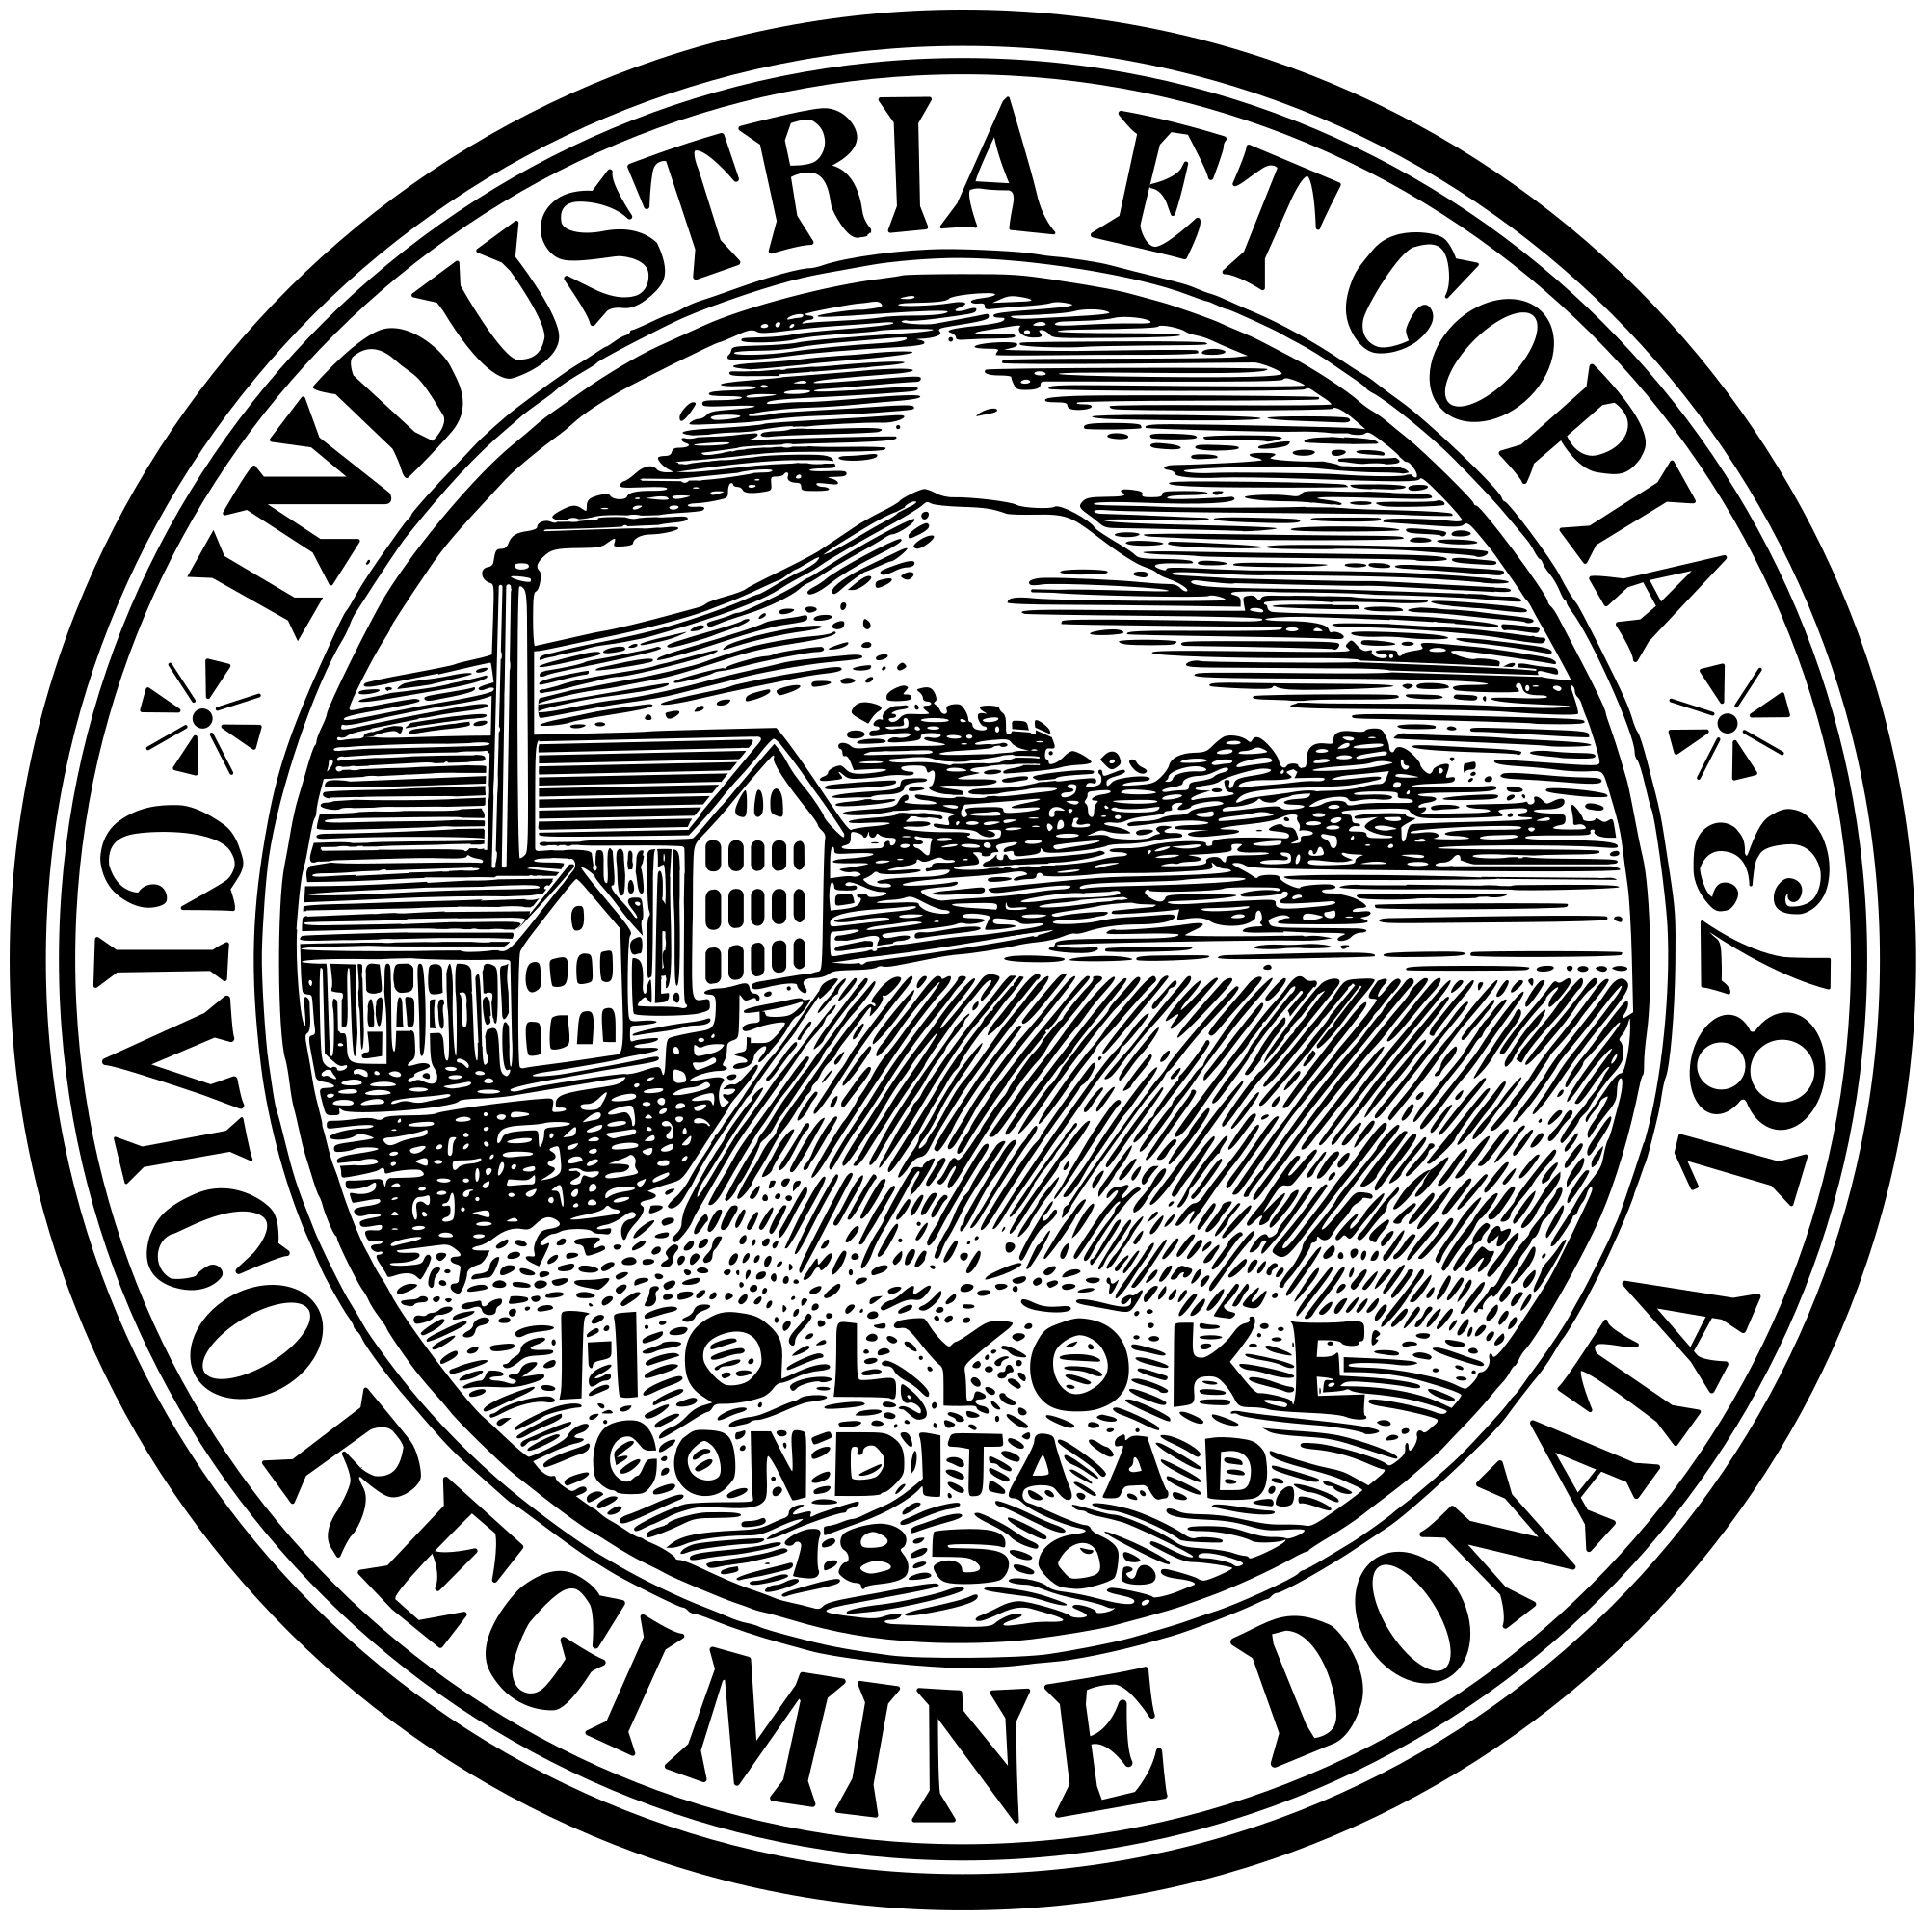
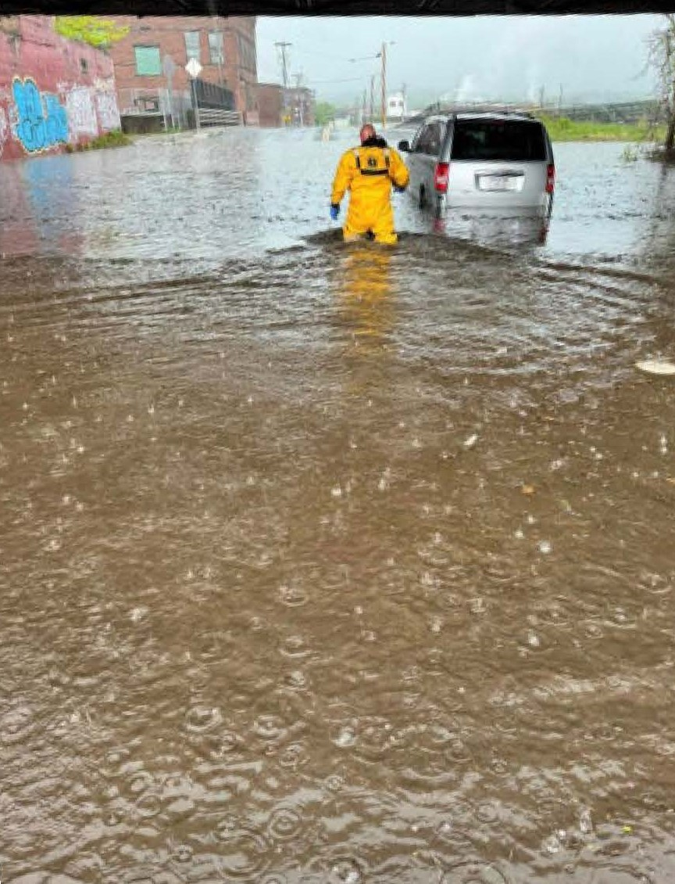
  Natural Hazards and Climate Change
The City of Holyoke is taking steps to reduce damage and losses from hazards such as floods, windstorms, and heat waves. The draft Hazard Mitigation and Climate Adaptation Plan is available for review at www.holyoke.org/hazard-mitigation-plan/ A public information meeting will be held on March 26, 2025 to present highlights from the plan. Please provide comments by March 28, 2025.

