Slide 1
Town of Loomis General Plan Housing Element
Housing Committee Meeting
December 9, 2020

Slide 2
Agenda
Introductions
Available Documents
Housing Element Overview
Regional Housing Needs Allocation (RHNA)
Existing Needs Assessment
Previous Programs
Changes to State Law
Housing Opportunity Areas
Referendum Properties
Schedule
Discussion

Slide 3
Introductions

Slide 4
Introductions
Town Staff
Consultant Team
Committee Members

Slide 5
Available Documents

Slide 6
Available Documents
General Plan Update
https://loomis.ca.gov/2020-general-plan-update/
Housing Element Fact Sheet
Distributed prior to this meeting
Available online

Slide 7
Housing Element Overview

Slide 8
Housing element overview
Adoption Deadline: May 15, 2021
Planning Period: June 30, 2021 – August 31, 2029
Required Element of the General Plan
State-mandated update schedule
Reviewed and certified by State (HCD) for compliance with state law
Plan for accommodating a jurisdictions “fair share” of the regional housing need

Slide 9
Housing Element Contents
Evaluation of previous housing element
Analysis of existing and projected housing needs
Inventory of available land for housing
Analysis of potential constraints on housing (e.g. permit processing procedures, fees)
Goals, policies, and implementation programs to meet unmet housing needs

Slide 10
Why Comply?
Plan for where housing should be located
Maintain local discretion over affordable housing projects
Potential legal challenges
Legal responsibility – Must be certified for adequate General Plan
Access to State funding resources
Enforcement by HCD

Slide 11
Regional housing needs allocation
California
(Housing and Community Development)
SACOG
Sacramento Area Council of Governments
2021 -2029 RHNA = 153,512 housing units
Auburn
310
Colfax 97
Lincoln 5,120
Loomis
352
Unincorp County 7,854
Rocklin 5,661
Roseville 12,066
Each jurisdiction must meet its “fair share” of the regional housing need.

Slide 12
Loomis rhna
Income Category | Town of Loomis
Housing Element Planning Period: 2021-2029 (8 years)
Very Low Income* (<50% of Median Income) | 117 units
Low Income (50-80% of Median Income) | 71 units
Moderate Income (81-120% of Median Income) | 49 units
Above Moderate Income (>120% of Median Income) | 115 units
Total | 352 units
*It is assumed that 50 percent of very low-income units will be for extremely low-income households.

Slide 13
Accommodating the RHNA
Cities and counties must show adequate land zoned for housing to accommodate the RHNA at each income level
Default density standard for lower-income housing:
Metropolitan jurisdictions: 30 u/a
Suburban jurisdictions: 20 u/a
Nonmetropolitan w/micropolitan area: 15 u/a
Nonmetropolitan jurisdictions: 10 u/a

Slide 14
REZONE REQUIRMENTS
If a jurisdiction does not have adequate capacity for lower-income housing, it must rezone within 3 years of adoption
Zoning must have 20 units/acre minimum density
Residential uses must be allowed by-right
No conditional use permit
No planned unit development permit
No discretionary review that would constitute a project under CEQA
Can conduct design review (but limited to the design and not the use itself)

Slide 15
Existing Needs Assessment

Slide 16
What does Low-income Mean?
State defines affordability
Affordability levels are countywide
2020 Placer County Median Income: $86,300
Income Category | Percent of Median Income | 2020 Annual Income (4-person household) | Gross Affordable Rent | Affordable Sales Price
Extremely Low | 30% | $26,200 | $655 | $128,436
Very Low | 50% | $43,150 | $1,079 | $211,528
Low | 80% | $69,050 | $1,726 | $338,493
Median | 100% | $86,300 | $2,158 | $423,055
Moderate | 120% | $103,550 | $2,589 | $507,617

Slide 17
Who is considered low-income?
HCD 2020 Median Income for a family of four in Loomis:
Households earning 80% or less of the median income ($69,050) are considered low-income
Approximately 48.5% of households in Loomis fall into the lower income category
Income Category | Typical Occupations | Percent of Loomis Households
Extremely Low (≤ 30% AMI) | Food Service Workers, Retail Clerks, Manicurists, Home Care Aids | 18.8%
Very Low (31 – 50% AMI) | Teaching Assistants, Waiters and Waitresses, Nursing Assistants, Security Guards | 7.3%
Low (51 – 80% AMI) | Mail Carriers, Graphic Designers, EMTs/Paramedics, Dental Assistants | 22.4%
Sources: 2020 HCD Income Limits, 2014-2018 American Community Survey, California Employment Development Department 2020

Slide 18
How affordable is Loomis?
Median Sales Price: $760,000 (November 2020)
Maximum Affordable Sales Price:
Low-Income: $338,493
Moderate-Income: $507,617
Median Rental Price: $1,888 (November 2020)
Maximum Affordable Rental Price:
Low-Income: $1,726
Moderate-Income: $2,589
Community | Median Home Sales Price | Median Rental Price
Newcastle | $744,000 | $1,639
Rocklin | $538,800 | $1,698
Lincoln | $519,000 | $1,350
Roseville | $525,800 | $1,731
Auburn | $509,000 | $1,400
Sources: realtor.com, rentcafe.com

Slide 19
Special housing needs
(TBD) Residents are Unsheltered
16.3% of Residents are Seniors
9.5% of Residents have a Disability
6.2% of Households are Female-Headed
18.8% of Households are Extremely-Low Income
Sources: 2014-2018 American Community Survey

Slide 20
Previous Housing Element Programs

Slide 21
Past Programs
Goal A: Affordable Housing
1. Identify Areas for Higher Density Residential Development | 11. Rehabilitation and Preservation
2. Provide Adequate Infrastructure to Town Center | 12. Density Bonus Law
3. Expedited Permit Assistance | 13. Incentives for Affordable Secondary Dwelling Units
4. Financing Assistance for Affordable Housing | 14. Affordable Housing Linkage Fee
5. Incentives for Affordable Development | 15. Housing Trust Fund
6. Apply for Funding for Affordable Development | 16. Define Extremely Low-Income (ELI) in Zoning Code
7. Community Reinvestment Act Financing | 17. Single-Room Occupancy
8. Inclusionary Housing Ordinance | 18. Fee Waivers for ELI Units
9. Facilitate Residential Development in Commercial and Multi-family Zones | 19. Ensure Availability of Services for Development
10. Rezoning to meet RHNA [Village at Loomis]

Slide 22
Past Programs
Goal B: Quality of Design
20. Design Guidelines
Goal C: Conservation and Rehabilitation
21. Funding for Rehabilitation Loans | 22. Code Compliance to Ensure Safe Homes
Goal D: Special Needs Housing
23. Incentives for Senior Housing | 25. Universal Design
24. Small Group Housing Projects
Goal E: Prevent and Reduce Homelessness
26. Regional Collaboration for Emergency Shelter | 28. Define Transitional and Supportive Housing
27. Allow Emergency Shelters By Right in CC and CG Zoning

Slide 23
Past Programs
Goal F: Energy Conservation
29. Energy Efficiency Provisions for Subdivisions | 32. Promote Use of Photovoltaic Systems
30. Encourage Innovate Energy Efficient Designs | 33. Encourage Water Efficient Landscaping
31. Provide Information on Weatherization Programs
Goal G: Equal Opportunity
34. Make Available Information on Equal Opportunity and Fair Housing | 36. Reasonable Accommodation Ordinance
35. Refer Housing Discrimination Complaints to Appropriate Agency

Slide 24
Key Changes to State Housing Law

Slide 25
Programs to Address New State Law
AB 101 – Low Barrier Navigation Centers
Amend the Zoning Code to allow Low Barrier Navigation Center developments by right in mixed-use zones and nonresidential zones permitting multifamily uses.
AB 1763 – Density Bonuses
Amend the Zoning Code to allow 80% density bonus for 100% affordable projects and reduce parking requirements.

Slide 26
AB 1397 – Adequate Housing Element Sites
Land Inventory Sites Must Be “Available” and May Only Include Non‐Vacant Sites with Realistic Development Potential.
Development potential must consider:
Extent to which existing uses are an impediment
Development trends
Regulatory incentives
Prior experience converting to higher density residential uses
Market demand
Leases and existing contracts for current uses.
If more than 50% of lower income sites are non-vacant sites, existing uses are presumed to impede development absent findings
Sites from prior elements allowed only if 20% lower income by‐right development required.
Stricter Requirements for Sites Smaller than ½ Acre or Greater than 10 Acres.

Slide 27
SB 166 – No Net Loss
Review all applications approved on Housing Element sites since adoption
List number of units approved and their income category
List all housing approved on sites not listed in the HE and their income levels
If a jurisdiction approves a market rate project on a HE site that doesn’t match the income categories in the adopted housing element they must:
Make findings that there are still sufficient sites, OR
Replenish the inventory of sites within 180 days (through rezoning, if necessary)

Slide 28
Housing Accountability Act (HAA)
Applies to All Housing Development Projects
If a housing project complies with all "objective" general plan, zoning, and subdivision standards, it may only be denied or have its density reduced if a city or county can find that the project would have a "specific adverse impact" on public health and safety
Applies to all housing development projects (not just affordable) and emergency shelters:
Residential units only
Mixed-use projects with at least 2/3 sq. ft. for residential
Transitional and supportive housing

Slide 29
AB 686 – Affirmatively Further Fair Housing
Housing elements must:
Assess fair housing issues in the community
Analyze areas of opportunity and access to resources
Identify housing sites that foster an inclusive community and provide equitable access to resources
Identify strategies to address barriers to fair housing and combat discrimination
Include a program to implement these strategies

Slide 30
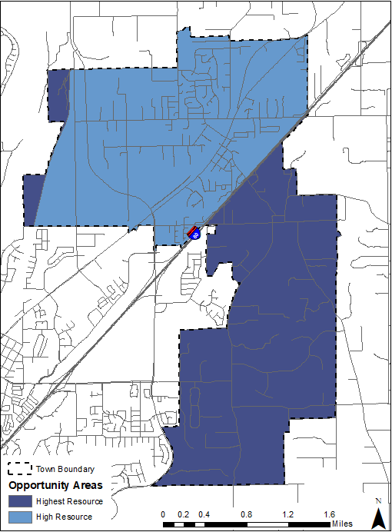
TCAC/HCD Opportunity Areas
High/Highest Resource Areas
Abundance of job opportunities, short commutes
High quality schools
Distance from environmental hazards (i.e. landfills)
Moderate Resource Areas
Slightly lower indicators in all categories
High Segregation & Poverty Areas
30 percent of the population is below the federal poverty line
Overrepresentation of people of color compared to County

Slide 31
Referendum Properties

Slide 32
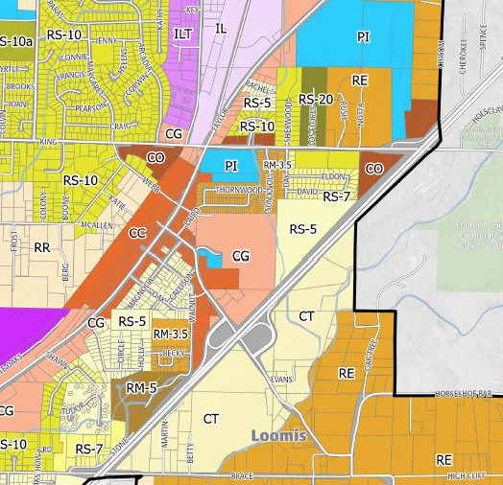
High Density Overlay
Ordinance 255 (2014)
Amended Zoning Ordinance to establish RH-20 Overlay District
Allows 20-25 dwelling units/acre with a minimum of 20
Ordinance 256 (2014)
Applied RH-20 Overlay to two parcels in the Village at Loomis project site
In effect regardless of the status of the Village at Loomis project
Created inconsistencies between parcels’ underlying zoning and General Plan land use designations
Rezones may be necessary to meet 2021-2029 RHNA

Slide 33
Schedule

Slide 34
Project Schedule
Task | Estimate Date
2020
Project Kick-Off | August
Prepare Administrative Draft | August – December
Open House Public Meeting | November
Community Survey | December – January
Stakeholder Interviews | November – December
Town Council Study Session | TBD
2021
Submit Administrative Draft for Town Review | January
Prepare Public Review Draft | February
Town Council Hearing Prior to Submitting to HCD | March
HCD Review (60 days) | April – May
Conference Call with HCD to Address Comments | Early Map
Town Receives Conditional Compliance Letter from HCD | May
Town Council Adoption Hearing | June
HCD Final Review and Certification (90 days) | July - September
We are here

Slide 35
Next Steps
Existing Needs Assessment
Determine housing needs
Identify special needs groups
Goals, Policies, and Programs
Review effectiveness of previous programs
Identify updates or additions needed
Confirm consistency with General Plan
Sites Inventory
Ensure adequate capacity to meet RHNA
Confirm infrastructure availability
Constraints
Identify barriers to development
Develop programs to address barriers

Slide 36
Questions?
Mary beth van Voorhis, town of loomis
mvanvoorhis@loomis.ca.gov
Jenny Gastelum, placeworks
jgastelum@placeworks.com
Cynthia Walsh, PlaceWorks
cwalsh@placeworks.com

